Slide 1
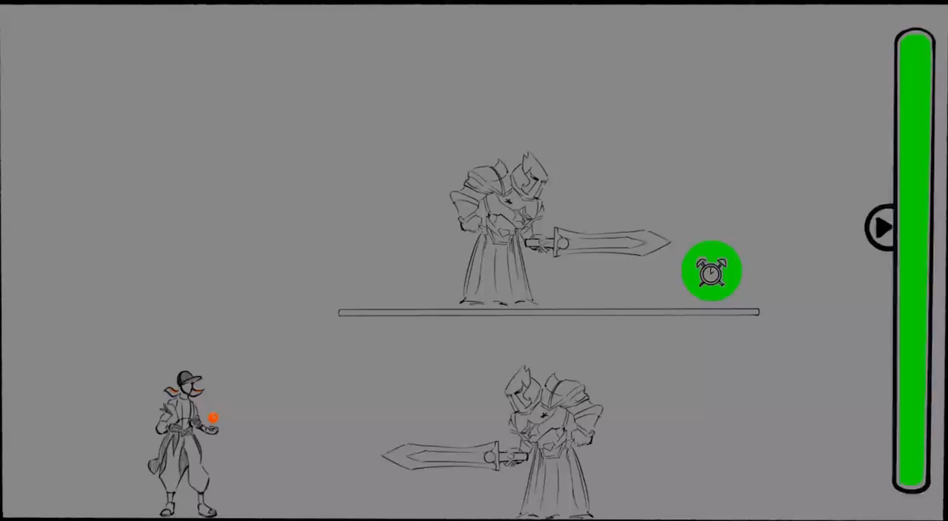
Prototype
Lingge Zhao
The stop time bar is the player's blood level.
When the player presses the start button, time stops (enemy movement slows down red filter).
Back kill mechanic - only killing an enemy from behind will increase time/life by “1”.
Green time item - when player approaches/picks it up, it increases time/life by “1”.

