Slide 1

PROFESSIONAL PERSONAL PORTFOLIO WEBSITE
Tshedza
Lungelo Mabaso
Aspiring Data Engineer & Data Scientist
A responsive portfolio created to showcase my skills, learning journey, certifications, CV and practical projects for internship and job opportunities.
LIVE SITE
https://lungelo-gif.github.io/tshedza-lungelo-portfolio/
Portfolio Project • Tshedza Lungelo Mabaso • 01

Slide 2
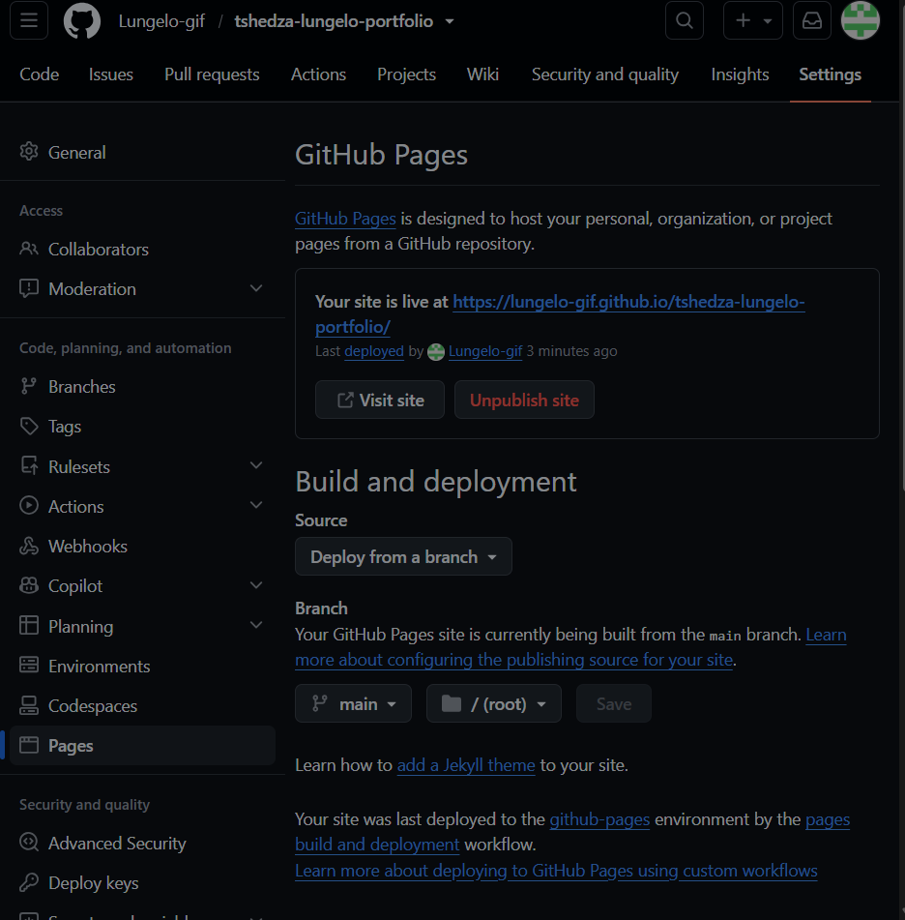
PROJECT OBJECTIVE
Build a portfolio that employers can open.
The website was designed to present who I am, what I am learning, and the practical work I have completed as an IT student aiming for a future in data.
Home & About
Skills
Professional introduction and personal story
Technical and soft skills for data and software
Projects
CV & Contact
Three project entries with screenshots and technologies
Downloadable CV, GitHub, LinkedIn and email
Live deployment evidence
GitHub Pages publishes the finished portfolio online.
Portfolio Project • Tshedza Lungelo Mabaso • 02

Slide 3
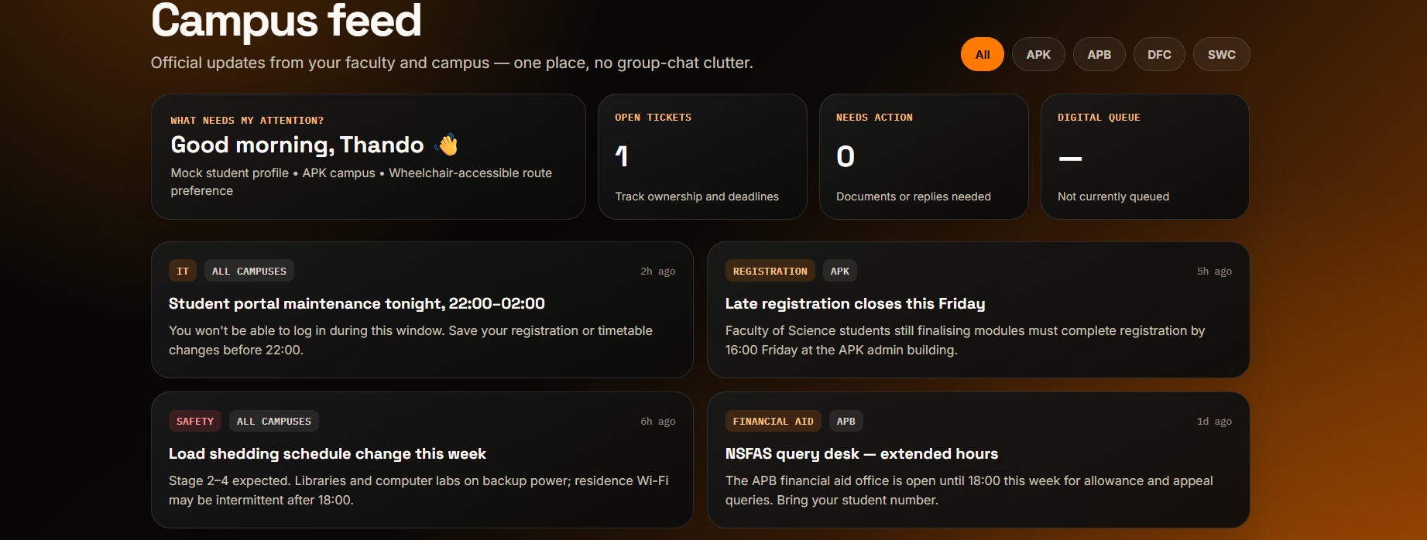
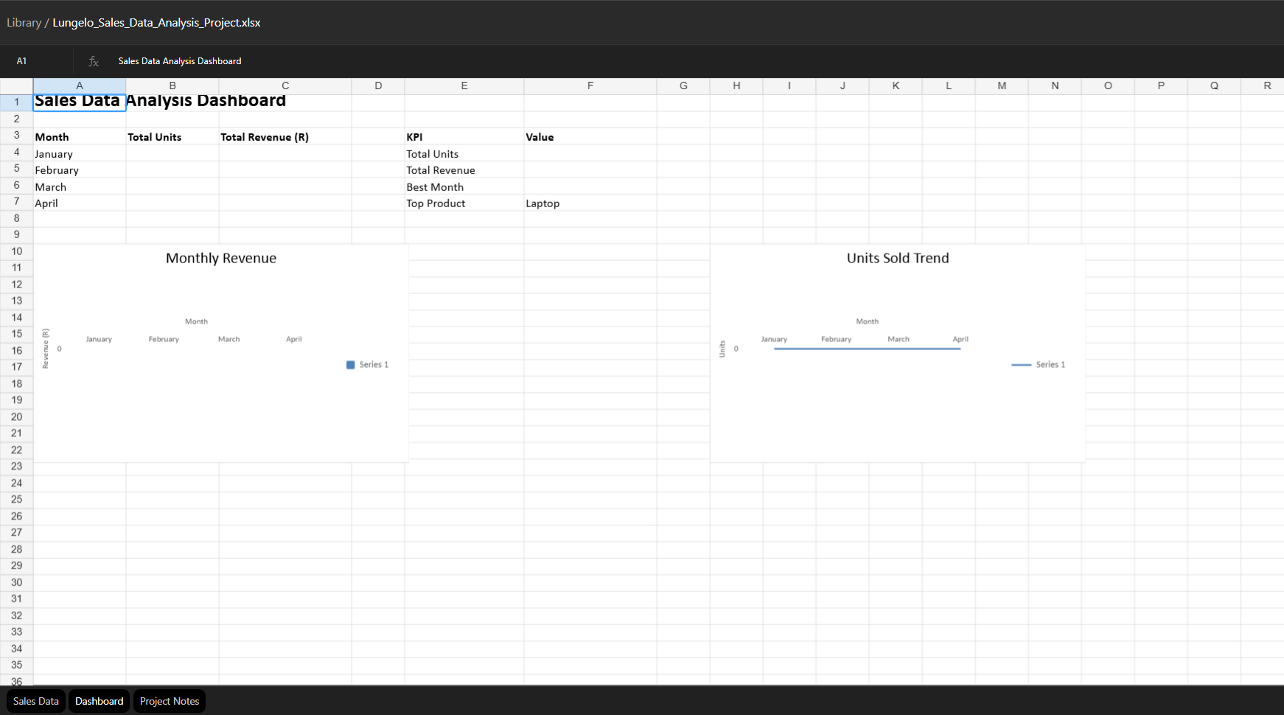
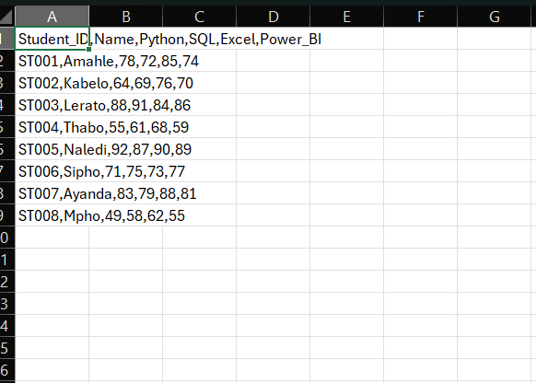

DESIGN DIRECTION
Dark tech style, clear story.
The portfolio combines a developer look with a data-focused identity: dark background, cyan accents, project evidence, readable sections and responsive design.
Identity + Career Focus
Aspiring Data Engineer & Data Scientist
Python • SQL • C# • Excel • Power BI
The site is built around evidence: screenshots, CV, links and project explanations.
Portfolio Project • Tshedza Lungelo Mabaso • 03

Slide 4
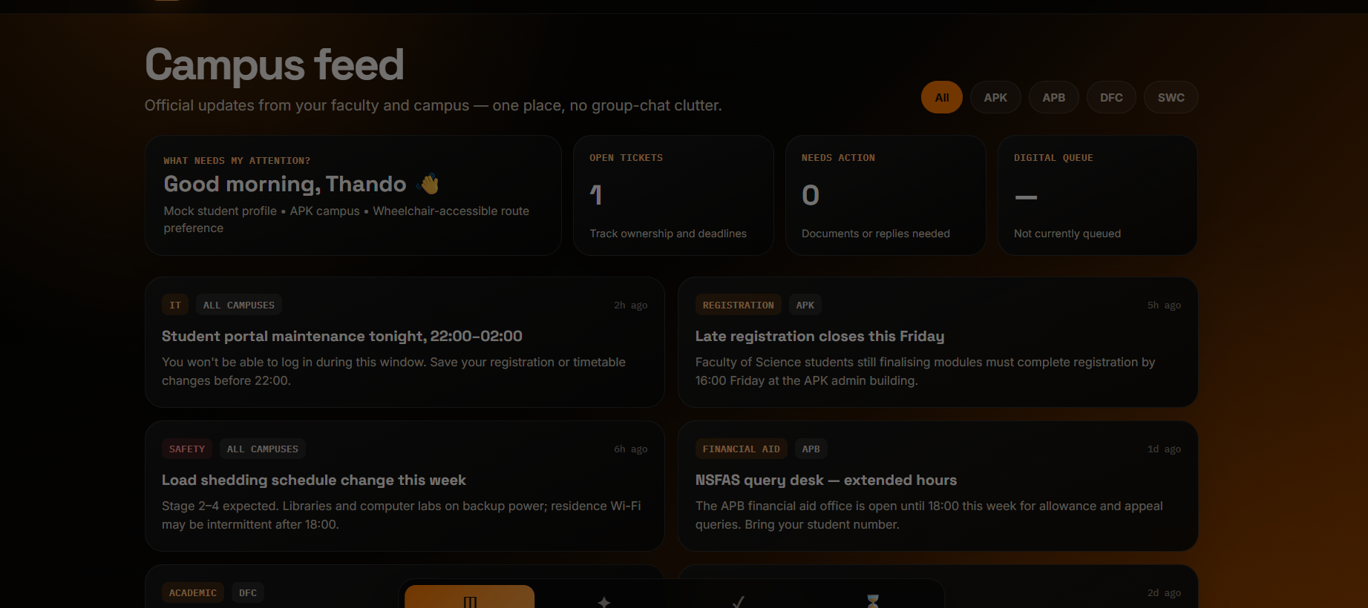
PROJECT 01 • WEB DEVELOPMENT
UJ Connect
Student Support & Digital Queue Hub
A responsive student-support concept with campus updates, service discovery, support-ticket tracking, accessibility features and remote digital queue functionality.
HTML
CSS
JavaScript
Responsive
Portfolio Project • Tshedza Lungelo Mabaso • 04

Slide 5
PROJECTS 02–03 • DATA ANALYSIS
From raw data to useful insights.
Sales Data Analysis Dashboard
Student Performance Data Analyzer
Excel • KPIs • charts • business insights
Python • CSV • averages • performance trends
Portfolio Project • Tshedza Lungelo Mabaso • 05

Slide 6
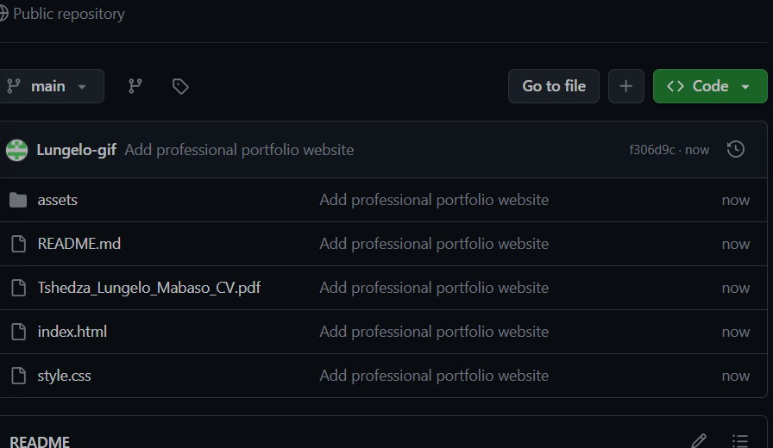
BUILD & DEPLOYMENT
Code in GitHub. Portfolio live online.
Source repository
https://github.com/Lungelo-gif/tshedza-lungelo-portfolio
Live website
https://lungelo-gif.github.io/tshedza-lungelo-portfolio/
Portfolio Project • Tshedza Lungelo Mabaso • 06

Slide 7
READY FOR SUBMISSION
Portfolio project
completed.
The final submission includes the live deployed website, the GitHub source-code repository, and this presentation summarising the design, technologies and projects.
Scan to open live portfolio
https://lungelo-gif.github.io/tshedza-lungelo-portfolio/
✓
Live website deployed with GitHub Pages
✓
Source code uploaded to GitHub repository
✓
CV download, profile photo and contact links included
Key learning: AI helped with speed and structure, while understanding the code, layout and deployment remains important for explaining the project.
✓
Three projects presented with evidence screenshots
Portfolio Project • Tshedza Lungelo Mabaso • 07

