Slide 1
Data Science Project – 02 March 2021
Presentation by : Lungisani Booi
Date

Slide 2
Menu
Problem Statement
Planning the model building task
Implementation :
- Data Exploratory Analysis
- Data Preparation
- Feature Selection
- Model Building

Slide 3
Problem Statement
Finding donor for charity
Employ supervised algorithm to accurately model individuals’ income using data collected from the 1994 U.S. Census.
The goal with this implementation is to construct a model that accurately predicts whether an individual makes more than $50,000 per year.
This sort of task can arise in a non-profit setting, where organizations survive on
on donations.
Understanding an individual’s income can help a non-profit better understand how
large of a donation to request.

Slide 4
Planning the model building task
Tools
Received Excel files (Transformation Details/Target)
Exported into SQL Database and Run Direct Query to PowerBI
PowerBI for data visualization and reporting
R Statistical Software for model building
Why Visualize with Powerbi?
Interactive report
Help us understand the data better
Summarizes the data and put it in a unified
view
Report Format
PowerPoint Slides
PowerBI Dashboards
GitHub

Slide 5
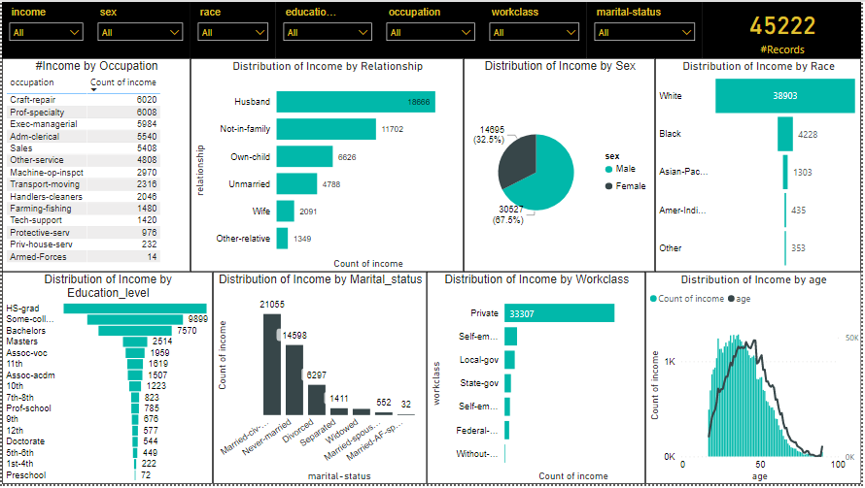
Implementation : Data exploratory Analysis
The Dashboard below show the overview and stats of all records in the data i.e. individuals’ income >$50k and <=$50k annually

Slide 6
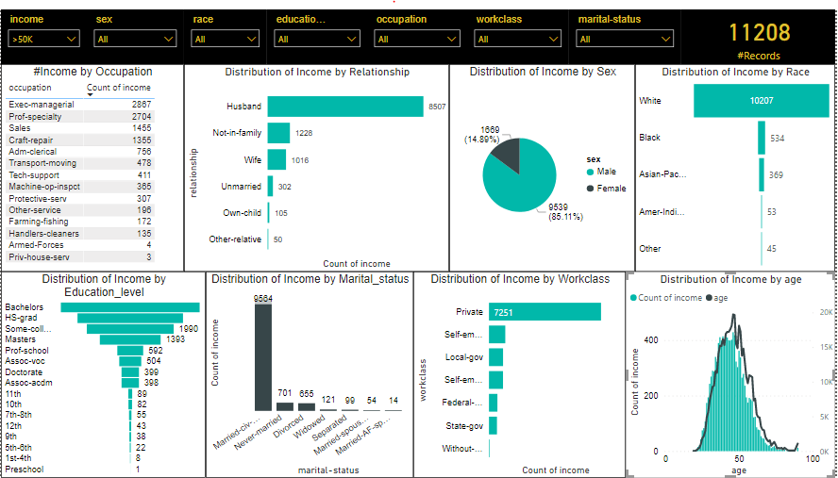
Implementation : Data exploratory Analysis
-The Dashboard below show the overview and stats for individuals’ income >$50k annually.

Slide 7
Implementation : Data Preparation
Preparing the data
Before data can be used in machine learning algorithm, it needs to be cleaned, formatted and restructured. This is known as data preprocessing.
We can achieve this through :
- gathering data into a statistical software, in this case we will use R
- understanding the structure and summary by using str() and summary() function on the data.
- Imputing nulls and transforming skewed continuous variables.
- Scaling/centering data

Slide 8
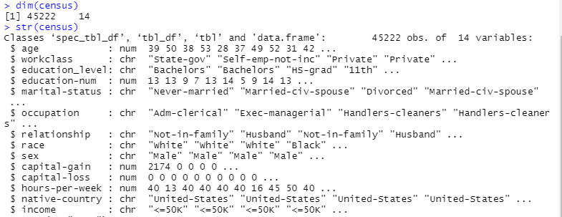
Implementation : Data Preparation
-By looking at the results below we can see that we have 45222 records and 14 variables
- The target variable (income) is a character and the data is mixture of categorical and continuous variables.

Slide 9
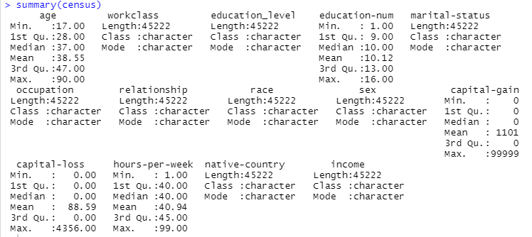
Implementation : Data Preparation
-By looking at the summary below we can note that capital-gain and capital-loss are stewed continuous variables so therefore we will transform them using Logarithm algorithm. Also our target value we will create a salary_flag variable that contains (0,1).

Slide 10
Implementation : Data Modelling
Modelling Process:
- We created the binary salary_flag (0,1) which will be our response variable
- We exclude independent variable in order to make the model simpler
- We split the data into training set (0.7) and test set(0.3) for model validation.
- We train a model to predict whether income exceeds $50k/annum
- We further remove insignificant features to improve the model
From the objectives clearly Logistic regression is the suitable model because the target variable is a dichotomous (0,1) variable.

Slide 11
Implementation : Data Modelling Outcomes
By looking the summary of the model we will see that we have insignificant variables.
We have to remove these variables to better the performance of the model
We retrain the model with the new dataset.
Highlights from the modified model : We will use the confusion matrix to compute the accuracy level of the model
Accuracy level: 82.2%
Predicted | <=$50k/annum | >$50k/annum
<=$50k/annum | 9377 | 1553
>$50k/annum | 860 | 1777

Slide 12
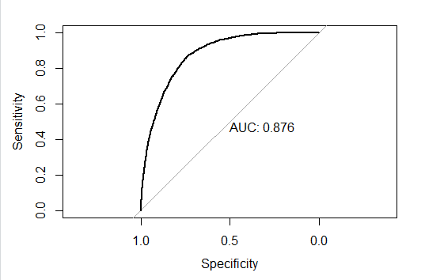
Model Validation (ROC)

