Slide 1
Representing Moving Images with Layers
J. Y. Wang and E. H. Adelson
MIT Media Lab

Slide 2
Goal
Represent moving images with sets of overlapping layers
Layers are ordered in depth and occlude each other
Velocity maps indicate how the layers are to be warped over time

Slide 3
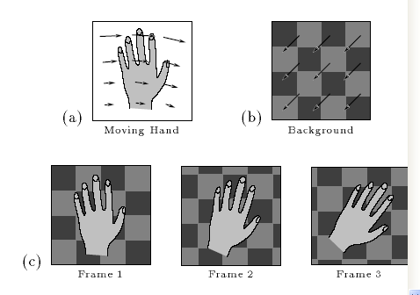
Simple Domain:
Gesture Recognition

Slide 4
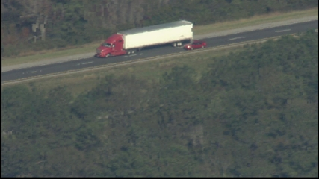
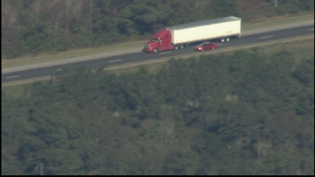
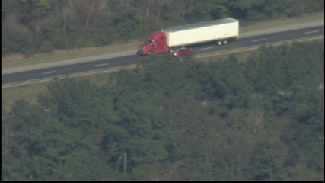
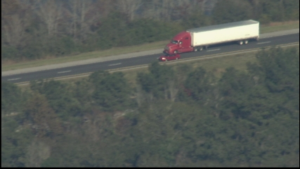
More Complex:
What are the layers?

Slide 5
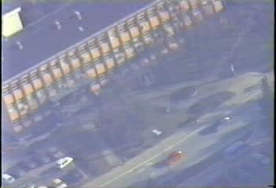
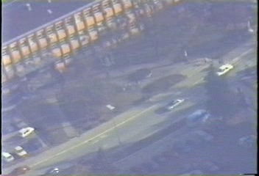
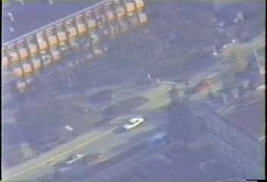
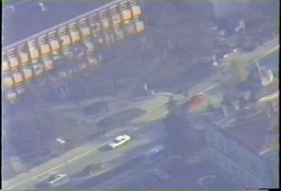
Even More Complex:
How many layers are there?

Slide 6
Definition of Layer Maps
Each layer contains three maps
Layers are ordered by depth
This can be for vision or graphics or both
intensity map (or texture map)
alpha map (opacity at each point)
velocity map (warping over time)

Slide 7
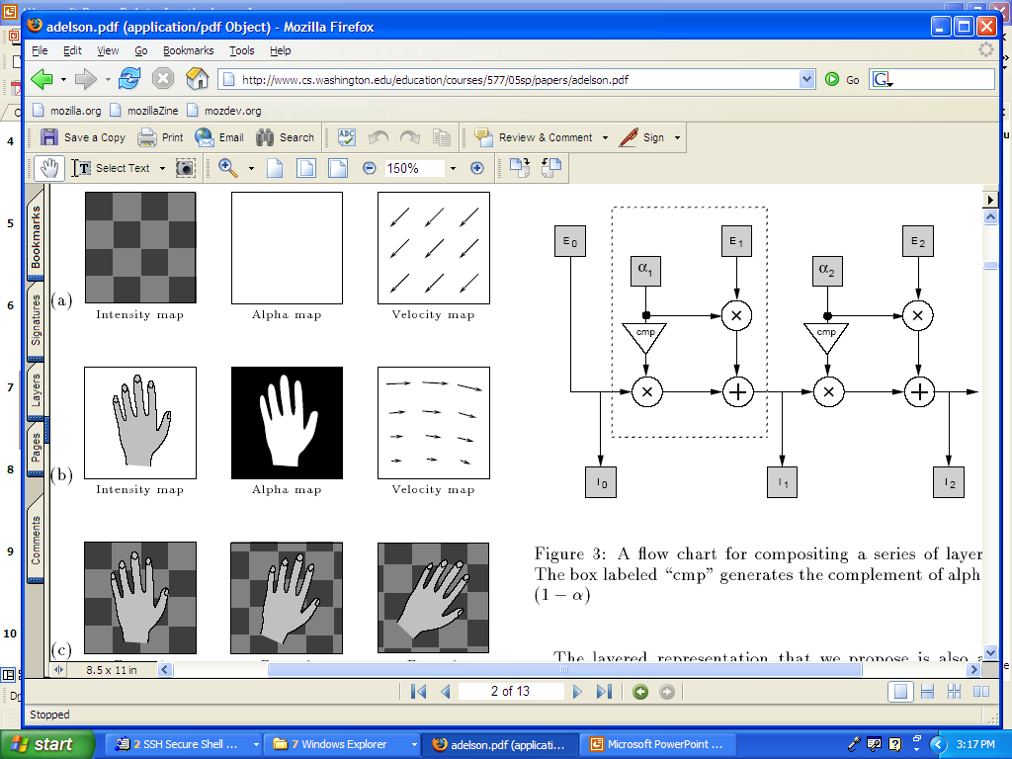
Layers for the Hand Gestures
Background
Layer
Hand Layer
Re-synthesized
Sequence

Slide 8
Optical Flow Doesn’t Work
Optical flow techniques typically model the world as a 2-D rubber sheet that is distorted over time.
When one object moves in front of another, the rubber sheet model fails.
Image information appears and disappears; optical flow can’t represent this.
Motion estimates near boundaries are bad.

Slide 9
Block Matching Can’t Do It
Block motion only handles translation well.
Like optical flow, block matching doesn’t deal with occlusion or objects that suddenly appear or disappear off the edge of the frame.

Slide 10
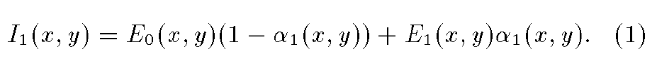
Layered Representation:
Compositing
E₀ is the background layer.
E₁ is the next layer (and there can be more).
α₁ is the alpha channel of E₁, with values between 0 and 1 (for graphics).
The velocity map tells us how to warp the frames over time.
The intensity map and alpha map are warped together, so they stay registered.

Slide 11
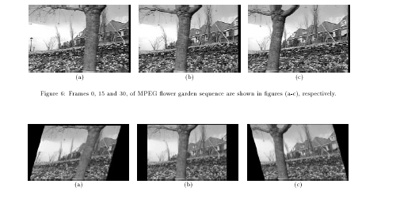
Analysis: Flower Garden Sequence
Frame 1 Frame 15 Frame 30
Camera is panning
to the right.
What’s going on
here?
Frame 1 Frame 15 Frame 30
warped warped

Slide 12
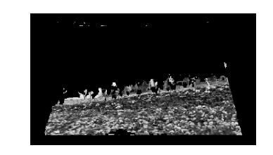
Accumulation of the Flowerbed Layer

Slide 13
Motion Analysis
Robust motion segmentation using a parametric (affine) model.
V_{x}(x,y) = a_{x0} + a_{xx}x + a_{xy}y
V_{y}(x,y) = a_{y0} + a_{yx}x + a_{yy}y
2. Synthesis of the layered representation.

Slide 14
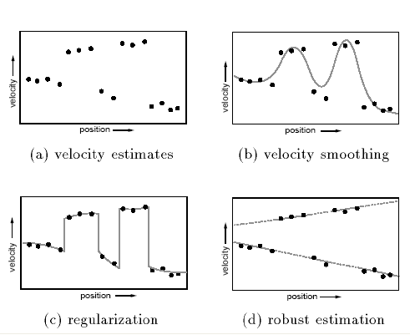
Motion Analysis Example
2 separate layers
shown as 2 affine
models (lines);
The gaps show
the occlusion.

Slide 15
Motion Estimation Steps
Conventional optical flow algorithm and representation (uses multi-scale, coarse-to-fine Lucas-Kanade approach).
From the optical flow representation, determine a set of affine motions. Segment into regions with an affine motion within each region.

Slide 16
Motion Segmentation
Use an array of non-overlapping square regions to derive an initial set of motion models.
Estimate the affine parameters within these regions by linear regression, applied separately on each velocity component (dx, dy).
Compute the reliability of each hypothesis according to its residual error.
Use an adaptive k-means clustering that merges two clusters when the distance between their centers is smaller than a threshold to produce a set of likely affine models.

Slide 17
Region Assignment by Hypothesis Testing
Use the motion models derived from the motion segmentation step to identify the coherent regions.
Do this by minimizing an error (distortion) function:
  G(i(x,y)) = ∑ (V(x,y) – V_{ai}(x,y))²
  ^{x,y}
where i(x,y) is the model assigned to pixel (x,y)
and V_{ai}(x,y) is the affine motion for that model.
The error is minimized at each pixel to give the best model for that pixel position.
Pixels with too high error are not assigned to models.

Slide 18
Iterative Algorithm
The initial segmentation step uses an array of square regions.
At each iteration, the segmentation becomes more accurate, because the parameter estimation is within a single coherent motion region.
A region splitter separates disjoint regions.
A filter eliminates small regions.
At the end, intensity is used to match unassigned pixels to the best adjacent region.

Slide 19
Layer Synthesis
The information from a longer sequence must be combined over time, to accumulate each layer.
The transforms for each layer are used to warp its pixels to align a set of frames.
The median value of a pixel over the set is used for the layer.
Occlusion relationships are determined.

Slide 20
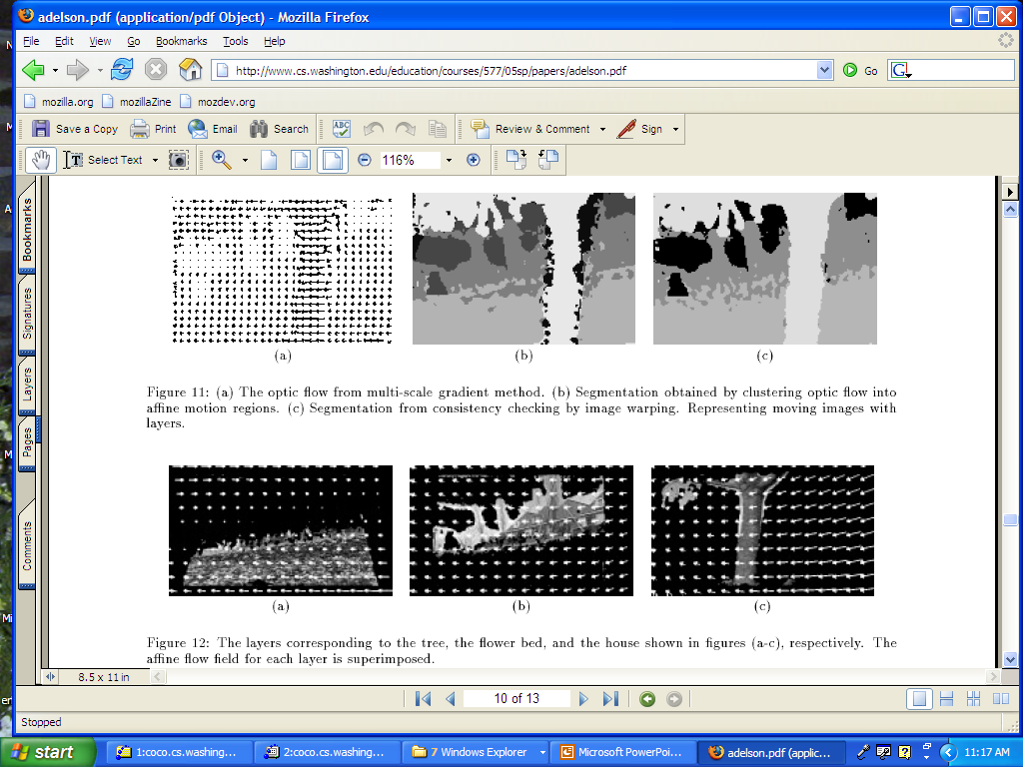
Results

Slide 21
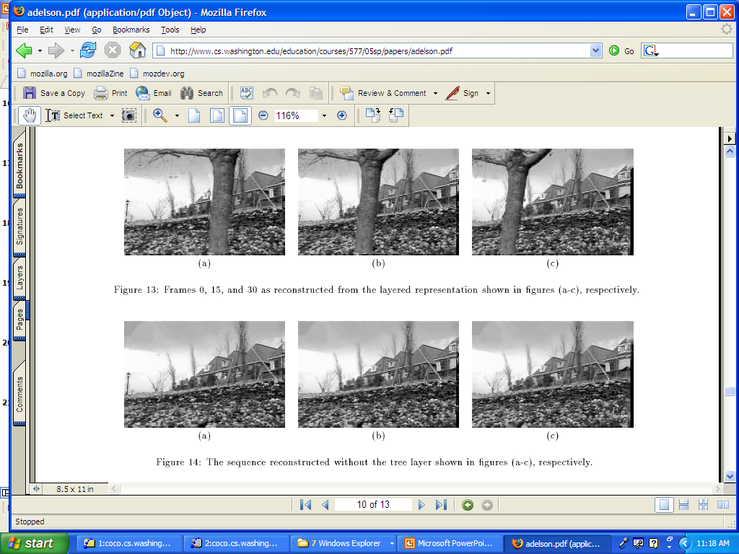
Results

Slide 22
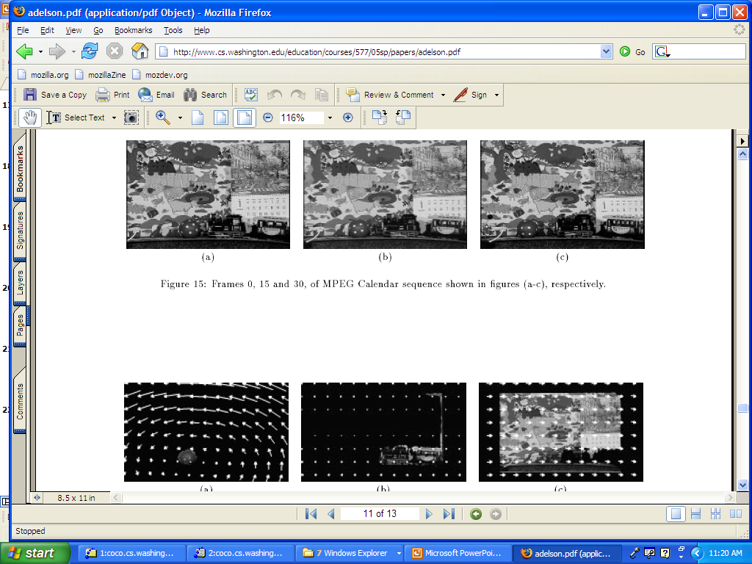
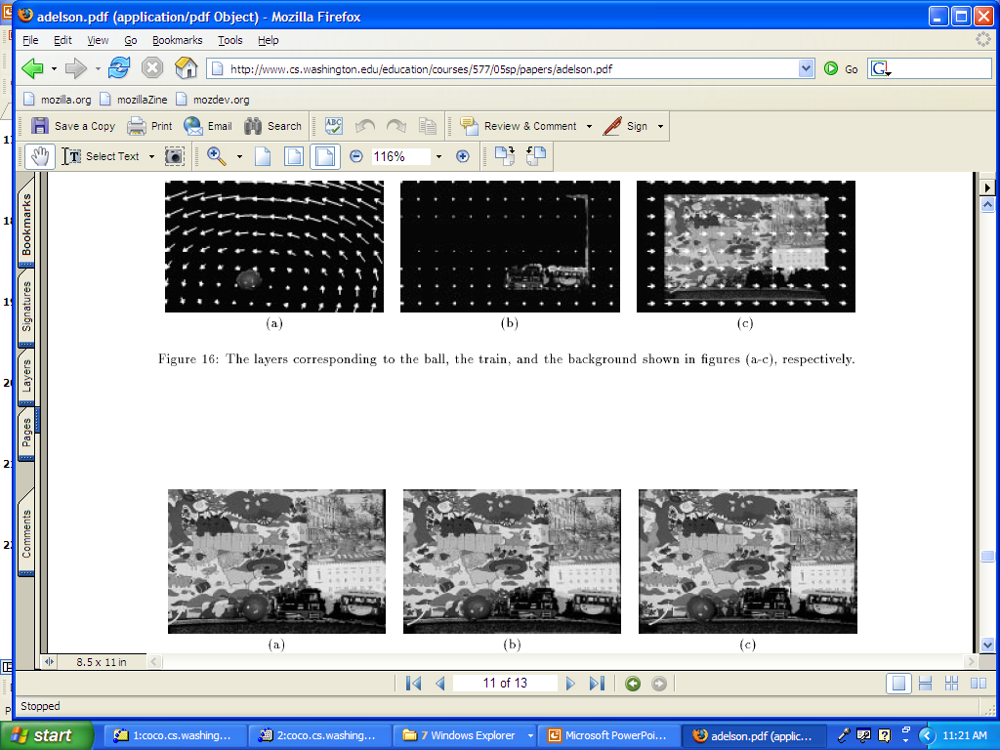
Results

