Slide 1
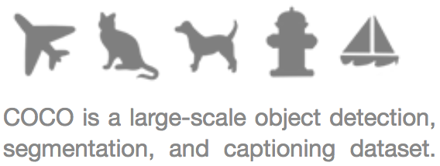
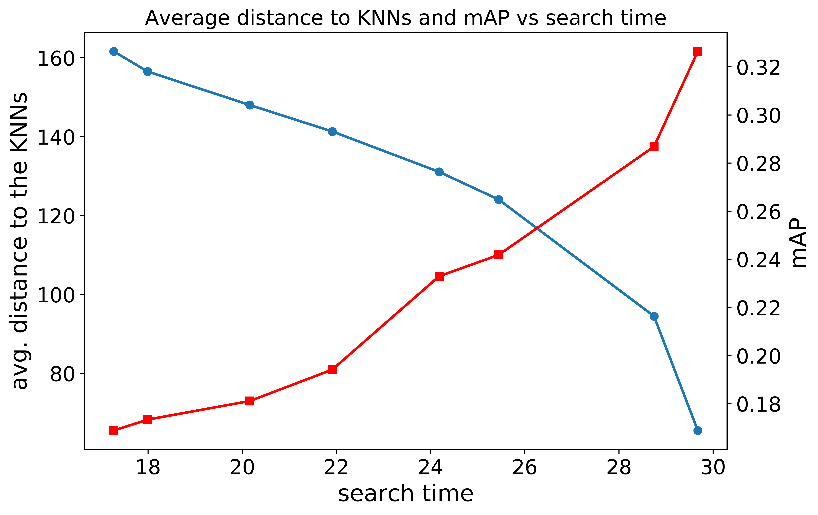

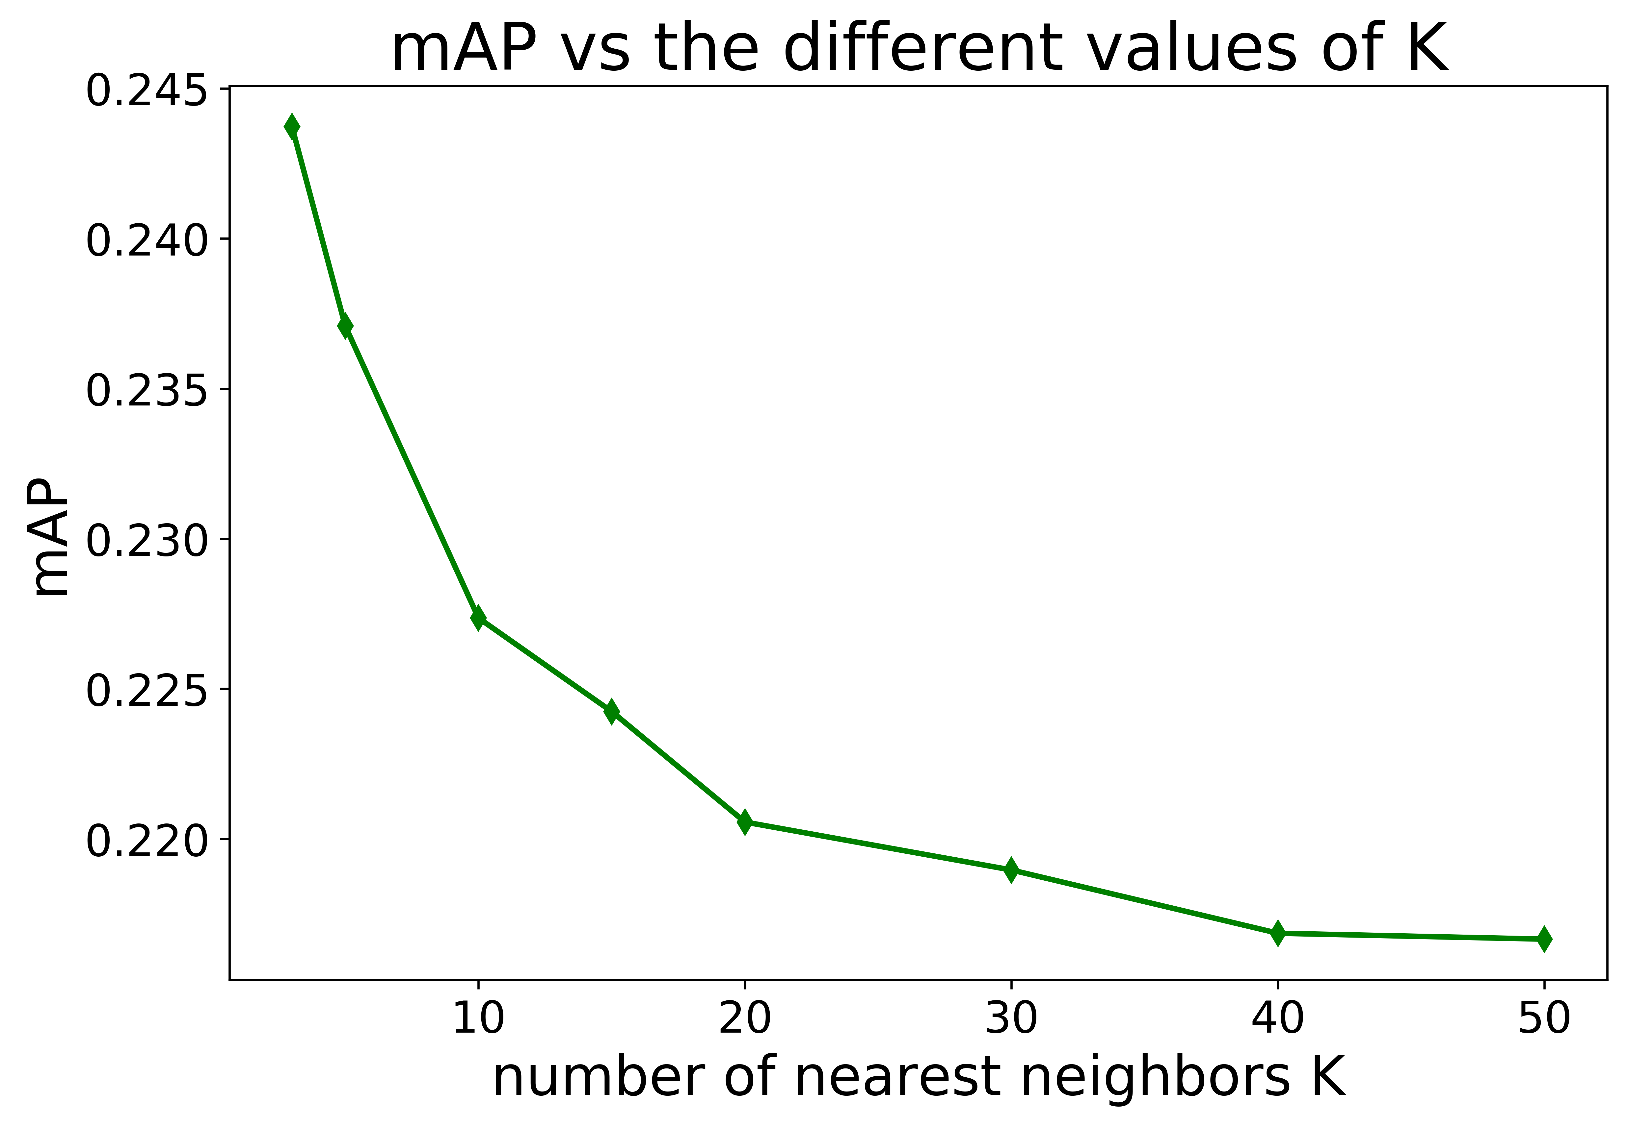
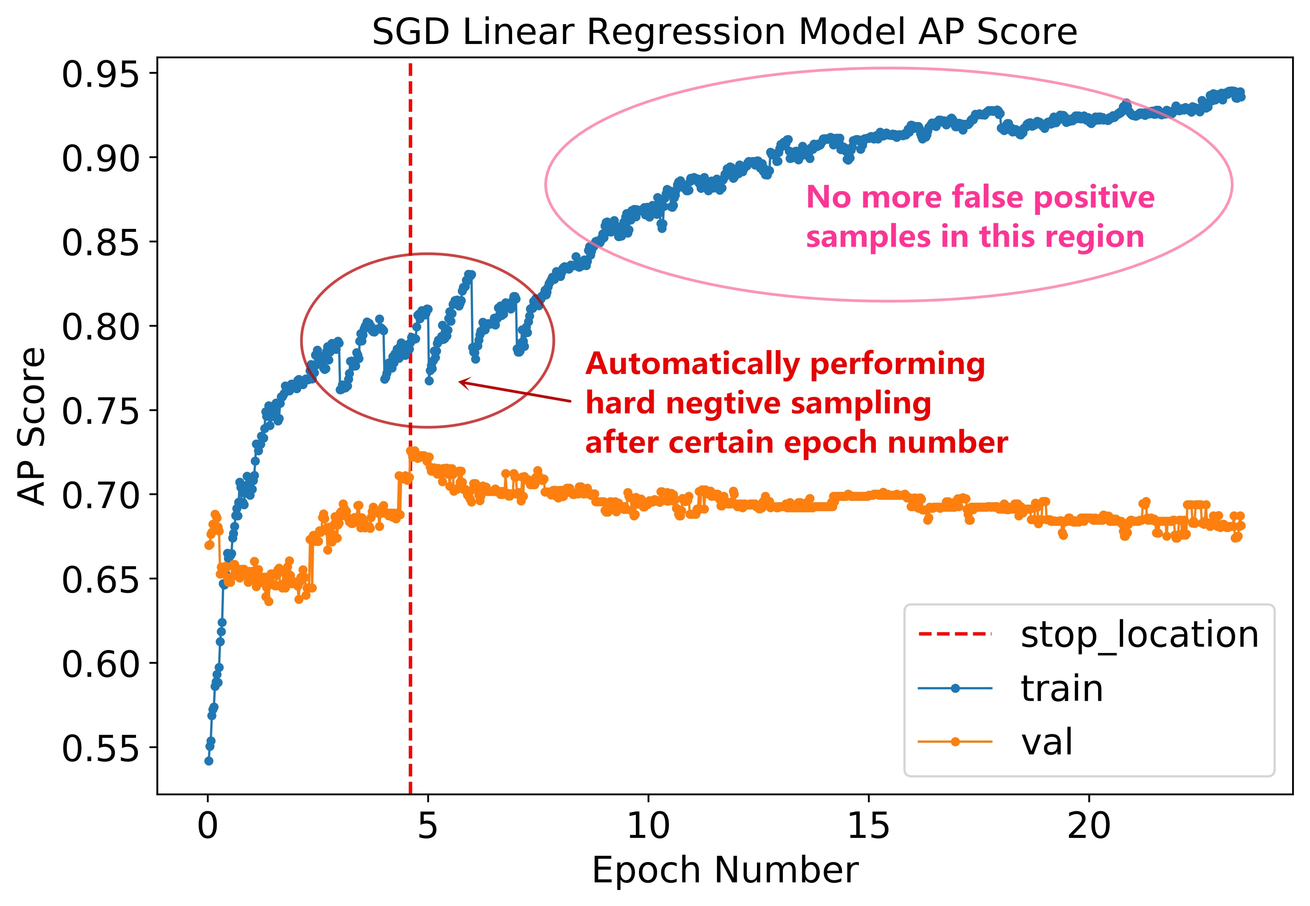
Comparison of Object Detection by Linear Classifier and Local Sensitive Hashing (LSH)
Lun Jiang, Applied Mathematics, University of Washington
COCO Dataset
LSH Algorithm
Speed-Quality Tradeoff
18 categories of COCO Dataset
Tiny and Small Dataset
Tiny (dim = 1472) and
Small (dim = 11776) feature vectors.
Linear Regression Model
Loss Function of Linear Model
Category | AP Score
airplane | 0.348313737
bear | 0.094608968
bicycle | 0.109999502
bird | 0.103223281
boat | 0.128537091
bus | 0.249275943
car | 0.141795107
cat | 0.397089824
cow | 0.186116586
dog | 0.196843699
elephant | 0.423391365
giraffe | 0.520327058
horse | 0.149371811
motorcycle | 0.182861128
sheep | 0.246667087
train | 0.209196683
truck | 0.121703411
zebra | 0.444227604
mAP | 0.236308327
LSH Functions
Structure of One Layer Perceptron
x₁
x₂
…
x_{d-1}
x_{d}
W₁
W₂
…
W_{d-1}
W_{d}
y
Perform linear regression for each category. The resulting AP score per category and the overall mAP are shown in table.
K Nearest Neighbors
Read-Time Visualization
Auto Hard Negative Mining
Hard Negative Mining is used to reduce the false positive predictions by the model, which will be done automatically after certain epochs after convergence.

