Slide 1
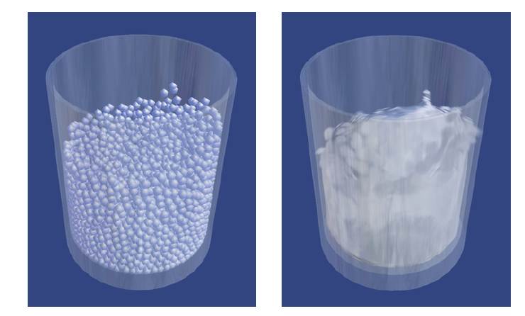
Comparison of Object Detection by Linear Classifier and Local Sensitive Hashing (LSH)
CSE547 Project
Lun Jiang
Introduction to SPH
Smoothed particle hydrodynamics (SPH) is a method for obtaining approximate numerical solutions of the equations of fluid dynamics by replacing the fluid with a set of particles.
It was first developed by Gingold and Monaghan (1977) and Lucy (1977) and has been studies for years.
Major Advantages:
Treating pure advection exactly.
Simplifying Interface problems among materials by assigning each material its own particle set.
Bridging the gap between the continuum and fragmentation in a natural way.
[Matthias Müller 2003]

Slide 2
Category | AP Score
airplane | 0.348313737
bear | 0.094608968
bicycle | 0.109999502
bird | 0.103223281
boat | 0.128537091
bus | 0.249275943
car | 0.141795107
cat | 0.397089824
cow | 0.186116586
dog | 0.196843699
elephant | 0.423391365
giraffe | 0.520327058
horse | 0.149371811
motorcycle | 0.182861128
sheep | 0.246667087
train | 0.209196683
truck | 0.121703411
zebra | 0.444227604
mAP | 0.236308327
x₁
x₂
…
x_{d-1}
x_{d}
W₁
W₂
…
W_{d-1}
W_{d}
y

