Slide 2
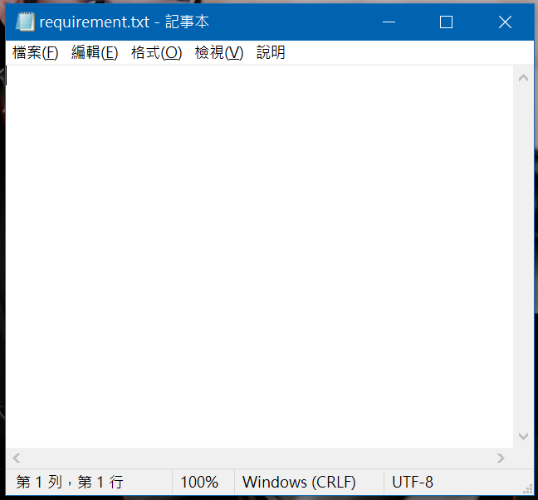
版本控管
keras
tensorflow
scipy
librosa
pandas
matplotlib
tqdm
ipywidgets
pyaudio
SpeechRecognition
虛擬環境
conda create --name py39 python=3.9
//model
pip install keras (2.9.0)
pip install tensorflow (2.9.1)
pip install scipy (1.8.1)
pip install librosa
pip install pandas
pip install matplotlib
pip install tqdm
pip install ipywidgets
//realtimeTest_warning.py
pip install C:\Users\USER\Downloads\PyAudio-0.2.11-cp39-cp39-win_amd64.whl
( https://www.lfd.uci.edu/~gohlke/pythonlibs/#pyaudio )
pip install SpeechRecognition

Slide 3
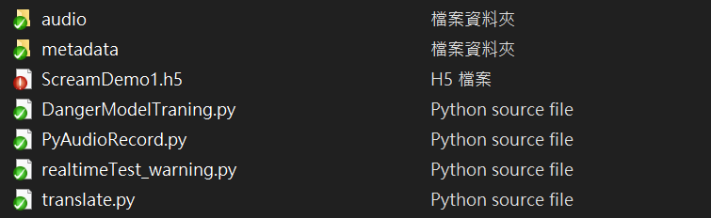


架構

Slide 4

DangerModelTraning.py
1. 讀取metadata資料夾裡的audioDataset.csv

