Slide 1
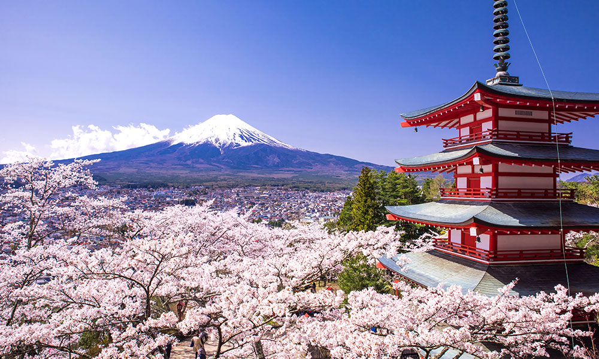
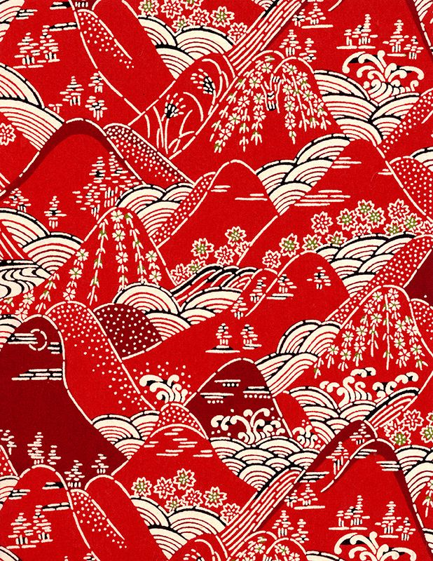
Japan, its Relations and its Culture, and How These Factors Affect Each Other.
By Luke Verhagen

