Slide 1

AI4S PROJECT
Science-Bot
Maintain your scientific research
ability in the age of AI
Research planning with human judgment
Notes:
Science-Bot helps researchers turn an unclear research idea into a reviewable experimental design. The scientific aim is to preserve researcher agency and understanding while using AI assistance.
Visual: AI-generated abstract decorative artwork. It does not depict a real apparatus.
Sources:
Source: supplied PPT-Science-Bot.pptx, project presentation outline and research proposition.
Supplied project introduction, Word document in the PPT folder, dated 30 October 2026. Describes intended users, the supervised local prototype, expected value and limitations.

Slide 2
How does AI affect skill formation?
Starting point: research from Anthropic
Mean quiz score by AI interaction pattern
52
Python programmers learning Trio
26 with AI, 26 without AI
Lower skill quiz scores with AI.
Cohen’s d = 0.738, p = .010
No significant average speed gain
(p = .391).
Our conclusion: humans must keep research under control
Source: Shen & Tamkin (2026), pp. 9–10, 13. Small qualitative subgroups are descriptive, not causal estimates.
This coding study motivates our design. It does not establish Science-Bot’s effect on researchers.
02
Notes:
The main randomized study contains 52 participants, 26 per condition. The paper reports a lower learning evaluation score with AI assistance, Cohen’s d=0.738, p=0.010, and no statistically significant acceleration in task time, p=0.391.
The editable chart reproduces Figure 11 subgroup mean quiz scores: AI Delegation 39% (n=4), Progressive AI Reliance 35% (n=4), Iterative AI Debugging 24% (n=4), Conceptual Inquiry 65% (n=7), Hybrid Code-Explanation 68% (n=3), Generation-Then-Comprehension 86% (n=2). These are small behavior clusters from qualitative analysis, not randomized assignments to strategies. Avoid extrapolating to long-term scientific skill or claiming a validated product learning benefit.
Sources:
Supplied PDF: How AI Impacts Skill Formation, Judy Hanwen Shen and Alex Tamkin, February 2026, arXiv:2601.20245v2. https://arxiv.org/abs/2601.20245
Source: supplied PPT-Science-Bot.pptx, project presentation outline and research proposition.

Slide 3
More interaction before designing your proposal
Although AI-generated code itself may not necessarily hinder learning, developing your own competence requires more than just interacting with AI. You also need to be able to explain the implementation and predict the behavior.
SCIENCE-BOT
For graduate researchers, supervisors and interdisciplinary teams.
A conversation that makes
research choices explicit
Clarify goals, preserve unknowns and connect selected paper evidence to a reviewable experimental plan.
Use cases: model comparison, paper replication and constrained pilot studies. Expected value: clearer decisions and less planning rework.
03
Notes:
Science-Bot focuses on research decisions and human review. Researchers need to explain the reasoning behind a design and anticipate what its results can establish. Lower communication cost and stronger understanding are expected benefits, not measured outcomes in the supplied materials.
Sources:
Source: supplied PPT-Science-Bot.pptx, project presentation outline and research proposition.
Supplied project introduction, Word document in the PPT folder, dated 30 October 2026. Describes intended users, the supervised local prototype, expected value and limitations.
Supplied PDF: How AI Impacts Skill Formation, Judy Hanwen Shen and Alex Tamkin, February 2026, arXiv:2601.20245v2. https://arxiv.org/abs/2601.20245

Slide 4
Research behind Science-Bot
LangGraph provides the orchestration structure
Reinforcement learning
Component | Role in the planning workflow
LangGraph | Routes the conversation and carries research state
LLM | Proposes clarification questions and experiment drafts
Harness | Checks sources, unknowns, budgets and content versions
Researcher | Confirms boundaries and reviews methods and conclusions
Research direction: learn which clarification action to take next under a policy.
The policy requires researchers to clarify their thinking and research plan before final approval.
Current default: rule policy. Learned policies remain experimental. Early drafts can contain unknowns, while final confirmation requires review.
04
Notes:
The current product can show an early draft with unresolved questions. Final approval requires clear boundaries and review. The default question policy uses rules, while learned policies remain experimental. The project does not fine-tune the underlying LLM. LangGraph orchestrates state, while the host Harness owns checks and permissions.
Sources:
Source: supplied PPT-Science-Bot.pptx, project presentation outline and research proposition.
Supplied project introduction, Word document in the PPT folder, dated 30 October 2026. Describes intended users, the supervised local prototype, expected value and limitations.
Current project README and planning implementation, as established in the project work preceding this deck.

Slide 5
Science-Bot aims for more trustworthy planning
The same task, made explicit through dialogue
Sample: Initial request prompt
Decision | Supplied Science-Bot sample
Unit | Independent research object. Aggregate repeated measurements within it.
Metric | Mean prediction error, lower is better. Cost is secondary.
Sampling | Pilot first to check variance and independence. No power guarantee.
Acceptance | Record negative and uncertain results. Stop at the resource limit.
“Compare two models on synthetic 2D fields by error and runtime. Budget: two hours."
A one-shot request leaves the unit, sampling basis and stopping rule unspecified.
Illustrative workflow comparison, not an independent competitor benchmark. Sample revision 22 is reviewable, methods remain unverified, and no experiments ran.
05
Notes:
Trustworthiness is a product aspiration rather than a measured superiority claim. The initial request leaves important decisions open. The supplied sample subsequently records the independent-unit definition, primary metric, pilot rationale and acceptance rules. There is no independent competitor benchmark.
The sample is a fallback/template plan with declarations complete and methods pending human review. It has selected zero paper fragments. It does not prove scientific correctness, successful model execution or human learning improvement. Its design family is CRD, not a paired experiment.
Sources:
Supplied science-bot-plan-sample.md, revision 22. A synthetic planning example, declarations complete, methods pending human review, no experiments executed.
Source: supplied PPT-Science-Bot.pptx, project presentation outline and research proposition.

Slide 6
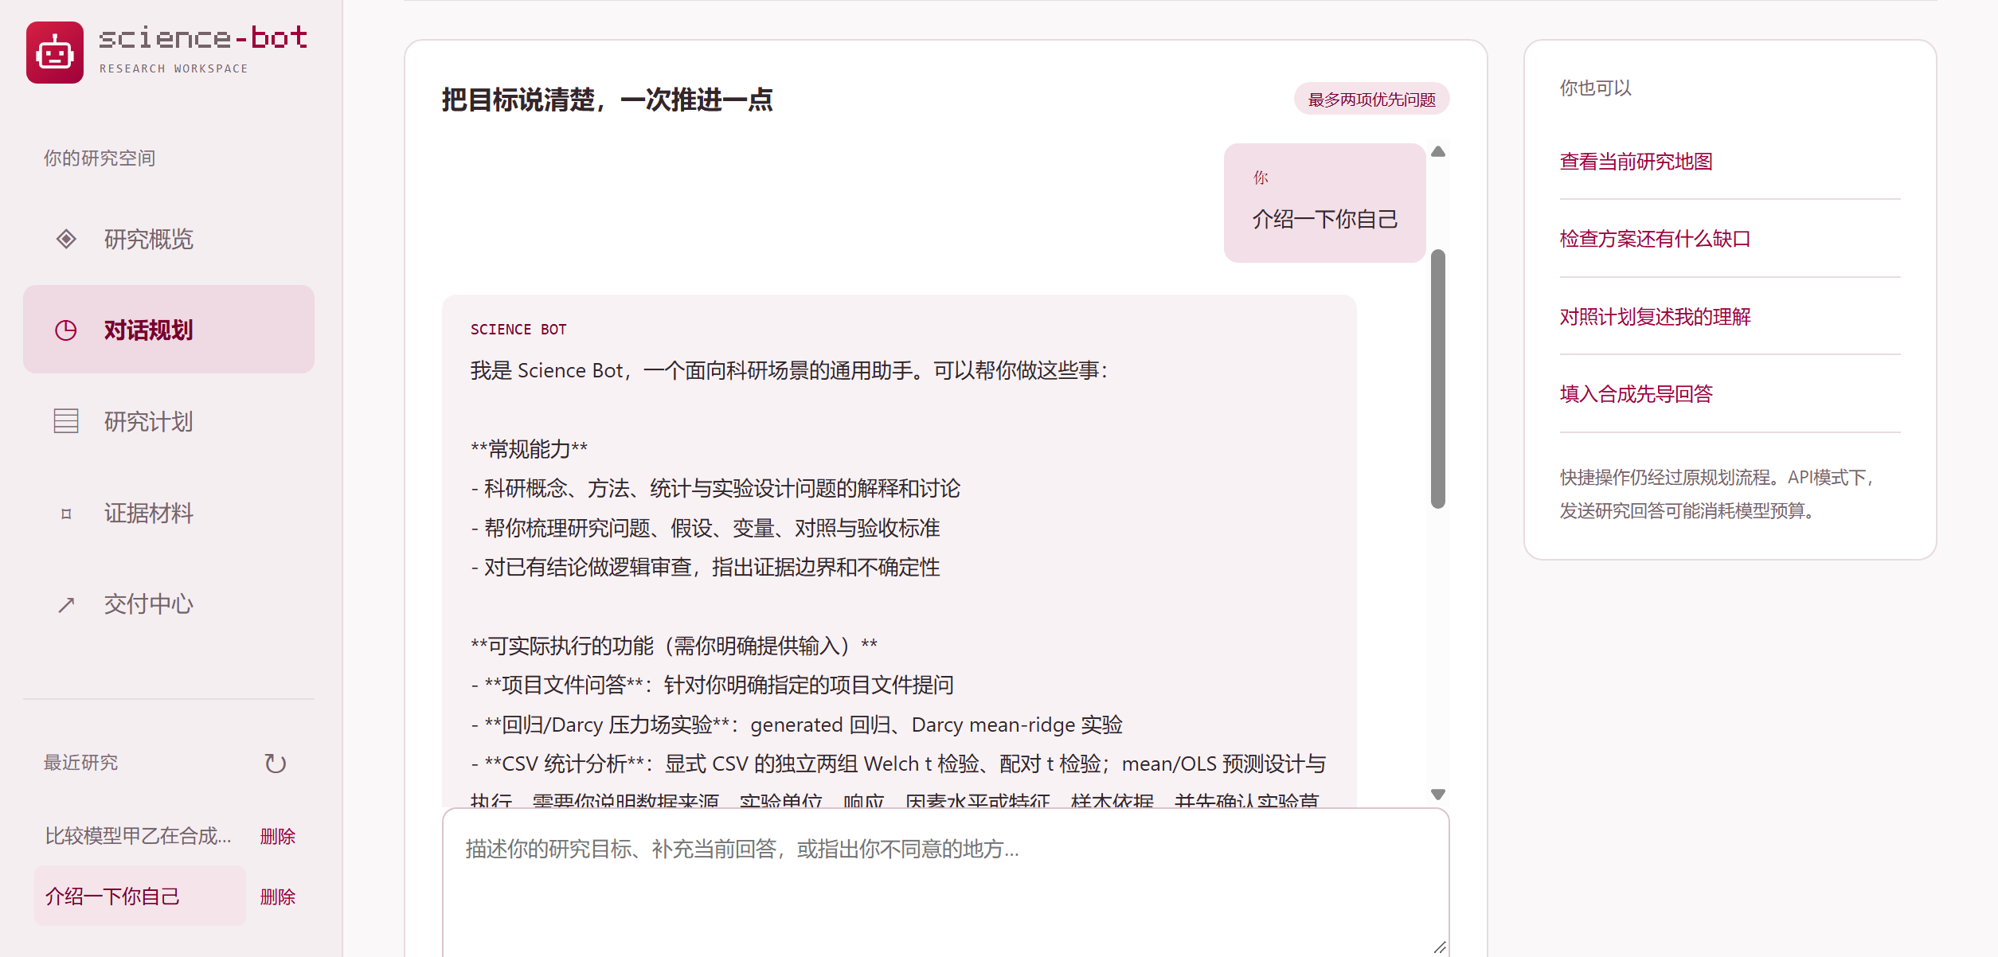
Transform a fuzzy idea into restrict research plan
01
Describe your goal and resource limit
02
Choose relevant options and review the plan
03
Add selected evidence, then export
English translation of the supplied UI. Export HTML, Markdown or JSON. Execution requires separate authorization.
06
Notes:
The displayed interface is an AI-assisted English translation of the supplied Chinese screenshot. It preserves the original layout and uses the same planning example. This is a translation illustration, not a claim that the application already offers an English localization.
Usage: describe a goal and limit, select or revise relevant choices, review the plan and unknowns, explicitly choose evidence to share with the model, and export the plan. Actual scientific execution needs separate authorization.
Sources:
Source: supplied PPT-Science-Bot.pptx, project presentation outline and research proposition.
Source image: image1.png embedded in the supplied source PPTX, slide 6.
Supplied project introduction, Word document in the PPT folder, dated 30 October 2026. Describes intended users, the supervised local prototype, expected value and limitations.

Slide 7
Visit our GitHub and learn more
github.com/Luo-1020-qc/Science-Bot-AI4S-LRS
Future Work: Build A pilot opportunity
for research teams
Supervised local prototype
Generalization ability
Graduate research, supervisor review and interdisciplinary experiment planning.
Understand Researcher’s idea from different field
07
Notes:
This is an invitation to explore the repository and discuss a pilot with research groups or academic partners. The supplied materials support a supervised local prototype, not commercial traction, revenue, a market-size claim or validated learning gains. The pilot priorities are proposed evaluation outcomes.
Sources:
Source: supplied PPT-Science-Bot.pptx, project presentation outline and research proposition.
Supplied project introduction, Word document in the PPT folder, dated 30 October 2026. Describes intended users, the supervised local prototype, expected value and limitations.
Project repository: https://github.com/Luo-1020-qc/Science-Bot-AI4S-LRS

Slide 8
Science-Bot
Thanks for
your attention
Maintain your scientific research
ability in the age of AI
Notes:
Science-Bot supports research planning while researchers retain scientific judgment and responsibility. Visual: AI-generated abstract decorative artwork, not a real apparatus.
Sources:
Source: supplied PPT-Science-Bot.pptx, project presentation outline and research proposition.

