Slide 1
AI4S Project: Science-Bot
Maintain your scientific research ability in the age of AI

Slide 2
How AI impact your skill formation?
Start from research from anthropic;
Our conclusion：Human being must keep research uder control
TODO：在这里根据论文深入讨论；

Slide 3
Our thought: More Interaction before design your proposal
Although AI-generated code itself may not necessarily hinder learning, developing your own competence requires more than just interacting with AI—you also need to be able to explain the implementation and predict the behavior.
TODO：进一步详细介绍我们的项目；

Slide 4
Research of Science-Bot
LangGraph structure: response form basic structure of Science Bot;
Reinforcement Learning: Like a bot, take action under a policy that force researchers to clearify their thought and research plan. Before there is a clear prompt, Bot would not give

Slide 5
Compare with other product：Science-Bot is more trustworthy
Here we compare a same task:
TODO：根据示例输出展示我们的Bot的输出细节和通过对话规划设计的能力

Slide 6
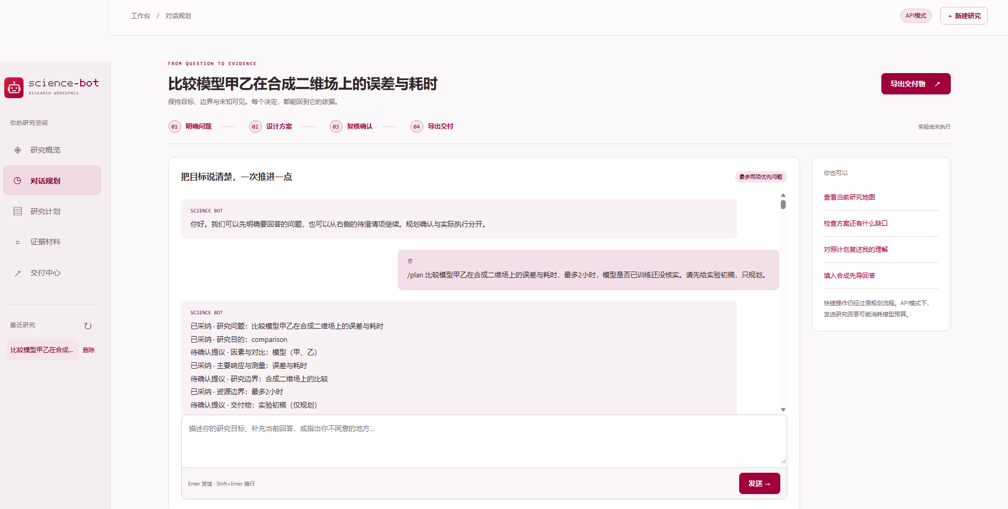
TODO： 展示我们的交互界面并讲解用法

Slide 7
Visit our GitHub and learn more

Slide 8
Thanks for your attention

