Slide 1


Slide 2
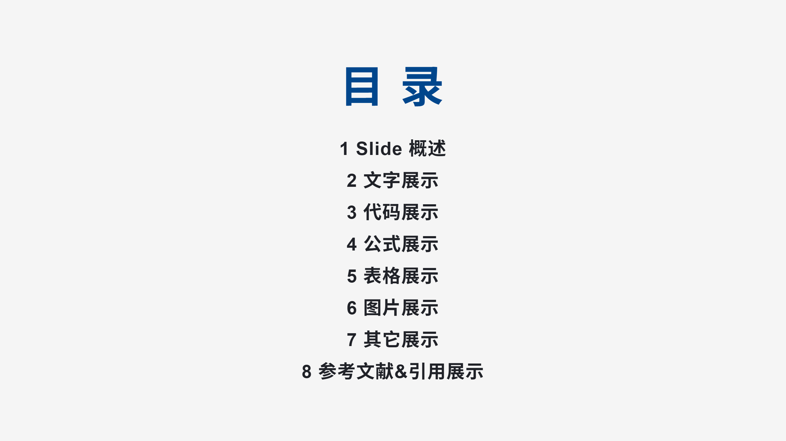
Notes:
![bg left:45%](./images/bg2.jpg)

Slide 3


Slide 4


Slide 5


Slide 6
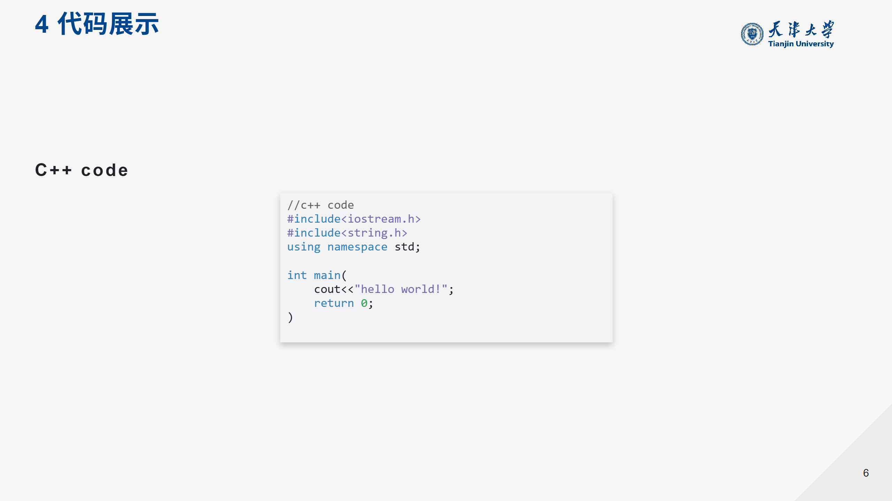

Slide 7
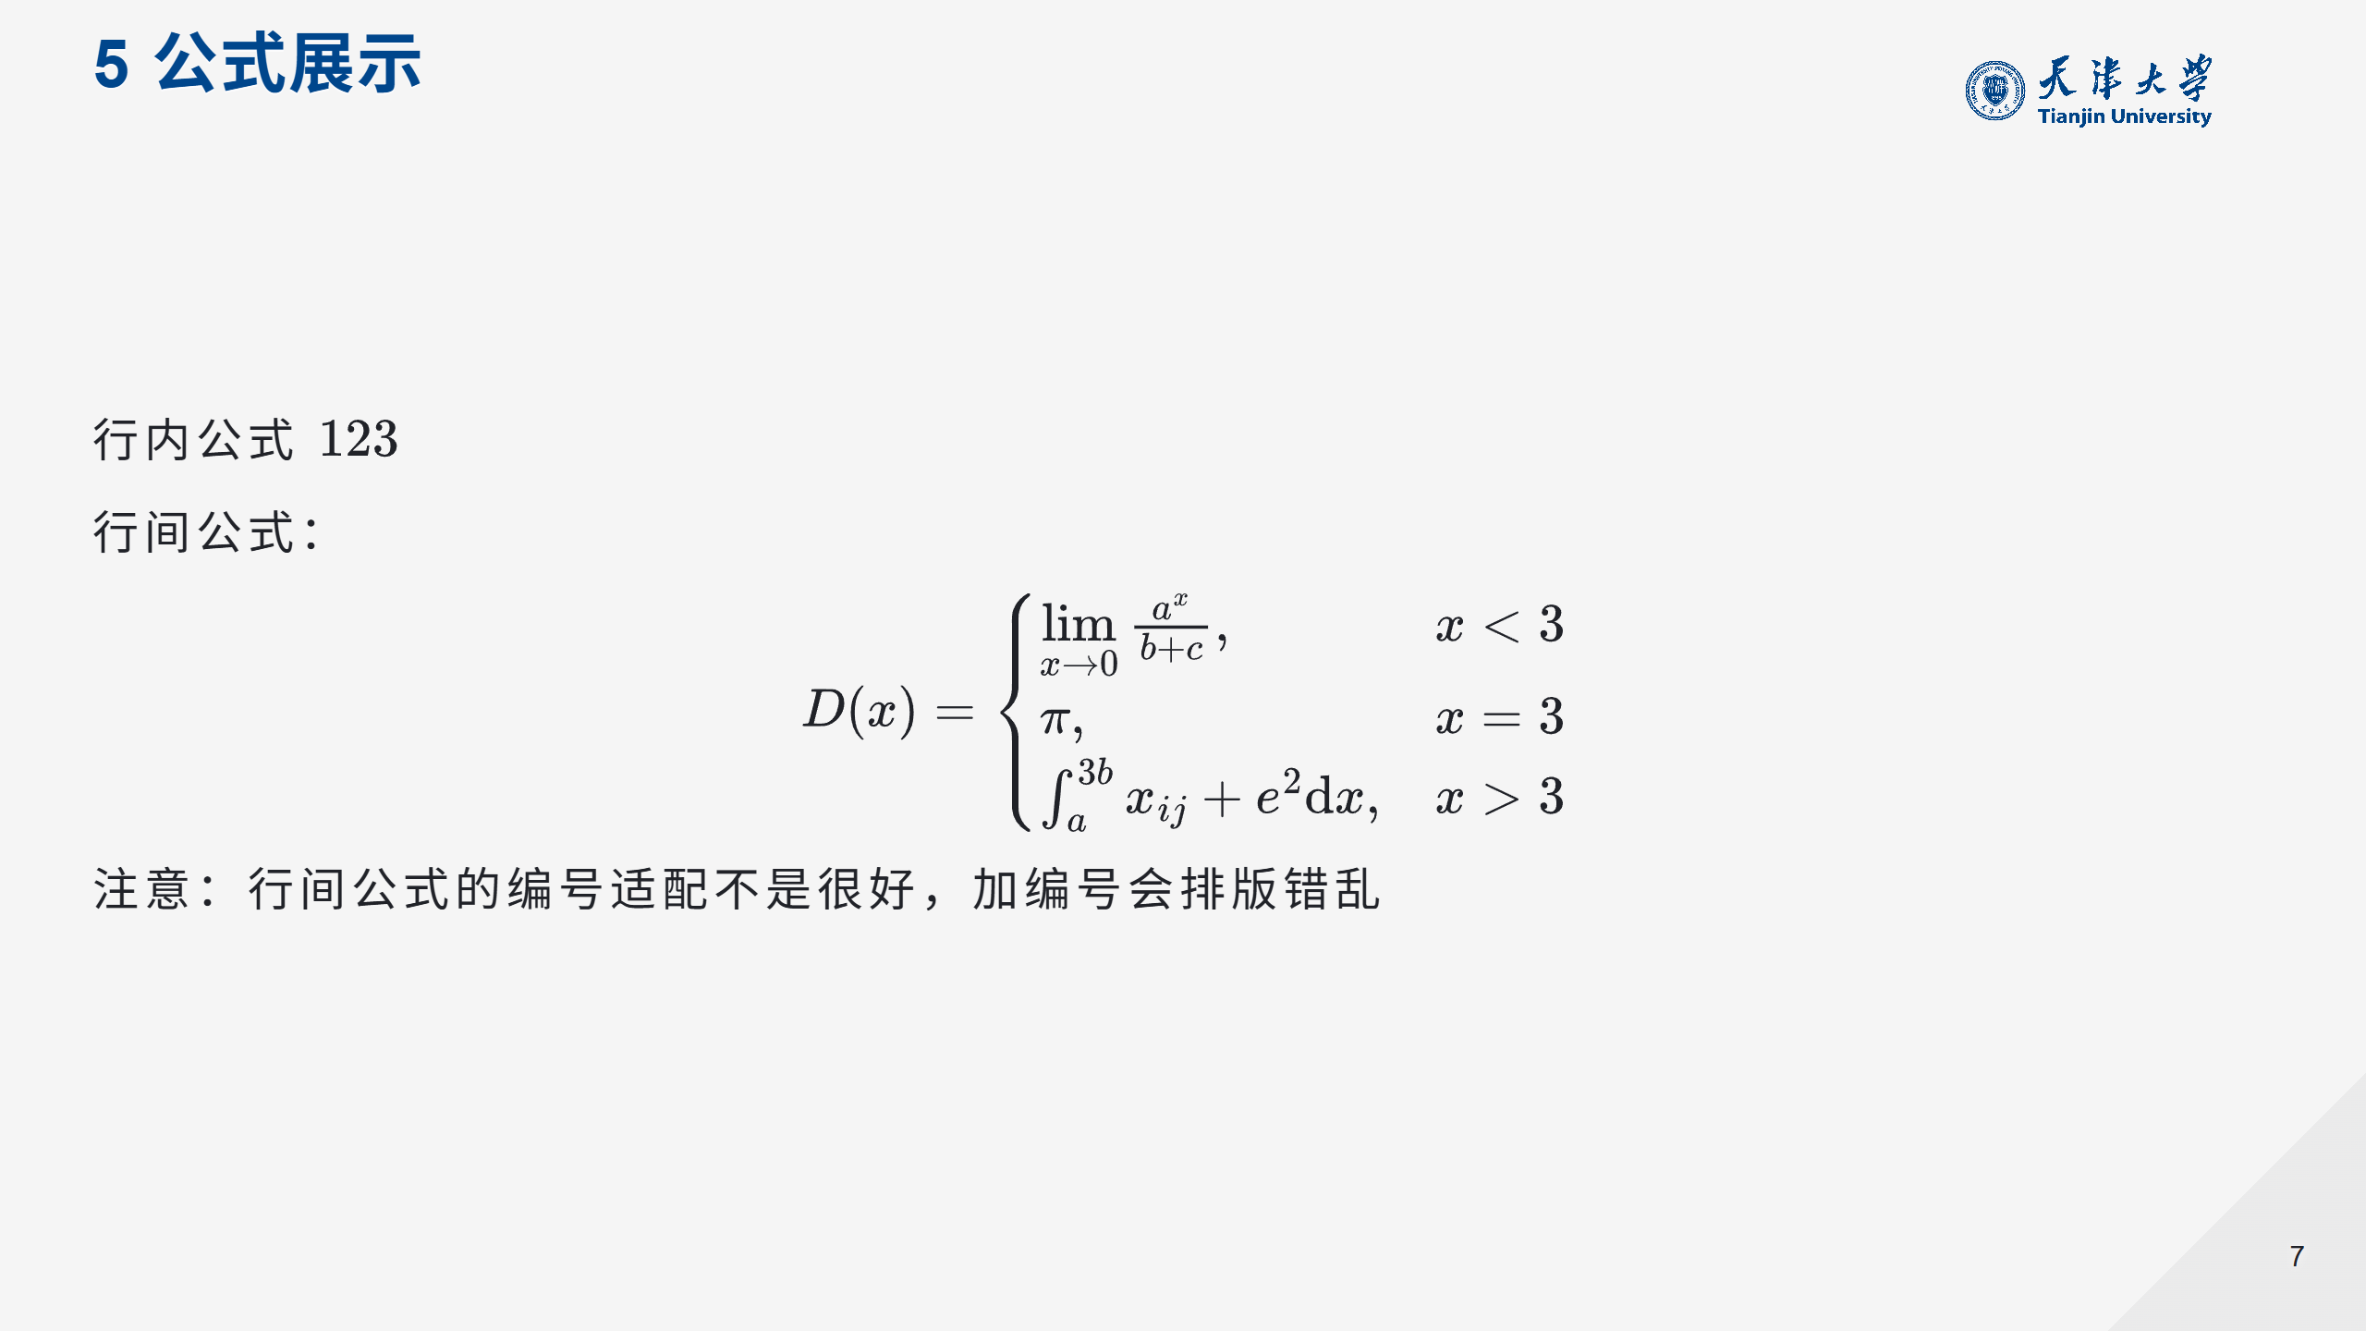

Slide 8


Slide 9

Notes:
![img w:300px](images/bg3.jpg)|

Slide 10
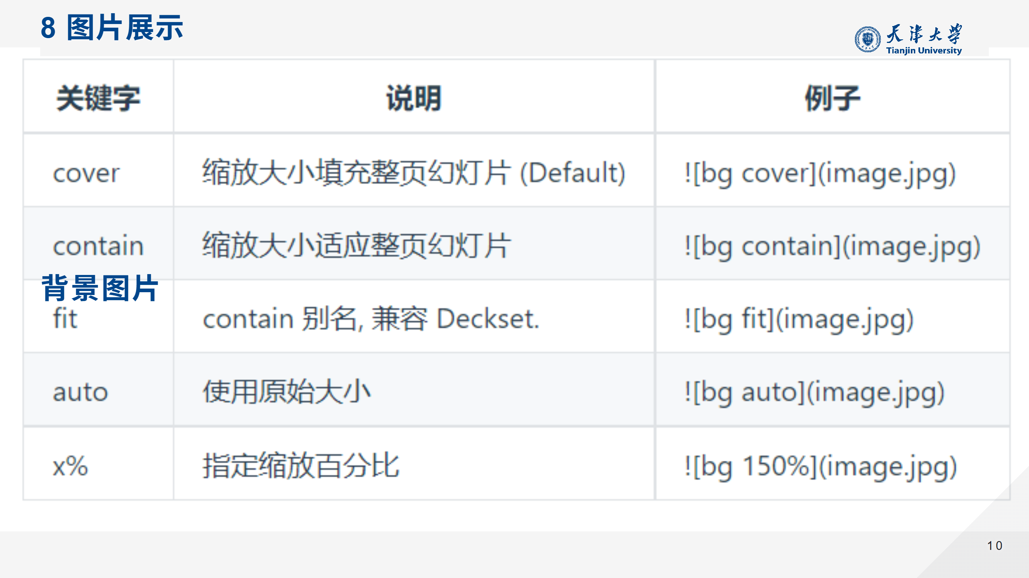

Slide 11


Slide 12


Slide 13


