Slide 1
Final project: Netflix popular movies dataset
Made by Shangkun Dai and Peizhen Luo

Slide 2
CONCENTS
01
03
02
Introduction
Summary
Questions and the analyses

Slide 3
ONE
Introduction

Slide 4
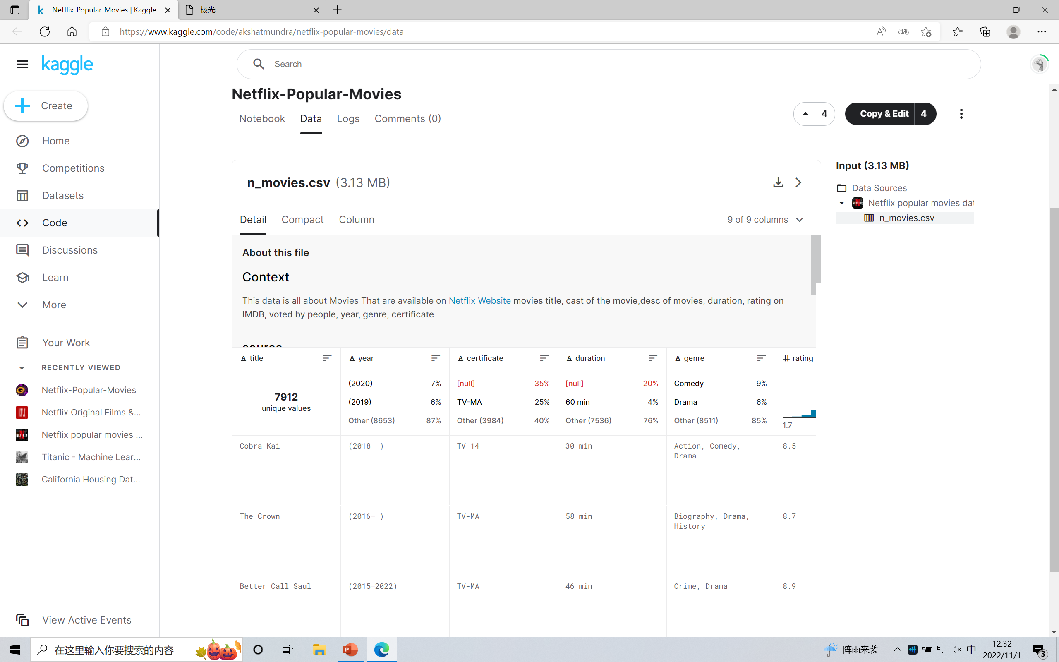
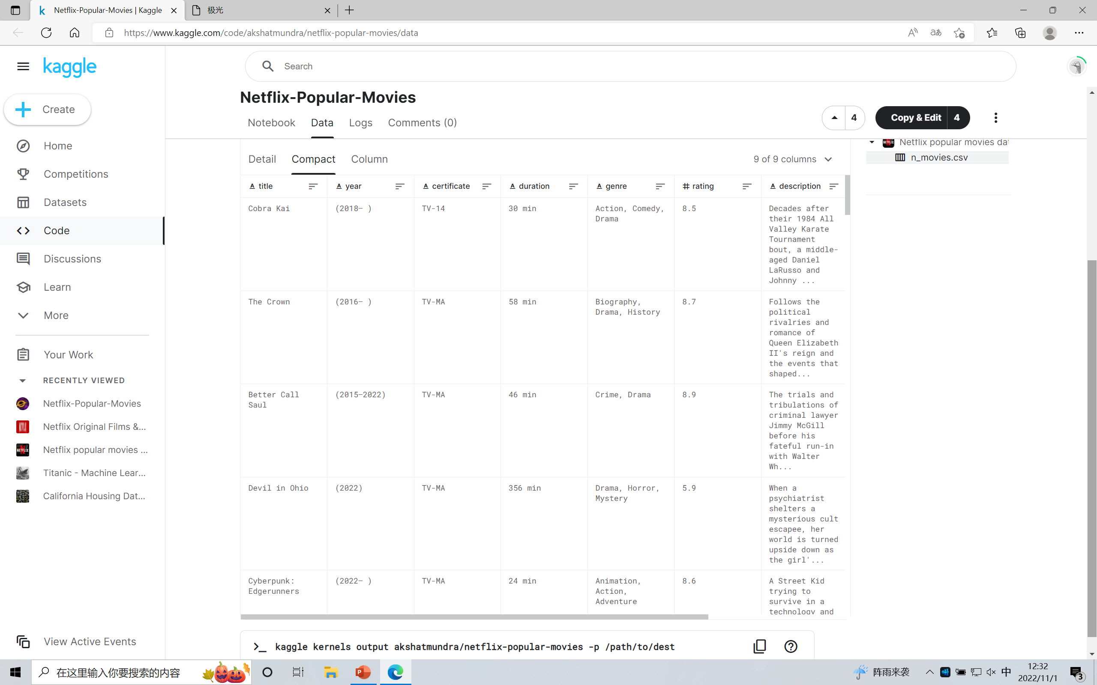
About our dataset
About the movies in Netflix.
We can find title, year, certificate, duration, genre, rating, description, stars and votes in our dataset.
Nicholas
Julian
Cameron
Designer
Designer
Designer

Slide 5
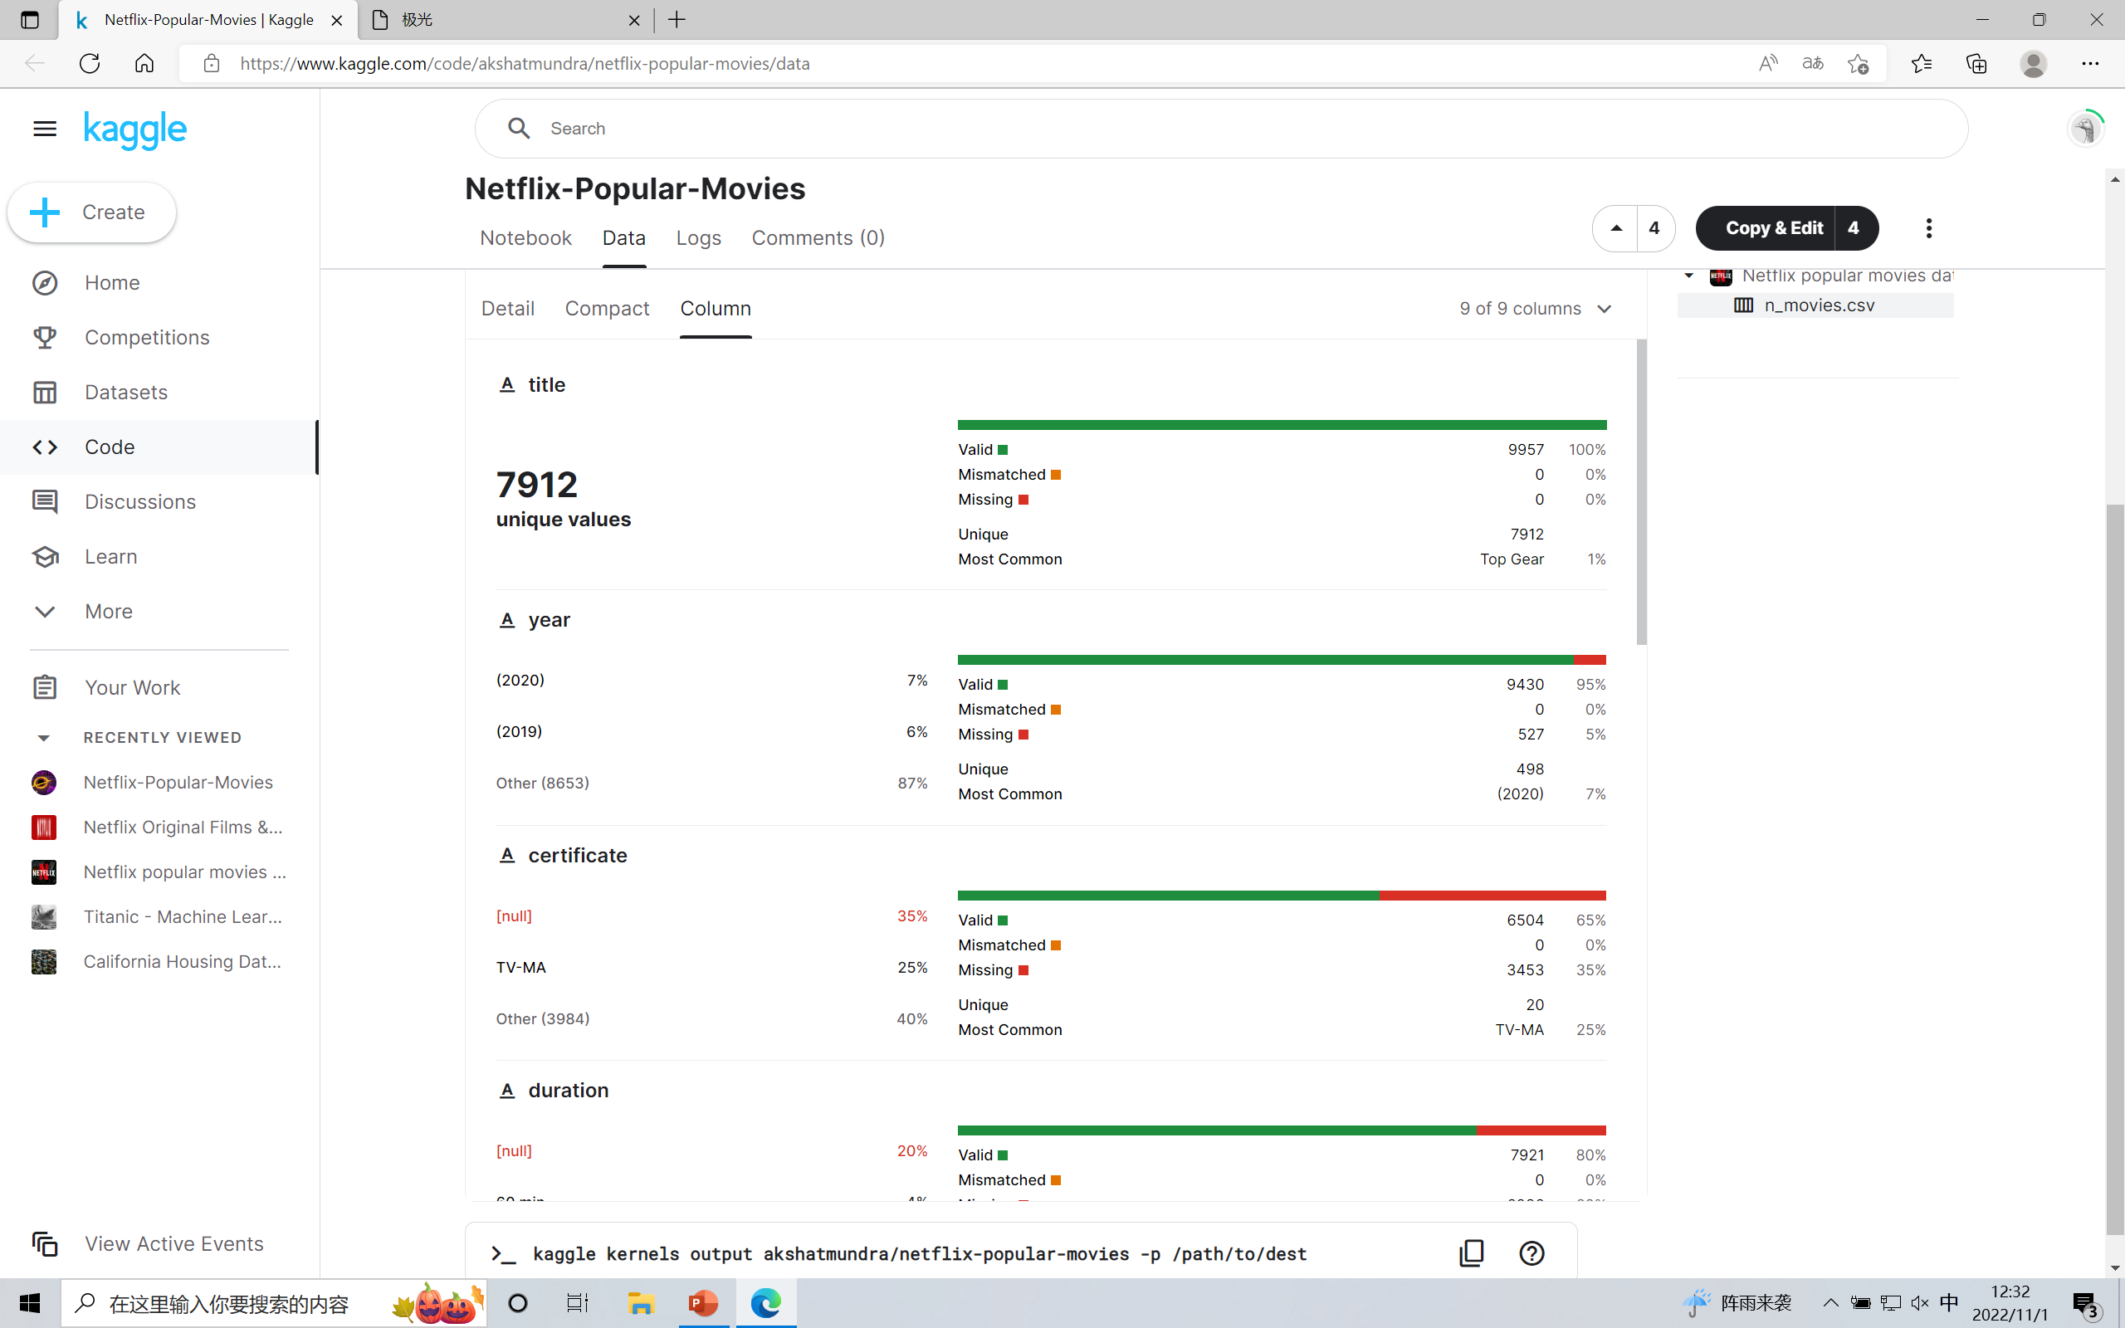
Introduction
We have 7912 unique values in our dataset. But since some values is null, the number of vaild values will be different in some chart.

Slide 6
Introduction
What we can do?
·What kind of movies audience like best?
·Whether certificate will influence their votes？
·How many movies produce in each certificate these year？
·What kind of movies make biggest votes？
·In order to get more votes, how long should the movie be？

Slide 7
TWO
Questions and the analyses

Slide 8

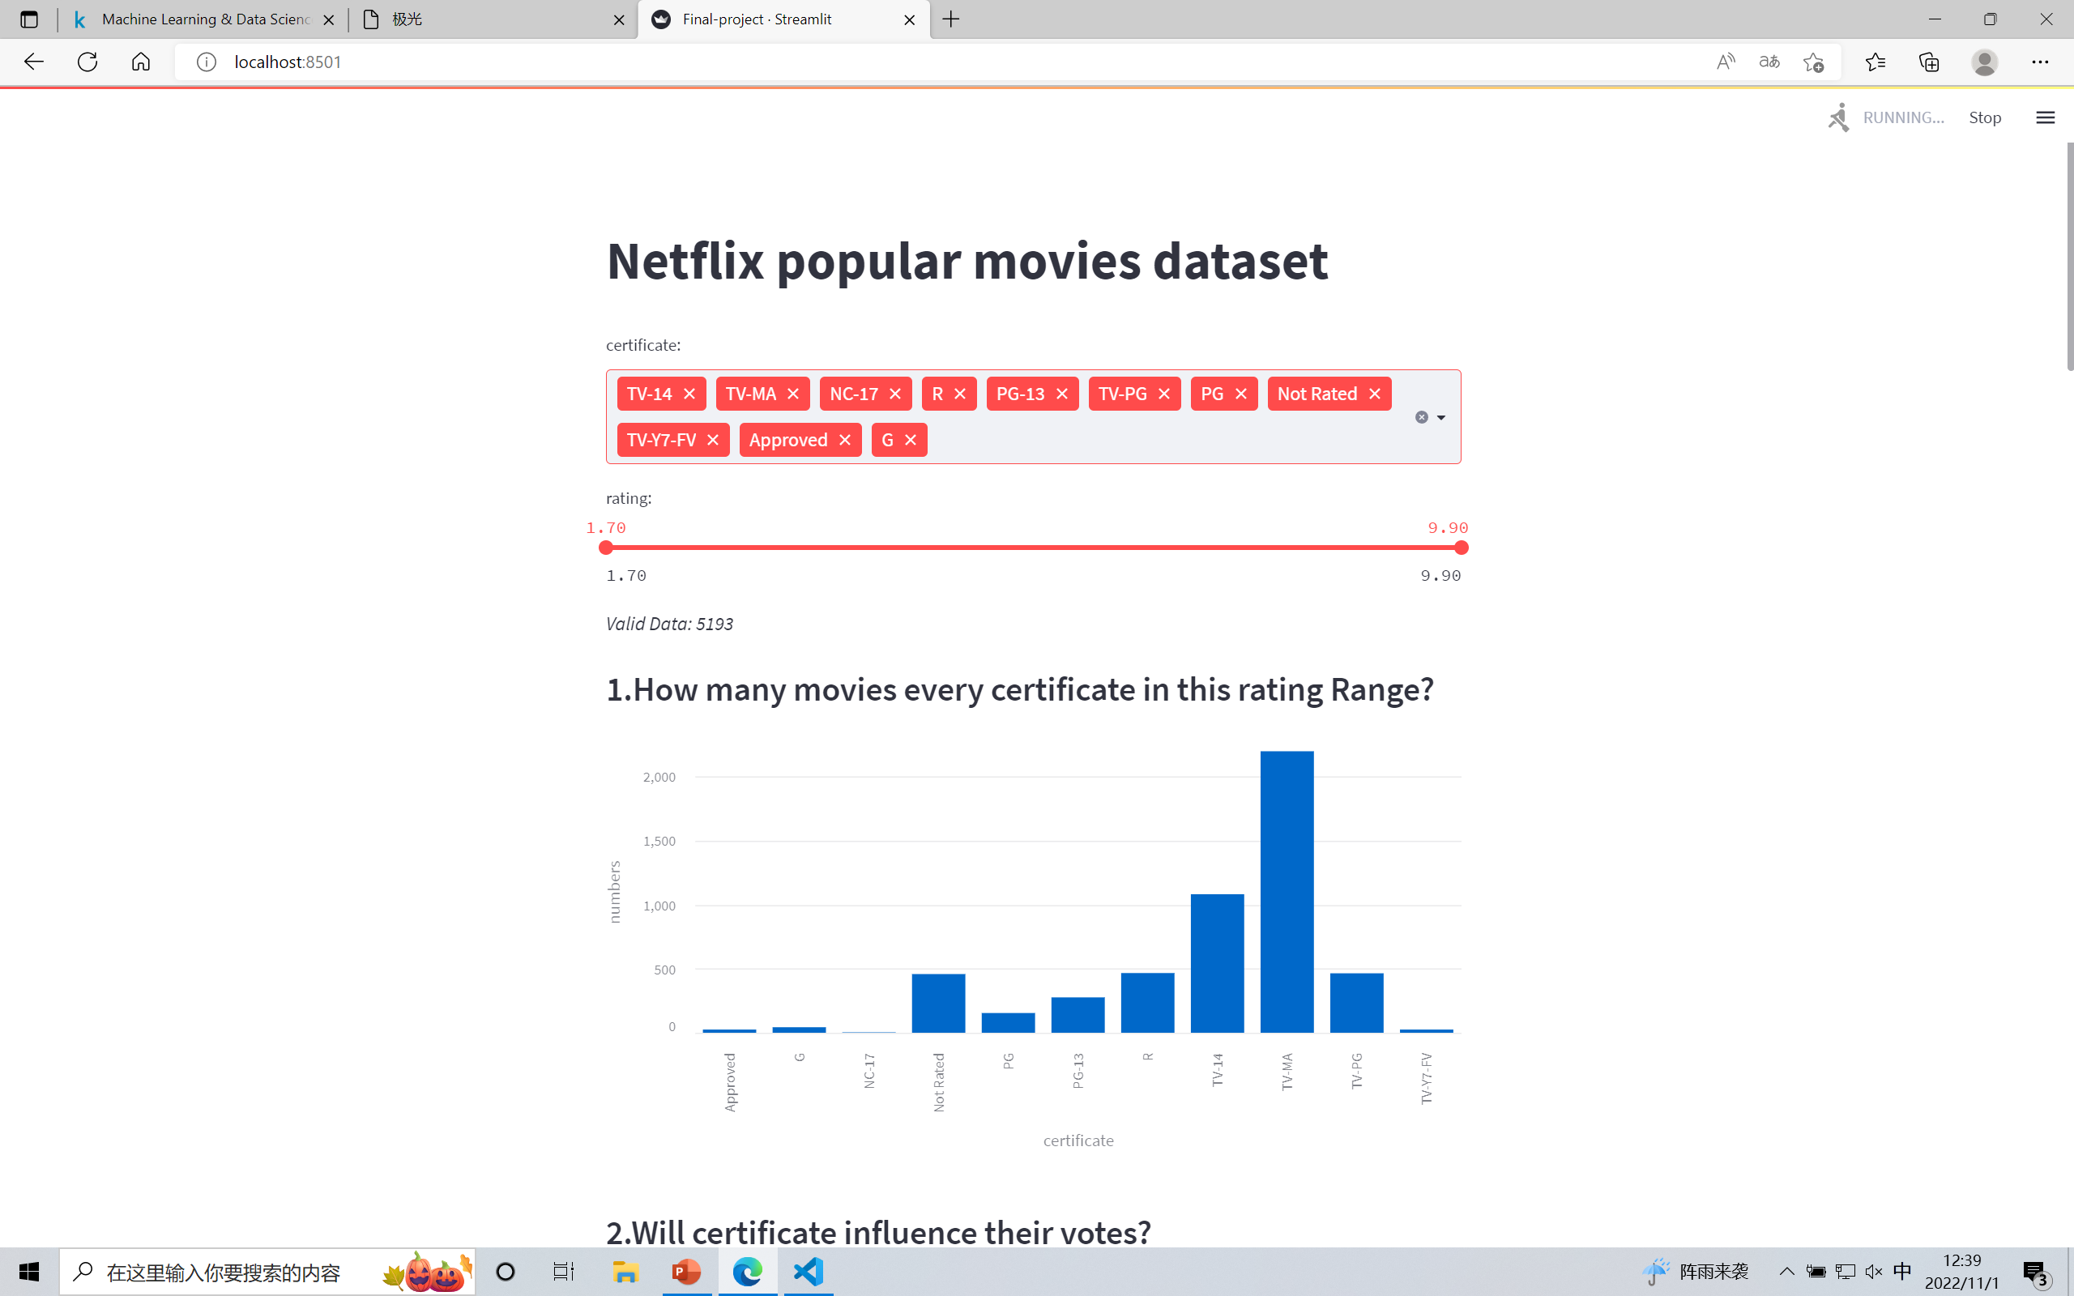
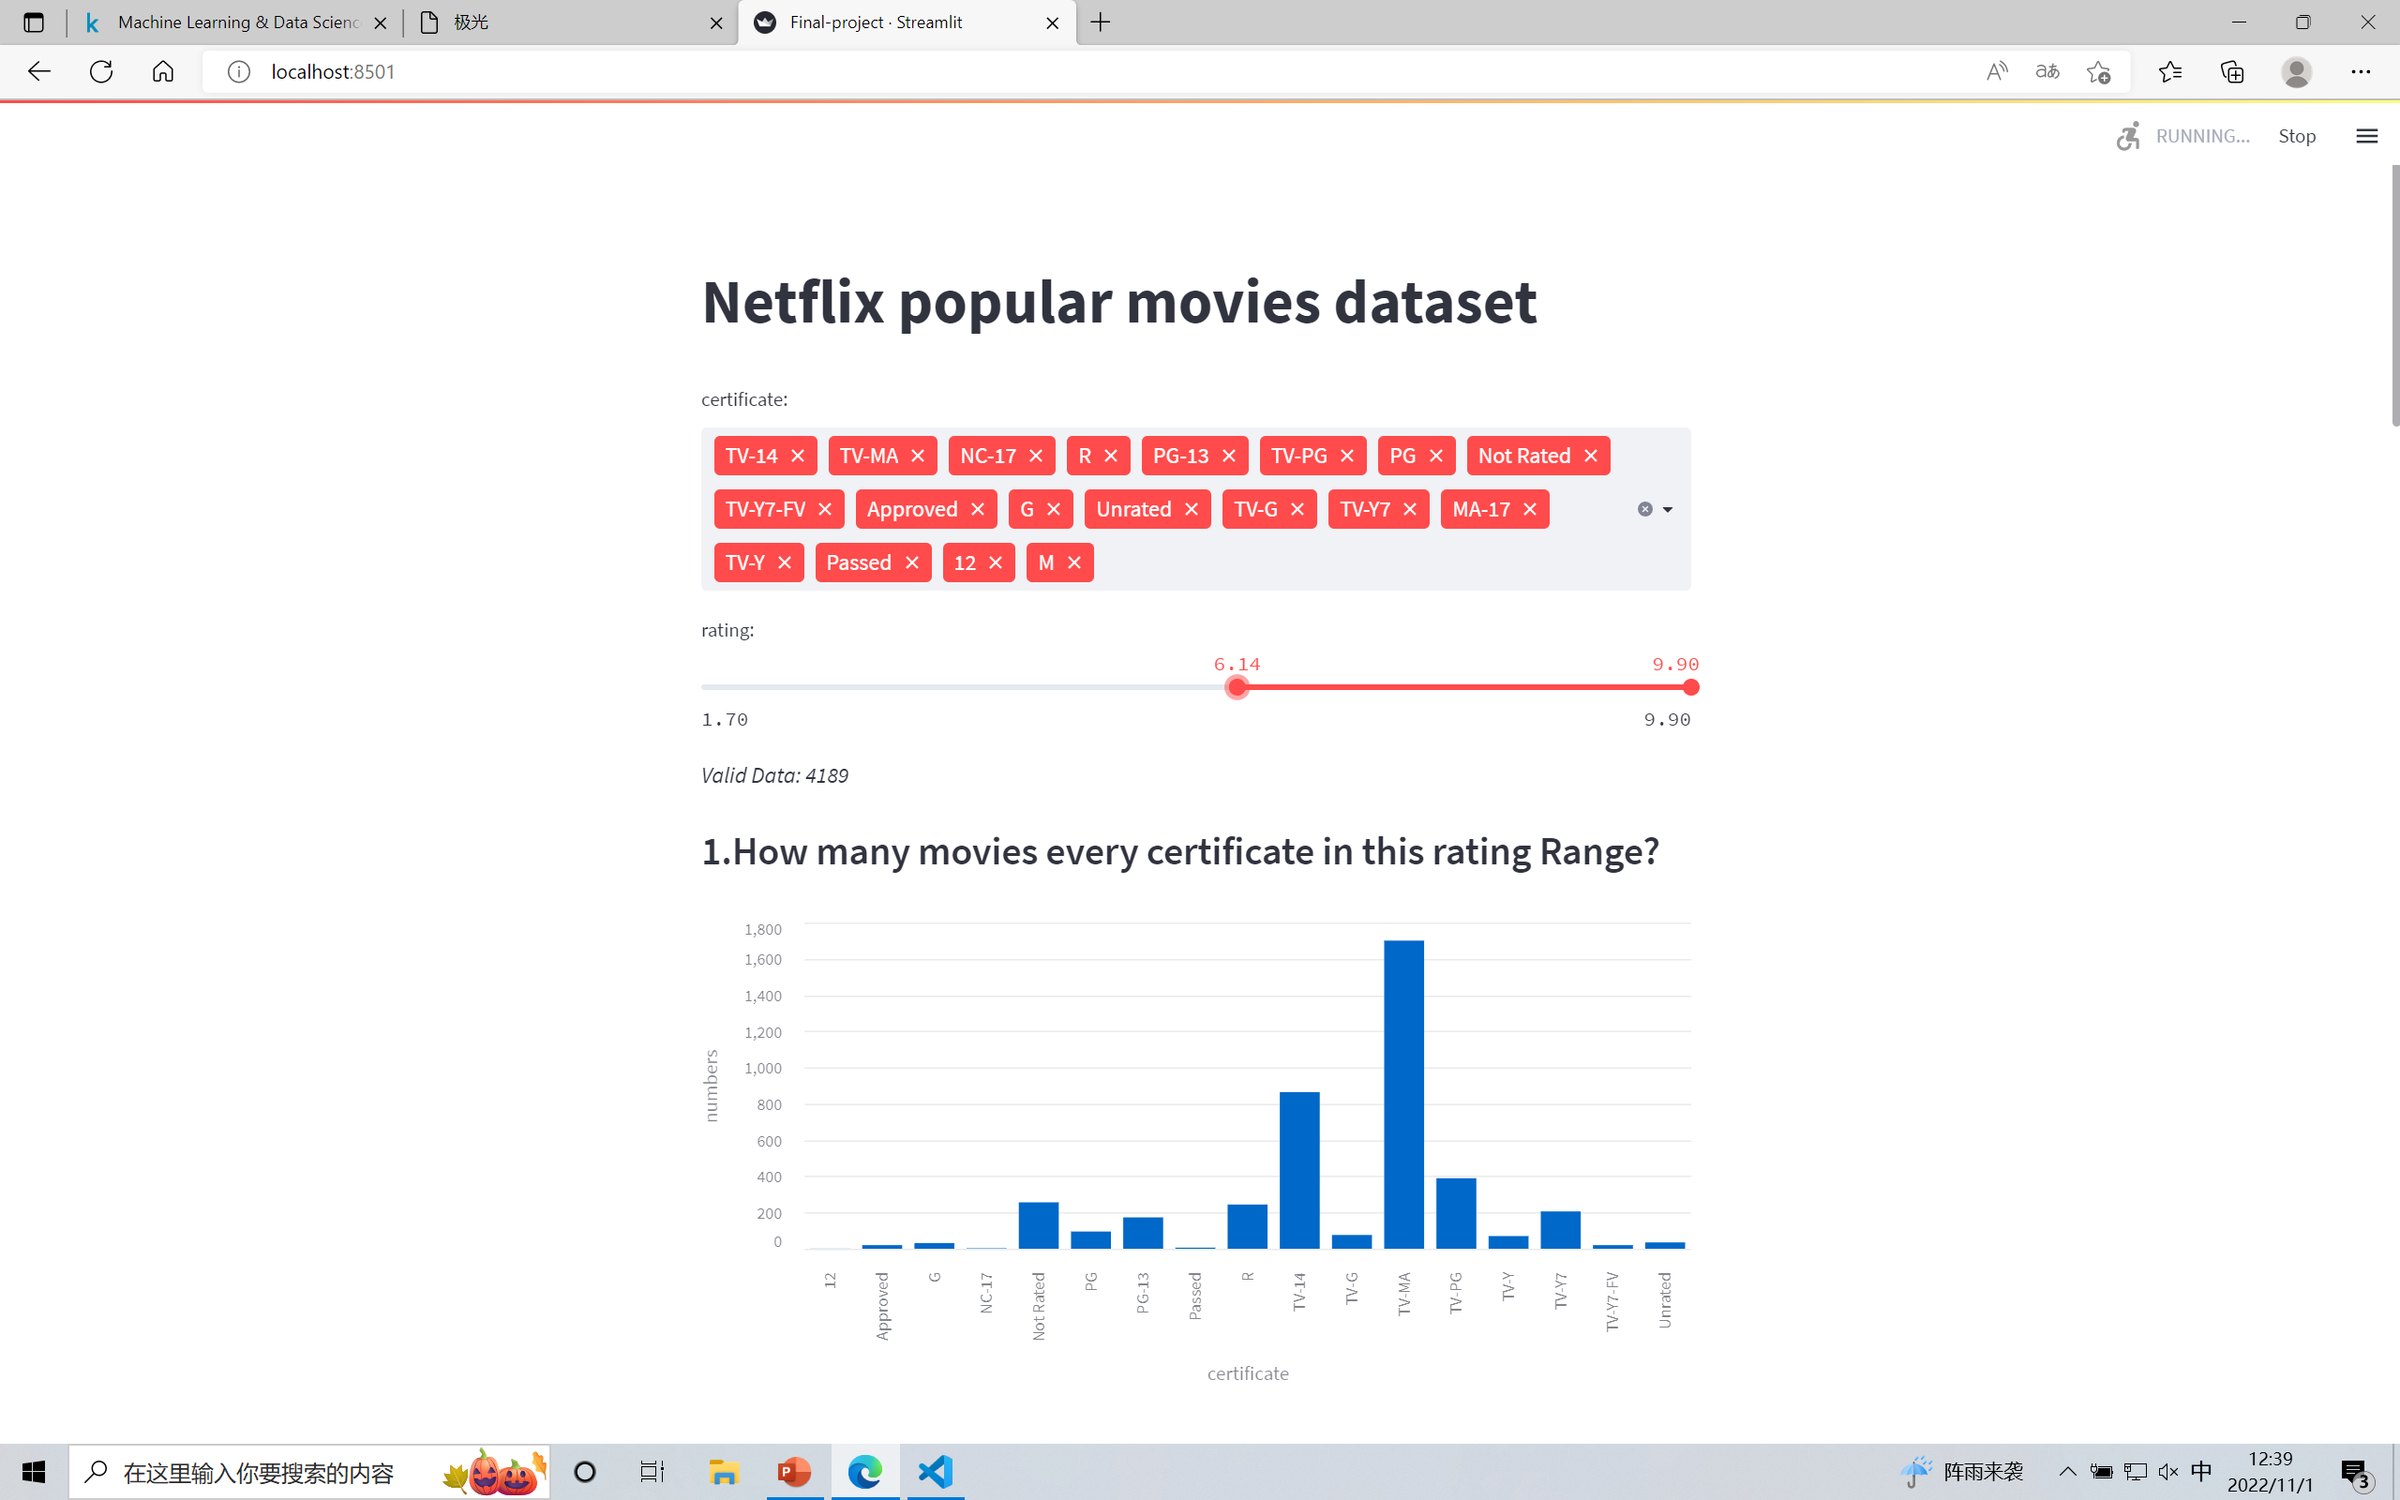
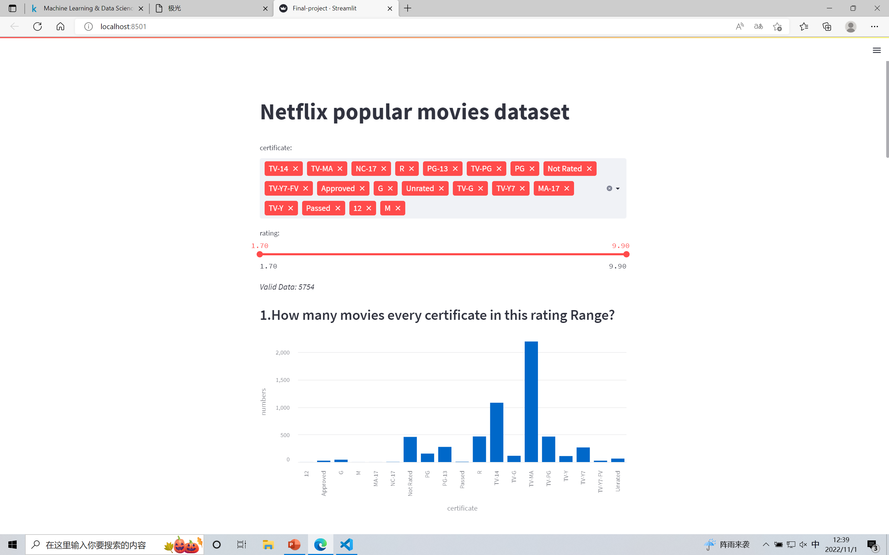
Questions and the analyses
Question 1:
How many movies every certificate in this rating Range?

Slide 9
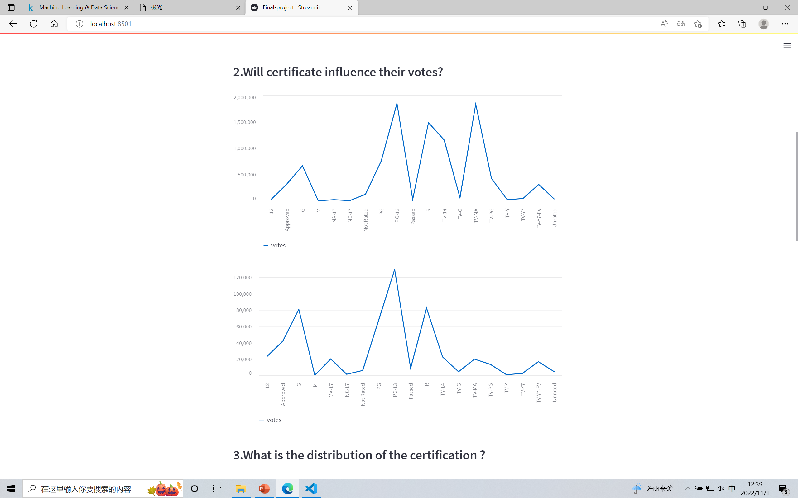
Questions and the analyses
Question 2:
Will certificate influence their votes?
max votes
average votes

Slide 10
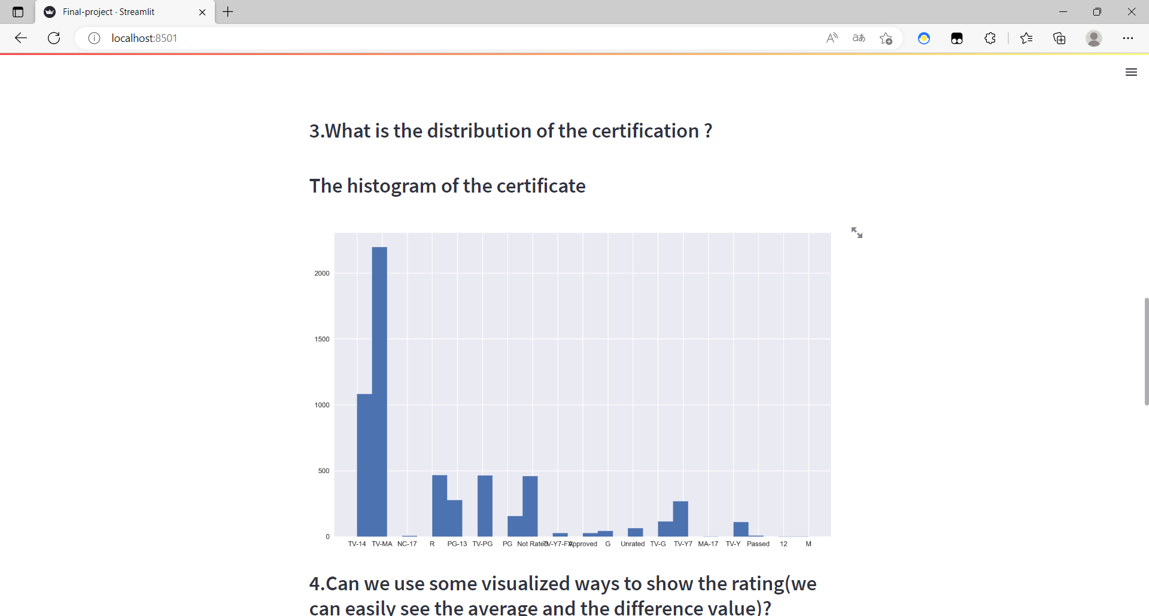
Questions and the analyses
Question 3:
What is the distribution of the certification?

Slide 11
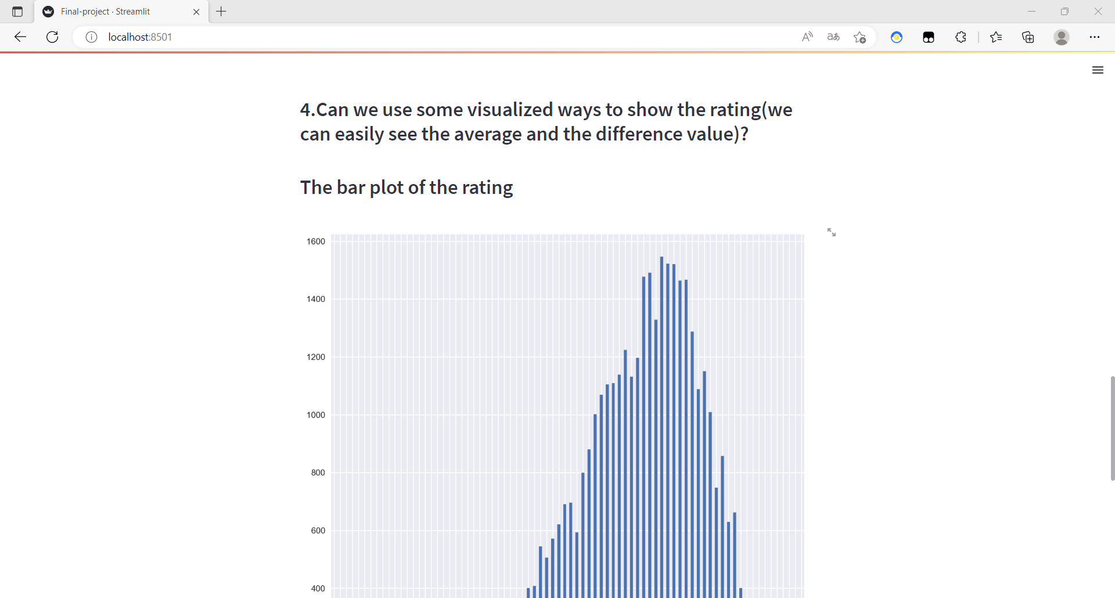
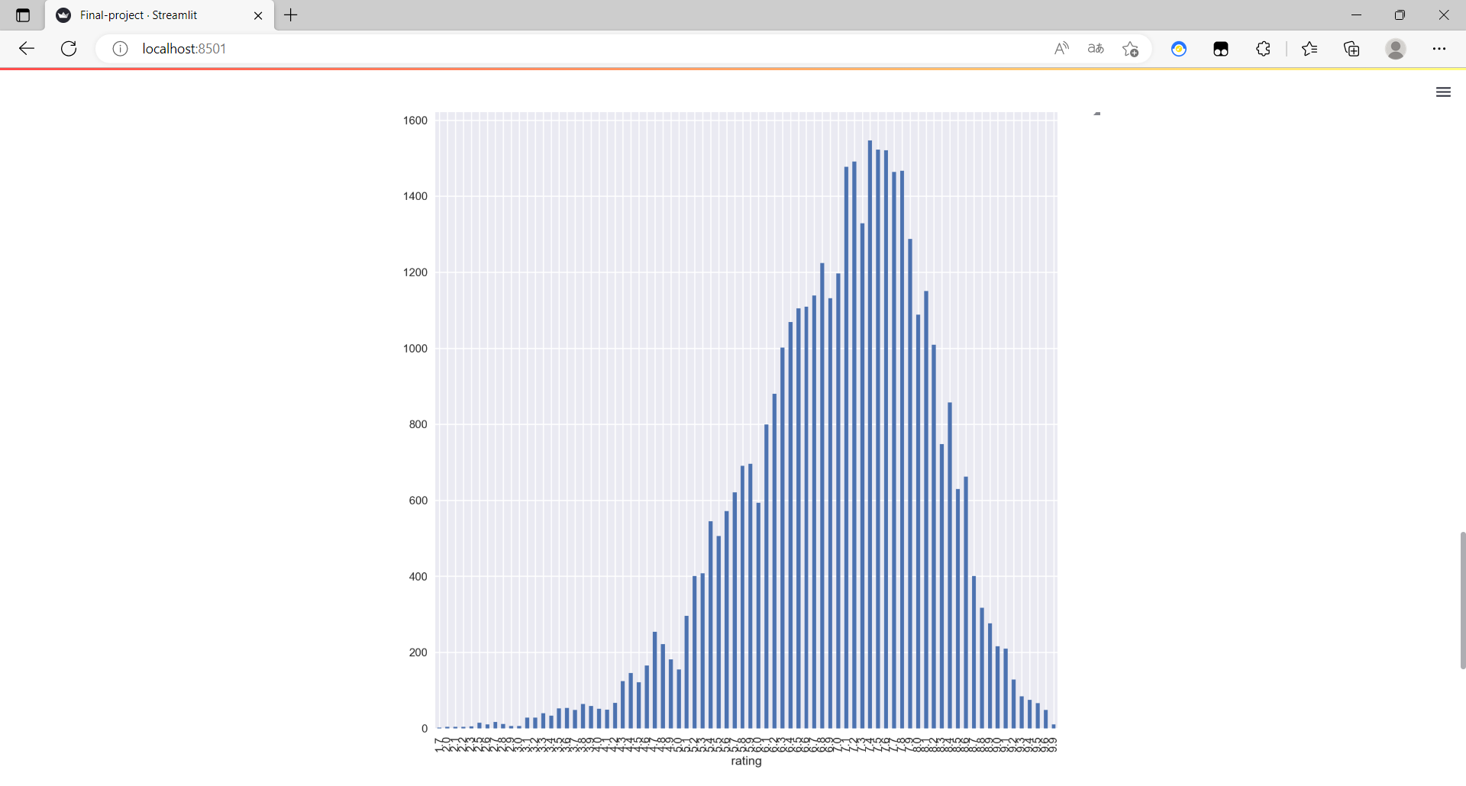
Questions and the analyses
Question 4:
Can we use some visualized ways to show the rating(we can easily see the average and the difference value)?

Slide 12
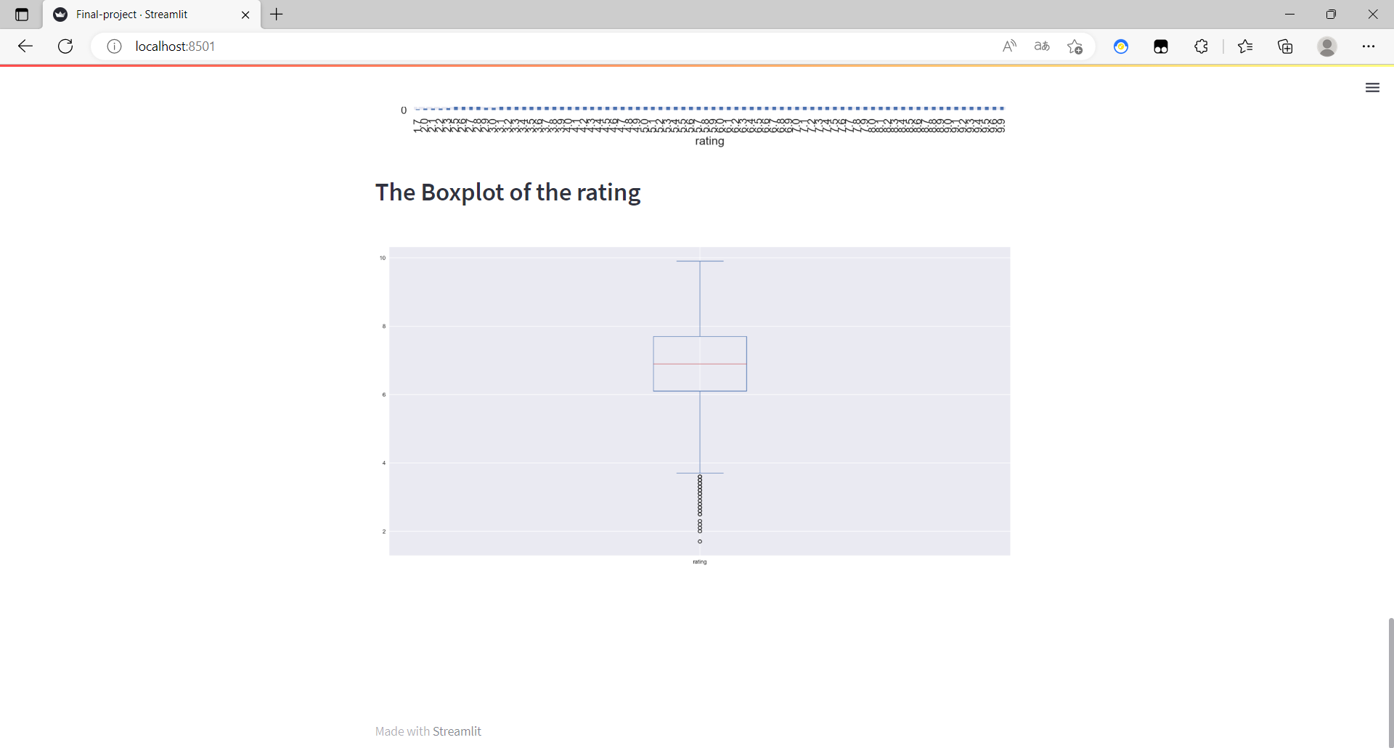
Questions and the analyses

Slide 13
THREE
Summary

Slide 14
THANKS FOR WATCHING

