Slide 1
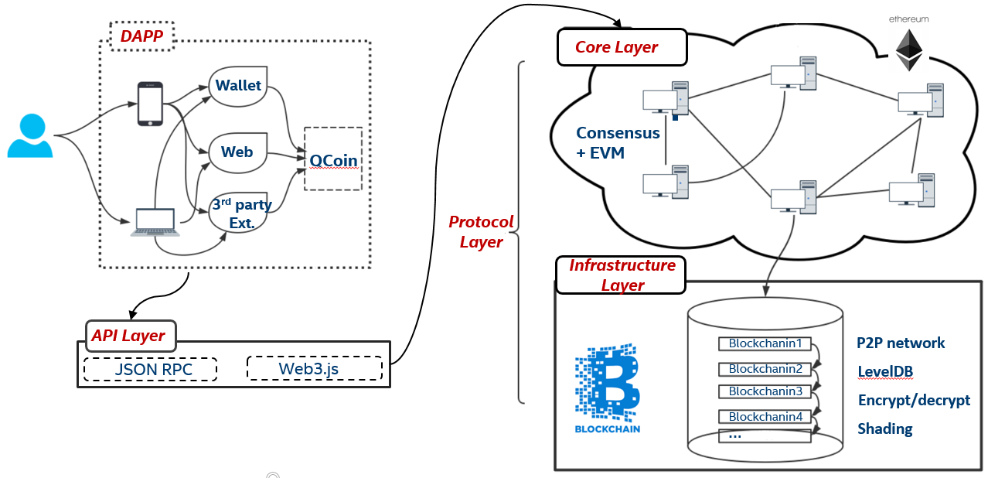
Qcoin for Media driver Quality
QCoin @ https://github.com/shural/qcoin
Cryptocurrency for Media driver Quality.
Encourages risk taking of extra efforts for better quality
Block chain w/ customized POS based on:
Design review
Code review/inspection
Dev ULT review
Smart validation review
Validation plan review
Continuous integration as check-ins of smaller granularity
Accuracy of documentation
......
High level architecture for QCoin

Slide 2
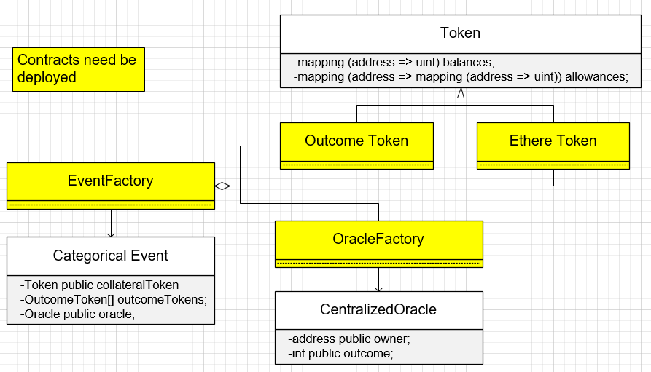
Qcoin Smart Contracts Hierarchy
Legend
2
3
1
4

Slide 3
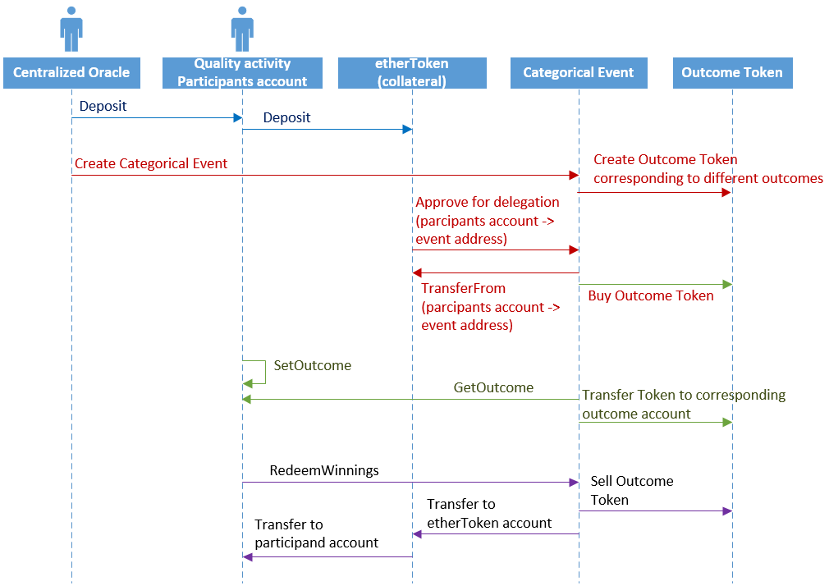
Qcoin Smart Contracts Calling Sequence
1
Deposit the Collateral
2
Create the bet Event
3
Set outcome based on fact
4
Redeem Winnings

