Slide 1
P3 Meeting

Slide 2
Agenda
Background and (Demo)
Code Review
Division of Labour
Handling Merge Conflicts
Future Design Discussion

Slide 3
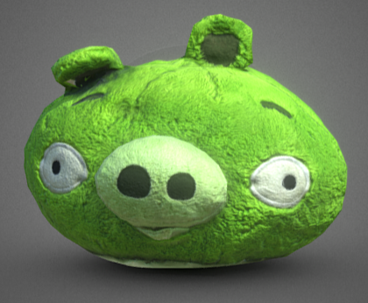



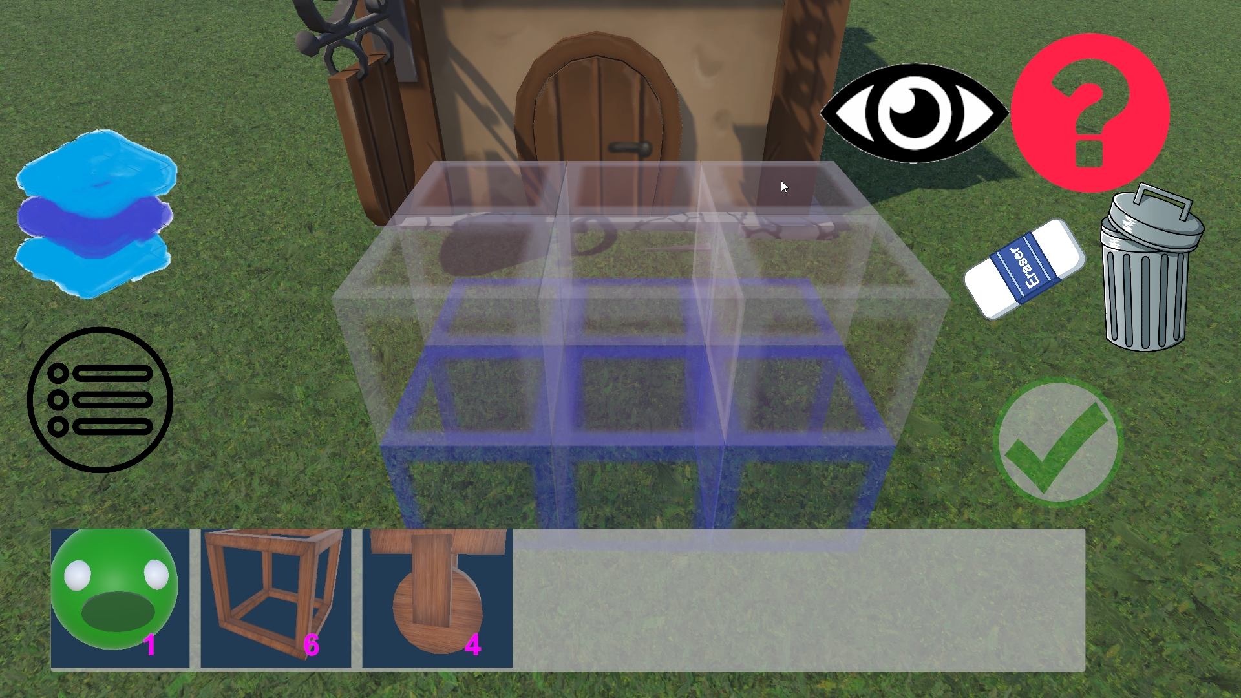
Roles Needed
Little need for the core mechanics (I’ll do it)
Modeling the character, expressions and vehicle components (wheels, ...), environment (houses, trees, etc.)
Redrawing UIs
Important: Map making (with ProBuilder)
Level designer
(Future) Juice: Background Story Animation and level transition (narrative) animation

Slide 4
Handling merge conflict:
Divide the scenes as much as possible.
Map making handled by only 1 person.
Testing vehicle mechanics in a separate scene.
Yield to other members when encountering a merge conflict. (Select “Accept all changes in [other member’s] commit”)

Slide 5
Current Design Philosophy
Give the player a sense of control.
Make the game satisfying instead of hard, while giving the player a sense of “I’m so clever”.
Simplify control mechanism, use conventional keyboard keys (WASD, Q, E, etc.)
Immersive feeling with first person camera (may contradict with a sense of control)

Slide 6
Discussion about Future Plans
What components to add?
What mechanism (levels) to add?
How to improve juiciness?
Gameplay experience (tutorial, UI, control)

Slide 7
P3 Gold Task
Model a piggy?
Add more levels regarding motor wheel and turn wheel
Add a new mechanic (rocket or something)
Adjust UI
All members: get familiar with the codebase and workflow.

