Slide 1
P3 Second Meeting

Slide 2

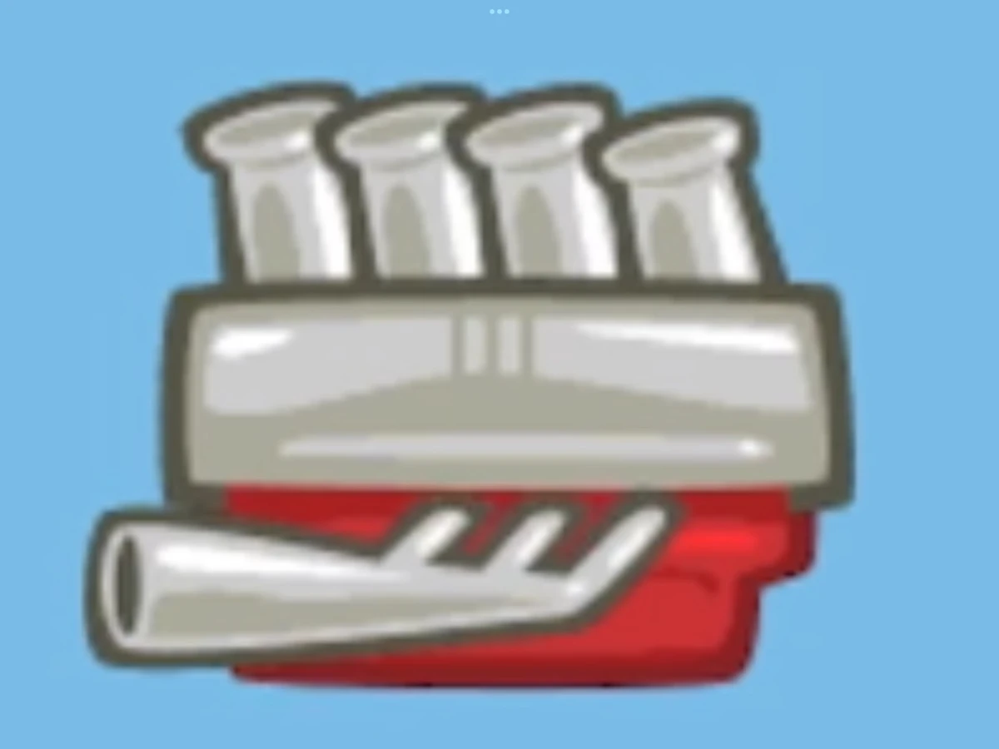
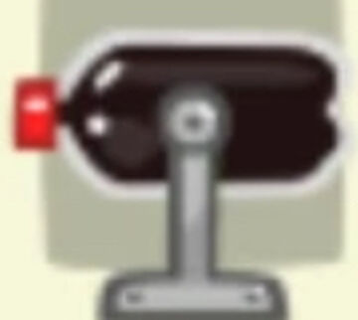
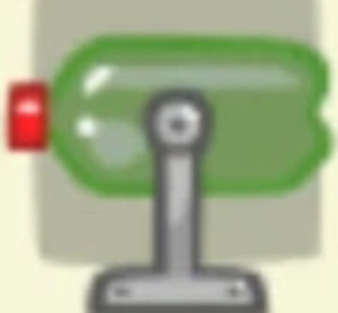


Tasks to do:
New Components (referencing wheel and its variants)
New Levels
Integrate them to the system

Slide 3
Adding new components concerns:
New Object Prefab that contains a VehiclePreview Component
New DragImage object to BuildCanvas
Adding new levels concerns:
Creating a level with a GridMatrix and a Goal in the main scene
Set GridMatrix dimension
Terrain and Camera movement (not our business)
Level component collection in Util class

