Slide 1
8.9汇报

Slide 2
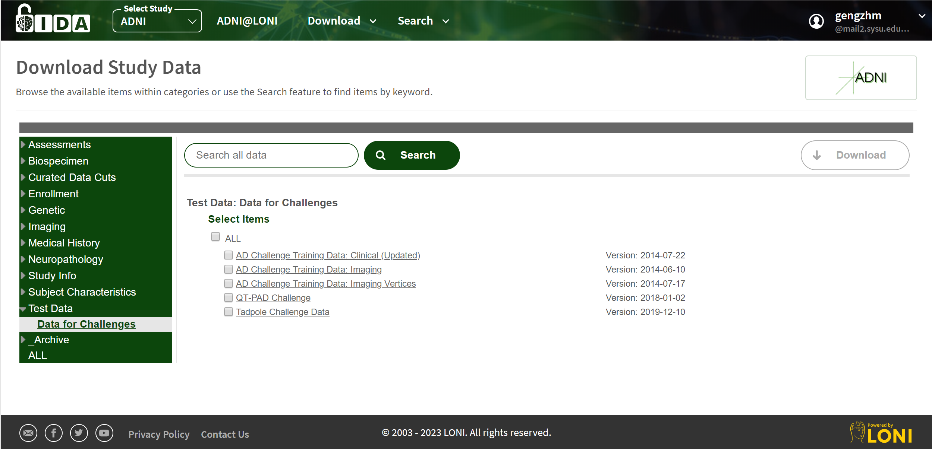
ADNI数据

Slide 3
Alzheimer MRI Preprocessed Dataset
Alzheimer MRI Preprocessed Dataset (128 x 128)
The Data is collected from several websites/hospitals/public repositories.
The Dataset is consists of Preprocessed MRI (Magnetic Resonance Imaging) Images.
All the images are resized into 128 x 128 pixels.
The Dataset has four classes of images.
The Dataset is consists of total 6400 MRI images. Class - 1: Mild Demented (896 images) Class - 2: Moderate Demented (64 images) Class - 3: Non Demented (3200 images) Class - 4: Very Mild Demented (2240 images)

Slide 4
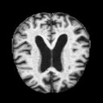
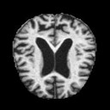
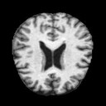
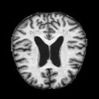
Alzheimer MRI Preprocessed Dataset
Mild Demented 896
Moderate Demented 64
Non Demented 3200
Very Mild Demented 2240

Slide 5
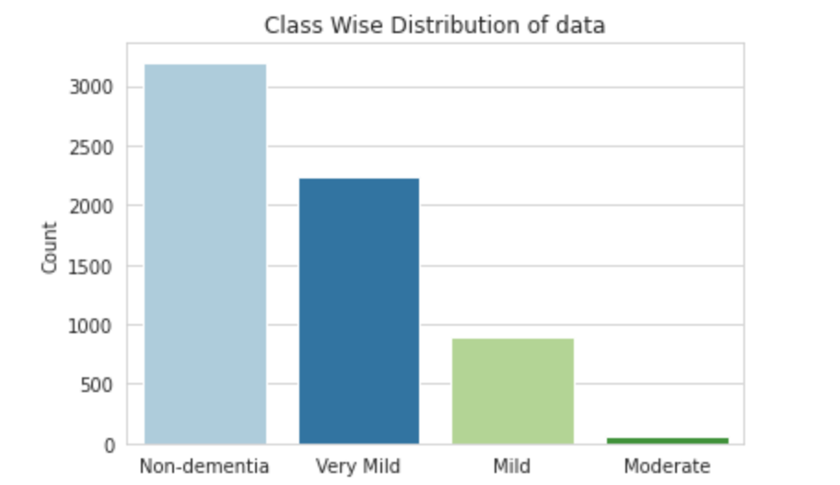
Step 1 : Data Extraction / Cleaning / Aggregation
Step 2 : EDA of variable

Slide 6
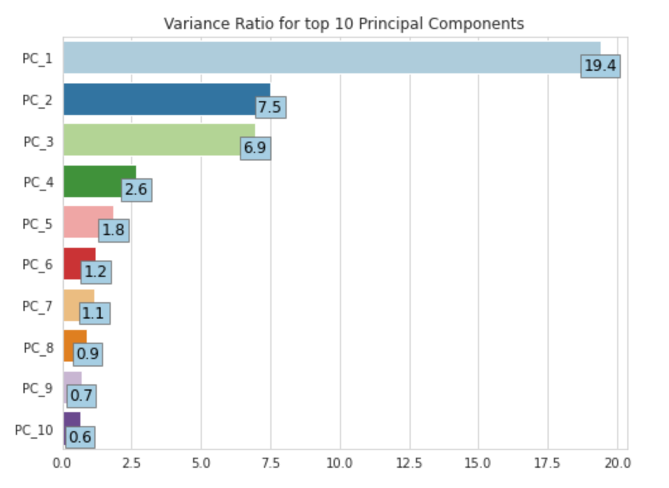
Step 3 : Splitting entire dataset into train and test sets
Step 4 : Data Preprocessing pipeline for scaling and dimensionality reduction
Original Data dimension: 10801 features
After PCA Data dimension: 548 features

Slide 7
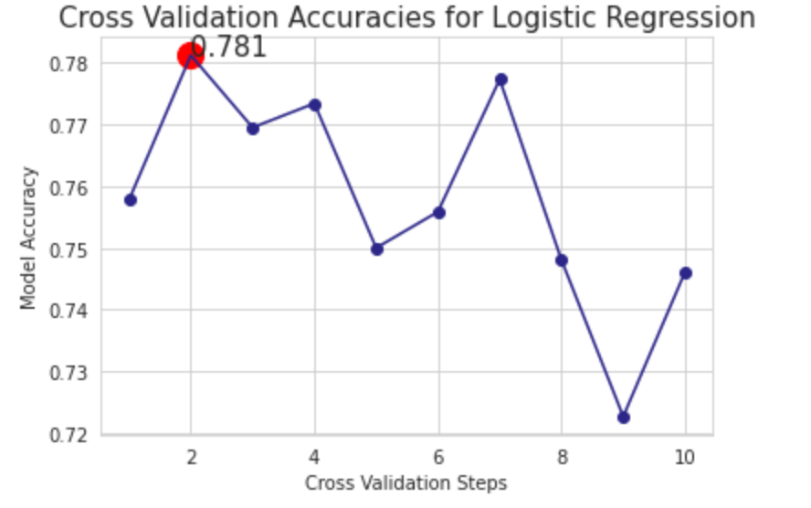
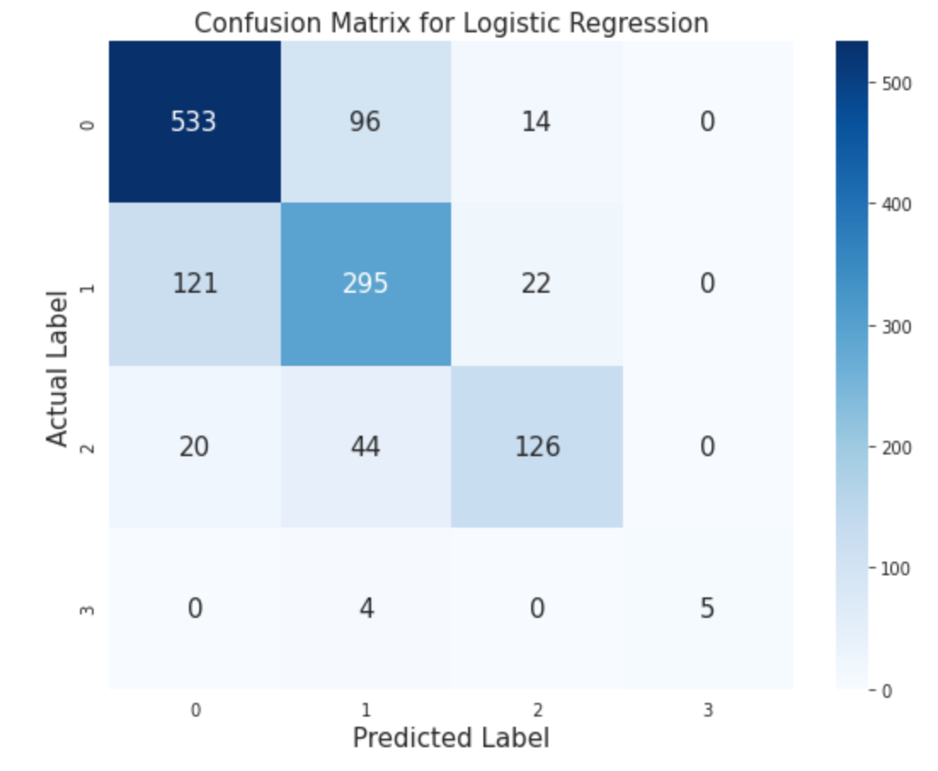
Step 5 : Data Modelling
Step 5.1 Logistic Regression

Slide 8
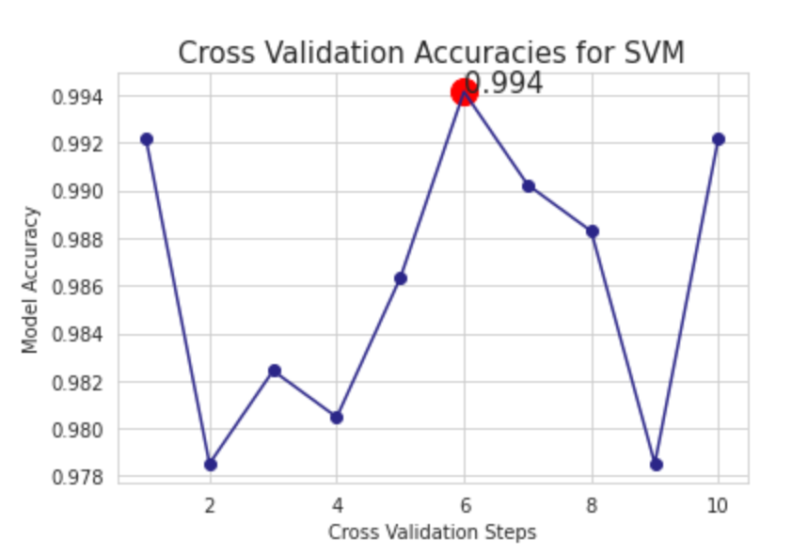
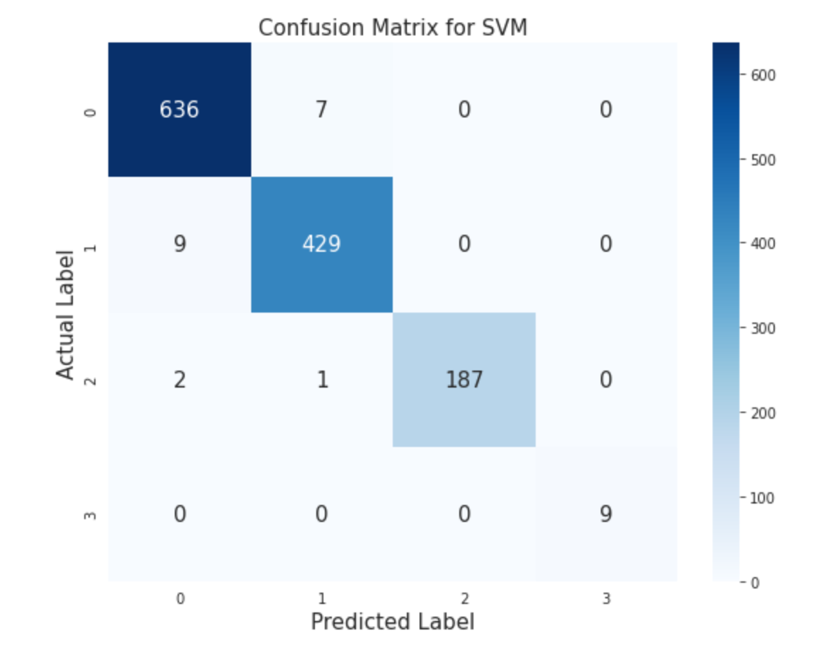
Step 5.2 : SVM

Slide 9
