Slide 1
7.26汇报

Slide 2


Brain MRI Images for Brain Tumor Detection

Slide 3
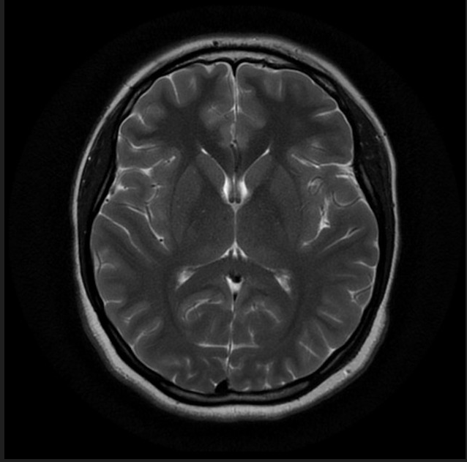
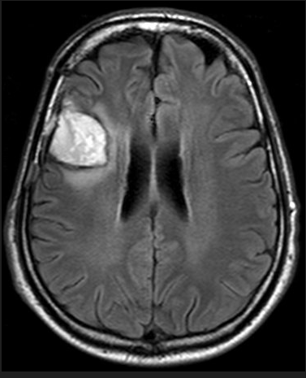
No Tumor vs Tumor 98 vs 172

Slide 4
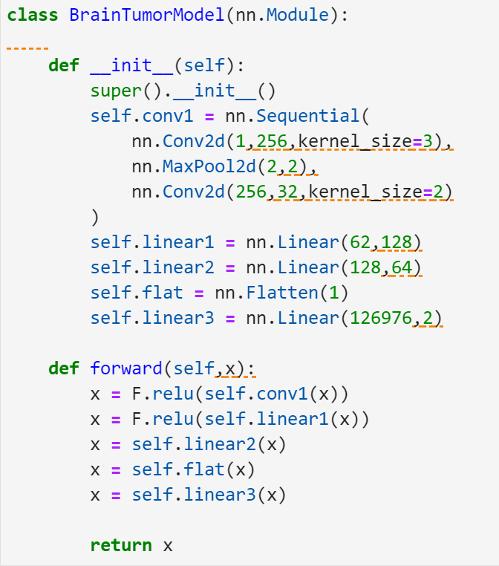
定义卷积神经网络模型

Slide 5


Slide 6

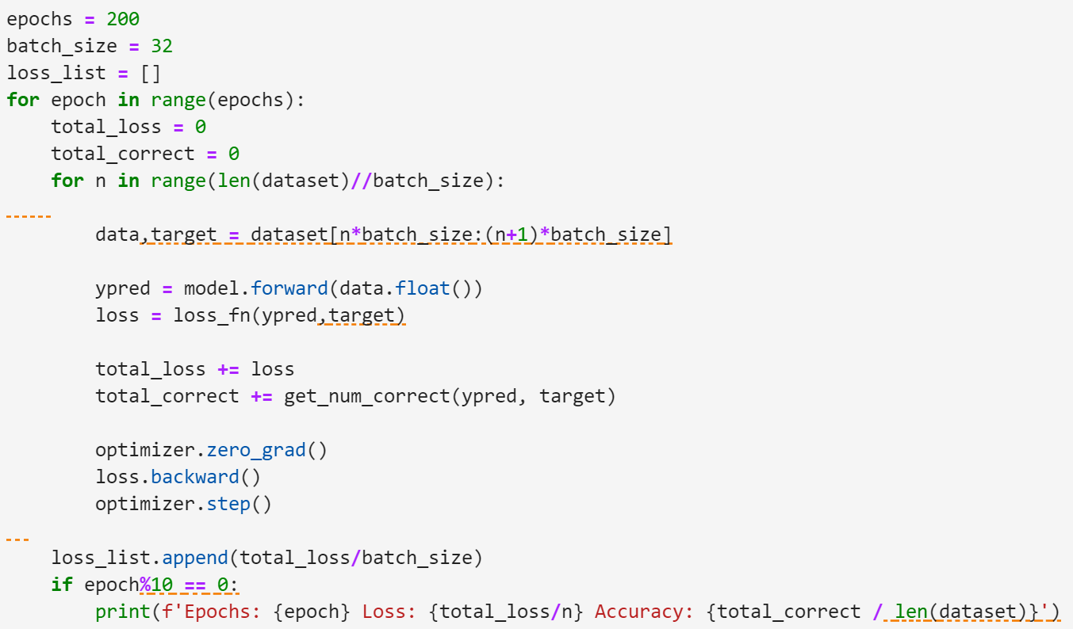
Model training

Slide 7
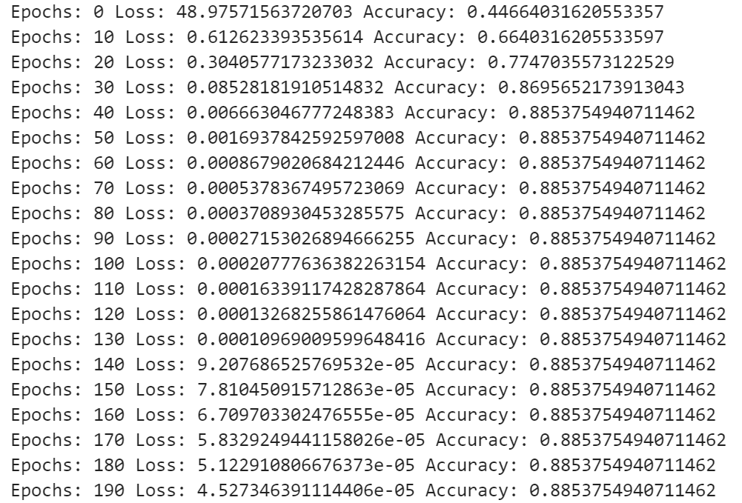

Slide 8
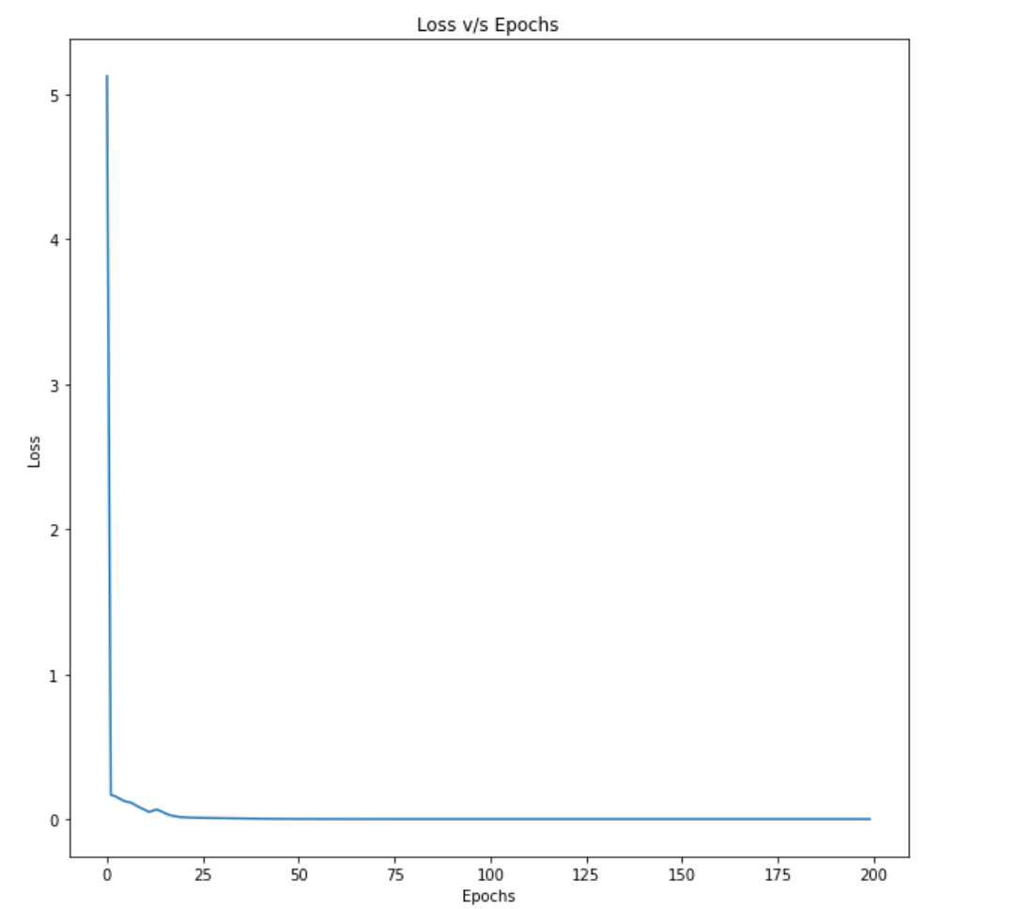

Slide 9
