Slide 1



Bayesian Classification
贝叶斯分类
Name：Huang Longfei
Date：21 Oct.

Slide 2

CONTENTS
01
An Example of Classification
02
Bayesian Theorem
03
Bayesian Classifier
04
Naive Bayesian Algorithm
05
Summary and Practice

Slide 3
An Example of Classification
By analyzing the Iris Data, let’s have a general understanding of the classification
Northwest University

Slide 4




An Example of Classification
NO. | sepal length | sepal width | petal length | petal width | Species
1 | 5.1 | 3.5 | 1.4 | 0.2 | Setosa
2 | 4.9 | 3 | 1.4 | 0.2 | Setosa
3 | 4.7 | 3.2 | 1.3 | 0.2 | Setosa
4 | 4.6 | 3.1 | 1.5 | 0.2 | Setosa
5 | 5 | 3.6 | 1.4 | 0.2 | Setosa
6 | 5.4 | 3.9 | 1.7 | 0.4 | Setosa
7 | 4.6 | 3.4 | 1.4 | 0.3 | Setosa
8 | 5 | 3.4 | 1.5 | 0.2 | Setosa
9 | 4.4 | 2.9 | 1.4 | 0.2 | Setosa
10 | 5 | 3 | 1.6 | 0.2 | Setosa
11 | 6.4 | 3.2 | 4.5 | 1.5 | Versicolour
12 | 6.9 | 3.1 | 4.9 | 1.5 | Versicolour
13 | 5.5 | 2.3 | 4 | 1.3 | Versicolour
14 | 6.5 | 2.8 | 4.6 | 1.5 | Versicolour
15 | 5.7 | 2.8 | 4.5 | 1.3 | Versicolour
16 | 6.3 | 3.3 | 4.7 | 1.6 | Versicolour
17 | 4.9 | 2.4 | 3.3 | 1 | Versicolour
18 | 6.6 | 2.9 | 4.6 | 1.3 | Versicolour
19 | 5.2 | 2.7 | 3.9 | 1.4 | Versicolour
20 | 5 | 2 | 3.5 | 1 | Versicolour
21 | 6.8 | 3 | 5.5 | 2.1 | Virginica
22 | 5.7 | 2.5 | 5 | 2 | Virginica
23 | 5.8 | 2.8 | 5.1 | 2.4 | Virginica
24 | 6.4 | 3.2 | 5.3 | 2.3 | Virginica
25 | 6.5 | 3 | 5.5 | 1.8 | Virginica
26 | 7.7 | 3.8 | 6.7 | 2.2 | Virginica
27 | 7.7 | 2.6 | 6.9 | 2.3 | Virginica
28 | 6 | 2.2 | 5 | 1.5 | Virginica
29 | 6.5 | 3.2 | 5.1 | 2 | Virginica
30 | 6.4 | 2.7 | 5.3 | 1.9 | Virginica
Northwest University

Slide 5

An Example of Classification
花瓣
Features
sepal length | sepal width | petal length | petal width
(花萼长 花萼宽 花瓣长 花瓣宽)
花萼
Feature vector
5.1 | 3.5 | 1.4 | 0.2
Category: Setosa
(Setosa,Versicolour,Virginica 是鸢尾花三种不同的品种)
Northwest University

Slide 6
An Example of Classification—Classification Process
sepal length | sepal width | petal length | petal width | Species
5.1 | 3.5 | 1.4 | 0.2 | Setosa
4.9 | 3 | 1.4 | 0.2 | Setosa
4.7 | 3.2 | 1.3 | 0.2 | Setosa
5.7 | 2.8 | 4.5 | 1.3 | Versicolour
6.3 | 3.3 | 4.7 | 1.6 | Versicolour
4.9 | 2.4 | 3.3 | 1 | Versicolour
6 | 2.2 | 5 | 1.5 | Virginica
6.5 | 3.2 | 5.1 | 2 | Virginica
6.4 | 2.7 | 5.3 | 1.9 | Virginica
sepal length | sepal width | petal length | petal width
5.1 | 3.5 | 1.4 | 0.2
4.9 | 3 | 1.4 | 0.2
4.7 | 3.2 | 1.3 | 0.2
5.7 | 2.8 | 4.5 | 1.3
Testing set
Training set
get
Use for
training
model
testing
Which species of this flower belong to ?
Northwest University

Slide 7
Bayesian Theorem
One kind of the earliest and most traditional classification methods
Northwest University

Slide 8
Bayesian Theorem
Choosing one record randomly (Experiment E 试验), from the Iris Data (Sample space S 样本空间) and we can get a flower’s data (Event A 随机事件)
Feature Vector
sepal length | sepal width | petal length | petal width | Species
5.1 | 3.5 | 1.4 | 0.2 | Setosa
4.9 | 3 | 1.4 | 0.2 | Setosa
4.7 | 3.2 | 1.3 | 0.2 | Setosa
5.7 | 2.8 | 4.5 | 1.3 | Versicolour
6.3 | 3.3 | 4.7 | 1.6 | Versicolour
4.9 | 2.4 | 3.3 | 1 | Versicolour
6 | 2.2 | 5 | 1.5 | Virginica
6.5 | 3.2 | 5.1 | 2 | Virginica
6.4 | 2.7 | 5.3 | 1.9 | Virginica
4.9 | 3 | 1.4 | 0.2 | Setosa
Label (标签、类别)
Sample space
Event
Northwest University

Slide 9
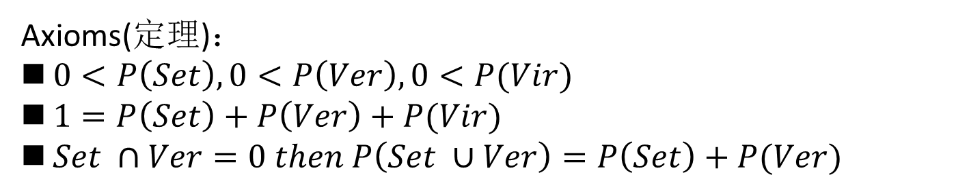
Bayesian Theorem
All the data
P(A₁) = choose “Setosa”
P(A₂) = choose “Versicolour”
P(A₃) = choose “Virginica”
_{Set}
_{Ver}
_{Vir}
Probability
Sample space
Axioms(定理)：
$0<P\left(Set\right),0<P\left(Ver\right),0<P(Vir)$
$1=P\left(Set\right)+P\left(Ver\right)+P(Vir)$
$Set ∩Ver=0 then P\left(Set ∪Ver\right)=P\left(Set\right)+P(Ver)$
A₁
A₂
A₃
Event
Northwest University

Slide 10
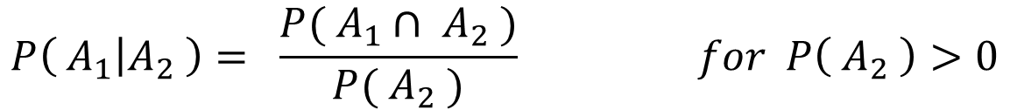

Bayesian Theorem—Conditional probability 条件概率
If A₁ and A₂ are two event, the probability of event A₁ when we already know that event A₂ has occurred is defined by the relation
A₁
A₂
Northwest University

Slide 11
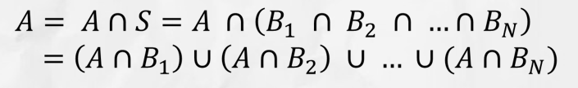
Bayesian Theorem—Total probability 全概率
Let B₁,B₂,……B_{N} be mutually exclusive（互斥） events whose union equals the sample space S. We refer to these set as a partition (划分) of S
A
Northwest University

Slide 12
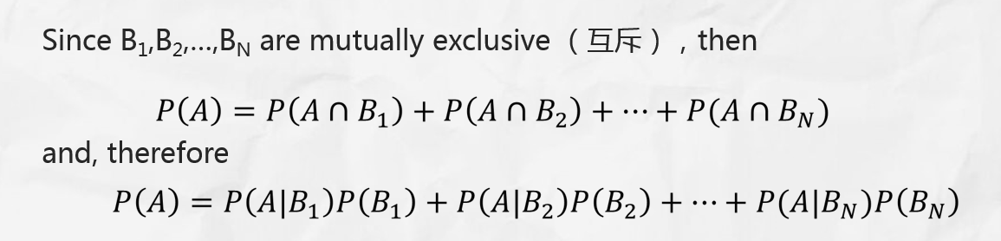
Bayesian Theorem—Total probability 全概率
A
Northwest University

Slide 13
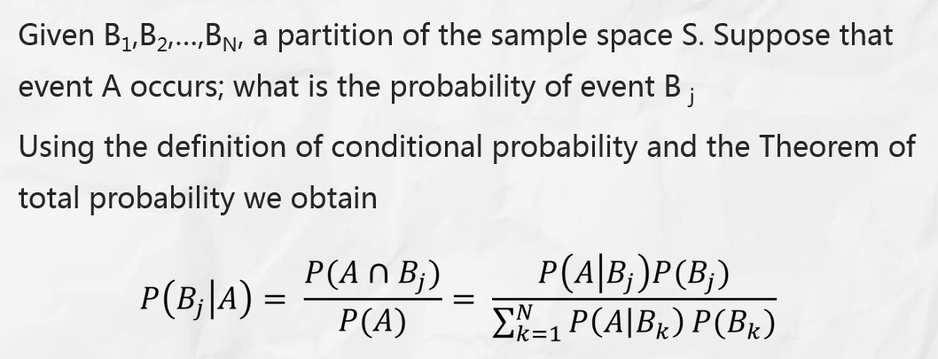
Bayesian Theorem—Bayes theorem 贝叶斯公式
Northwest University

Slide 14
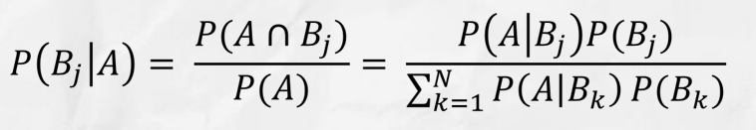
Bayesian Theorem—Review
sepal length | sepal width | petal length | petal width | Species
5.1 | 3.5 | 1.4 | 0.2 | Setosa
4.9 | 3 | 1.4 | 0.2 | Setosa
4.7 | 3.2 | 1.3 | 0.2 | Setosa
5.7 | 2.8 | 4.5 | 1.3 | Versicolour
6.3 | 3.3 | 4.7 | 1.6 | Versicolour
4.9 | 2.4 | 3.3 | 1 | Versicolour
6 | 2.2 | 5 | 1.5 | Virginica
6.5 | 3.2 | 5.1 | 2 | Virginica
6.4 | 2.7 | 5.3 | 1.9 | Virginica
Sample space / Event；
Feature / Feature vector；
Class / Label ;
Partition: property ?
Northwest University

Slide 15
Bayesian Theorem—Another example
有一家医院为了研究癌症的诊断，对一大批人作了一次普查（非完美试验 imperfect test），给每人打了试验针，然后进行统计，得到如下统计数字：
①这批人中，每1000人有5个癌症病人；
②这批人中，每100个正常人有1人对试验的反应为阳性，
③这批人中，每100个癌症病人有95入对试验的反应为阳性。
通过普查统计，该医院可开展癌症诊断。
现在某人试验结果为阳性，这个人是正常人以及患癌的概率分别是多少?
Northwest University

Slide 16





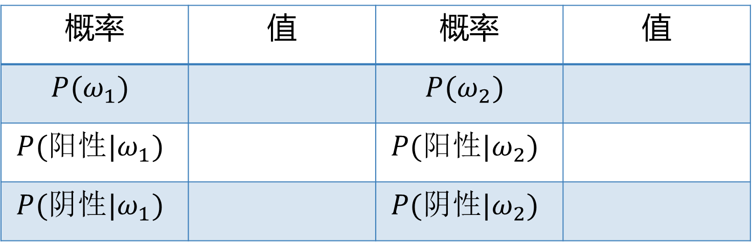




Bayesian Theorem—Another example
Solution
设正常人用$B_{1}$ 表示，癌症病人用 $B_{2}$ 表示
概率 | 值 | 概率 | 值
$$B_{1}$$
0.995
$$B_{2}$$
0.005
$$B_{1}$$
0.01
$$B_{2}$$
0.95
$$B_{1}$$
0.99
$$B_{2}$$
0.05
0.677
0.333
$$P\left(B_{1} | 阳性\right)= ？$$
$$P\left(B_{2} | 阳性\right)= ？$$
Northwest University

Slide 17
Bayesian Theorem—Another example
There is a hospital in order to diagnosing cancer, a large number of people join the survey (imperfect test 非完美试验) and each one is hit the test needle, last we get the following statistics:
There are 5 cancer patients in each of these 1000 people;
1 of the 100 normal subjects responded positively to the test,
95 of the 100 cancer patients were positive for the test.
Through the statistics, the hospital can carry out cancer diagnosis.
Now, a person’s test result is positive and the probability of being a cancer person?
Northwest University

Slide 18


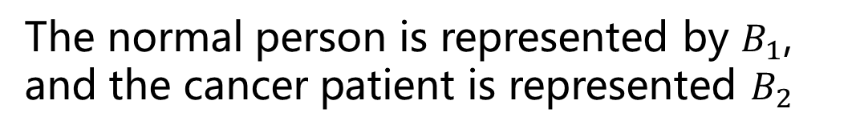






Bayesian Theorem—Another example
Solution
The normal person is represented by $B_{1}$,
and the cancer patient is represented $B_{2}$
概率 | 值 | 概率 | 值
$$B_{1}$$
0.995
$$B_{2}$$
0.005
$$P(positive|B_{1})$$
0.01
$$P(positive|B_{2})$$
0.95
$$P(negative|B_{1})$$
0.99
$$P(negativ|B_{2})$$
0.05
$$P(B_{1}|positive)$$
0.677
$$P(B_{2}|positive)$$
0.333
$$P\left(B_{1} | 阳性\right)= ？$$
$$P\left(B_{2} | 阳性\right)= ？$$
Northwest University

Slide 19
Bayesian Classifier
What is the relationship between the Bayesian classifier and the Bayesian Theorem ? Can we use Bayesian Theorem to solve the classification problem?
Northwest University

Slide 20
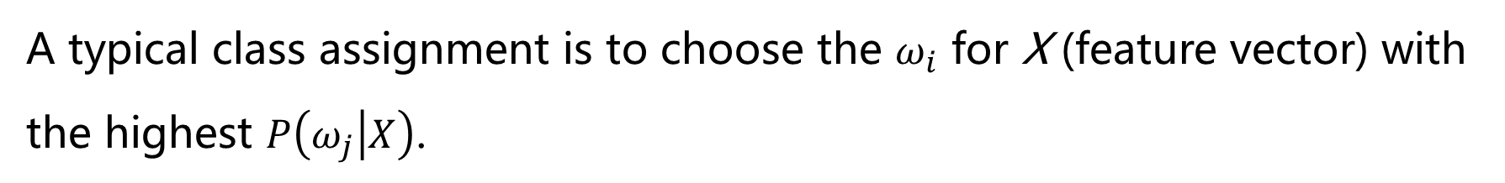
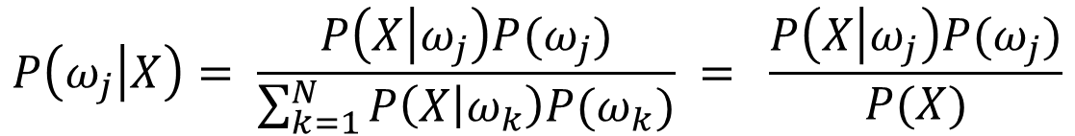
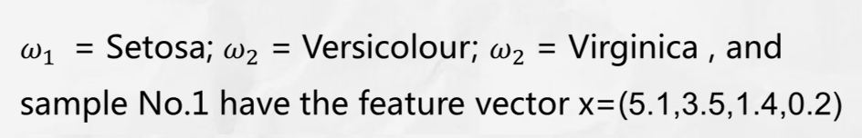
Bayesian Classifier
What is the different for the meaning of the characters in the two formulas?
Northwest University

Slide 21
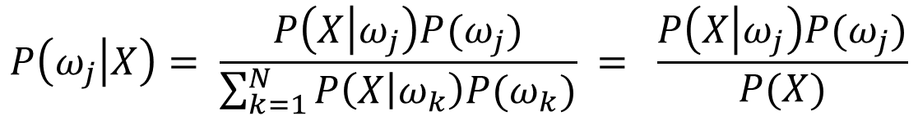
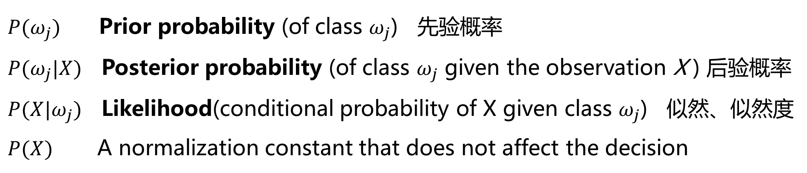
Bayesian Classifier
For the purpose of classification,Bayes Theorem can be expressed as:
For the Bayes Theorem here, you should be similar with this names:
Northwest University

Slide 22
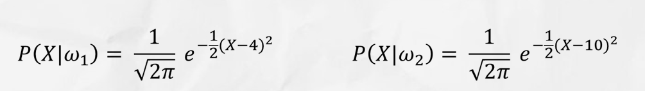


Bayesian Classifier—Exercise
现已知有两种类别 $ω_{1}$ 和 $ω_{2}$ ，且对于单个的样本特征 X 的条件概率，满足以下公式：
假设类别$ω_{1}$ 和$ω_{2}$ 具有相同的先验概率。
问：当一个样本的特征 X=3 时，该样本属于哪一类？
Northwest University

Slide 23
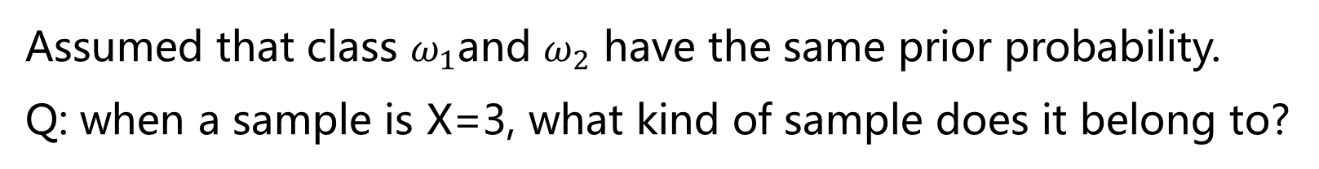
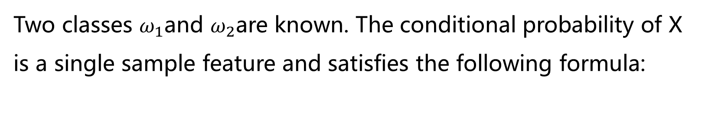
Bayesian Classifier—Exercise
Two classes $ω_{1}$and $ω_{2}$are known. The conditional probability of X is a single sample feature and satisfies the following formula:
Assumed that class $ω_{1}$and $ω_{2}$ have the same prior probability.
Q: when a sample is X=3, what kind of sample does it belong to?
Northwest University

Slide 24
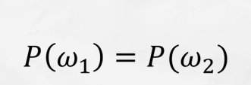
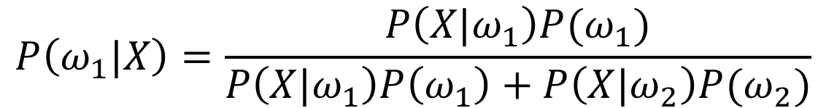
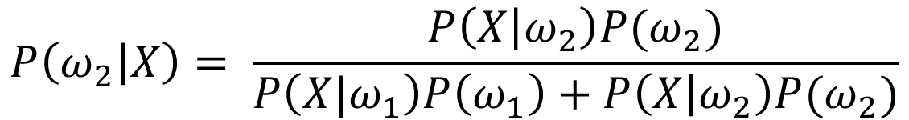
Bayesian Classifier—Exercise
$$P\left(ω_{2} | X\right)= \frac{P\left(X | ω_{2}\right)P(ω_{2})}{P\left({X|ω}_{1}\right)P\left(ω_{1}\right)+P\left(X | ω_{2}\right)P(ω_{2})}$$
Northwest University

Slide 25

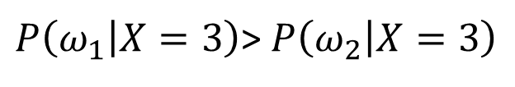
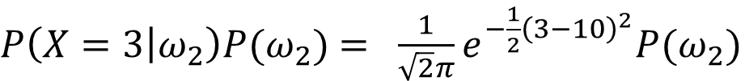
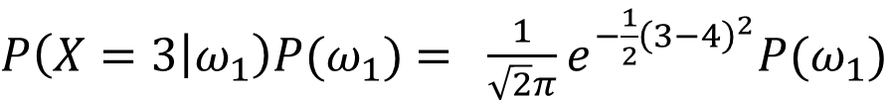
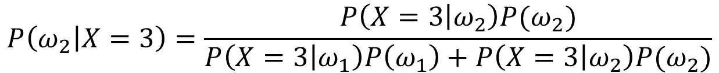
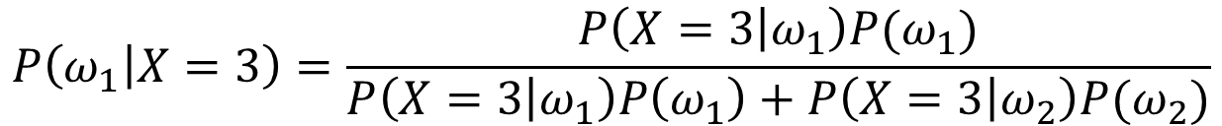
Bayesian Classifier—Exercise
$$P\left(ω_{1} | X=3\right)=\frac{P\left(X=3 | ω_{1}\right)P(ω_{1})}{P\left(X=3 | ω_{1}\right)P\left(ω_{1}\right)+P\left(X=3 | ω_{2}\right)P(ω_{2})}$$
$$P\left(ω_{2} | X=3\right)=\frac{P\left(X=3 | ω_{2}\right)P(ω_{2})}{P\left(X=3 | ω_{1}\right)P\left(ω_{1}\right)+P\left(X=3 | ω_{2}\right)P(ω_{2})}$$
$$P\left(ω_{1} | X=3\right) ⋛ P\left(ω_{2} | X=3\right)$$
$=P\left(X=3 | ω_{1}\right)P(ω_{1})$ $⋚P\left(X=3 | ω_{2}\right)P(ω_{2})$
$P\left(X=3 | ω_{1}\right)P(ω_{1})$ $= \frac{1}{\sqrt{2}π}e^{−\frac{1}{2}{\left(3−4\right)}^{2}}P(ω_{1})$
$P\left(X=3 | ω_{2}\right)P(ω_{2})$ $= \frac{1}{\sqrt{2}π}e^{−\frac{1}{2}{\left(3−10\right)}^{2}}P(ω_{2})$
So that,
$P\left(ω_{1} | X=3\right)$> $P\left(ω_{2} | X=3\right)$
$$X=3 ,X∈ω_{1}$$
Northwest University

Slide 26
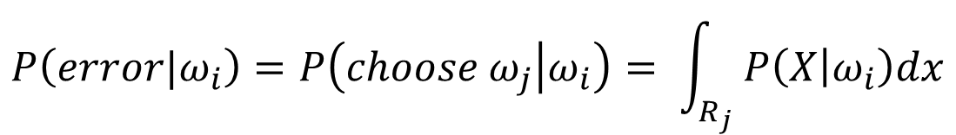
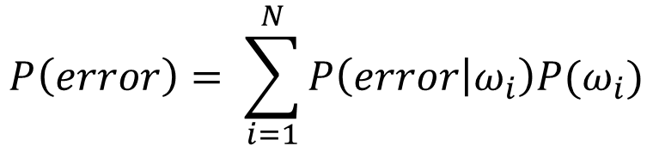
Bayesian Classifier—Probability of error
The performance of any decision rule can be measured by its probability of error (错误率)P(error)，which making use of the Theorem of total probability ,can be broken up into
$$P\left(error\right)= \sum_{i=1}^{N}{P\left(error | ω_{i}\right)P(ω_{i})}$$
The class conditional probability of error $P\left(error | ω_{i}\right)$ can be expressed as
$$P\left(error|ω_{i}\right)=P\left(choose ω_{j} | ω_{i}\right)= \int_{R_{j}}{P\left(X | ω_{i}\right)dx}$$
Northwest University

Slide 27
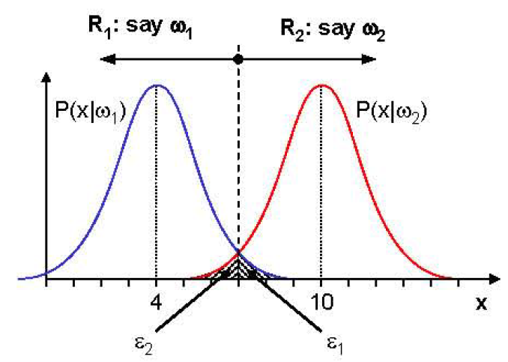


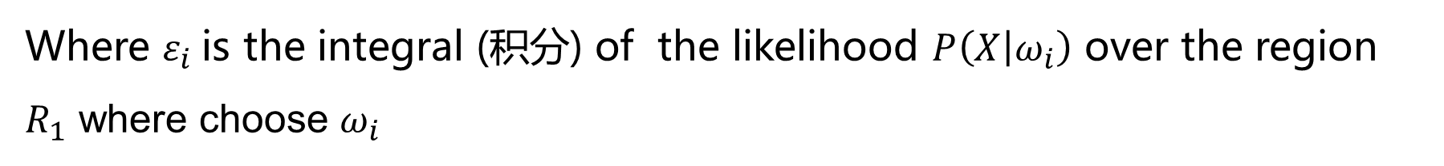
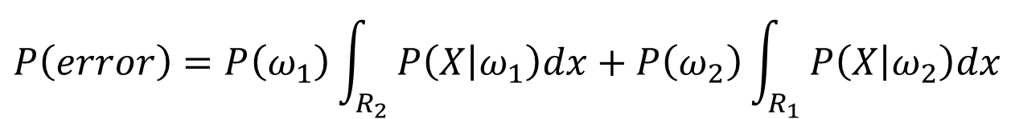
Bayesian Classifier—Probability of error
So, for our 2-class problem ,the probability of error becomes
$$P\left(error\right)=P\left(ω_{1}\right)\int_{R_{2}}{P\left(X | ω_{1}\right)dx}+P\left(ω_{2}\right)\int_{R_{1}}{P\left(X | ω_{2}\right)dx}$$
$$ε_{1}$$
$$ε_{2}$$
Where $ε_{i}$is the integral (积分) of the likelihood $P\left(X | ω_{i}\right)$ over the region $R_{1}$ where choose $ω_{i}$
Since we assumed equal priors ,then P(error) = ${(ε}_{1}+ε_{2})/2$
Northwest University

Slide 28
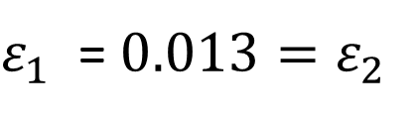
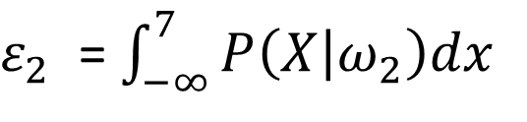
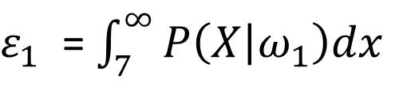
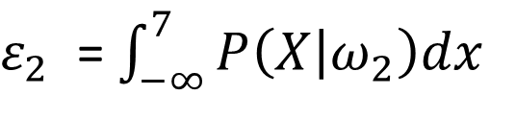
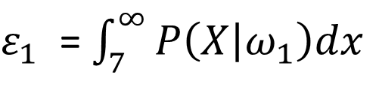
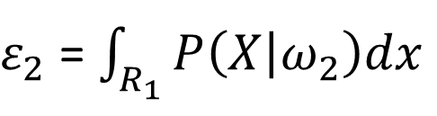
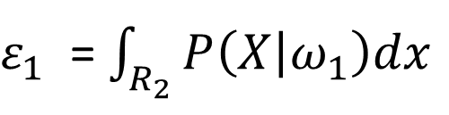
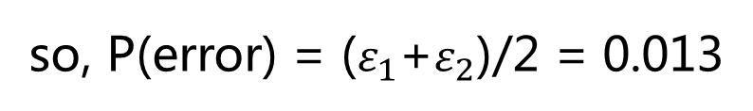
Bayesian Classifier—Probability of error
Compute the probability for the example above
$ε_{1}$ = $\int_{R_{2}}{P\left(X | ω_{1}\right)dx}$
$ε_{2}$ = $\int_{R_{1}}{P\left(X | ω_{2}\right)dx}$
$ε_{1}$ = $\int_{7}^{∞}{P\left(X | ω_{1}\right)dx}$
$ε_{2}$ = $\int_{−∞}^{7}{P\left(X | ω_{2}\right)dx}$
$ε_{1}$ = $\int_{7}^{∞}{P\left(X | ω_{1}\right)dx}$
$ε_{2}$ = $\int_{−∞}^{7}{P\left(X | ω_{2}\right)dx}$
$ε_{1}$ = $0.013=ε_{2}$
so, P(error) = ($ε_{1}$+$ε_{2}$)/2 = 0.013
Northwest University

Slide 29
Bayesian Classifier—Minimum error rate rules
Minimum error rate rules 最小错误率准则(MERR)
1. Problem description
2. Decision rules
3. Decision function
4. Parameter estimation
5. Example
Northwest University

Slide 30
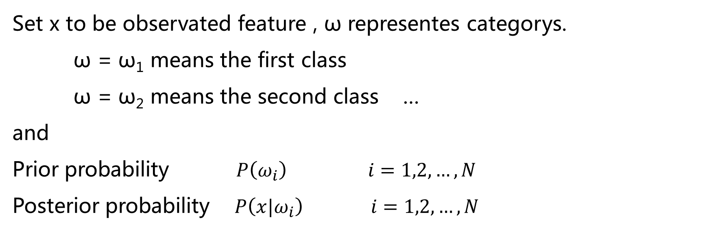


Bayesian Classifier—MERR -1.Problem description
$$X$$
$$P(X|ω_{i})$$
Northwest University

Slide 31
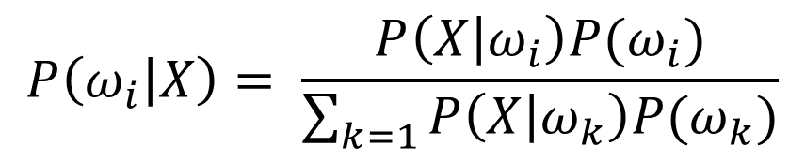

Bayesian Classifier—MERR -1. Problem description
By Bayes formula
Which can determine the category x belongs to ...
Northwest University

Slide 32
Bayesian Classifier—MERR -2. Discrimination rules
The Bayes formula transforms the prior probabilities P (ω_{i}) into the posterior probability P (ω_{i} | X) by the pattern feature information X provided by the sample.
Thus, the Bayesian rule based on the minimum error rate is:
If P (ω_{i} | X)> P (ω_{j} | X) then x ∈ ω_{i}
If P (ω_{j} | X)> P (ω_{i} | X) then x ∈ ω_{j}
If P (ω_{i} | X) = P (ω_{j} | X) can not be determined, refused to judge
Northwest University

Slide 33
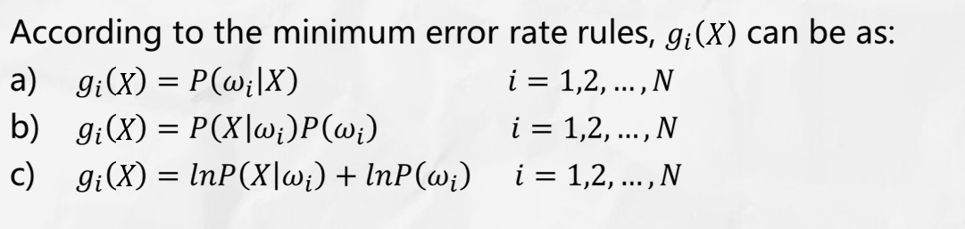

Bayesian Classifier—MERR -3. Decision function
For each class, defining a function $g_{i}\left(X\right) i=1,2,…,N$,which satisfies that if $g_{i}\left(X\right)>g_{j}\left(X\right) j=1,2,…,N \& i≠j$ ,then $X ∈ ω_{i}$
Northwest University

Slide 34
Bayesian Classifier—MERR -3. Decision function
In general,
One - dimensional, the decision - making boundary is a dividing point;
Two - dimensional, the decision - making boundary is a curve;
Three - dimensional, the decision - making boundary is a surface;
Dimension > 3 - the decision boundary is a hyperplane.
Northwest University

Slide 35
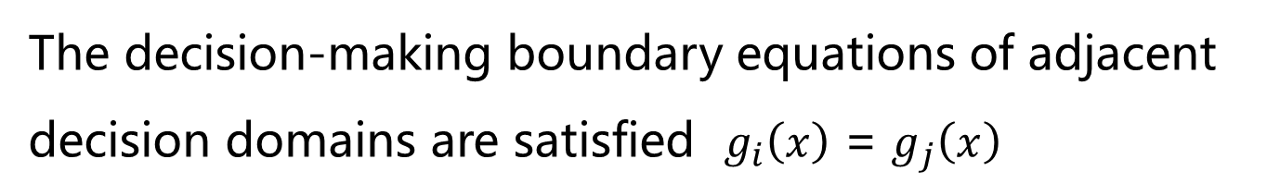



Bayesian Classifier—MERR -3. Decision function
x2
$$X$$
R _{i}
Class i decision domain
R _{j}
x1
Decision boundary
$$X$$
$$X$$
Northwest University

Slide 36
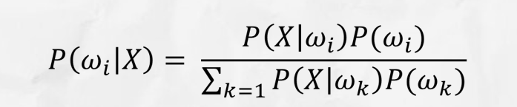
Bayesian Classifier—MERR -4. Parameter estimation
The key to using the minimum error rate rule is to estimate the following probabilities through known samples:
(1)Prior probability P (ω_{i}) i = 1,2, ..., N
(2)Conditional probability P (X | ω_{i}) i = 1,2, ..., N
Northwest University

Slide 37

Bayesian Classifier—MERR -5. Example
Wolf is coming
狼来了
Northwest University

Slide 38
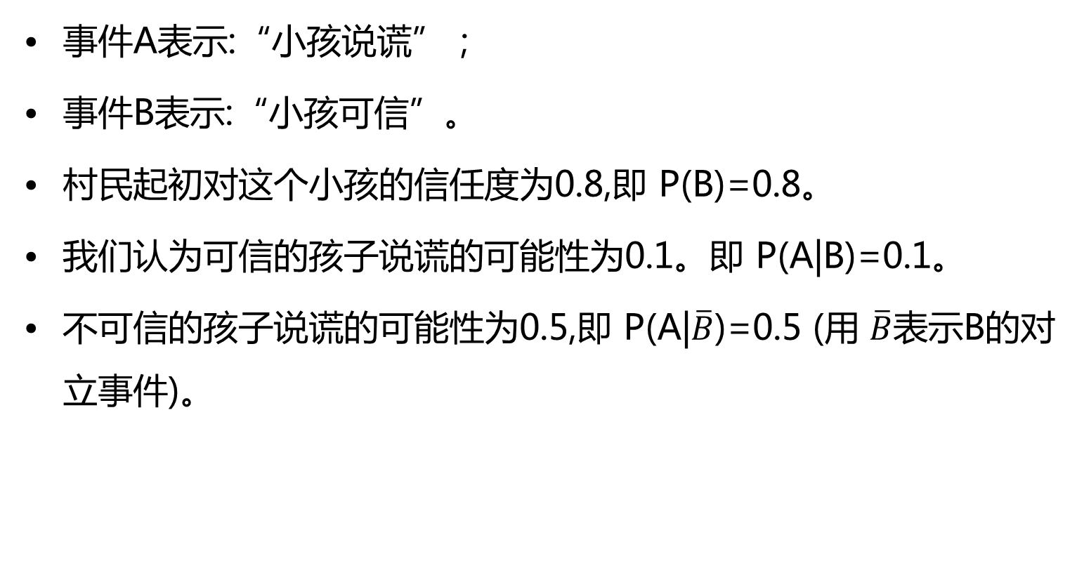
Bayesian Classifier—MERR -5. Example
一些合理的假设：
事件A表示:“小孩说谎”；
事件B表示:“小孩可信”。
村民起初对这个小孩的信任度为0.8,即 P(B)=0.8。
我们认为可信的孩子说谎的可能性为0.1。即 P(A|B)=0.1。
不可信的孩子说谎的可能性为0.5,即 P(A|$\overline{B}$)=0.5 (用 $\overline{B}$表示B的对立事件)。
Northwest University

Slide 39
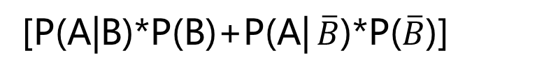
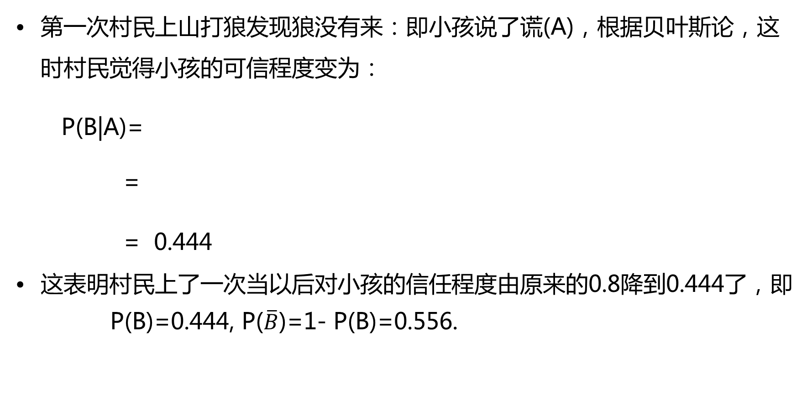
Bayesian Classifier—MERR -5. Example
第一次说谎的后果
第一次村民上山打狼发现狼没有来：即小孩说了谎(A)，根据贝叶斯论，这时村民觉得小孩的可信程度变为：
P(B|A)=
=
= 0.444
这表明村民上了一次当以后对小孩的信任程度由原来的0.8降到0.444了，即
P(B)=0.444, P($\overline{B}$)=1- P(B)=0.556.
[P(A|B)*P(B)]
[P(A|B)*P(B)+P(A| $\overline{B}$)*P($\overline{B}$)]
(0.1*0.8)
[0.1*0.8+0.5*(1-0.8)]
Northwest University

Slide 40
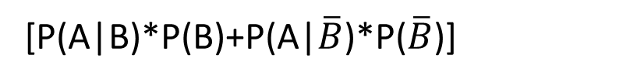
Bayesian Classifier—MERR -5. Example
第二次说谎的后果
第二次村民上山打狼发现狼没有来这时村民觉得小孩的可信程度变为：
P(B|A) =
=
= 0.138
这表明村民经过两次上当，对这个小孩的信任程度已经从0.8降到了0.138。如此低的可信度，别说狼来了，喊华南虎来了都不管用了。
[P(A|B)*P(B)]
[P(A|B)*P(B)+P(A|$\overline{B}$)*P($\overline{B}$)]
(0.1*0.444)
[0.1*0.444+0.5*(1-0.444]
Northwest University

Slide 41
Bayesian Classifier—MERR -5. Example
思考：如果这个孩子要改邪归正，他需要多少次才能把信任度提高到80%？
Northwest University

Slide 42
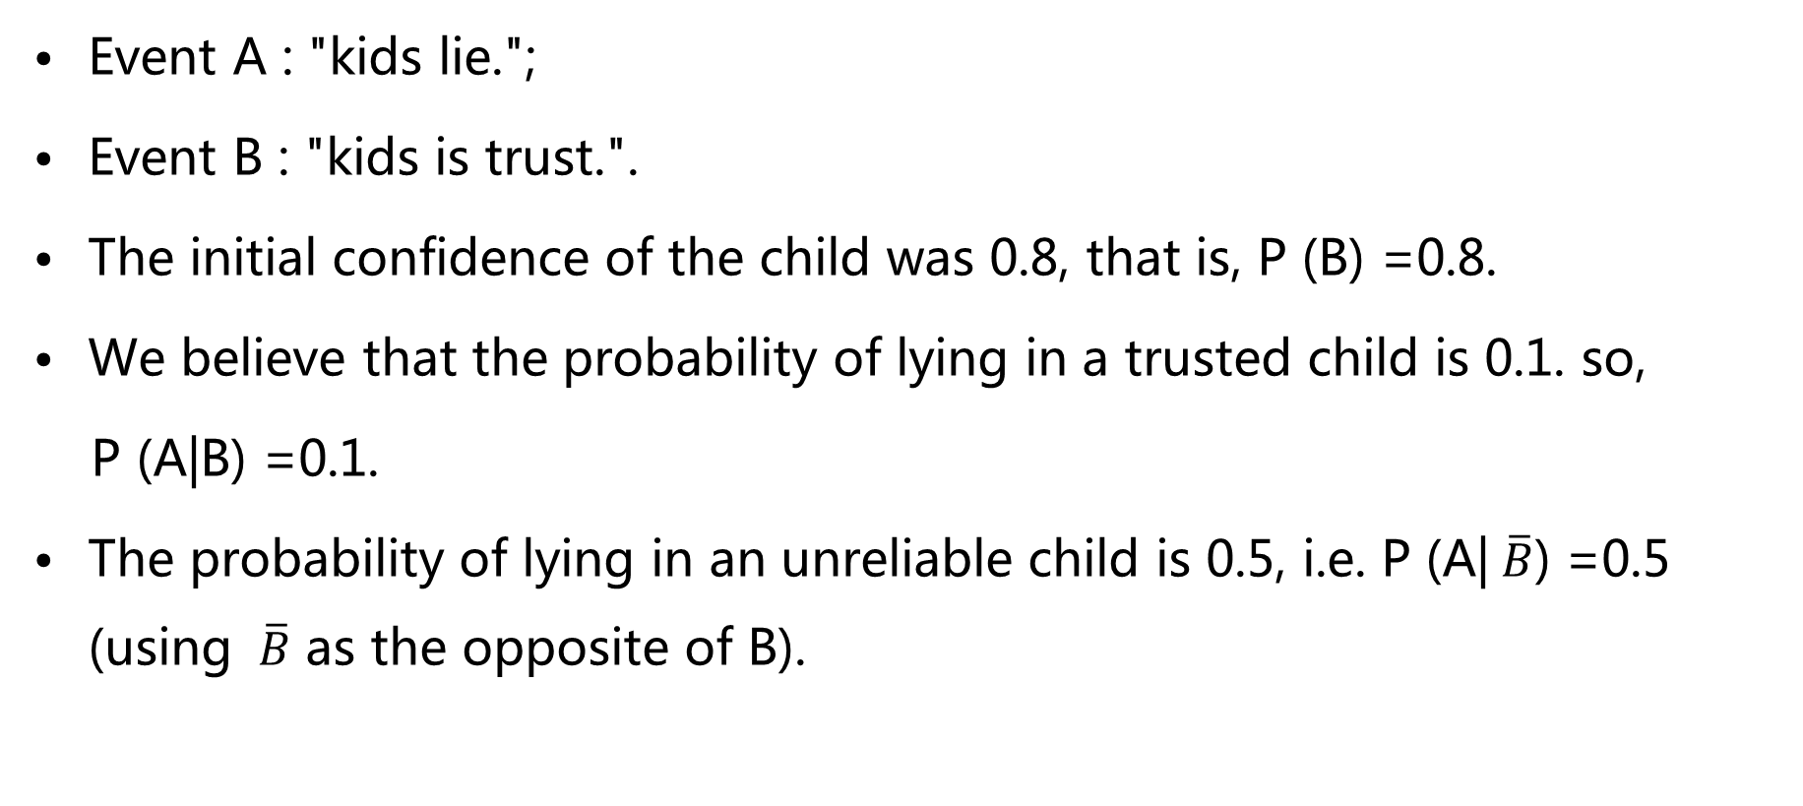
Bayesian Classifier—MERR -5. Example
Supposing that：
Event A : "kids lie.";
Event B : "kids is trust.".
The initial confidence of the child was 0.8, that is, P (B) =0.8.
We believe that the probability of lying in a trusted child is 0.1. so,
P (A|B) =0.1.
The probability of lying in an unreliable child is 0.5, i.e. P (A| $\overline{B}$) =0.5 (using $\overline{B}$ as the opposite of B).
Northwest University

Slide 43
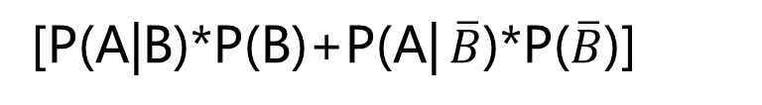
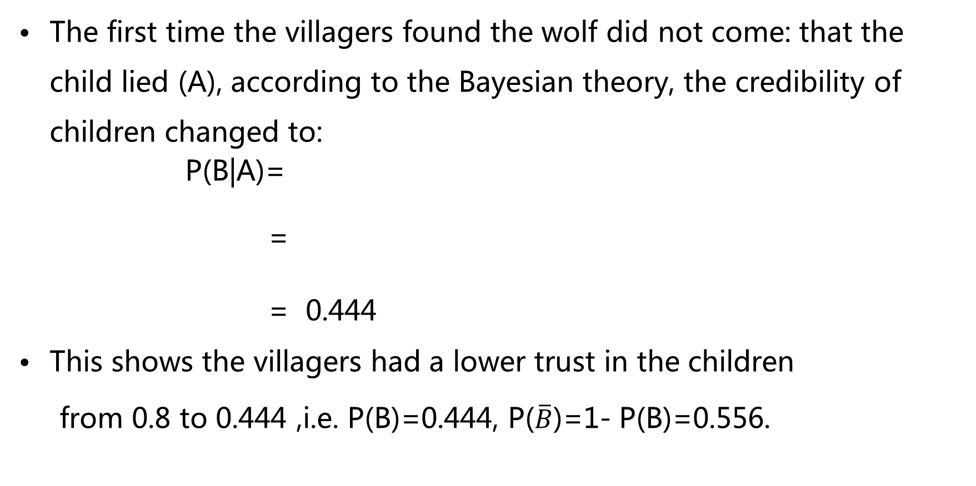
Bayesian Classifier—MERR -5. Example
The consequences of the first lie
The first time the villagers found the wolf did not come: that the child lied (A), according to the Bayesian theory, the credibility of children changed to:
P(B|A)=
=
= 0.444
This shows the villagers had a lower trust in the children
from 0.8 to 0.444 ,i.e. P(B)=0.444, P($\overline{B}$)=1- P(B)=0.556.
[P(A|B)*P(B)]
[P(A|B)*P(B)+P(A| $\overline{B}$)*P($\overline{B}$)]
(0.1*0.8)
[0.1*0.8+0.5*(1-0.8)]
Northwest University

Slide 44
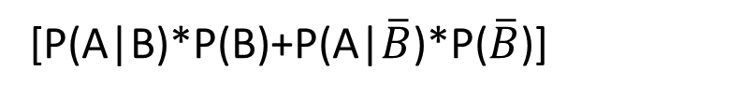
Bayesian Classifier—MERR -5. Example
The consequences of second lying
The second time the villagers found the wolf did not come, then the villagers changed the credibility of children to：
P(B|A) =
=
= 0.138
This shows that after two times the villagers fooled, the child's trust has dropped from 0.8 to 0.138.
[P(A|B)*P(B)]
[P(A|B)*P(B)+P(A|$\overline{B}$)*P($\overline{B}$)]
(0.1*0.444)
[0.1*0.444+0.5*(1-0.444]
Northwest University

Slide 45
Bayesian Classifier—MERR -5. Example
Think：if the children want to return to be trust, how many times the trust degree increased to 80%?
Northwest University

Slide 46
Bayesian Classifier
Minimum risk discrimination rule 最小风险判别准则(MRDR)
1. Problem description
2. Risk of loss
3. Decision rules
4. Two Bayesian discrimination methods
5. Example
Northwest University

Slide 47
Bayesian Classifier—MRDR -1 Statement of problem
In the previous example, someone's test results are positive, according to the minimum error rate Bayesian decision, he belongs to normal, then probability that he is a normal equals to 100%?
Northwest University

Slide 48
Bayesian Classifier—MRDR -2 Risk of loss
This concept can be formalized in terms of a loss function
$l_{ij}$ represents the loss of choosing class $ω_{i}$ when class $ω_{i}$ is the true class
$ω_{1}$ — normal people ; $ω_{2}$ — cancer people
$l_{12}$ represents the loss of classifying a cancer people to the normal category
Northwest University

Slide 49
Bayesian Classifier—MRDR -2 Risk of loss
According to the definition of the conditional risk: the conditional expectation of the loss caused by the sample X given to the ω₁
r₁( X ) =l₁₁P (ω₁| X ) + l₂₁P (ω₂| X )
Similarly, the risk of the sample X given to the ω ₂
r₂( X ) = l₁₂P (ω₁| X ) + l₂₂P (ω₂| X )
Northwest University

Slide 50
Bayesian Classifier—MRDR -2 Risk of loss
We can according to the size of the risk of conditions to determine.
if r₁( X ) ＜r₂( X ), so X ∈ ω ₁
if r₁( X ) ＞r₂( X ), so X ∈ ω ₂
Northwest University

Slide 51
Bayesian Classifier—MRDR -2 Risk of loss
(1) posterior probability form
(2) conditional probability density form
l₁₁ P (ω ₁ | X) + l₂₁ P (ω ₂ | x)
ω ₁
ω ₂
x ∈
＜
l₁₂ P (ω ₁ | x) + l₂₂ P (ω ₂ | x)
＞
l₁₁ P (x |ω ₁) P (ω ₁) + l₂₁ P (x |ω ₂) P (ω ₂)
ω ₁
ω ₂
x ∈
＜
l₁₂ P (ω ₁ | x) P (ω ₁) + l₂₂ P (ω ₂ | x) P (ω ₂)
＞
Northwest University

Slide 52

Bayesian Classifier—MRDR -3 Discrimination rules
IPMI
Suppose the sample space of the mode is composed of N categories:
$Ω=\{ω_{1},ω_{2},ω_{3},……,ω_{N}\}$;
Loss function $l_{ij} i,j=1,2,3,……,N$ obviously $l_{ii}=0$
represents the loss caused by samples belonging to the $ω_{j}$ class are judged as the $ω_{i}$ class;
Samples X = (X₁,X₂,X₃,……,X_{M})；

Slide 53

Bayesian Classifier—MRDR -3 Discrimination rules
Conditional risk $r_{i}\left(X\right)=1,2,3,……,N$;
represents conditional risk of the sample X judged to class $ω_{i}$
$$r_{i}\left(X\right)= \sum_{j=1}^{N}{l_{ij}P(ω_{j}|X)} i=1,2,3,……,N$$
Northwest University

Slide 54

Bayesian Classifier—MRDR -3 Discrimination rules
For $r_{i}\left(X\right)=1,2,3,……,N$,it has two ways of expression
(1). Posterior probability form
$$r_{i}\left(X\right)= \sum_{j=1}^{N}{l_{ij}P(ω_{j}|X)} i=1,2,3,……,N$$
(2). Conditional probability form
$$r_{i}\left(X\right)= \sum_{j=1}^{N}{l_{ij}P\left(X | ω_{j}\right)P(ω_{j})} i=1,2,3,……,N$$
The Bayesian rule of the minimum risk is :
if $r_{i}\left(X\right)$ < $r_{j}\left(X\right)$ , i,j= 1,2,3,…..,N $i≠j$
Then $x∈ ω_{i}$.
Northwest University

Slide 55
Bayesian Classifier—MRDR -4 Two Bayesian methods
Minimum error rate Bayesian decision rule
assuming that the wrong decision is always greater than the loss caused by the correct decision, that is, l₁₂> l₁₁, l₂₁> l₂₂, the minimum risk Bayesian decision rule is
P (X | ω ₁)
P (ω ₂)
x ∈ ω ₁
＞
P (X | ω ₂)
＜
P (ω ₁)
x ∈ ω ₂
P (X | ω ₁)
(l₂₁ －l₂₂ )P (ω ₂)
x ∈ ω ₁
＜
P (X | ω ₂)
＞
(l₁₂ － l₁₁ )P (ω ₁)
x ∈ ω ₂
Northwest University

Slide 56
Bayesian Classifier—MRDR -4 Two Bayesian methods
P (X | ω ₁)
In the statistics is called the
likelihood ratio function
l ( x ) =
P (X | ω ₂)
The value to the right of the inequality is called the likelihood ratio threshold.
The likelihood ratio of the minimum error rate Bayesian decision is the threshold of λ ₁
The likelihood threshold for the minimum risk Bayesian decision is λ ₂
Northwest University

Slide 57
Bayesian Classifier—MRDR -4 Two Bayesian methods
P (ω₂)
(l₂₁ －l₂₂ )P (ω₂)
So λ₁ =
λ₂ =
P (ω₁)
(l₁₂ － l₁₁ )P (ω₁)
These two discriminant rules use the likelihood ratio function, the only difference is to take different likelihood ratio threshold.
In particular, when l₁₁ = l₂₂ = 0, l₁₂ = l_{21,}these two decisions are equivalent, in other words, the minimum error rate Bayesian decision is a special case of the smallest risk Bayesian decision.
Northwest University

Slide 58
Bayesian Classifier—MRDR -5 Example
On the basis of the “Bayesian Theorem—Another example”, set
l₁₁ = 0, l₂₁ = 3, l₁₂ = 1, l₂₂ = 0
According to the minimum risk Bayesian decision
r ₁ ( x ) = l₁₁ P (ω ₁ | x) + l₂₁ P (ω ₂ | x) =0.999
r ₂ ( x ) = l₁₂ P (ω ₁ | x) + l₂₂ P (ω ₂ | x) =0.677
Since r ₁ (x) > r ₂ (x), x ∈ ω ₂
Northwest University

Slide 59
Naive Bayesian Algorithm
The feature vector of samples in above example is one-dimensional, if that is
two-dimensional or multi-dimensional, how should we solve?
Northwest University

Slide 60
Naive Bayesian algorithm
In reality, the feature vectors of data are one-dimensional rarely. Moreover, for multidimensional data, there is a correlation between different feature, and these correlations are often hard to find. So naive Bayesian algorithm assume that the features to be classified items are independent of each other.
Northwest University

Slide 61
Naive Bayesian algorithm
The naive Bayesian algorithm is defined as follows:
1. Let X = {a₁, a₂, ..., a_{m}} be a feature to be sorted, and each a_{i} is a characteristic attribute of X. And the characteristic attributes are independent of each other.
2. Let C = {y₁, y₂, ..., y_{N}} be a set of categories.
3. Calculate P (y₁ | X), P (y₂ | X), ..., P (y_{N} | X).
4.P(y_{k} | X) = max { P(y₁ | X)，P(y₂ | X)，...,P(y_{N} | X) }，so X ∈ y_{k}。
Northwest University

Slide 62


Naive Bayesian algorithm
The following table is a set of statistical data on people’s body characteristics. Know that someone is 6 feet tall, weighs 130 pounds, 8 inches feet, may I ask the man is male or female?
Northwest University

Slide 63
Naive Bayesian algorithm
It can be assumed that the height and weight of the male and female are normal distribution, and the mean and variance are calculated by the sample, that is, the density function of the normal distribution. With the density function, you can substitute the value, calculate the density function of a point value.
Northwest University

Slide 64



Naive Bayesian algorithm
Intuitively, the probability of women nearly 10,000 times higher than that of men, so to judge the people as a woman.
Northwest University

Slide 65
Naive Bayesian algorithm
The advantages of the naive Bayesian algorithm:
a. The algorithm logic is simple and easy to implement;
b. the space and time overhead in the classification process is small;
c. algorithm stability, for different data characteristics of its classification performance is not very different, robustness is better.
Northwest University

Slide 66
Summary and Practice
Northwest University

Slide 67
Summary and Practice
Process for classification
Bayesian Theorem
Conditional probability 条件概率
Total probability 全概率
Bayes theorem 贝叶斯公式
Bayesian Classifier
probability of error 错误率
Minimum error rate rules 最小错误率准则
Northwest University

Slide 68
Summary and Practice
According to the Iris Data ,choosing date of two kind of category and:
(1).Calculating the mean and variance of one kind of feature;
(2).Utilizing above mean and variance to produce a new dataset;
(3).Producing a model using above mean and variance and check the model with above new dataset;
(4).Testing the model using the set choosing from Iris Data.
(5). Using two-dimensional data, repeat the above steps
Northwest University

Slide 69
Thank You!
感谢大家的聆听

