Slide 1

Extreme Learning Machine
Yang gang

Slide 2
Contents
SLFNs
Single-hidden Layer Feedforward neural Netwroks (SLFNs)
The shortcomings of SLFNs
Extreme Learning Machine
Basic idea
Implement
DELM
Others
Homework

Slide 3
Single-hidden Layer Feedforward neural Netwroks (SLFNs)
1

Slide 4
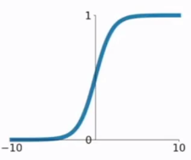







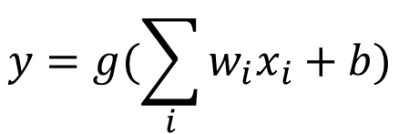


SLFNs (Neuron)
Neuron is the basic unit of neural network 。
$$x_{1}$$
$$w_{1}$$
$$y=g(\sum_{i}{{w_{i}x}_{i}}+b)$$
$$∑$$
$$g$$
$$c$$
$g$ is activation function。
$$x_{2}$$
$$w_{2}$$
$$b$$
Input
Output
Notes:
激活函数式为了解决非线性问题。

Slide 5


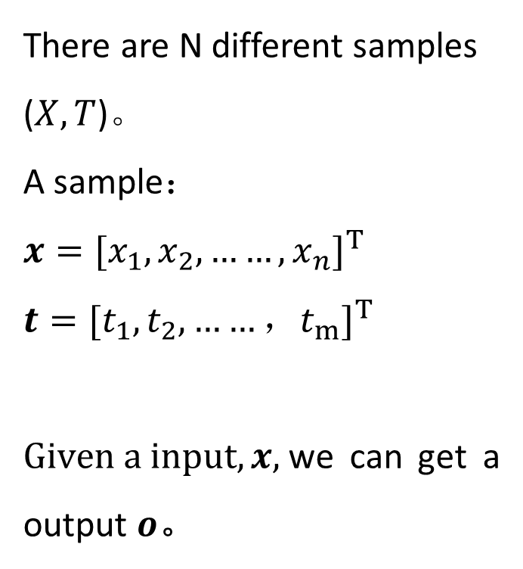





SLFNs
Neuron
There are N different samples ($X,T$)。
A sample：
$$x={[x_{1},x_{2},……,x_{n}]}^{T}$$
$$t={[t_{1},t_{2},……，t_{m}]}^{T}$$
$Given a input, x,$we can get a output $o$。
$$x_{1}$$
1
1
1
$$o_{1}$$
$$x_{2}$$
2
2
2
$$o_{2}$$
……
……
……
How to calculate ?
$$x_{n}$$
n
$$\tilde{N}$$
m
$$o_{m}$$
Input layer
Hidden layer
Output layer
Notes:
输入层和输出层均无激活函数。

Slide 6















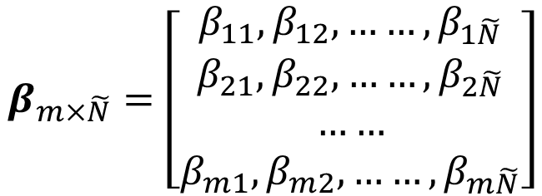



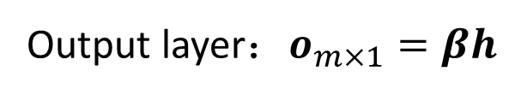
SLFNs
$$x={[x_{1},x_{2},……,x_{n}]}^{T}$$
$$t={[t_{1},t_{2},……，t_{m}]}^{T}$$
$$W_{\tilde{N}×n}=\left[\begin{aligned}w_{11}, w_{12}, ……,w_{1n} \\ w_{21}, w_{22}, ……,w_{2n} \\ …… \\ w_{\tilde{N}1}, w_{\tilde{N}2}, ……,w_{\tilde{N}n}\end{aligned}\right]$$
$$x_{1}$$
1
1
1
$$o_{1}$$
$$b_{\tilde{N}×1}={\left[b_{1},b_{2},……,b_{\tilde{N}}\right]}^{T}$$
$$x_{2}$$
2
2
2
$$o_{2}$$
$$β_{m×\tilde{N}}=\left[\begin{aligned}β_{11}, β_{12}, ……,β_{1\tilde{N}} \\ β_{21}, β_{22}, ……,β_{2\tilde{N}} \\ …… \\ β_{m1}, β_{m2}, ……,β_{m\tilde{N}}\end{aligned}\right]$$
……
……
……
$$x_{n}$$
n
$$\tilde{N}$$
m
$$o_{m}$$
Input layer：
$$x_{n×1}={[x_{1},x_{2},……,x_{n}]}^{T}$$
$$i$$
$$w_{ji}$$
$$j$$
$$β_{kj}$$
$$k$$
Hidden layer：
$$h_{\tilde{N}×1}=g(Wx+b)$$
$$b_{j}$$
Output layer：$o_{m×1}=βh$

Slide 7


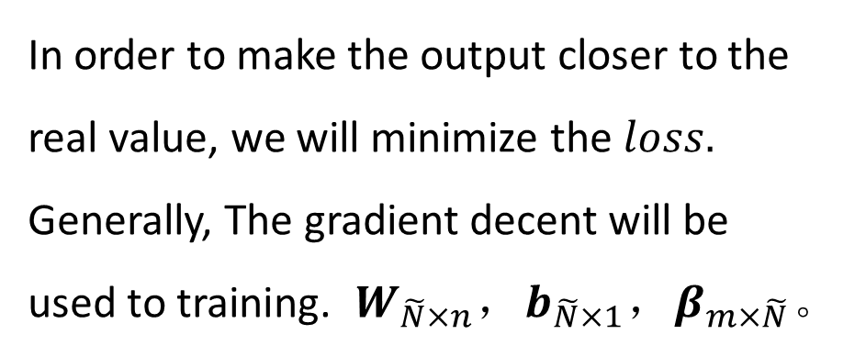
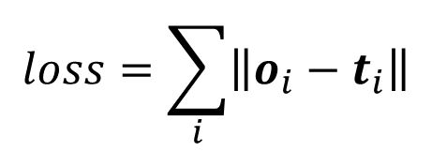
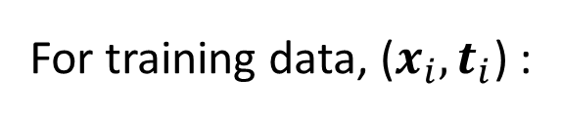
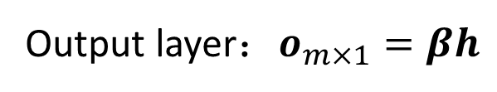


SLFNs
Input layer：
$$x_{n×1}={[x_{1},x_{2},……,x_{n}]}^{T}$$
Training：
For training data, ($x_{i},t_{i}$) :
Hidden layer：
$$h_{\tilde{N}×1}=g(Wx+b)$$
Output layer：$o_{m×1}=βh$
$$loss=\sum_{i}{\left\|o_{i}−t_{i}\right\|}$$
In order to make the output closer to the real value, we will minimize the $loss.$
Generally, The gradient decent will be used to training. $W_{\tilde{N}×n}$，$b_{\tilde{N}×1}$，$β_{m×\tilde{N}}$。
$$loss$$
$$t={[t_{1},t_{2},……，t_{m}]}^{T}$$

Slide 8

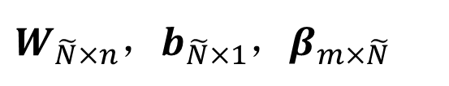
The shortcomings of SLFNs——Speed
All the parameters of the networks are tuned.
The gradient-based learning algorithms are slow.
In neural network training, the gradient descent algorithm needs to iterate thousands of times。
$W_{\tilde{N}×n}$，$b_{\tilde{N}×1}$，$β_{m×\tilde{N}}$
$$\tilde{N}×n+\tilde{N}×1+m×\tilde{N}$$
2004《Extreme Learning Machine: A New Learning Scheme of Feedforward Neural Networks》

Slide 9
The basic idea of Extreme Learning Machine (ELM)
2.1

Slide 10




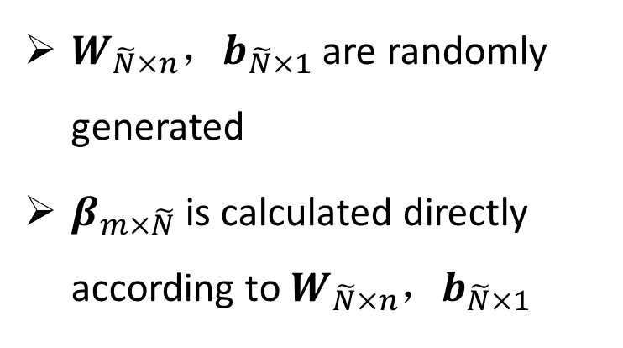






Extreme Learning Machine——Basic idea
A New Learning Scheme of Feedforward Neural Networks
$$x_{1}$$
1
$$W$$
1
$$β$$
1
$$o_{1}$$
$W_{\tilde{N}×n}$，$b_{\tilde{N}×1}$ are randomly generated
$β_{m×\tilde{N}}$ is calculated directly according to $W_{\tilde{N}×n}$，$b_{\tilde{N}×1}$
$$x_{2}$$
2
2
2
$$o_{2}$$
……
……
……
$$x_{n}$$
n
$$\tilde{N}$$
m
$$o_{m}$$
$$b$$
Randomly generated
Calculated

Slide 11

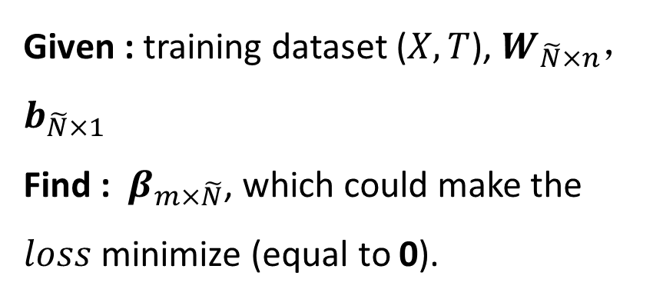
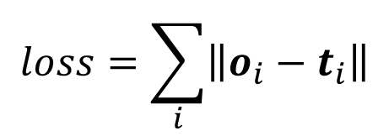
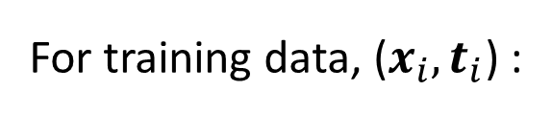
Extreme Learning Machine——Basic idea
$W_{\tilde{N}×n}$，$b_{\tilde{N}×1}$ are randomly generated
$β_{m×\tilde{N}}$ is calculated directly according to $W_{\tilde{N}×n}$，$b_{\tilde{N}×1}$
For training data, ($x_{i},t_{i}$) :
$$loss=\sum_{i}{\left\|o_{i}−t_{i}\right\|}$$
Given : training dataset ($X,T$), $W_{\tilde{N}×n}$，$b_{\tilde{N}×1}$
Find : $β_{m×\tilde{N}}$, which could make the $loss$ minimize (equal to 0).
How to calculate ?

Slide 12
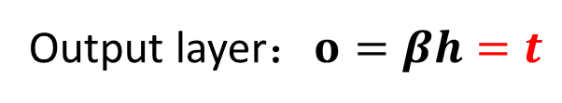

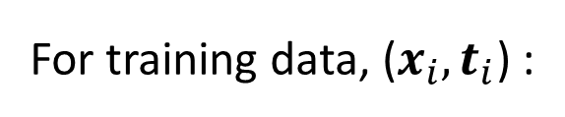




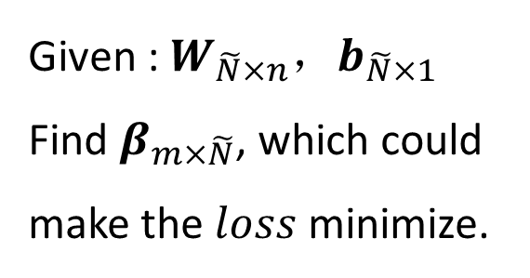

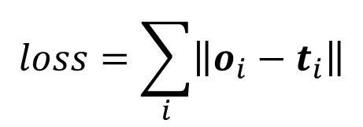
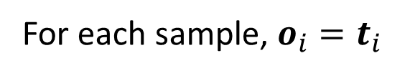
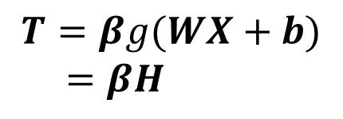
Extreme Learning Machine——Basic idea
For training data, ($x_{i},t_{i}$) :
Single Sample：
Input layer：
$$x={[x_{1},x_{2},……,x_{n}]}^{T}$$
$$loss=\sum_{i}{\left\|o_{i}−t_{i}\right\|}$$
Hidden layer：
$$h=g(Wx+b)$$
Output layer：$o=βh=t$
Given : $W_{\tilde{N}×n}$，$b_{\tilde{N}×1}$
Find $β_{m×\tilde{N}}$, which could make the $loss$ minimize.
$$t=βg(Wx+b)$$
All training Sample：
$$X= [x_{1},x_{2},……,x_{N}]$$
$$H= [h_{1},h_{2},……,h_{N}]$$
$$T=βg(WX+b)$$
$=βH$
$$T= [t_{1},t_{2},……,t_{N}]$$
For each sample, $o_{i}=t_{i}$

Slide 13

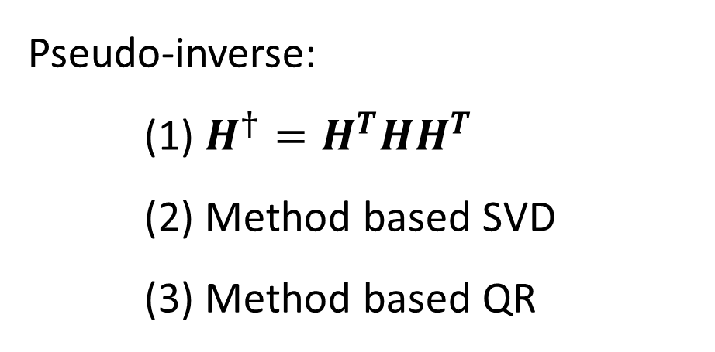


Extreme Learning Machine——Basic idea
No exactly correct.
right？
$$T=βH$$
$$β=TH^{†}$$
$$β=TH^{−1}$$
Pseudo-inverse:
(1) $H^{†}=H^{T}HH^{T}$
(2) Method based SVD
(3) Method based QR

Slide 14
Implement (ELM)
2.2

Slide 15
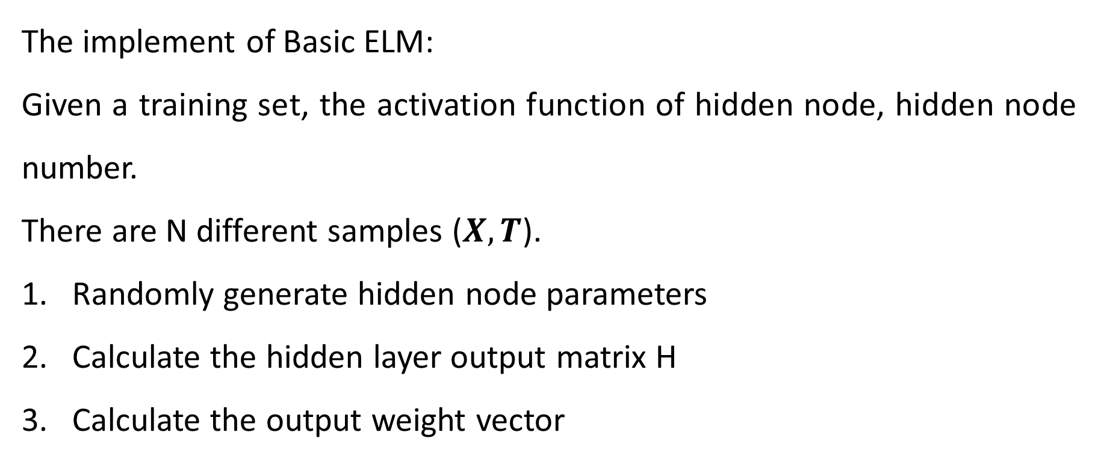
Extreme Learning Machine——Implement
The implement of Basic ELM:
Given a training set, the activation function of hidden node, hidden node number.
There are N different samples ($X,T$).
Randomly generate hidden node parameters
Calculate the hidden layer output matrix H
Calculate the output weight vector

Slide 16
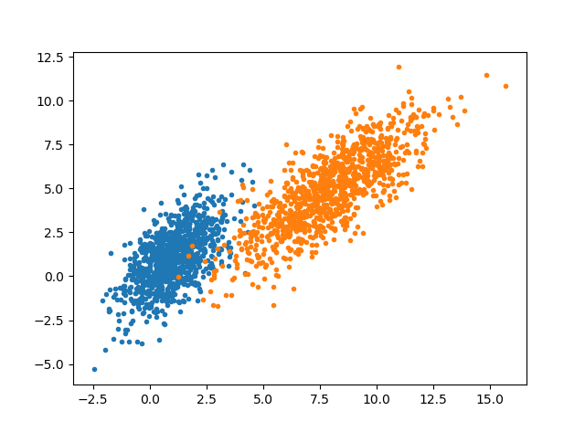
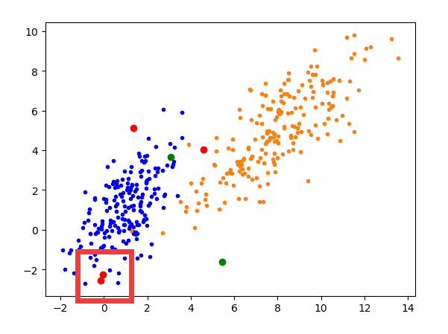
Extreme Learning Machine——Case 1
Classification:
Given a training set:
Training data: 1600
Test data: 400
the activation function of hidden node:
Sigmoid
hidden node number: 200
Result: 98.5%
Overfitting

Slide 17
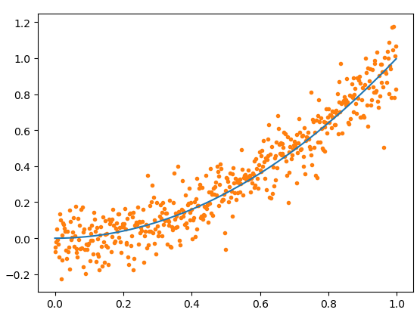
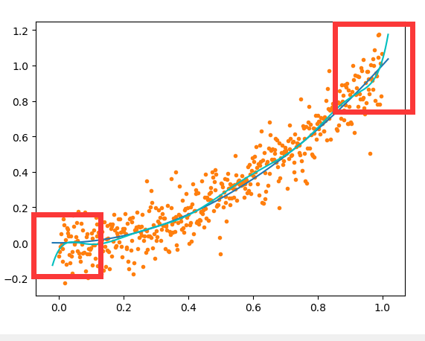
Extreme Learning Machine——Case 2
Regression:
Given a training set:
Training data: 500
the activation function of hidden node:
Sigmoid
hidden node number: 50
Overfitting

Slide 18
DELM
2.3

Slide 19
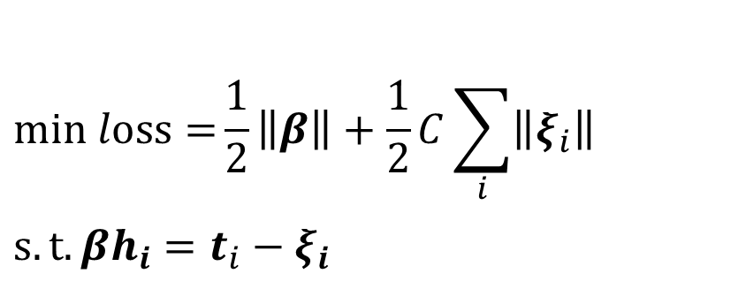
Extreme Learning Machine——DELM
For training data, ($x_{i},t_{i}$) :
Solution:
Normally, we add 2 norm constraints to the model weights.
$$loss=\sum_{i}{\left\|o_{i}−t_{i}\right\|}$$
Given : $W_{\tilde{N}×n}$，$b_{\tilde{N}×1}$
Find $β_{m×\tilde{N}}$, which could make the $loss$ minimize.
$$min loss={\frac{1}{2}\left\|β\right\|}+\frac{1}{2}C\sum_{i}{\left\|ξ_{i}\right\|}$$
$$s.t.βh_{i}=t_{i}−ξ_{i}$$
Notes:
$ξ_{i}$：可塞

Slide 20

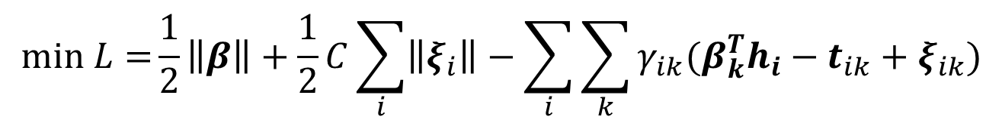
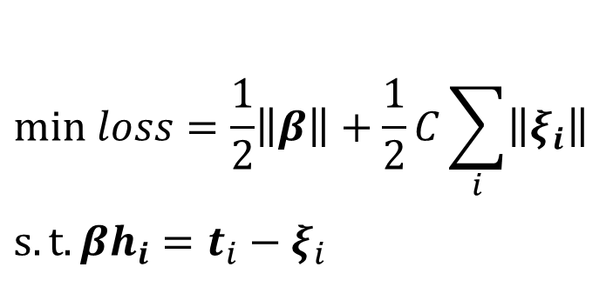
Extreme Learning Machine——DELM
$$min loss=\frac{1}{2}\left\|β\right\|+\frac{1}{2}C\sum_{i}{\left\|ξ_{i}\right\|}$$
$$s.t.βh_{i}=t_{i}−ξ_{i}$$
$$β= {[β_{1}^{T},β_{2}^{T},……,β_{m}^{T}]}^{T}$$
the method of Lagrange multipliers
$$min L={\frac{1}{2}\left\|β\right\|}+\frac{1}{2}C\sum_{i}{\left\|ξ_{i}\right\|}−\sum_{i}{\sum_{k}{γ_{ik}(β_{k}^{T}h_{i}−t_{ik}+ξ_{ik})}}$$

Slide 21
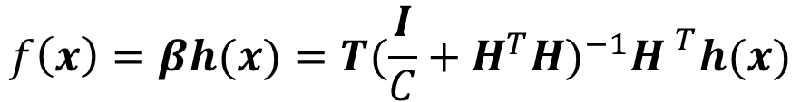
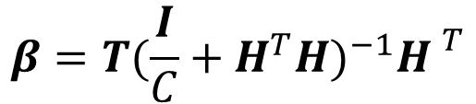
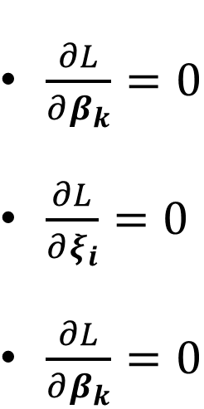
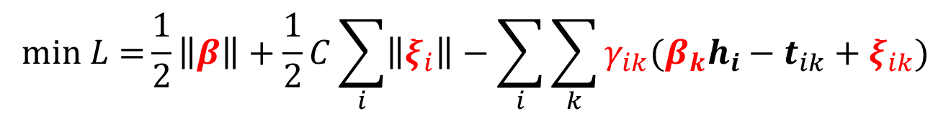
Extreme Learning Machine——DELM
$$min L={\frac{1}{2}\left\|β\right\|}+\frac{1}{2}C\sum_{i}{\left\|ξ_{i}\right\|}−\sum_{i}{\sum_{k}{γ_{ik}(β_{k}h_{i}−t_{ik}+ξ_{ik})}}$$
Let each partial derivative equal 0 :
$\frac{∂L}{∂β_{k}}=0$
$\frac{∂L}{∂ξ_{i}}=0$
$\frac{∂L}{∂β_{k}}=0$
$$β=T{(\frac{I}{C}+H^{T}H)}^{−1}{H }^{T}$$
The output of ELM:
$$f\left(x\right)=βh(x)=T{(\frac{I}{C}+H^{T}H)}^{−1}{H }^{T}h(x)$$

Slide 22
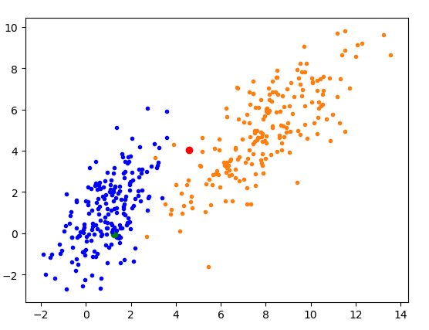
Extreme Learning Machine——DELM
Case 1: classification
Given a training set:
Training data: 1600
Test data: 400
C: 0.8
the activation function of hidden node:
hidden node number: 200

Slide 23
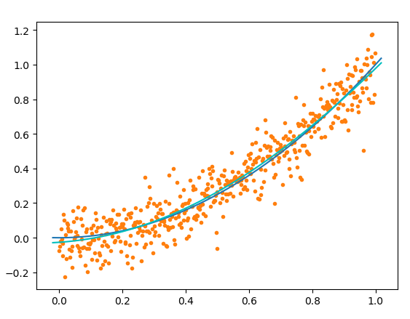
Extreme Learning Machine——DELM
Case 2: Regression
Given a training set:
Training data: 200
C: 100
the activation function of hidden node:
Sigmoid
hidden node number: 50

Slide 24
Others
2.3

Slide 25
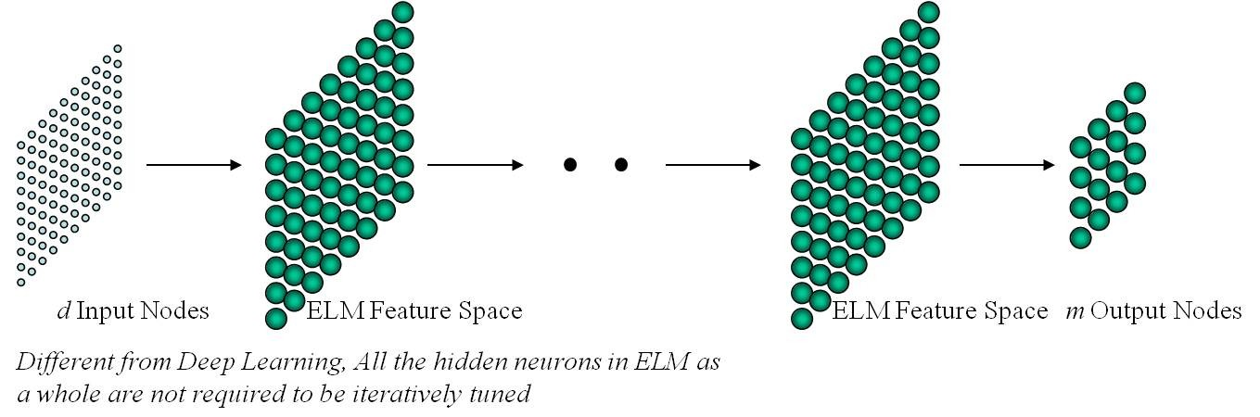
Extreme Learning Machine——Others
Kernel ELM:
Hierarchical ELM

Slide 26
Extreme Learning Machine——Others
References
[1] Extreme learning machine: A new learning scheme of feedforward neural networks
[2] Extreme Learning Machine for Multilayer Perceptron
[3] Extreme Learning Machine for Regression and Multiclass Classification
[4] Extreme learning machine: Theory and applications [5] Local Receptive Fields Based Extreme Learning Machine
Code
http://www.ntu.edu.sg/home/egbhuang/elm_codes.html

Slide 27
Home work
3

Slide 28
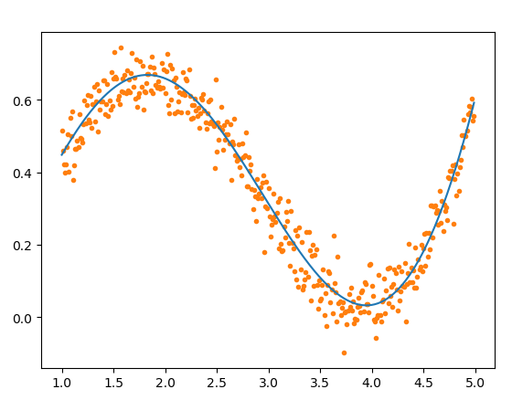
Home work
Data set Description:
Iris data set: http://archive.ics.uci.edu/ml/datasets/Iris
r_test.csv
Target:
1. Implement basic ELM and DELM
2. Classify Iris datasets using ELM and DELM (five fold cross)
3. Regress r_test dataset using ELM and DELM

Slide 29
Extreme Learning Machine
Thanks

