Slide 1
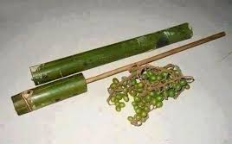



$$L_{0}$$
$$D$$

Slide 2
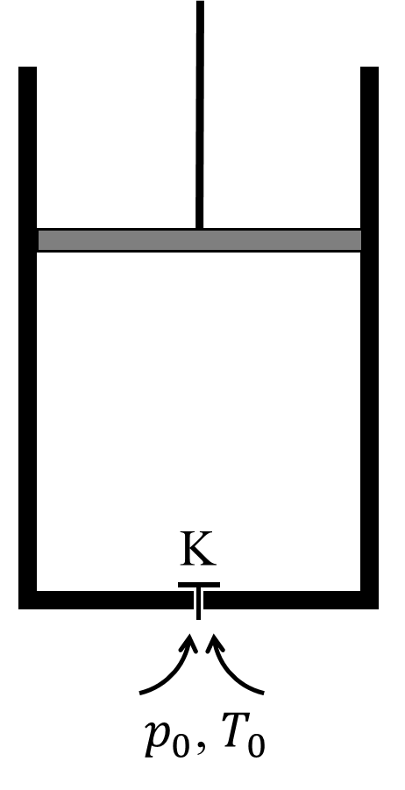
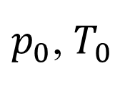
K
$p_{0}$, $T_{0}$

