Slide 1
Estimation

Slide 2
Planning: 10%-15% Analysis (BA): 15-20% Design & Implementation: 40% Testing:10%-20%

Slide 3
Never accuracy 100% +/- 50% - 400%

Slide 4
Analogous Estimating
is a technique which uses the values of parameters from historical data as the basis for estimating similar parameter for a future activity

Slide 5
Analogous Estimating
Domain
Technology
Context
Customer’s expectation

Slide 6
Work Breakdown Structure
Devide and conquor

Slide 7
2 ways to devide:
Functional WBS
Activity WBS
Shoping
Review
About
Shoping
List product
Add to Cart
Billing detail
Place order
Payment
Shoping
Desgin the page
Design db
Create API
Integrate to payment gatewat
Coding FE
Coding BE
Testing
Integration test

Slide 8
2 ways to devide:
Functional WBS
Activity WBS
A
B
Finish to start (FS)
Finish to Finish (FF)
Activities: Task dependency relationship
A
B

Slide 9
ways to estimate:
Three point = (O+M+L)/3
PERT (Program Evaluation and Review Techique) = (O + 4*M + L)/6
O: best case
M: Most likely
L: worst

Slide 10
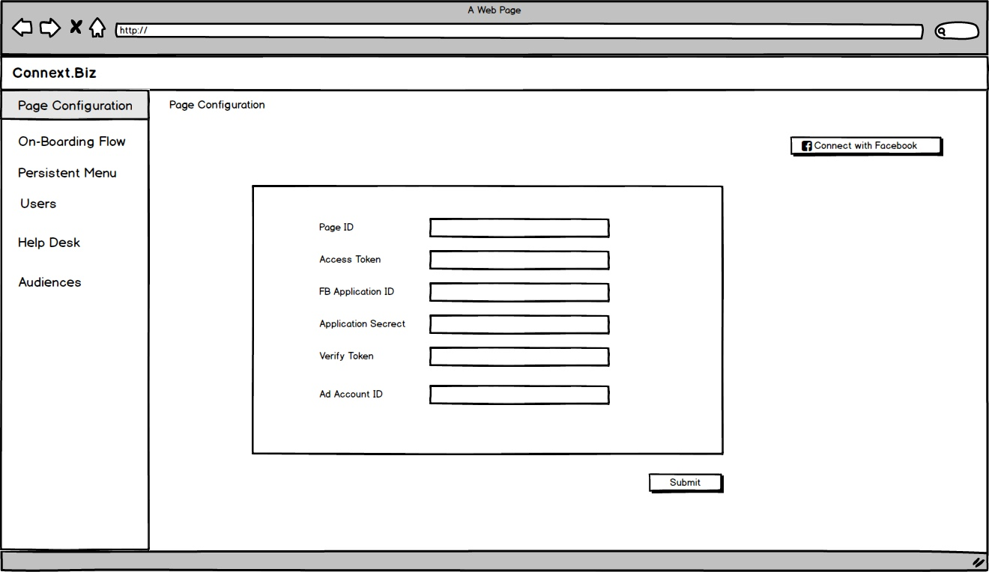

Slide 11
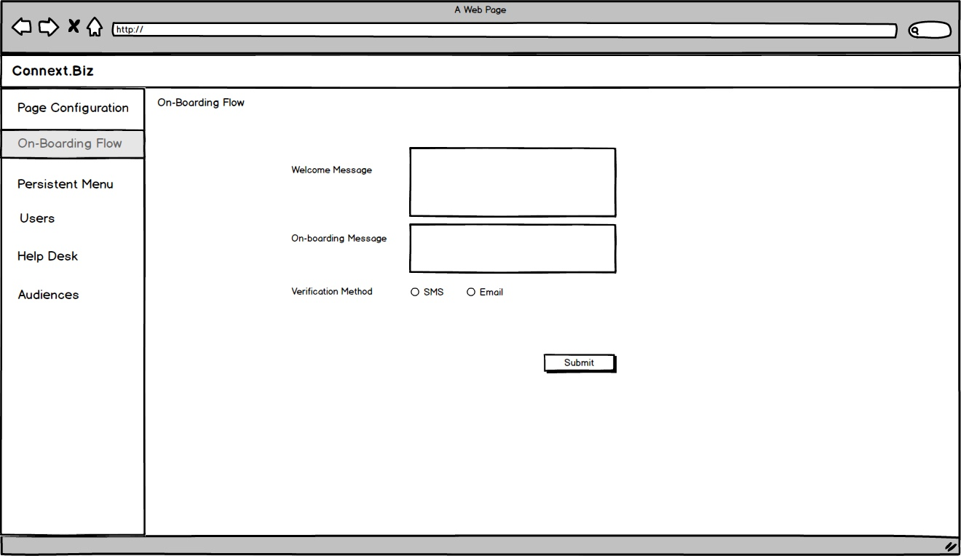

Slide 12
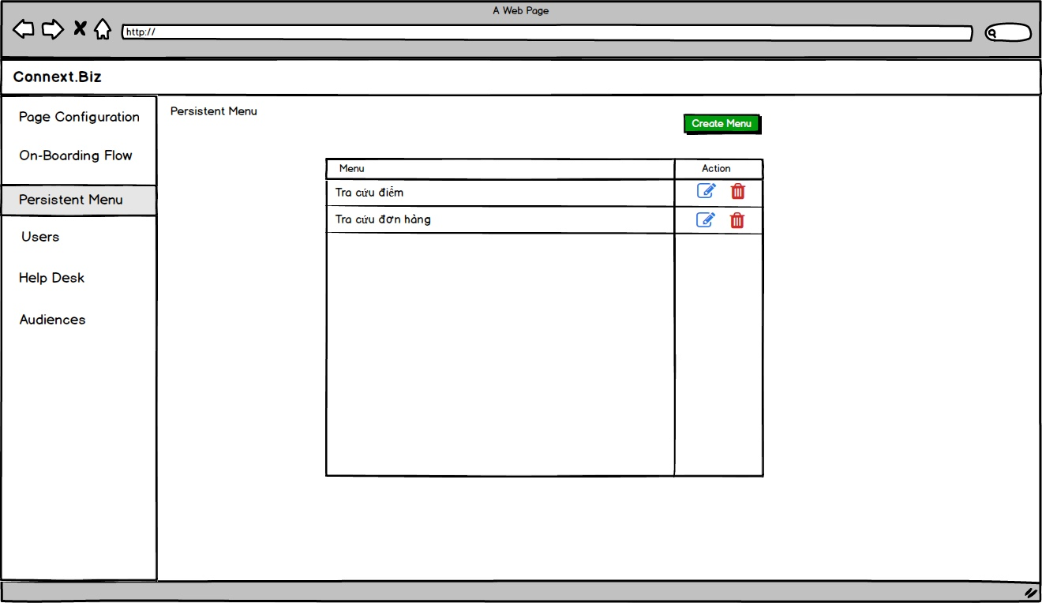

Slide 13
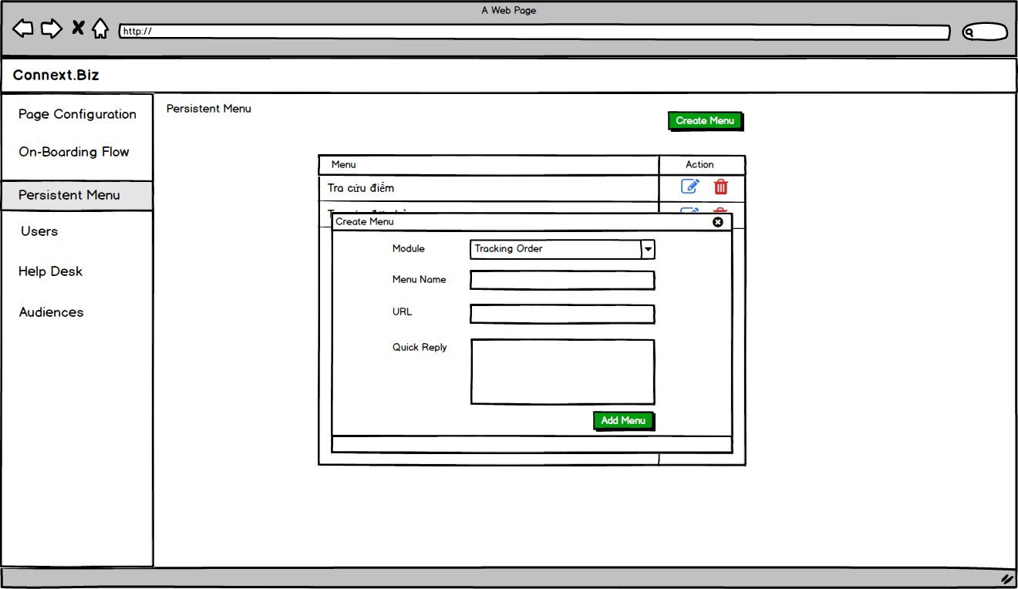

Slide 14
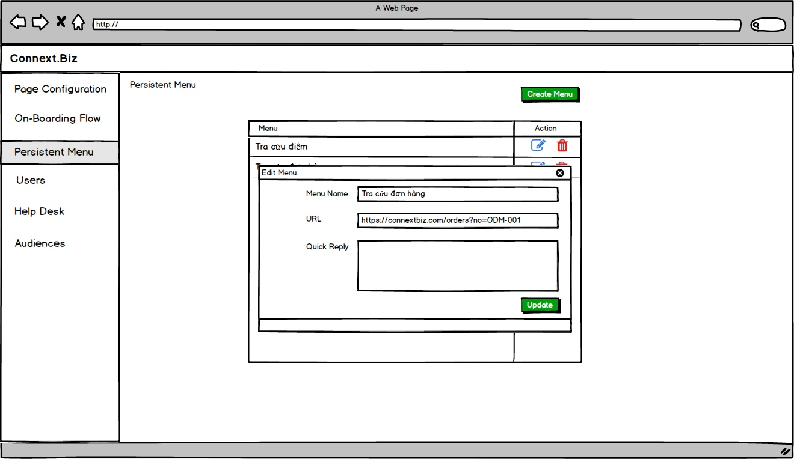

Slide 15
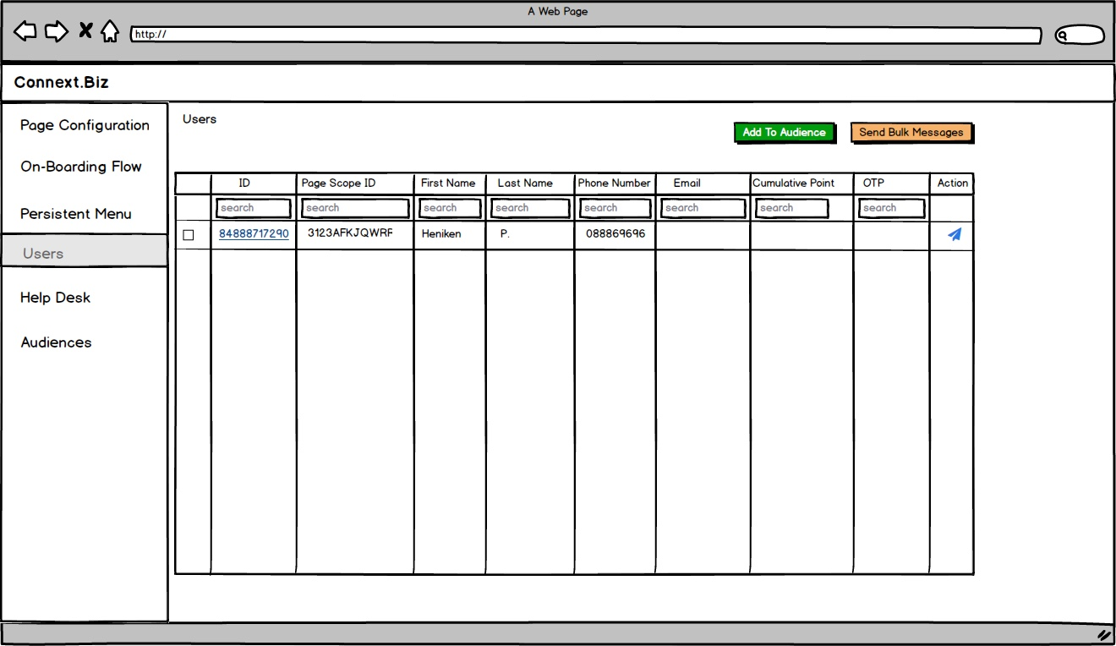

Slide 16
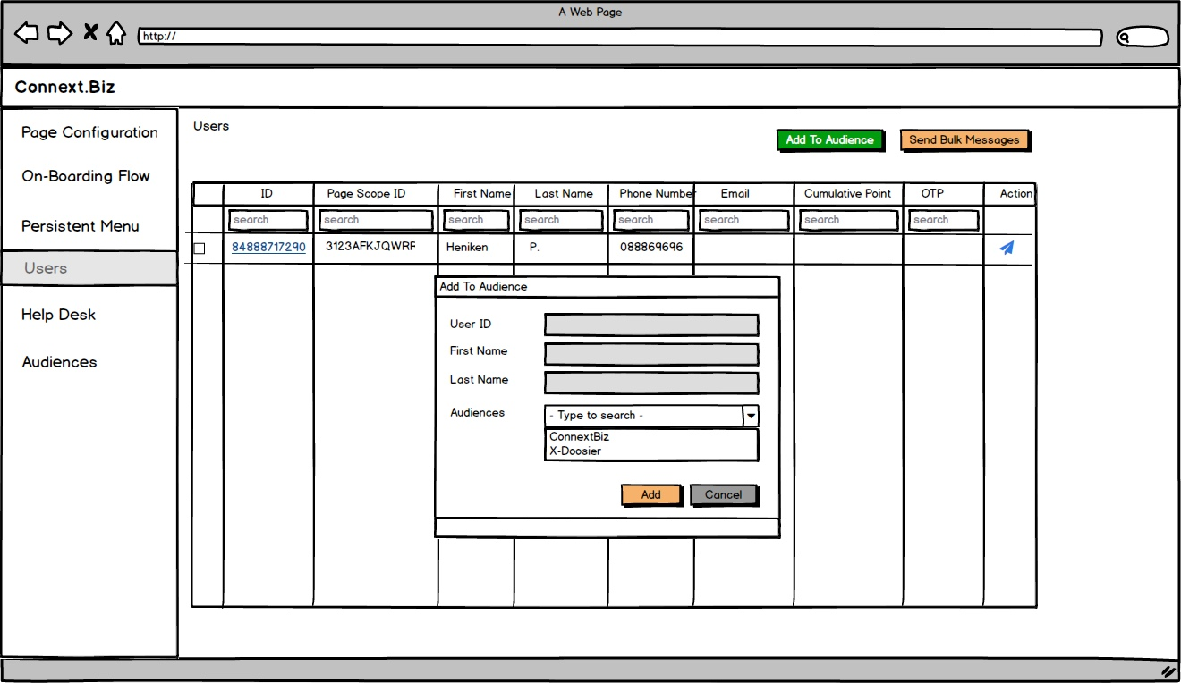

Slide 17
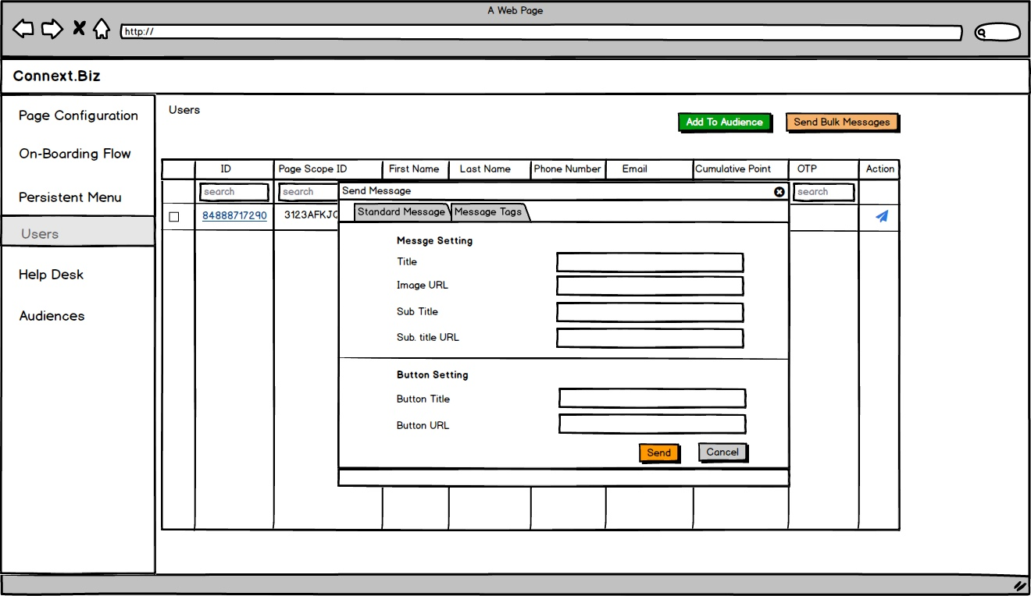

Slide 18
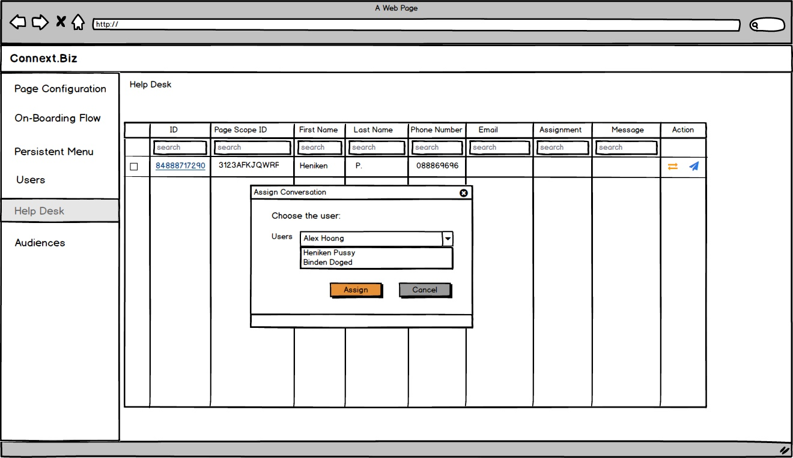

Slide 19
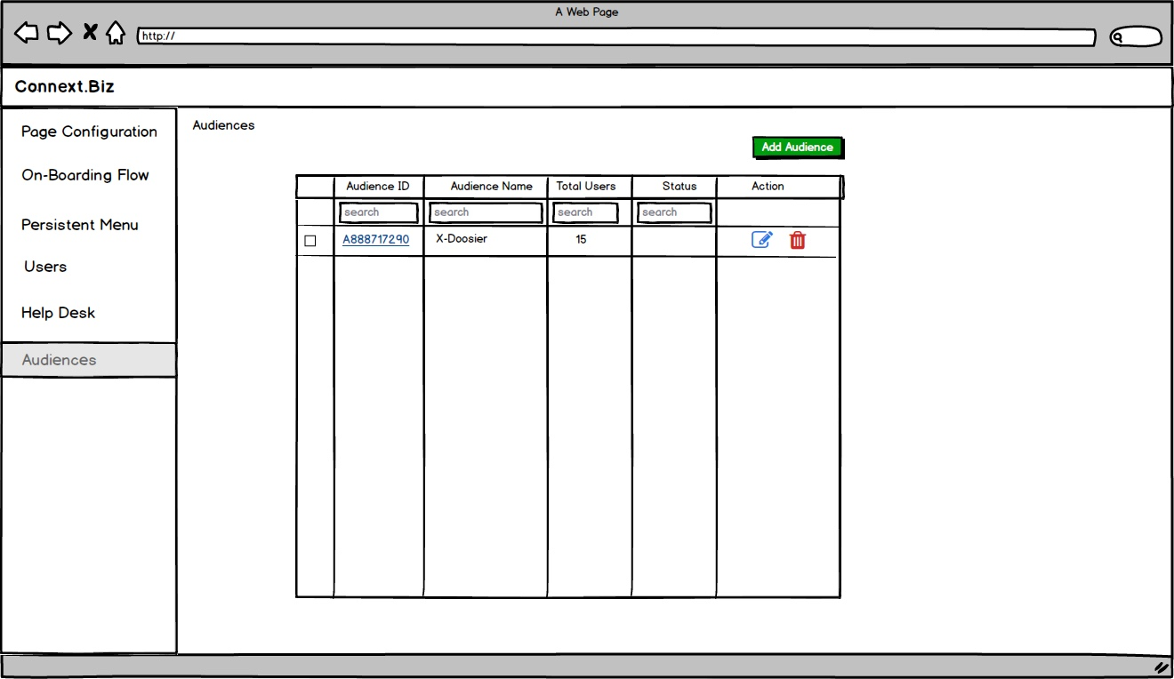

Slide 20
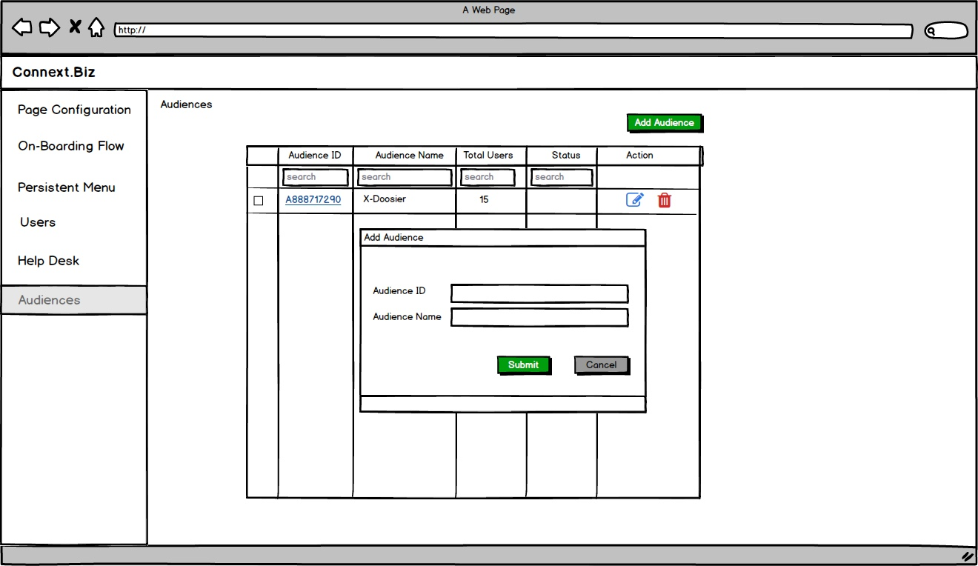

Slide 21
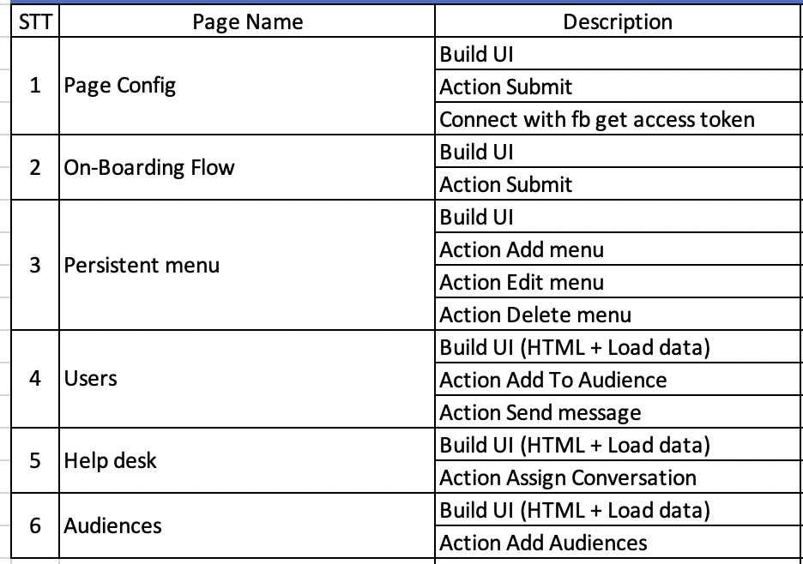
Work Breakdown

Slide 22
Three-point Estimating
Test Estimate = (O + M + L)/3

Slide 23
Program Evaluation and Review Technique (PERT)
Test Estimate = (O + (4 × M) + L)/6

Slide 24
Function Point

Slide 25
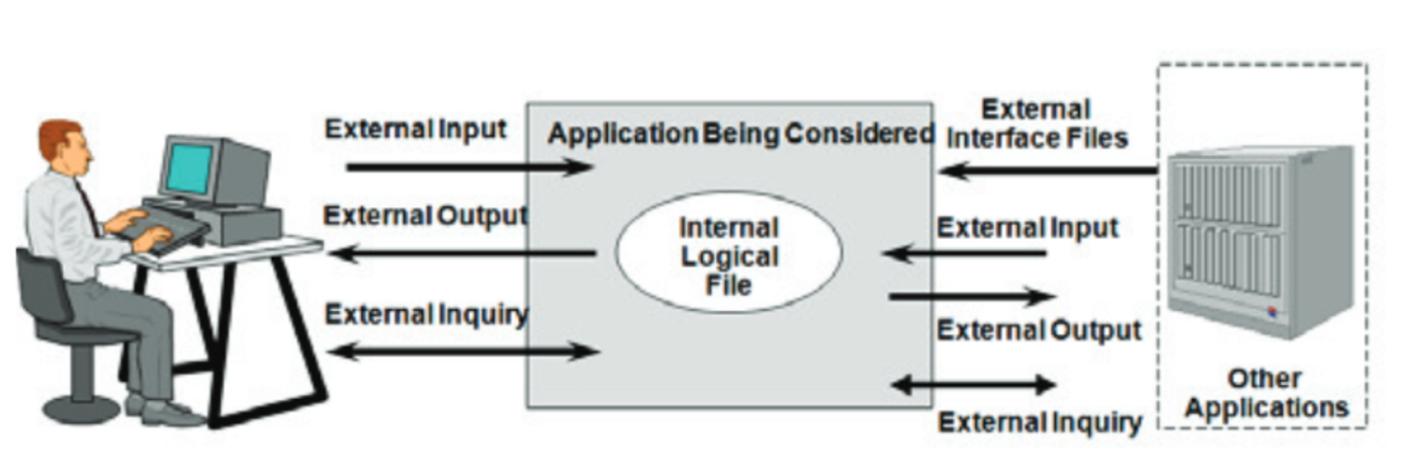
Elementary Process (EP)
Data Functions
Internal Logical Files (ILF)
External Interface Files (EIF)
Transaction Functions
External Inputs (EI)
External Outputs (EO)
External Inquiries (EQ)
Record Element Type (RET)
Data Element Type (DET)

Slide 26
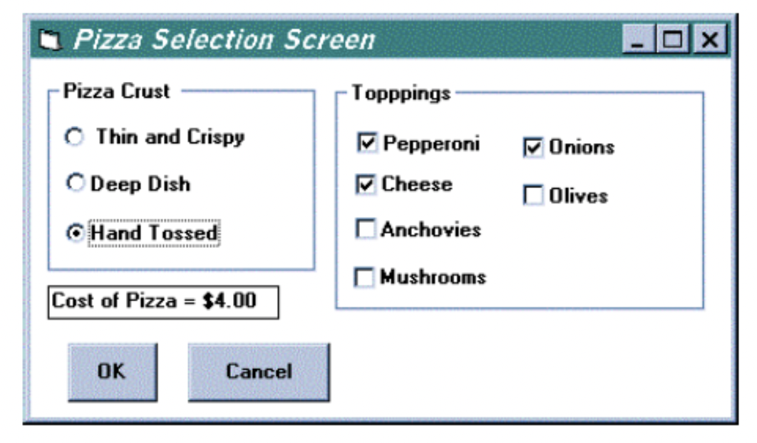
Toppings are read from another application (kitchen application).
If the topping is not available it is not displayed.
The cost of the Pizza is calculated automatically.
When the OK button is clicked the Toppings, Pizza Crust Type and
Cost of Pizza are saved for further processing.

Slide 27
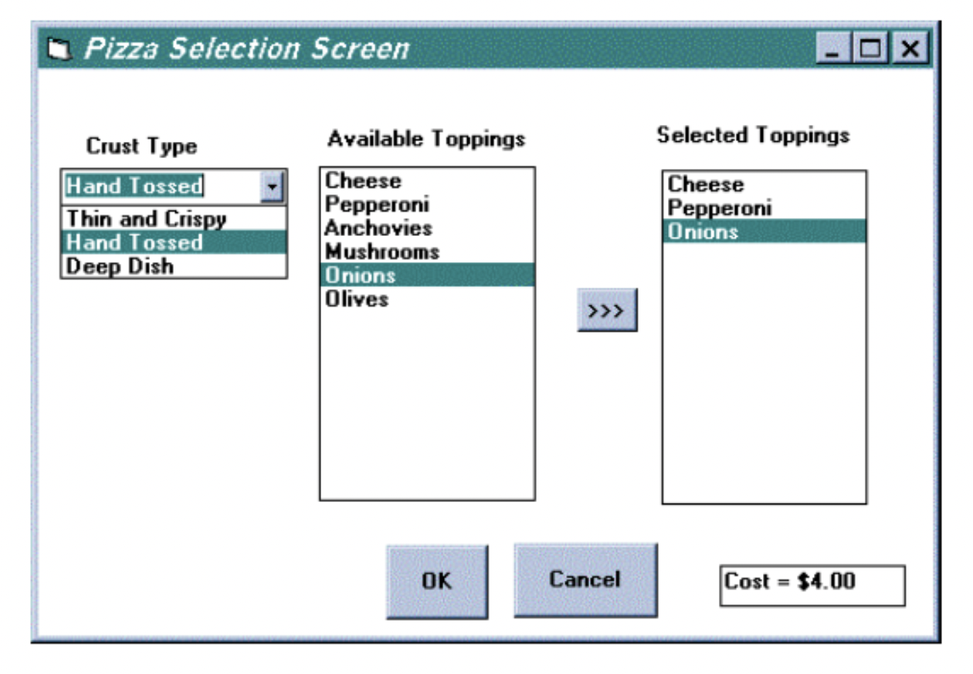
The Items in the drop down box are hard coded – not read from a file.
Available Toppings are read from another application (kitchen application).
When a Topping is selected from Available Toppings it is copied to Selected Toppings
The Cost of the Pizza is automatically calculated.
When the OK button is clicked the Selected Toppings, Pizza Crust
Type and Cost of Pizza are saved for further processing.

