Slide 1

TOUCH-SCREEN TECHNOLOGY
Nguyen Tran phong – se150974 – fptu hcm

Slide 2

CONTENT
Touch-screen Technology
What is a touch-screen?
History of touch-screen technology
Some kinds of touch-screens
Resistive
Capacitive
SAW
Infrared

Slide 3

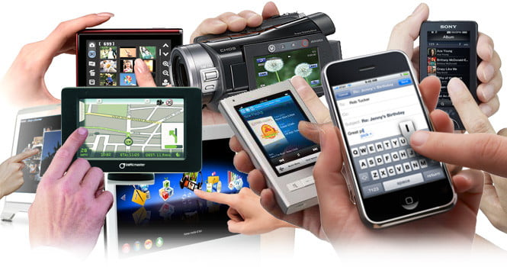
WHAT IS A touch-screen?
Both input and output device.
Layered on the top of an electronic visual display of an information processing system.
Give input by touching the screen with stylus or fingers.

Slide 4
Game consoles
Personal computers
Electronic voting machines
Point-of-sale (POS) systems
Medical field
Heavy industry
Automated teller machines (ATMs)
Kiosks such as museum displays or room automation

Slide 5

History
[1965]
The first touch screen was invented by E. A. Johnson
[1982]
The first multi-touch device successfully developed at the University of Toronto
[1993]
IBM’s first mobile device to own a touchscreen
[2007]
The first mobile phone to have a capacitive touch screen was the LG Prada
[2015]
Apple launches Apple Watch, iPhone 6s, iPhone 6s Plus with a force-sensitive screen
[1970]
Professor G. Samuel Hurst accidentally invented the resistive touch screen
[1983]
HP officially introduces HP-150, one of the first computers with touch screens
[2007]
Steve Jobs introduced iPhone 2G using multi-point capacitive touch technology

Slide 6
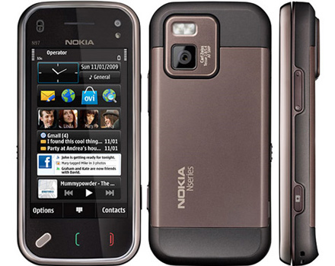
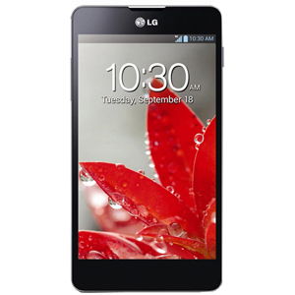
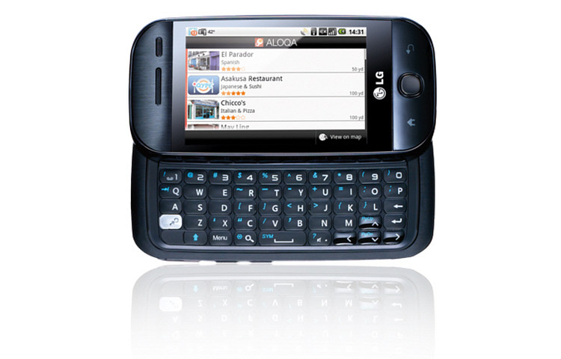
SOME KINDS OF TOUCH-SCREENS
RESISTIVE
LG Optimus
LG GW620
Nokia N97 mini

Slide 7
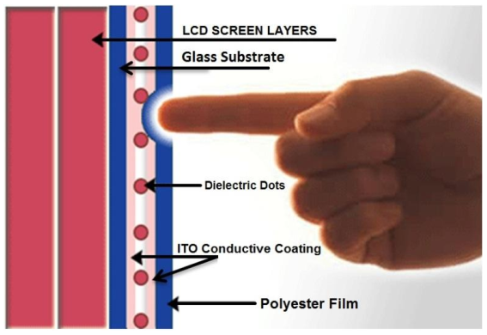
SOME KINDS OF TOUCH-SCREENS
RESISTIVE
Advantages | Disadvantages
Works with finger, gloves, stylus or any non-sharp object so it can be used in hospitals and restaurants. Relatively easy to manufacture. Lowest-cost touch technology. Widely available. Low power consumption. Resistant to screen contaminants. Less sensitive to scratches as compared to capacitive screens. | Not durable enough. Loss of clarity of image. Exponential cost to manufacture as screen sizes increase. Becomes non-responsive at temperature extreme. Poor multi-touch capability.

Slide 8
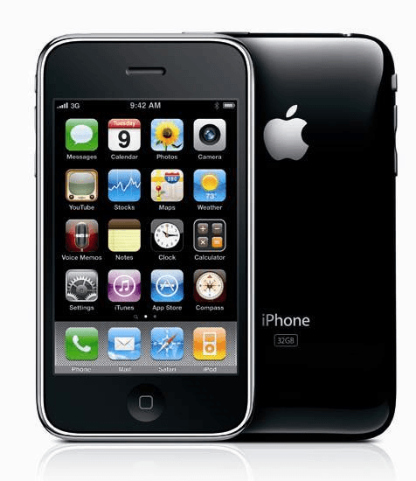
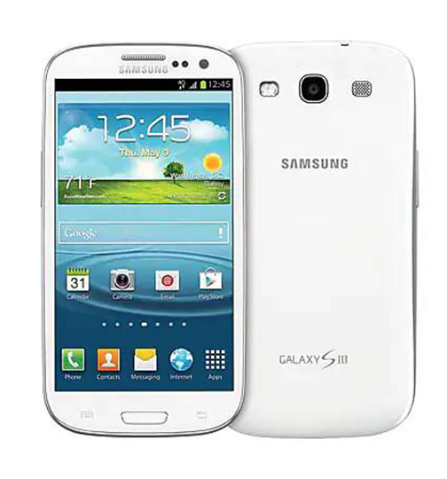
SOME KINDS OF TOUCH-SCREENS
CAPACITIVE
Apple iPhone 2G
Samsung Galaxy S

Slide 9
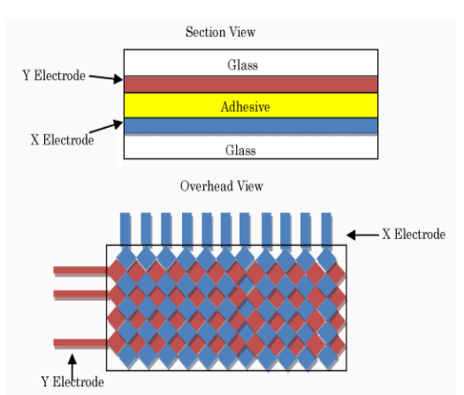
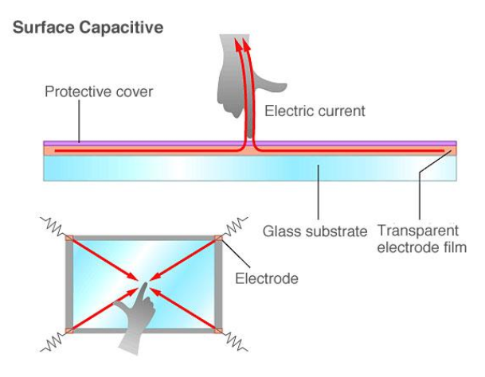
SOME KINDS OF TOUCH-SCREENS
CAPACITIVE
Advantages | Disadvantages
Multi-touch gestures. Requires less pressure. More durable than resistive touchscreens. Displays image efficiently. | Can only be touched with fingers. More expensive than resistive touch screens. Scratches in coatings cause dead spots.

Slide 10
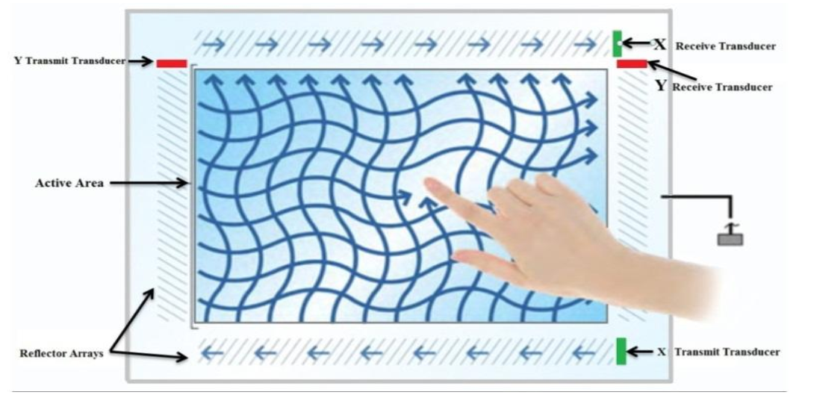
SOME KINDS OF TOUCH-SCREENS
Surface acoustic wave (SAW)
Advantages | Disadvantages
Better clarity than Resistive and Capacitive. Work almost with any stylus. Very high scratch immunity. Can be deployed to a curved surface. Provides superior resolution. | Must use soft object to enable touch. Surface contaminants cause dead spots. Low weather immunity (water and dust). Require periodic cleaning of sensor. Can be activated inadvertently by dirt.

Slide 11
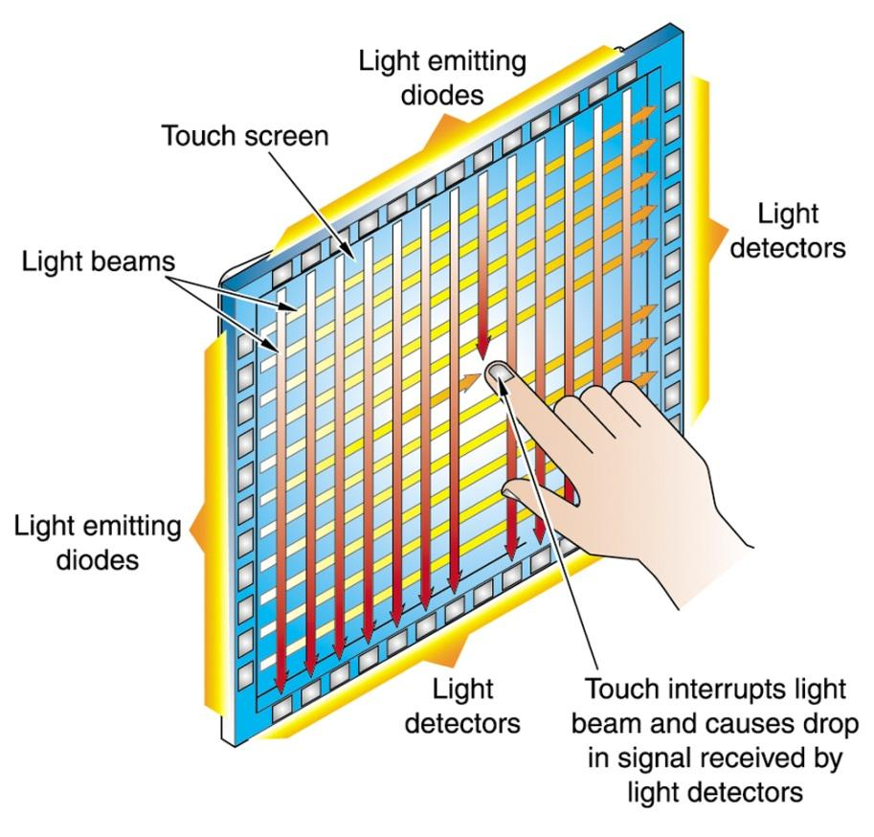
SOME KINDS OF TOUCH-SCREENS
INFRARED
Advantages | Disadvantages
Higher accuracy and system durability. Excellent clarity, 100% light transmission. Especially suitable for large-size (over 40 inch) touch screen. Can be operated with finger, stylus, etc. Less prone to vandalism (scratching etc.). Support multi-touch. | Expensive to manufacture. Issue of performance in bright ambient light (e.g. sunlight). Overlay sensitive, touch can be sensed before screen touched.

Slide 12

REFERENCES
Different paradigm for Touch-Screen technology: A Survey - Researchgate.net - https://www.researchgate.net/publication/260134012_Touch_screen_technology
Comparative study of various touch screen technologies: A Review - Ijrar.org - http://www.ijrar.org/papers/IJRAR2001146.pdf
Lịch sử hình thành và phát triển của công nghệ màn hình cảm ứng – Tinhte.vn – https://tinhte.vn/thread/lich-su-hinh-thanh-va-phat-trien-cua-cong-nghe-man-hinh-cam-ung.2335998/

Slide 13


