Slide 1
Course: Programming Fundamentals using C

Slide 2
Contents
Why we program?
Why C is chosen?
Pre-requisites
Course Objectives
Course Description and Course Plan
Materials/ Tools/ References
Course Requirements
Grading
Academic Policies
How to Study?
Getting/Installing Programming Tool

Slide 3
Why We Program?
We usually cause errors (hay sai), quickly forget something (mau quên) and are not tenacious (chóng chán)
Computers are our assistances
They need to be taught how to work
To teach a computer working, we use a programming language.

Slide 4
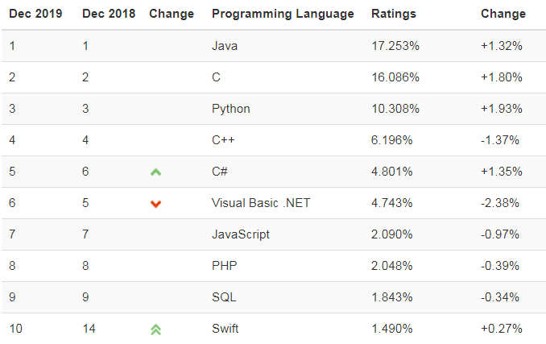
Why C is chosen?
Top ten common programming languages:
For latest data http://www.tiobe.com/index.php/content/paperinfo/tpci/index.html

Slide 5
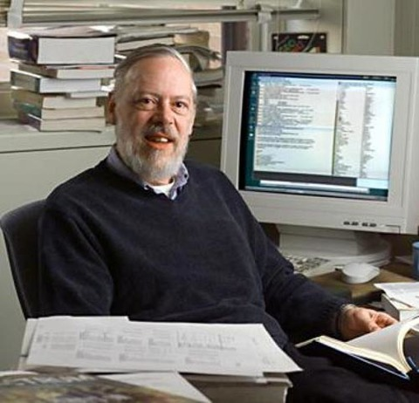
Dennis Ritchie (1941-2011)
C was originally developed at Bell Labs by Dennis Ritchie between 1972 and 1973 to make utilities running on Unix. Later, it was applied to re-implementing the kernel of the Unix operating system. During the 1980s, C gradually gained popularity (wiki, Photos from the internet).

Slide 6
Prerequisites
Completed EN051 or obtain 500+ TOEFL equivalent international certificates

Slide 7
Course Objectives
We plan to understand a subset of the C language, rather than the whole thing, is to make learning easier, and how and why the C language is learned and applied as the basic language syntax.
The keyword is understand !! We must not be satisfied by just learning a bunch of information about the C language syntax – our goal is to learn how to implement the console application/ algorithms/ … using the C language and what makes them good.
As we proceed to learn and use the C language, we shall pick up the underlying theory and basic syntax.
This will be a practical course !! We shall use the Dev-C++ 5 Beta 9.2 for Windows program to learn C language.
Remember: The C language is the language of the low level nature. Therefore, it is critical to understand the C language syntax.

Slide 8
Course Description- Course Plan
Introduction to PFC
Basic Computation
Basic Logics
Modules and Functions
Pointers
Libraries
Contiguous Storage
Strings
Text Files

Slide 9
Materials/ Tools/ References
Textbook:
Evan Weaver – Foundations of Programming Using C, July 2006 Edition, Trường Đại học FPT – Hà Nội – tháng 9, 2007
Course Website (forum): http://cms-hcm.fpt.edu.vn/
Tool: You can use an arbitrary C/C++ programming software, such as:
(1) Dev-C++ 5 Beta 9.2 (recommended):
Link: http://www.bloodshed.net/
(2) NetBeans with C/C++ plug-in: http://www.oracle.com/technetwork/java/javase/downloads/jdk-netbeans-jsp-142931.html

Slide 10
Course Requirements
Following lessons in classrooms
Reading textbook and documents at home
Completing chapter assessments in time ( programs and/or reports)
Discussing actively in your teams and in classrooms

Slide 11
Grading
Maximum score: 10
On-going assessments:
02 Quiz (Q) (10%)
08 Workshops (W) (10%)
01 Assignments (AS) (10%)
01 Practical Exam (PE) (40%)
(Practical exam retake only when the score of PE < 4)
Final exam (FE) (30%)
Total score = 0.1*Q + 0.1*W + 0.1*AS + 0.4*PE + 0.3*FE
Pass:
Every on-going assessment component >0 and
Practical Exam >=4 and
Final Examination score ≥ 4
Total score ≥ 5
FE Retake only when not passed

Slide 12
How to study?
Read lesson before class
Attend lectures
Listen, understand, then make your own notes
Give your explanation about some topic in lectures
Ask questions
Give some examples that are not existed in your book
Practice all the exercises to make your sense
After classes
Discuss your classmate in directly, on forum
Analyze, design and implement workshops and assignment. Write reports to your notebook.
Build your teams in yourselves to support together in studying

Slide 13
Academic policies
Cheating, plagiarism and breach of copyright are serious offenses under this Policy.
Cheating
Cheating during a test or exam is construed as talking, peeking at another student’s paper or any other clandestine method of transmitting information.
Plagiarism
Plagiarism is using the work of others without citing it; that is, holding the work of others out as your own work.
Breach of Copyright
If you photocopy a textbook without the copyright holder's permission, you violate copyright law.

Slide 14
Enjoy the Course!
Be enthusiastic about the material because it is interesting, useful and an important part of your training as a software engineer. Our job is to help you learn and enjoy the experience. We will do our best but we need your help. So let’s all have fun together with Foundations of Programming Using C!!!

Slide 15
Getting and Installing Tool
Download and Install Dev-C++ 5
Link: http://www.bloodshed.net/

Slide 16
Q&A

