Slide 1
Text Files
Module H: Files
Notes:
Prepared by Thân Văn Sử

Slide 2
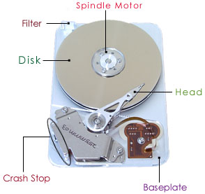
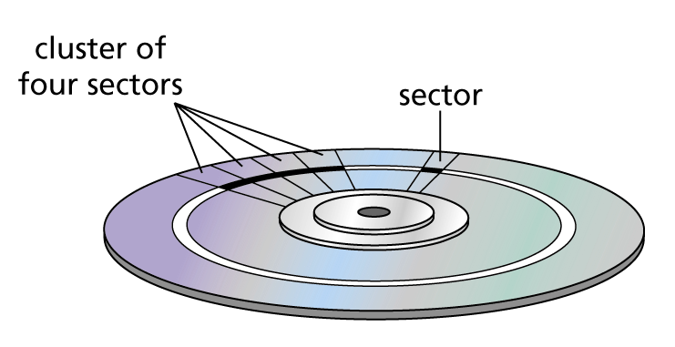
Objectives
What is a file?
How are data stored in files?
How to access data in a text file?

Slide 3
Contents
1- What is a file?
2- File types
3- Ways for accessing files
4- Connecting to a file
5- Declaration a file variable
6- Steps for accessing a file
7- File Functions and Demonstrations
Bonus- Text Files and Parallel Arrays

Slide 4
1- What is a file?
A complete, named collection of information, such as a program, a set of data used by a program, or a user-created document. A file is the basic unit of storage that enables a computer to distinguish one set of information from another. A file is the “glue” that binds a conglomeration of instructions, numbers, words, or images into a coherent unit that a user can retrieve, change, delete, save, or send to an output device ( from MS Computer Dictionary)

Slide 5

What is a file?...
A file is not necessarily stored contiguously on a secondary storage device .
Disk → Track → Sector
Some sectors → Cluster
Unit of disk allocation: Cluster
This cluster contains data to point to the next one.
The contents of a file is accessible after we have turned the power off and back on at a later time.

Slide 6
2- File Types
The fundamental unit of a file is a byte.
A file is a stream of bytes.
A file concludes with a special mark called the end of file mark (EOF).
Based on the way used to store data:
Text file: Unit of data in a file is an ASCII code of character.
Binary file: Unit of data in a binary byte → Each byte on the file is a direct image of the corresponding byte in memory

Slide 7
File Types…
01000001
01000010
01000011
00110010
00110110
00110000
Characters
“ABC”
01000001 (‘A’)
01000010 (‘B’)
01000011 (‘C’)
00000000 (NULL)
Text file
ASCII codes
of digits
Data
00110010 (‘2’)
00110110 (‘6’)
00110000 (‘0’)
Number
260 (2 bytes)
convert
00000001
00000100
Binary
file
00000001
00000100
Text format is more portable than binary format
But binary format is more efficient than text format

Slide 8
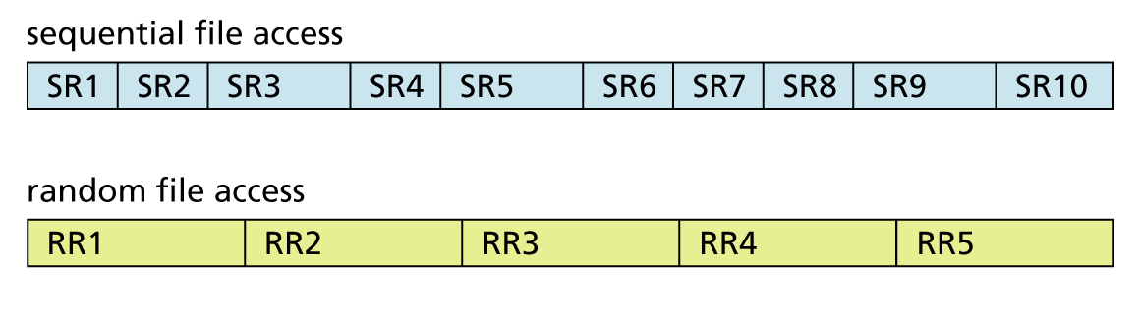
3- Ways for Accessing Files
Typically, a file consists of records that we can access in either of two ways
randomly (like CD's, hard disks) or
sequentially (like Cassette Tapes).

Slide 9
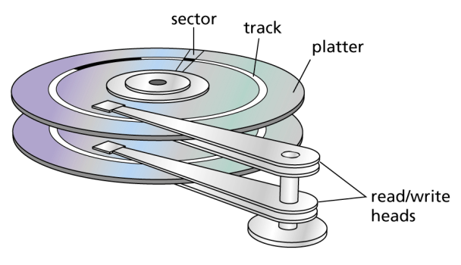
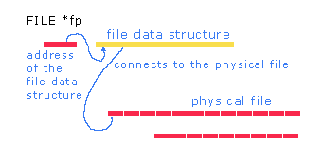
4- Connecting to a File
Os manages hardware → Connecting a file in a program should be announced to the OS.
OS can manage some files concurrently. At a time, only one file can be accessed → Information about the opened file must be maintained for next read or write.
stdio.h
typedef struct _iobuf
{
char* _ptr;
int _cnt;
char* _base;
int _flag;
int _file;
int _charbuf;
int _bufsiz;
char* _tmpfname;
} FILE;

Slide 10
5- Declaration
FILE* identifier ;
Example
#include <stdio.h>
FILE* f=NULL;
The variable f will be updated when a specific file is opened.
f points to a memory block having the pre-defined structure
typedef struct _iobuf
{
char* _ptr;
int _cnt;
char* _base;
int _flag;
int _file;
int _charbuf;
int _bufsiz;
char* _tmpfname;
} FILE;

Slide 11
6- Steps for Accessing a File
Reading file to variables
Writing variables to file
Select file by filename
Select file by filename
// function
2) Open the file.
3) Determine the position in the
file will be read.
4) Loop
Read file contents to variables.
Process variables.
5) Close file
// function
2) Open the file
3) Determine position in the
file will be written.
4) Loop
- Set data to variables (if needed)
- Write data of variables
to file
5) Close file
Generally, we used to process
a file from the begin of the file.
Specify a filename (a string):
Absolute pathname:
“c:/t1/t11/f1.txt” or
“c:\\t1\\t11\\f1.txt”
File in the current folder: “f1.tcxt”

Slide 12
To specify a filename
D:
T1
T2
T3
T21
T22
f4.txt
T221
T222
f3.txt
“f1.txt”
“./f1.txt”
“.\\f1.txt”
”T2221/f2.txt”
“./T2221/f2.txt”
“../f3.txt”
“D:/T3/f4.txt”
When p.exe executes, the directory T222 is the working (current) directory.
T2221
f1.txt
p.exe
f2.txt

Slide 13
7- Some Common File Functions
Purpose STDIO.H | Syntax
Open a file | FILE* fopen(char fname[], char mode[])
Close a opening file | int fclose(FILE*)
Read a character | int fgetc(FILE*)
Write a character | int fputc(char, FILE*) → EOF (-1)
Read a string | fgets( char S[], int nbytes, FILE* f); → NULL if EOF
Write a string | fputs ( char*, FILE*)
Read a number | fscanf ( FILE*, char* format, PointerList)
Write a number | fprintf ( FILE*, char* format, VarList)
Test whether the file is EOF? | int feof(FILE*)
Rewind to the beginning | void rewind (FILE*)
Get the current file position | long ftell(FILE*)
Move the current position | int fseek (FILE*, long offset, int fromPos)
Rename a closed file | rename ( char fName[], char newName[])
Remove a closed file | remove ( char fName[])

Slide 14
7.1- The fopen() function
FILE *fopen(char file_name[], char mode[]);
file_name parameter is a null-byte terminated string containing the name of the file.
mode parameter is a null-byte terminated string containing the connection mode
"r" - read from the file,
"w" - write to the file: if the file exists, truncate its contents and then write; if the file does not exist, create a new file and then write to that file,
"a" - write to the end of the file: if the file exists, append to the end of the file; if the file does not exist, create it and then write.

Slide 15
The fopen() function…
The other connection modes for text files are
"r+" - opens the file for reading and possibly writing,
"w+" - opens the file for writing and possibly reading; if the file exists, truncates its contents and then writes to the file; if the file does not exist, creates a new file and then writes to that file,
"a+" - opens the file for writing to the end of the file and possibly reading; if the file exists, appends to the end of the file; if the file does not exist, creates it and then writes to the file.
Modes for binary files: “rb”, “wb”, “r+b”, “w+b”,”a+b”
fopen returns NULL if the attempt to connect to the file fails.

Slide 16
7.2- The fclose() function
int fclose(FILE *); 0: successful, EOF (-1): fail
File opened writing, fclose writes any data remaining in the file stream's buffer to the file and concludes by appending an end of file mark immediately after the last character.
File opened reading, fclose ignores any data left in the file stream's buffer and closes the connection.
fclose can fail if the secondary storage medium is full, an I/O error occurs or the medium has been prematurely removed.

Slide 17
7.3- The fgetc(), fputc() Functions
Return | Function | Parameter
The next byte read (ASCII code) or EOF(-1) End of File | int fgetc(FILE* fp) | Pointer of the file opened
The character written or EOF | int fputc( int ch, FILE* fp) | Character will be written to the file

Slide 18


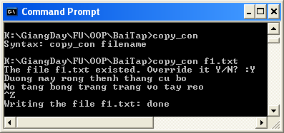
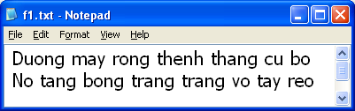
Demonstration 1
Write a C-program that will use command line to perform writing a text file from characters inputted by user until the keys Ctrl+Z then ENTER are pressed.
Syntax of the program:
copy_con filename

Slide 19
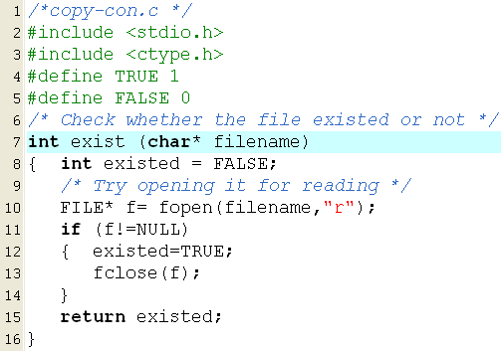
Demonstration 1…

Slide 20
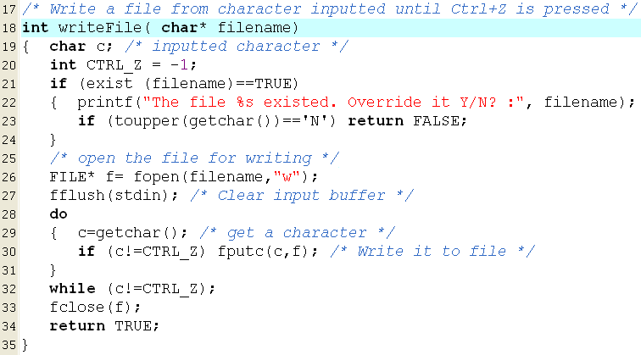
Demonstration 1…

Slide 21
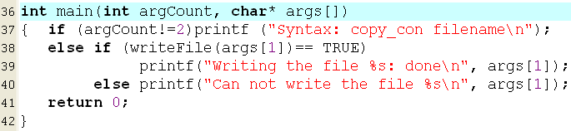
Demonstration 1…
argCount=1
argCount=2
args[0]: name of the program
args[1]: parameter of the program
Notes:
#include <stdio.h>
int main(int n,char* arr[]){
printf("n = %d\n",n);
for(int i =0; i<n;i++)
{
printf("%s\n",arr[i]);
}
return 0;
}

Slide 22
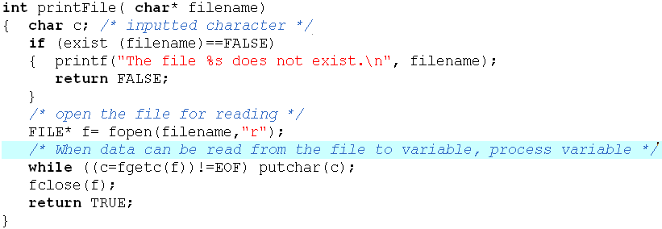
Demonstration 1…
Function for printing the content of a text file

Slide 23
7.4- The fgets(), fputs() Functions
Return | Function | Parameter
Success: str Fail: NULL | char* fgets(char* str, int num, FILE* fp) | num: Maximum number of characters will be read
Success: >=0 Fail: EOF (-1) | int fputs( char* str, FILE* fp) | str: string is written will be written to the file
The fputs() function: The null that terminates str is not written and it does not automatically append a carriage return/linefeed sequence.
The fgets() function reads characters from the file associated with fp into a string pointed to by str until num-1 characters have been read, a newline character is encountered, or the end of the file is reached. The string is null-terminated and the newline character is retained. The function returns str if successful and a null pointer if an error occurs.

Slide 24
Demonstration 2
Write a C-program that will performs the following operations:
User enters a filename of a text file
User will enter data to the file line-by-line until a null string is inputted.
User will see the content of the file.

Slide 25
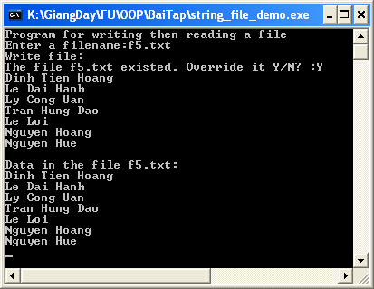
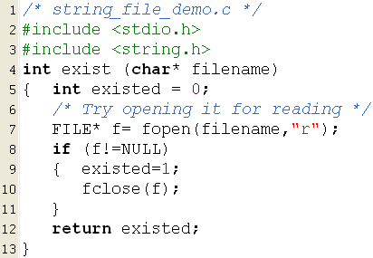
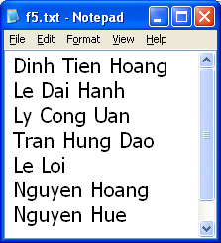
Demonstration 2…

Slide 26
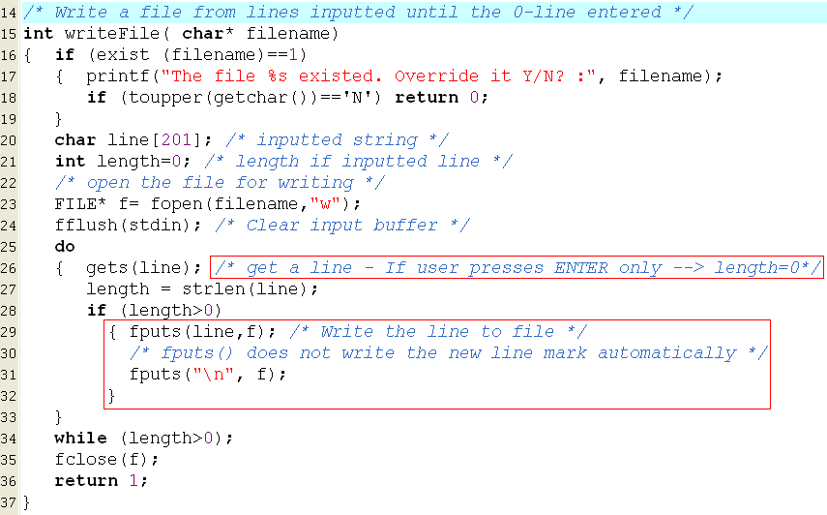
Demonstration 2…

Slide 27
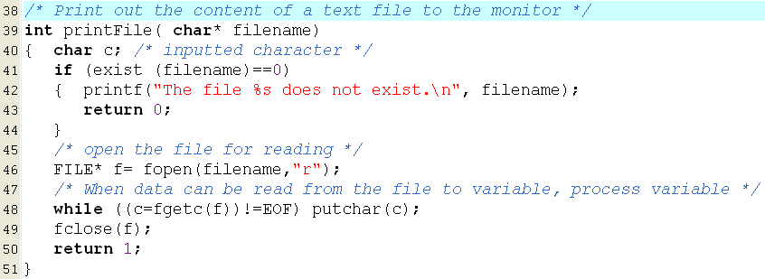
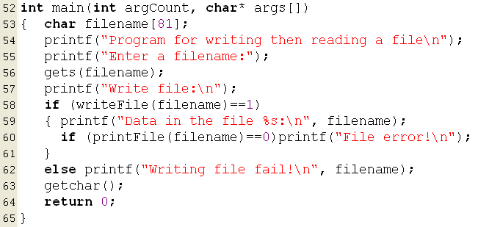
Demonstration 2…

Slide 28
7.5- The fscanf(), fprintf() Functions
Return | Function | Parameter
- Success: Number of data items which are read - Fail: 0 or EOF(-1) | int fscanf(FILE* fp, char* format, ListOfVarAddresses) | They are the same in the function scanf()
 | int fprintf( FILE* fp, char* format, VarList) | They are the same in the function printf()

Slide 29
Demonstration 3
Write a C-program that will perform the following operations:
User enters a filename of a text file
User will enter data to the file line-by-line until a null string is inputted.
User will see the content of the file.
(The problem of the previous demo. But, the functions fscanf() and fprintf() are used.)

Slide 30
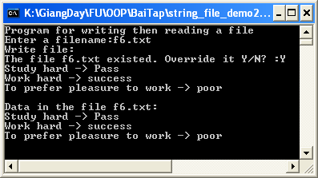
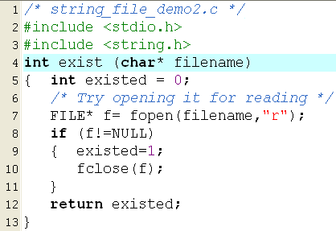
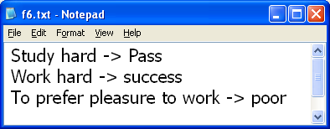
Demonstration 3….

Slide 31
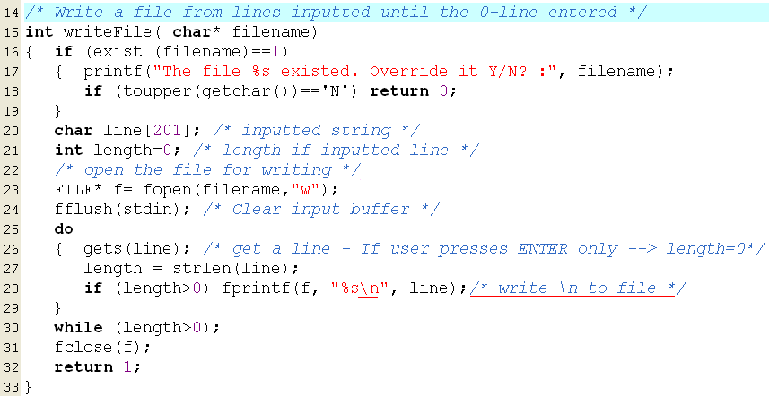
Demonstration 3…

Slide 32
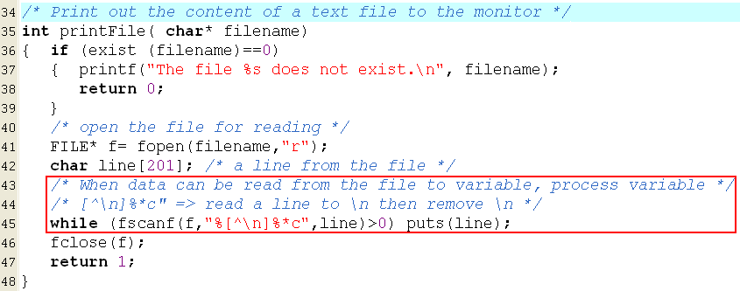
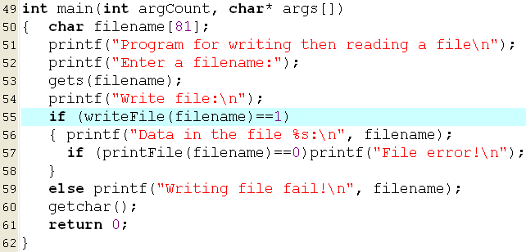
Demonstration 3…

Slide 33



Demonstration 4
Create a file, named array1.txt. The first number in the file is number of elements of an integer array. The later numbers are values of elements.
Write a C-program that will:
Read the array contained in the above file.
Print it’s elements in ascending order to monitor.
Write it to the file array2.txt using the same format with the file array1.txt.

Slide 34
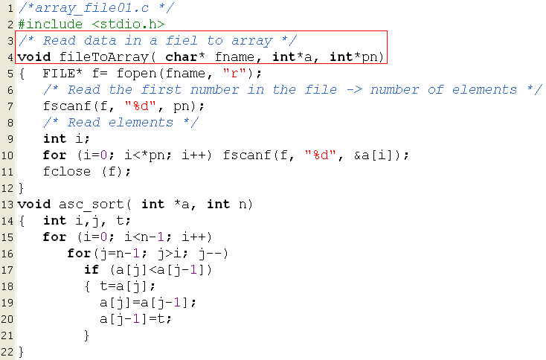
Demonstration 4…

Slide 35
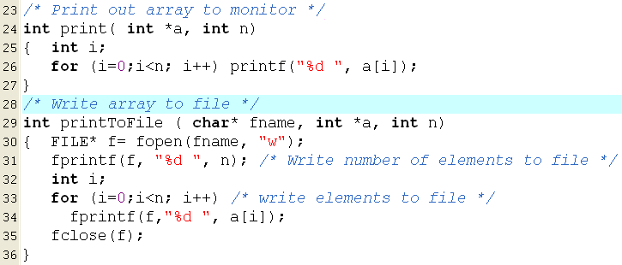
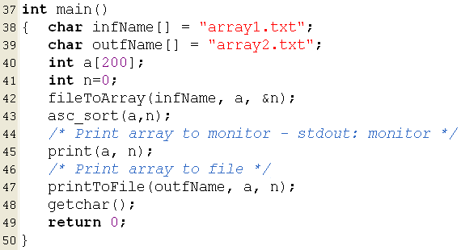
Demonstration 4…

Slide 36


Demonstration 5
Create a file, named array3.txt containing real numbers.
Write a C-program that will:
Print out number of values
Print out the average of values contained in the above file.

Slide 37
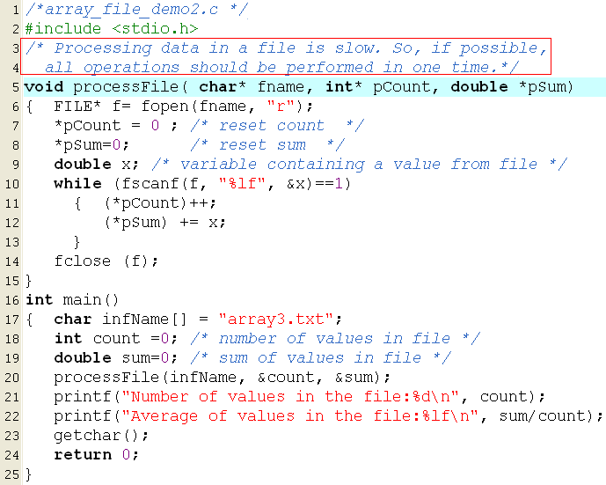
Demonstration 5…

Slide 38
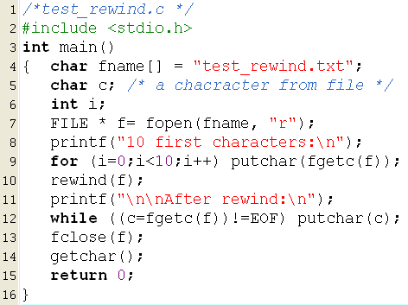

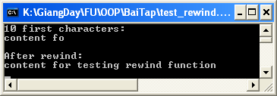
Demonstration 6: rewind(FILE*)

Slide 39

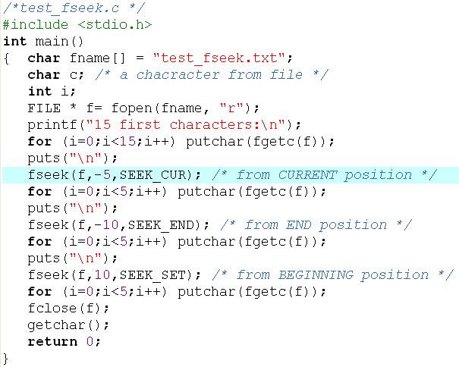
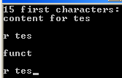
Demonstration 7: fseek(…)
content for testing fseek function
content for testing fseek function
content for testing fseek function
content for testing fseek function
EOF
(2bytes)
content for testing fseek function
content for testing fseek function
content for testing fseek function

Slide 40
Summary
File: Related data that are stored in a mass storage (disks).
Files are managed by the operating system (OS).
OS identifies a file through it’s name.
To specify a absolute filename in C:
“C:\\f1\\f11\\file1.dat” or “C:/f1/f11/file1.dat”
To process data in a file: We need to know format and meaning of each data in file.

Slide 41
Summary
Purpose STDIO.H | Syntax
Open a file | FILE* fopen(char fname[], char mode[])
Close a opening fle | int fclose(FILE*)
Read a character | int fgetc(FILE*)
Write a character | int fputc(char, FILE*) → EOF (-1)
Read a string | fgets( char S[], int nbytes, FILE* f); → NULL if EOF
Write a string | fputs ( char*, FILE*)
Read a number | fscanf ( FILE*, char* format, PointerList)
Write a number | fprint ( FILE*, char* format, VarList)
Test whether the file is EOF? | int feof(FILE*)
Rewind to the beginning | void rewind (FILE*)
Get the current file position | long ftell(FILE*)
Move the current position | int fseek (FILE*, long offset, int fromPos)
Rename a closed file | rename ( char fName[], char newName[])
Remove a closed file | remove ( char fName[])

Slide 42
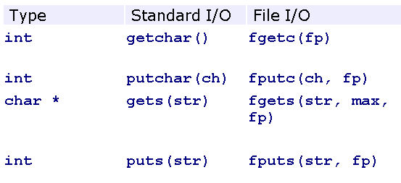
Summary

Slide 43
Summary
Text
file
ch= fgetc(f);
char ch;
int fputc(ch,f);
Text
file
fgets(S,nbytes,f);
char S[20];
fputs(S,f);
!=NULL or NULL
numeric
variable
x
fscanf ( f, “%♣” , &x);
fprintf ( f, “%♣” , x);
Return value:
-1 (EOF) end-of- file error or file error
>0 : read successfully

Slide 44
Thank You

Slide 45
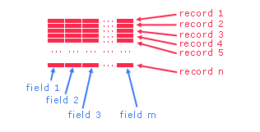
Bonus: Text Files and Parallel Arrays
Actually, each real object contains some data, such as details of students include name, address and mark. Some arrays can be used to manage a list of objects.
Data of a class (group of students) are usually presented in a file as a table.
A row in a data table is called as a record.
Each column in the table is call a field.

Slide 46
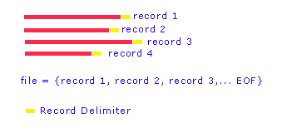
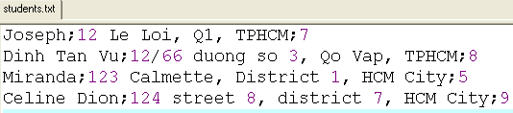
Bonus…
We call each line in a text file a record.
A record is a sequence of characters that ends with a newline delimiter.
Typically, one record refers to one entity of information.

Slide 47
Bonus…
To manage a list of records, some arrays are needed. All elements at the same position present a record.
If one change is performed on an array (such as sorting), others may be changed appropriately.
Joseph
12 Le Loi, Q1, TPHCM
7
Dinh Tan Vu
12/66 duong so 3, Qo Vap, TPHCM
8
Miranda
123 Calmette, District 1, HCM City
5
Celine Dion
124 street 8, district 7, HCM City
9

Slide 48
Bonus…
Data representing a student include: name, address, mark.
A list of students are stored in the file students.txt as below:
Write a C-program that will print out the list of students in descending order based on their marks then the list will be written to the file students_2.txt with the same format as the previous file.

Slide 49
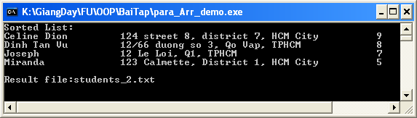
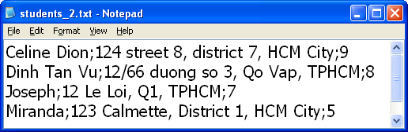
Bonus…

Slide 50
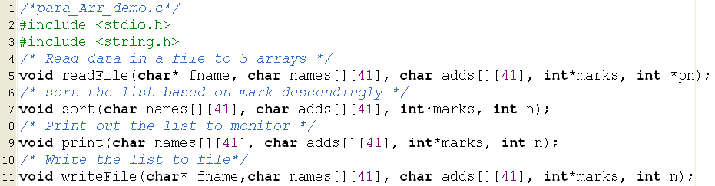
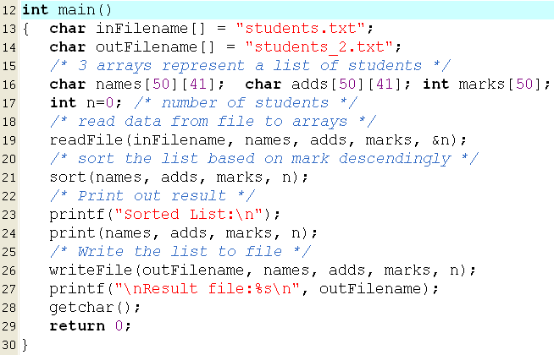
Bonus…

Slide 51
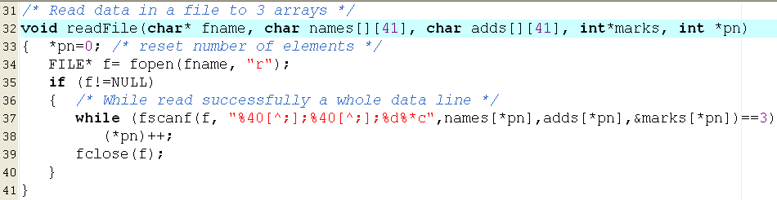
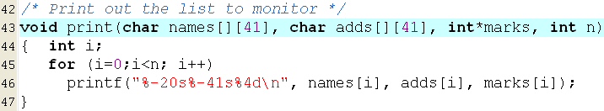
Bonus…

Slide 52
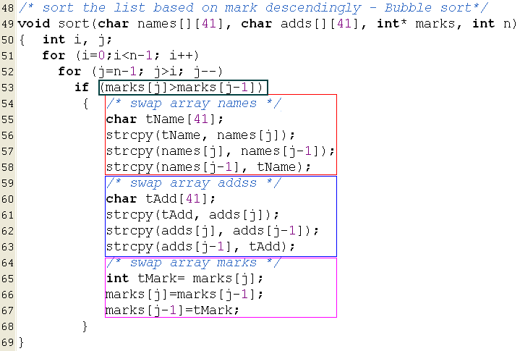
Bonus…

Slide 53
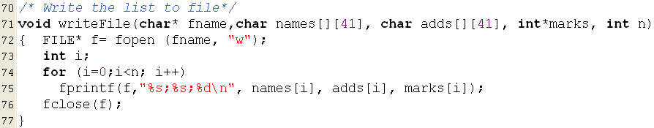

Bonus…

Slide 54
Thank You

