Slide 1
IOT102 PROJECT
Topic 1 - Automatic fire alarm system
use heat, smoke and gas sensors
Nguyen Tuan Anh
SE150633
Nguyen Tran Phong
SE150974
Vo Van Thanh Phuc
SE150980

Slide 2
CONTENTS
01
02
03
INTRODUCTION
DESIGN & IMPLEMENTATION
CONCLUSION & DEVELOPMENT DIRECTIONS
04
DEMONSTRATION

Slide 3
1. INTRODUCTION
75
casualties
Civilian-related
Annual Report of Vietnam’s Police Department of Fire Prevention and Fighting and Rescue in 2020
5000 fire incidients nation-wide
60%
25%
Electrical Malfunctions
Misuse of Heat and Fuel sources

Slide 4

1. INTRODUCTION
Simplicity
Cost-efficiency
Effectiveness
Scalability

Slide 5






1. INTRODUCTION
A fire is detected within the specified range
Environments where fire is least expected to combust
Fire Sensors
Heat Sensors
Temperature increased exceeded the designated value
TRIGGER
ALARM
ALARM
Gas Source
Gas Sensors
Gas concentration exceeds the safe recommended value of 1000ppm
DISABLE
Built-in RESET Button on the Arduino
Deactivating the Power Supply

Slide 6
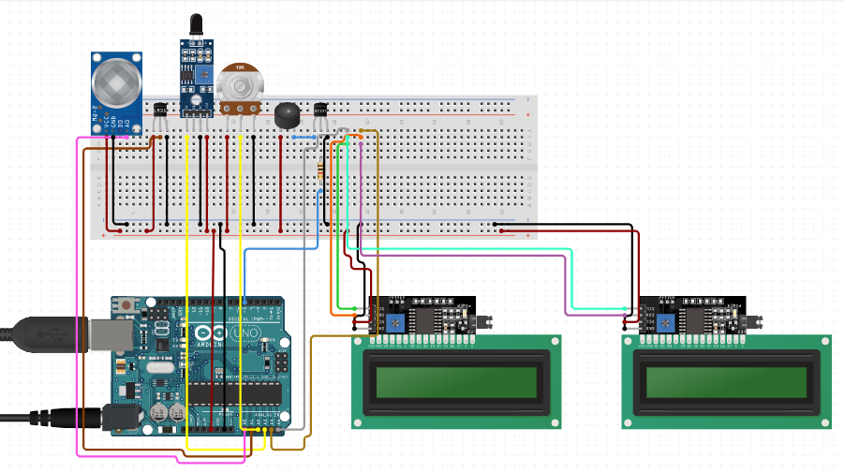
2. DESIGN & IMPLEMENTATION
Wiring connectivity

Slide 7
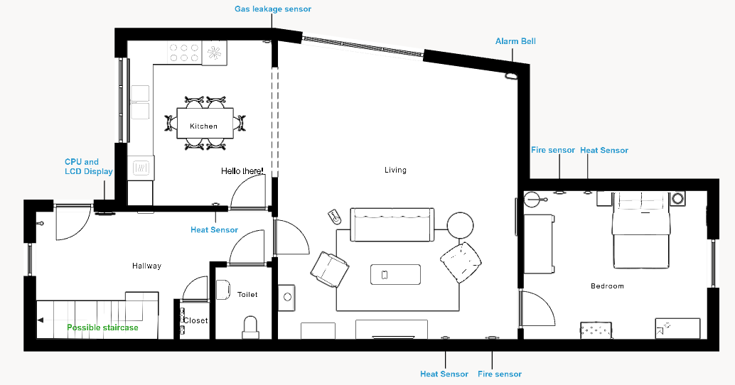
2. DESIGN & IMPLEMENTATION
Household implementation

Slide 8
2. DESIGN & IMPLEMENTATION

Slide 9
3. CONCLUSION & DEVELOPMENT DIRECTIONS
The system worked as intended.
Flame detected within an acceptable distance.
Preempt most situations, which can, at times, lead to false alarms.
Gas leakage detection is dependent on external factors such as winds and humidity. Requires further calibrations.
Alarm bell is dependent on the main power source to operate, no backup power due to time limitation. Requires further subsidiary.
The fire sensor does not cover a comparatively wide angle.

Slide 10
3. CONCLUSION & DEVELOPMENT DIRECTIONS
Expected cost is reasonably afforable.
The system is relatively simple to implement in a practical setting.
Can be further improved via the usage of more advanced and precise measument modules.

Slide 11
3. CONCLUSION & DEVELOPMENT DIRECTIONS
REQUIREMENT ANALYSIS
Simplicity is prioritised. User can manually disable the system.
Must cover most scenarios, considerate of false alarms.
Integrable despite hardware changes.

Slide 12
3. CONCLUSION & DEVELOPMENT DIRECTIONS
DECISION FLOWCHART
System started
Continuously measure the environment
Gas
detected
Temperature
exceeds
threshold
Fire detected
No
Yes
User
disables
alarm
User
disables
alarm
Alarm is activated
System terminated
Yes
Yes

Slide 13
3. CONCLUSION & DEVELOPMENT DIRECTIONS
PSUEDO CODE
Lcd.start();
defaultTempThreshold = read(potentiometed);
While(systemNotTerminated) { // begin While
Lcd.display(defaultTempThreshold);
currentGas = read(gasSensor);
currentTemp = read(heatSensor);
currentFire = read(fireSensor);
Lcd.display(currentTemp);
If(currentGas == true) {
Alarm();
}
else if (currentTemp >= defaultTempThreshold)
{
Alarm();
}
else if (currentFire == true) {
Alarm();
}
} // End While

