Slide 1
IOT102 PROJECT
Topic 1 - Automatic fire alarm system
use heat, smoke and gas sensors
Nguyen Tuan Anh
SE150633
Nguyen Tran Phong
SE150974
Vo Van Thanh Phuc
SE150980

Slide 2
CONTENTS
01
02
03
INTRODUCTION
DESIGN & IMPLEMENTATION
CONCLUSION & DEVELOPMENT DIRECTIONS
04
DEMONSTRATION

Slide 3
1. INTRODUCTION
75
casualties
Civilian-related
Annual Report of Vietnam’s Police Department of Fire Prevention and Fighting and Rescue in 2020
5000 fire incidients nation-wide
60%
25%
Electrical Malfunctions
Misuse of Heat and Fuel sources

Slide 4

1. INTRODUCTION
Simplicity
Cost-efficiency
Effectiveness
Scalability

Slide 5






1. INTRODUCTION
A fire is detected within the specified range
Environments where fire is least expected to combust
Fire Sensors
Heat Sensors
Temperature increased exceeded the designated value
TRIGGER
ALARM
ALARM
Gas Source
Gas Sensors
Gas concentration exceeds the safe recommended value of 1000ppm
DISABLE
Built-in RESET Button on the Arduino
Deactivating the Power Supply

Slide 6
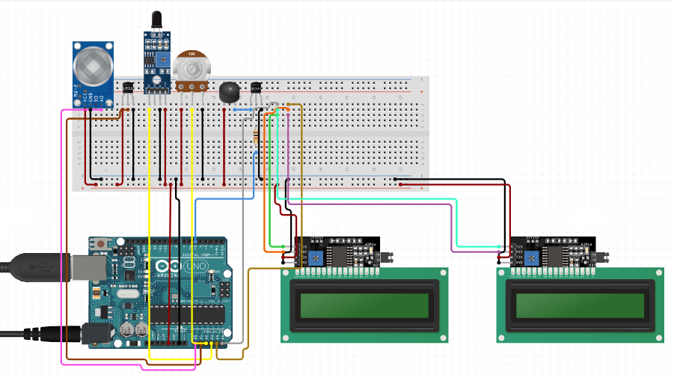
2. DESIGN & IMPLEMENTATION
Wiring connectivity

Slide 7
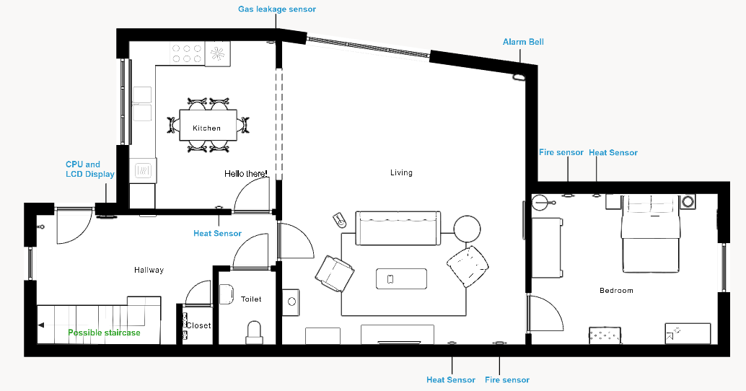
2. DESIGN & IMPLEMENTATION
Household implementation

Slide 8
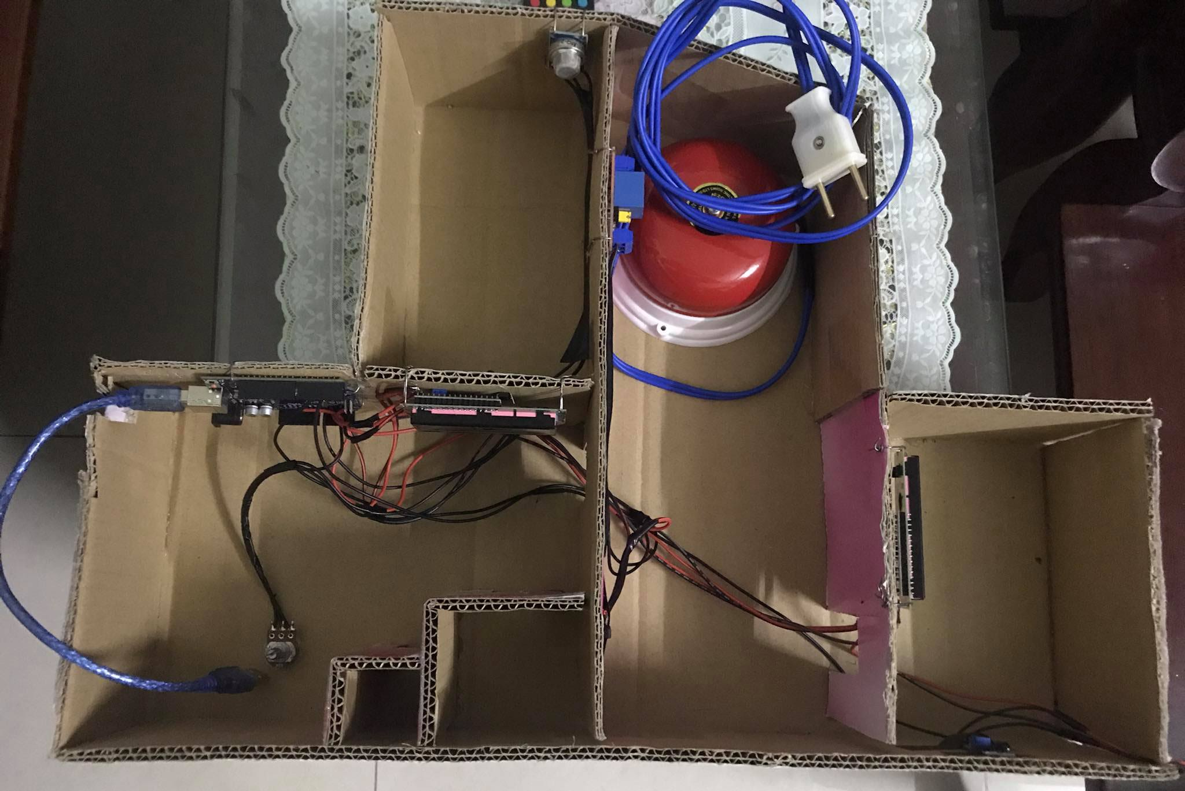
2. DESIGN & IMPLEMENTATION

Slide 9
3. CONCLUSION & DEVELOPMENT DIRECTIONS
The system worked as intended.
Flame detected within an acceptable distance.
Preempt most situations, which can, at times, lead to false alarms.
Gas leakage detection is dependent on external factors such as winds and humidity. Requires further calibrations.
Alarm bell is dependent on the main power source to operate, no backup power due to cost limitation. Requires further subsidiary.
The fire sensor does not cover a comparatively wide angle.

Slide 10
3. CONCLUSION & DEVELOPMENT DIRECTIONS
DECISION FLOWCHART
System started
Continuously measure the environment
Gas
detected
Temperature
exceeds
threshold
Fire detected
No
Yes
User
disables
system
User
disables
alarm
Alarm is activated
System terminated
Yes
Yes

Slide 11
3. CONCLUSION & DEVELOPMENT DIRECTIONS
PSEUDO CODE
lcd.start();
defaultTempThreshold = read(potentiometed);
while(systemNotTerminated){
lcd.display(defaultTempThreshold);
currentGas = read(gasSensor);
currentTemp = read(heatSensor);
currentFire = read(fireSensor);
lcd.display(currentTemp);
if(currentGas == true){
alarm();
}
else if(currentTemp >= defaultTempThreshold){
alarm();
}
else if(currentFire == true){
alarm();
}
}

Slide 12
3. CONCLUSION & DEVELOPMENT DIRECTIONS
SOURCE CODE
#include "LiquidCrystal_I2C.h"
const int DANGEROUS_GAS = 1000;
int interval = 1000;
int potPinDef = A3;
int defHeatValue;
int gasPin = A0; int gasValue;
int firePin = 2; int fireValue;
int heatPin = A1; int heatValue;
int bellPin = 4;
//Create the LCD object
LiquidCrystal_I2C lcd(0x27, 16, 2);
void setup() {
pinMode(firePin,INPUT);
//Set up the LCD's rows and columns
lcd.init();
lcd.backlight();
//Activate bell's digital pin
pinMode(bellPin,OUTPUT);
lcd.print("Welcome! Welcome!");
delay(interval);
}

Slide 13
3. CONCLUSION & DEVELOPMENT DIRECTIONS
SOURCE CODE
#include "LiquidCrystal_I2C.h"
const int DANGEROUS_GAS = 1000;
int interval = 1000;
int potPinDef = A3;
int defHeatValue; int defGasValue;
int gasPin = A0; int gasValue;
int firePin = 2; int fireValue;
int heatPin = A1; int heatValue;
int bellPin = 4;
//Create the LCD object
LiquidCrystal_I2C lcd(0x27, 16, 2);
void alarm(){
digitalWrite(bellPin,HIGH);
delay(3000);
digitalWrite(bellPin,LOW);
}

Slide 14
3. CONCLUSION & DEVELOPMENT DIRECTIONS
SOURCE CODE
#include "LiquidCrystal_I2C.h"
const int DANGEROUS_GAS = 1000;
int interval = 1000;
int potPinDef = A3;
int defHeatValue; int defGasValue;
int gasPin = A0; int gasValue;
int firePin = 2; int fireValue;
int heatPin = A1; int heatValue;
int bellPin = 4;
//Create the LCD object
LiquidCrystal_I2C lcd(0x27, 16, 2);
void displayTemp(int reading){
delay(interval);
lcd.clear();
//Set the LCD to start displaying on the first row
lcd.setCursor(0,0);
//Display the threshold value
lcd.print("THRESHOLD(C):");
lcd.print(defHeatValue);
//Set the LCD to start displaying on the second row
lcd.setCursor(0,1);
//Print out current temperature
lcd.print("CURRENT(C):");
lcd.print(reading);
//Room's temperature exceeds specified value
if(reading > defHeatValue){
lcd.setCursor(0,0);
lcd.print("MAXIMUM EXCEEDED!");
alarm();
}
}

Slide 15
3. CONCLUSION & DEVELOPMENT DIRECTIONS
SOURCE CODE
void displayGas(int reading){
delay(interval);
lcd.clear();
//No gas leakage yet
if(reading < DANGEROUS_GAS){
lcd.setCursor(0,0);
lcd.print(" NORMAL STATUS");
}
//Gas leakage exceeds the recommended level
else if(reading >= DANGEROUS_GAS){
lcd.setCursor(0,0);
lcd.print(" GAS DETECTED!");
alarm();
}
}
#include "LiquidCrystal_I2C.h"
const int DANGEROUS_GAS = 1000;
int interval = 1000;
int potPinDef = A3;
int defHeatValue; int defGasValue;
int gasPin = A0; int gasValue;
int firePin = 2; int fireValue;
int heatPin = A1; int heatValue;
int bellPin = 4;
//Create the LCD object
LiquidCrystal_I2C lcd(0x27, 16, 2);

Slide 16
3. CONCLUSION & DEVELOPMENT DIRECTIONS
SOURCE CODE
void displayFire(int reading){
delay(interval);
lcd.clear();
//No fire detected
if(reading == 0){
lcd.setCursor(0,1);
lcd.print(" NO FLAME");
}
//A fire's IR is sufficient to decrease the sensor's thermal resistance
else{
lcd.setCursor(0,1);
lcd.print("FLAME DETECTED");
alarm();
}
}
#include "LiquidCrystal_I2C.h"
const int DANGEROUS_GAS = 1000;
int interval = 1000;
int potPinDef = A3;
int defHeatValue; int defGasValue;
int gasPin = A0; int gasValue;
int firePin = 2; int fireValue;
int heatPin = A1; int heatValue;
int bellPin = 4;
//Create the LCD object
LiquidCrystal_I2C lcd(0x27, 16, 2);

Slide 17
3. CONCLUSION & DEVELOPMENT DIRECTIONS
SOURCE CODE
void loop() {
lcd.clear();
//Read the default thresholds, adjustable with the potentiometer
defHeatValue = (analogRead(potPinDef)*5.0/1024)*100;
//Read the MQ2's sensor values
gasValue = analogRead(gasPin);
//Read the fire sensor values
fireValue = digitalRead(firePin);
//Read the heat sensor values
heatValue = (analogRead(heatPin)*5.0/1024)*100;
displayTemp(heatValue);
displayGas(gasValue);
displayFire(fireValue);
delay(interval);
}
#include "LiquidCrystal_I2C.h"
const int DANGEROUS_GAS = 1000;
int interval = 1000;
int potPinDef = A3;
int defHeatValue; int defGasValue;
int gasPin = A0; int gasValue;
int firePin = 2; int fireValue;
int heatPin = A1; int heatValue;
int bellPin = 4;
//Create the LCD object
LiquidCrystal_I2C lcd(0x27, 16, 2);

Slide 18
4. DEMONSTRATION

Slide 19
REFERENCES
Vietnamese Police Department of Fire Prevention and Fighting and Rescue. (2020). Annual report regarding the process of fire prevention, fighting, and rescue of 2020. Retrieved from: http://canhsatpccc.gov.vn/ArticlesList/tabid/192/cateid/1172/language/vi-VN/default.aspx
Đ.V. Mạnh. (2018). Vietnam’s state of fire incidents in recent years, and preemptive measures to be applied. Retrieved from: http://csnd.vn/Home/Nghien-cuu-Trao-doi/3983/Tinh-hinh-chay-no-o-Viet-Nam-trong-nhung-nam-gan-day-va-mot-so-giai-phap-phong-ngua-ngan-chan
Seeed. (2020). Grove - Gas Sensor (MQ2). Retrieved from: https://wiki.seeedstudio.com/Grove-Gas_Sensor-MQ2/
Proctor NH, Hughes JP, Fischman ML [1988]. Liquified petroleum gas. In: Chemical hazards of the workplace. 2nd ed. Philadelphia, PA: J.B. Lippincott Company, pp. 301, 420-421.

Slide 20
THANK YOU FOR YOUR ATTENTION

