Slide 1
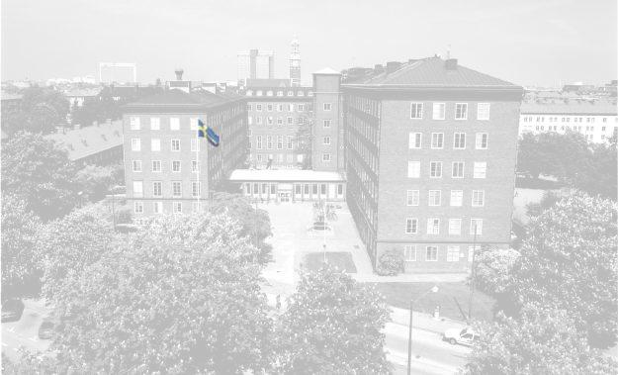



The Virtual Classroom!
Fact and myth
Nikos Mattheos
Centre for Oral Health Sciences, Malmö, Sweden

Slide 2

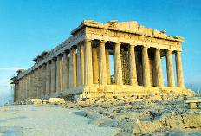

Slide 4

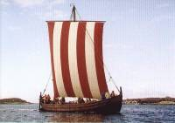
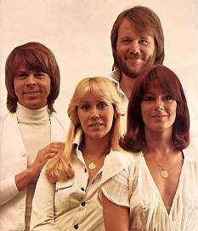
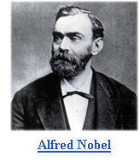
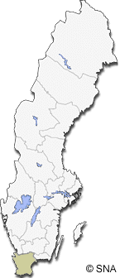




Sweden !

Slide 5
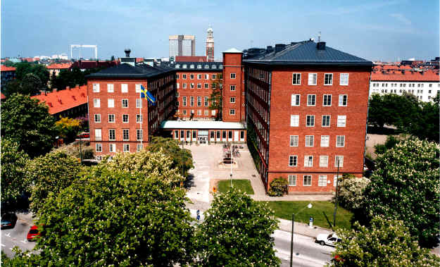
University of Malmö
Centre for Oral health sciences
Dentists
Dental Hygienists
Dental Technicians
Biological Research
Health Informatics Research

Slide 6

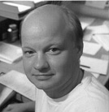
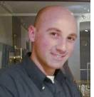
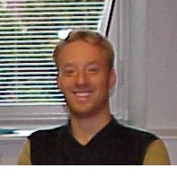


The e-team !!!
Rolf Attström, Professor, Malmö | Anders Nattestad, Assoc. Professor, Copenhagen | Nikos Mattheos, Res. Associate, Malmö | Martin Schittek, Res. Associate, Malmö
Cris. Ramseyer, Res. Associate, Bern | Lorenza Canegallo, Res. Associate, Milan | Daniel Cerny, Res. Associate Prague

Slide 7

Virtual Classrooms
Web - based learning
Cyber learning communities
e-learning
Internet classroom
Virtual Seminar rooms
Virtual Learning Environments
Integrated Distance Learning Environments

Slide 8

In the Classroom…
Interaction
Student – tutor
Student – student
Student – learning resources
Learning resources
students
tutor

Slide 9
Virtual Classroom:
The network environment that can facilitate similar kinds of interaction as in a physical classroom.

Slide 10


The Itajai Virtual Classroom !
Home

Slide 11
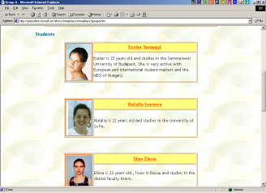
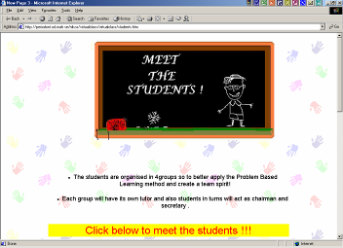
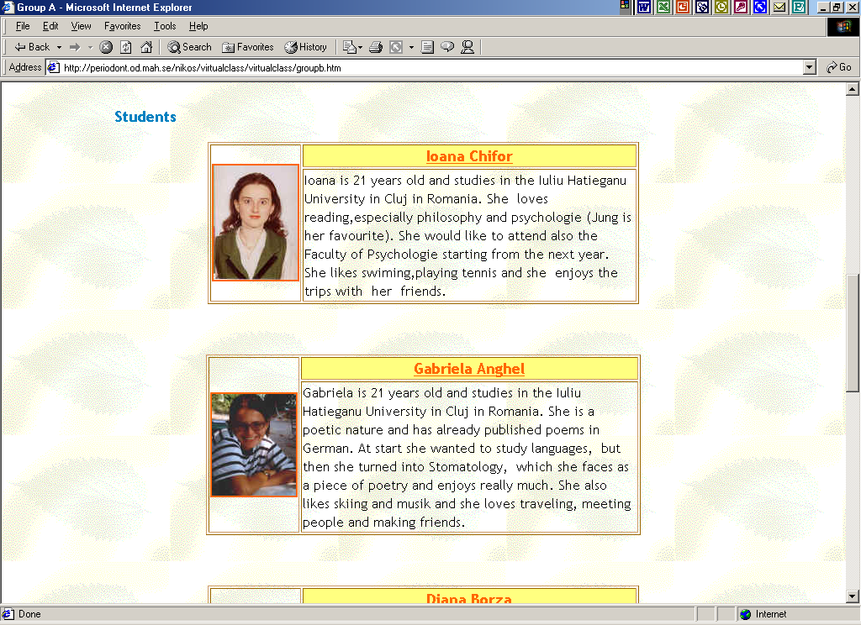
The Itajai Virtual Classroom !
Home
Students

Slide 12

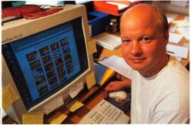
The Itajai Virtual Classroom !
Home
Rolf Attström, DDS, PhD
Professor
Centre for Oral health Sciences,
Malmö, Sweden
Students
Teachers
CV Homepage e-mail links
Anders Nattestad, DDS, PhD Associate professor,
School of Dentstry, University of Copenhagen
CV Homepage e-mail links

Slide 13
The Itajai Virtual Classroom !
Home
Students
Course syllabus
Calendar
On-Line Registration
Addressbooks
Admission requirements
Students’ progress
Teachers
Admin.

Slide 14
The Itajai Virtual Classroom !
Home
Students
Examinations
Learning Golas
Competence and knowledge aquired
Knowledge still to be aquired
Progress in time
Comparisons?
Teachers
Admin.
Portfolio

Slide 15

The Itajai Virtual Classroom !
Home
Students
Teachers
Admin.
Portfolio
Bulletin board
Chat
Virtual beers
News
Homepages
SMS service
Bar !

Slide 16
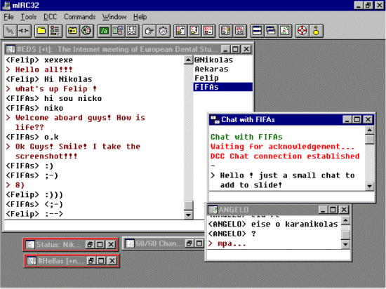
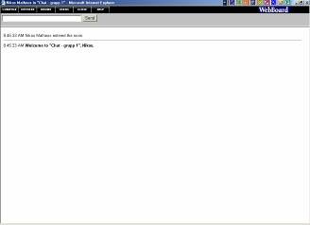
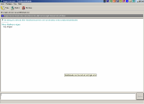

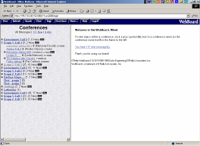
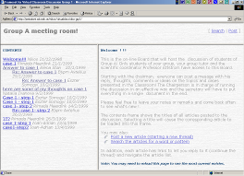
Synchronous communication tools
Asynchronous communication tools

Slide 17
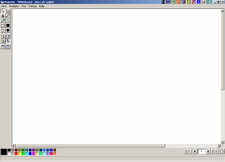
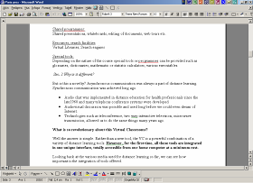
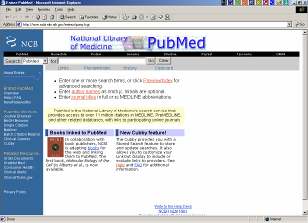
Sharing of programmes and documents
On-line libraries, Search engines

Slide 18
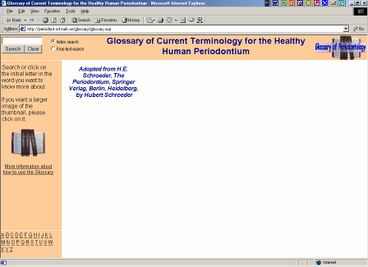
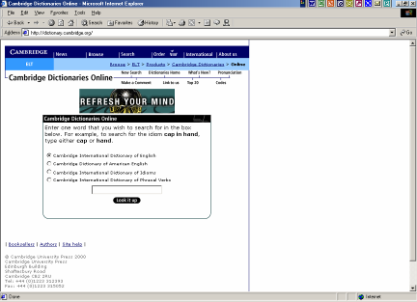
Special tools and CAL programmes

Slide 20
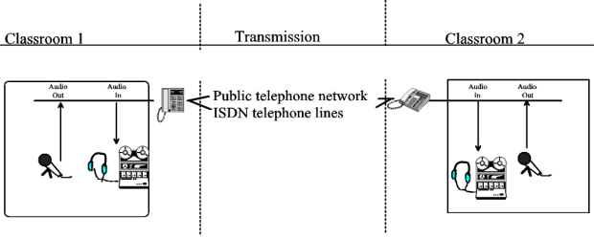
Audio telephone conference as has been used since 1960s:

Slide 21
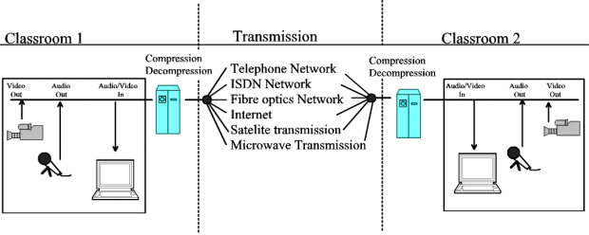
Audiovisual teleconference:

Slide 22
Integrated environment
Simple equipment
Affordable cost

Slide 23
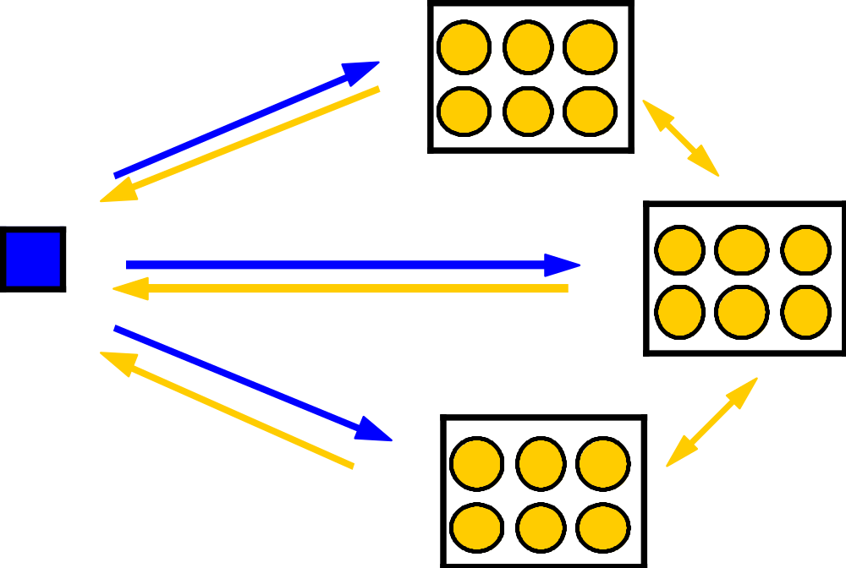
Interaction in a typical teleconference session:

Slide 24
A Virtual Classroom allows the individual student or professional to access the whole learning process from the comfort of his/her home, with only a standard PC and a reasonably fast Internet connection.

Slide 25
The Itajai Virtual Classroom !
How do we build a Virtual Classroom?
The expensive way..!
The less expensive way..!
The least expensive way..!
Notes:
Now how do we build it

Slide 26
The Itajai Virtual Classroom !
How do we build a Virtual Classroom?
The expensive way..!
Server
Programmers
Time
-
+
Very high cost
expert maintennance needed
Don’t re-invent the wheel!
Tailor made
Share or Sell ?

Slide 27
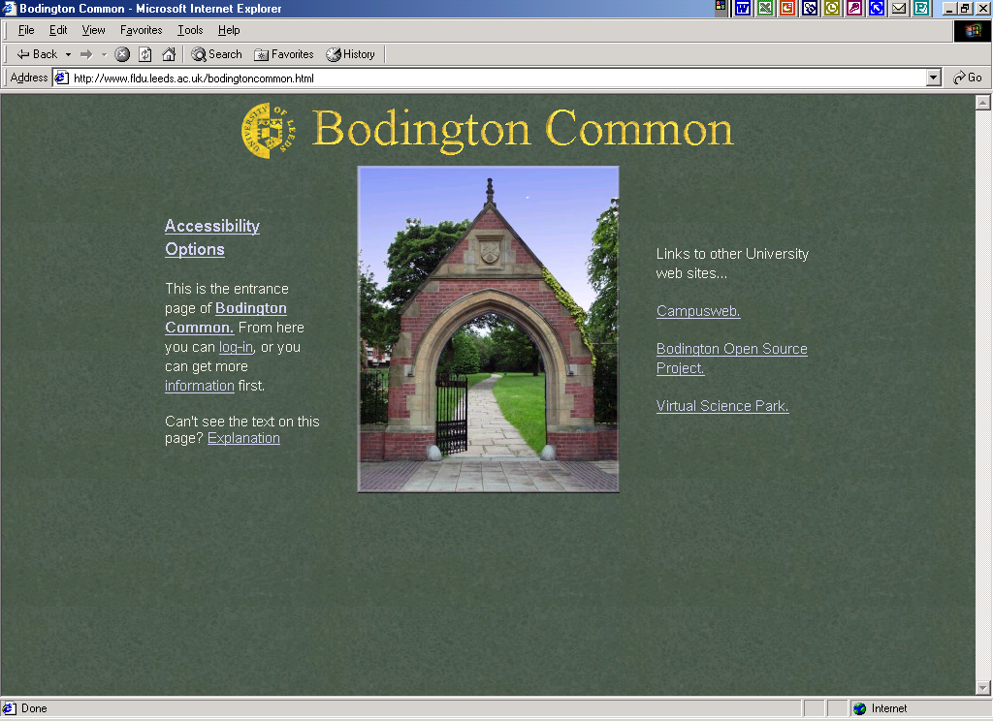

Slide 28
The Itajai Virtual Classroom !
How do we build a Virtual Classroom?
The less expensive way..!
Some commercial Packages:
Aymetrix Librarian
Blackboard
Centra.com
ConveneEmbanet
Cursus
Eduprice.com
First Class
e.College.com
IMserries
IntraLearn
Integrated Virtual Learning
Environment (IVLE)
Serf
LUVIT
Symposium
Softarc
TopClass
The Learning Manager
Lotus Learning Space
Virtual Workspace
Virtual U
WebCT
WebMentor
Webboards

Slide 29
The Itajai Virtual Classroom !
How do we build a Virtual Classroom?
The less expensive way..!
Commercial packages:
+
-
Quick
Easy interface
Technical support
Limited adjustability in technology and method
Need of expert maintenance
Cost ?

Slide 30
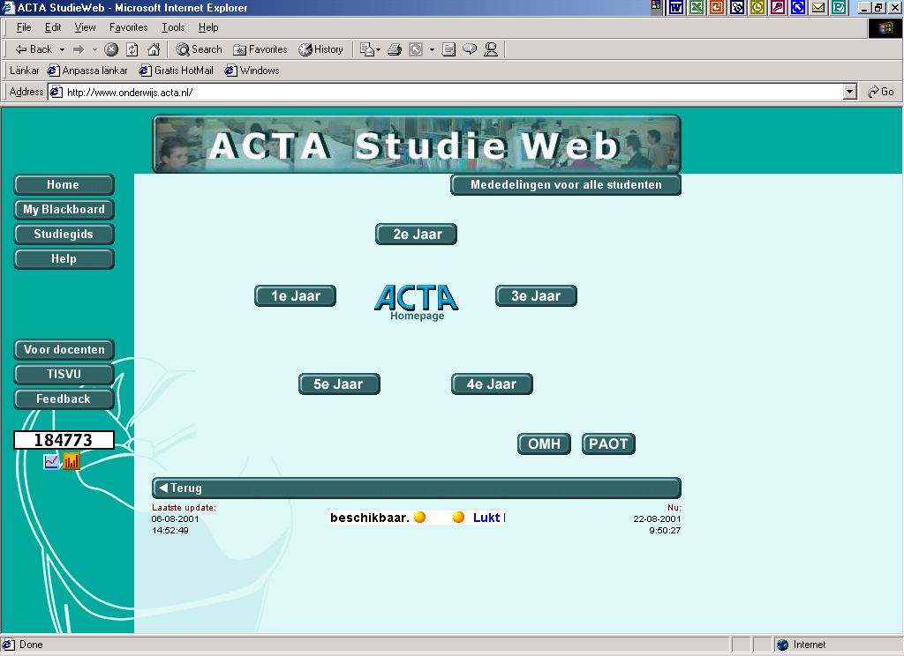

Slide 31
The Itajai Virtual Classroom !
How do we build a Virtual Classroom?
The least expensive way:
Do it Yourself..!

Slide 32


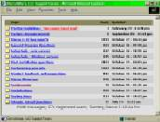









Discus
Web communities
Messenger service

Slide 33
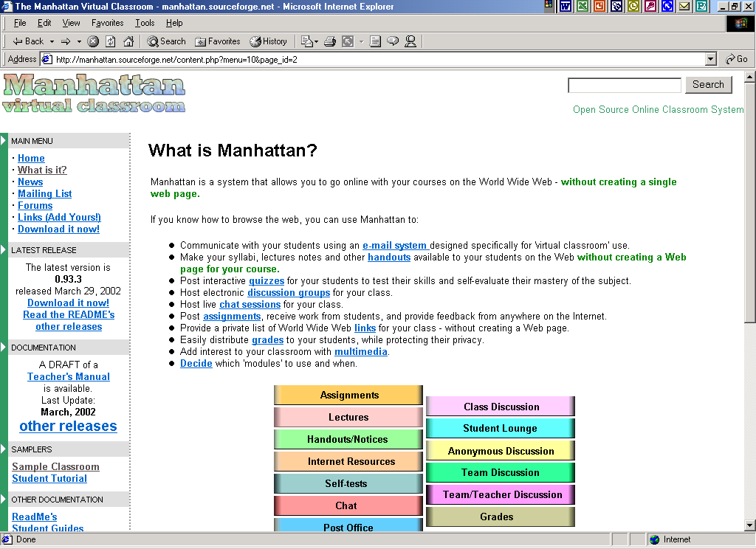

Slide 34
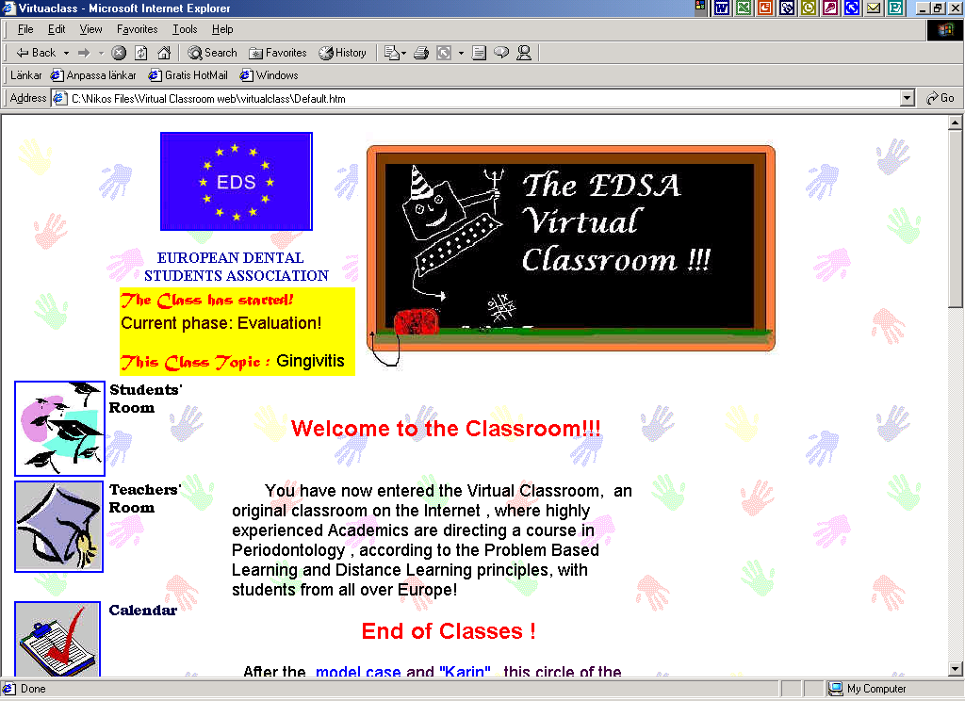

Slide 35
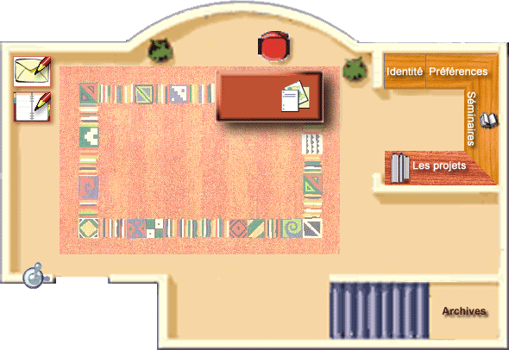
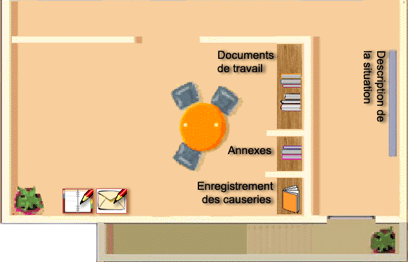
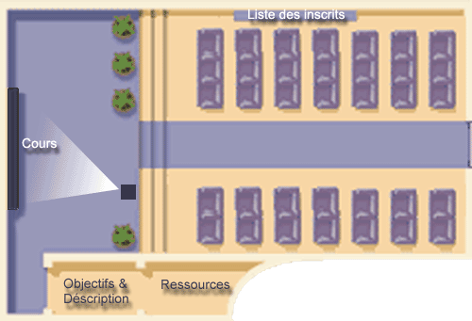
ACOLAD
salon
bureau personnel
amphithéâtre
salle du séminaire
salle des professeurs….

Slide 36
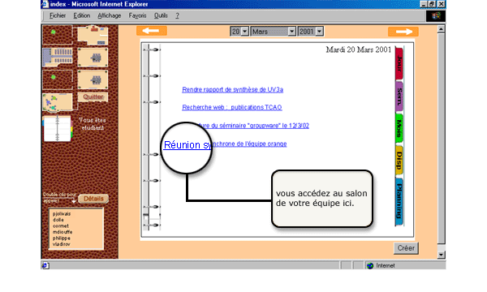
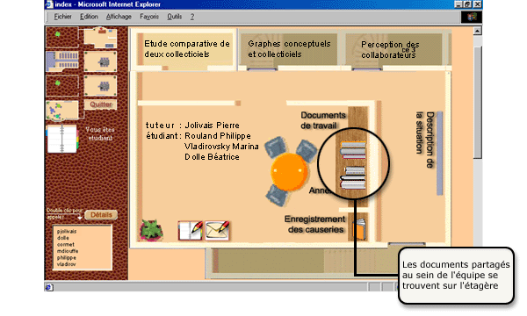
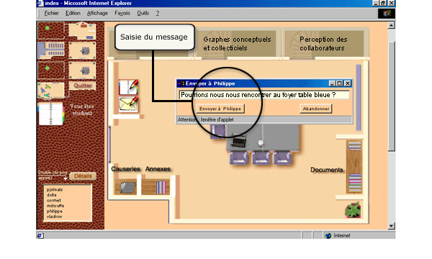
http://acolad.u-strasbg.fr

Slide 37
The Itajai Virtual Classroom !
How do we build a Virtual Classroom?
The alternative way:
Do it yourself..!
+
-
0 cost! (?)
Reasonably adjustable
Easy to support
Functional
Costs time
Limited control over freeware services
Need of evaluation of all offered options
Need for alternatives

Slide 38
The Itajai Virtual Classroom !
Home
Students
Teachers
Admin.
Bar !
What now?

Slide 39



THE SOUP MODEL !
E-mail
Web boards
Search engines
Multimedia
Chat
Audioconference
On-line library

Slide 41

Doing some research
Great ! Increased interaction, higher test results up to 20%, high acceptance of the media, team spirit, learning in less time.
Potential - limitations
Not so good… Lower interaction, student frustrations, inferior results, decreasing acceptance during a course.

Slide 42
Some research results
Similar test scores
Better accommodate students’ diversity
Reaching the ”unreachable”
Added value to in-campus teaching
Factors of importance
Notes:
Added value not only by adding practical flexibility, but also by adding new ways of interaction and reenforcing characteristics such as collaborative…Collaborative Discussion led, Student centred, Resource based learning

Slide 43
Factors of importance in a Virtual Classroom
Before the course:
the course determines the media – not vice versa.
students and tutors must handle the technology
Strict time planning – inform students and tutors on the time they must allocate to the course.

Slide 44
Factors of importance in a Virtual Classroom
During the course:
New media – new methods! Employ active learning PBL, DKN
Groupwork, team spirit, distribution of roles, peer evaluation.
Explore the limitattions of the learning tools. Async. – Sync. Communication contribute in different ways.
Don’t exclude personal contact.
Continuos technical assistance
Adjust the Virtual Classroom to the needs of participants.
Emphasise on the feedback.

Slide 45
Factors of importance in a Virtual Classroom
After the course:
Peer evaluation.
Continuos evaluation of all stages
Study the interaction – assess facts and figures

Slide 46
Future trends:
Reliable and affordable technology
Wide variety of tools for development
Wide variety of courses available
More demanding learner

Slide 47
(David Polard et al, 1999):
Would you pay £50 for a computer based continuous education module ?
1993: 50%
1994: 60%.
1995 37%
1998
5% with the vast majority drawing the line at £20.
Notes:
So those of you who think there is an “easy” market out there, better prepare yourselves for a disilusionment phase

Slide 48
Future trends:
Reliable and affordable technology
Wide variety of tools for development
Wide variety of courses available
More demanding learner
Methodological framework – Evaluation framework
”Smart” database driven web applications will undertake important part of the interaction

Slide 49

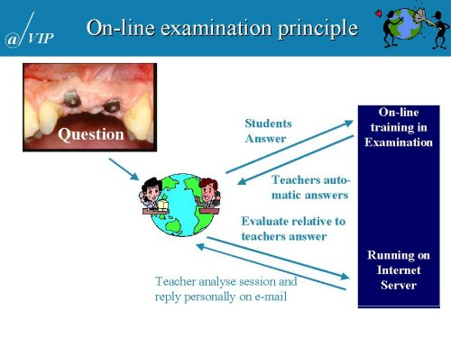
Anders Nattestad, Associate professor,
School of Dentistry, University of Copenhagen

Slide 50


e-fraid …
e-nthusiasts !
Notes:
As the novelty will soon expire and people move beyond the bias of the media, the real potential of virtual classrooms will be unrolled.

Slide 51
Thank you !

