Slide 1
Sec:3.3
Fixed- Point Iteration

Slide 2
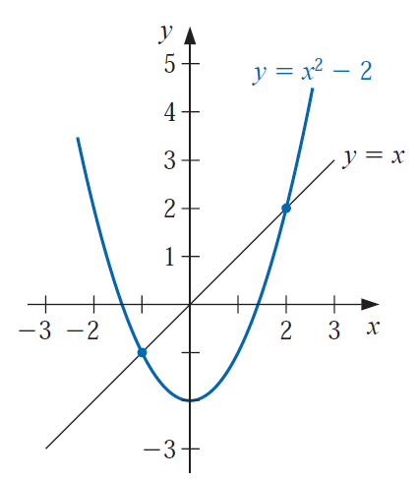
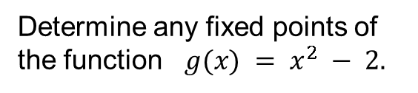

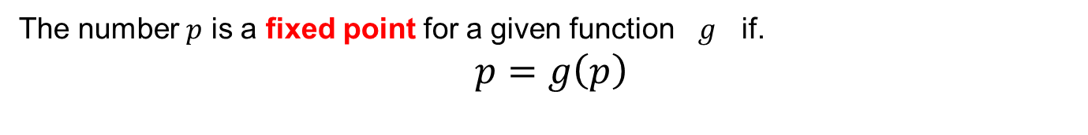




Sec:3.3 Fixed- Point Iteration
The number $p$ is a fixed point for a given function $g$ if.
$p=g\left(p\right)$
Example:
A fixed point for g occurs precisely when the graph of $y = g(x)$intersects the graph of $y = x$
Determine any fixed points of the function $g(x) = x^{2} − 2.$
solution
$$p=g(p)$$
$$p= p^{2} − 2$$
$$0= p^{2} −p− 2$$
$$p=−1, p=2$$

Slide 3
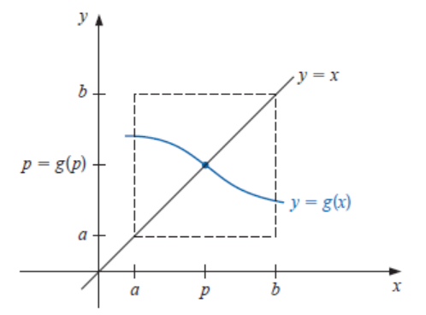
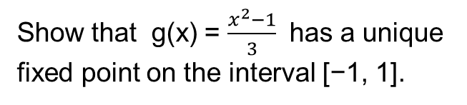
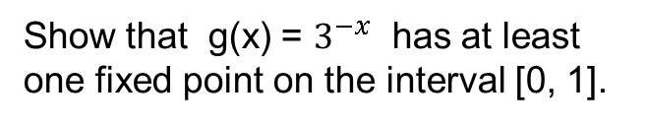
Sec:3.3 Fixed- Point Iteration
Theorem 2.3
(i) If g ∈ C[a, b] and g(x) ∈ [a, b] for all x ∈ [a, b], then g has at least one fixed point in [a, b].
(ii) If, in addition, g(x) exists on (a, b) and a positive constant k < 1 exists with
|g’(x)| ≤ k, for all x ∈ (a, b),
then there is exactly one fixed point in [a, b].
Example
Show that g(x) = $\frac{x^{2}−1}{3}$ has a unique fixed point on the interval [−1, 1].
Example
Show that g(x) = $3^{−x}$ has at least one fixed point on the interval [0, 1].

Slide 4

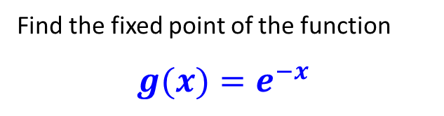









Sec:3.3 Fixed- Point Iteration
The number $p$ is a fixed point for a given function $g$ if.$p=g\left(p\right)$
Example
$$p_{n}$$
$$n$$
Find the fixed point of the function
$g(x)=e^{−x}$
1 0.0000000000000
2 1.0000000000000
3 0.3678794411714
4 0.6922006275553
5 0.5004735005636
6 0.6062435350856
7 0.5453957859750
8 0.5796123355034
9 0.5601154613611
10 0.5711431150802
11 0.5648793473910
12 0.5684287250291
$$p_{i+1}=g(p_{i} )$$
$p_{i+1}=e^{−p_{i}}$
Starting with an initial guess of p0 = 0
$$p_{1}=g\left(p_{0} \right)=e^{−0}=1$$
$$p_{2}=g\left(p_{1} \right)=e^{−1}=0.367879$$
$$p_{3}=g\left(p_{2} \right)=e^{−0.367879}=0.692201$$
Thus, each iteration brings the estimate closer to the true fixed point: 0.56714329
$$⋮$$
$$⋮$$
$$⋮$$
$$⋮$$

Slide 5
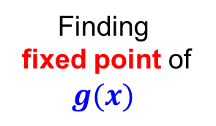

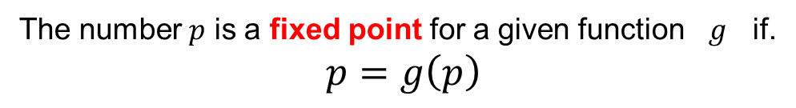
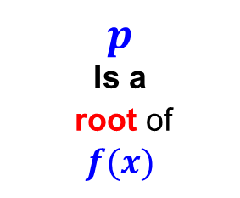

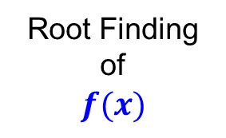
Sec:3.3 Fixed- Point Iteration
The number $p$ is a fixed point for a given function $g$ if.
$p=g\left(p\right)$
Finding
fixed point of $g(x)$
Root Finding of
$$f(x)$$
$$p$$
Is a
fixed point of $g(x)$
$$p$$
Is a
root of
$$f(x)$$
$$f (x) = x − g(x)$$

Slide 6

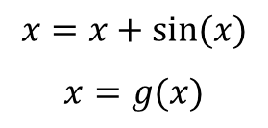
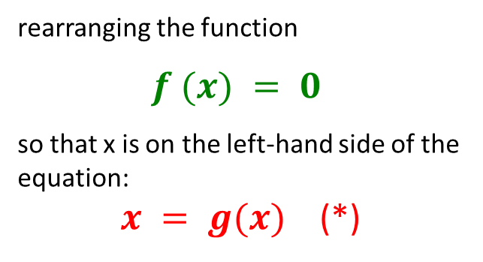

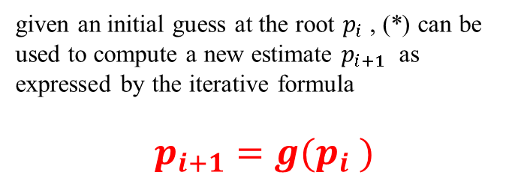

Sec:3.3 Fixed- Point Iteration
simple fixed-point iteration
Example1
$$x^{2} − 2x + 3 = 0$$
can be simply manipulated to yield
Step 1
$x=\frac{x^{2} + 3}{2}$
$$x=g(x)$$
rearranging the function
$$f (x) = 0$$
so that x is on the left-hand side of the equation:
$x = g(x)$ (*)
Example2
$$sin⁡(x)= 0$$
can be simply manipulated to yield
$$x=x+sin⁡(x)$$
$$x=g(x)$$
Step 2
given an initial guess at the root $p_{i}$ , (*) can be used to compute a new estimate $p_{i+1}$ as expressed by the iterative formula
$$p_{i+1}=g(p_{i} )$$
Note
Convert the problem from root-finding to finding fixed-point

Slide 7












Sec:3.3 Fixed- Point Iteration
Step 1
Example1
rearranging the function
$x=e^{−x}$
$x=g(x)$
Use simple fixed-point iteration to locate the root of
$$f\left(x\right)=e^{−x}−x$$
Step 2
$$n$$
$$p_{n}$$
$$p_{i+1}=g(p_{i} )$$
1 0.0000000000000
2 1.0000000000000
3 0.3678794411714
4 0.6922006275553
5 0.5004735005636
6 0.6062435350856
7 0.5453957859750
8 0.5796123355034
9 0.5601154613611
10 0.5711431150802
11 0.5648793473910
12 0.5684287250291
$p_{i+1}=e^{−p_{i}}$
Starting with an initial guess of p0 = 0
$$x_{1}=g\left(p_{0} \right)=e^{−0}=1$$
$$p_{2}=g\left(p_{1} \right)=e^{−1}=0.367879$$
$$p_{3}=g\left(p_{2} \right)=e^{−0.367879}=0.692201$$
$$⋮$$
$$⋮$$
$$⋮$$
$$⋮$$
Thus, each iteration brings the estimate closer to the true value of the root: 0.56714329

Slide 8



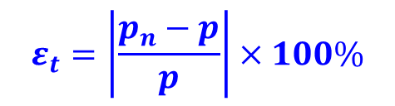

Sec:3.3 Fixed- Point Iteration
$$ε_{t}=\left|\frac{p_{n}−p}{p}\right|×100\%$$
clear; clc; format long
p(1) = 0;
g = @(x) exp(-x);
true_root = 0.56714329;
for k=1:11
p(k+1) = g( p(k) );
rel=abs( (p(k) - true_root )/ true_root );
fprintf('%d %10.4f %10.4f\n', k,p(k),rel);
end
$$n$$
$$p_{n}$$
$$ε_{t}(\%)$$
1 0.0000000000000 100.00
2 1.0000000000000 76.32
3 0.3678794411714 35.13
4 0.6922006275553 22.05
5 0.5004735005636 11.75
6 0.6062435350856 6.89
7 0.5453957859750 3.83
8 0.5796123355034 2.19
9 0.5601154613611 1.23
10 0.5711431150802 0.70
11 0.5648793473910 0.39
12 0.5684287250291 0.22
Notice that the true percent relative error for each iteration is roughly proportional (by a factor of about 0.5 to 0.6) to the error from the previous iteration. This property, called linear convergence

Slide 9
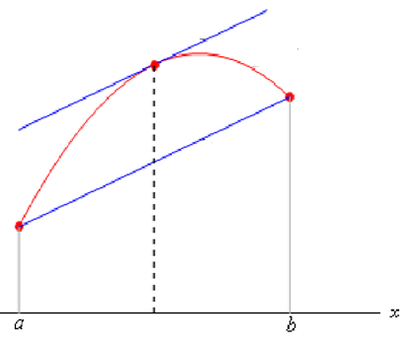


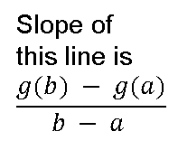
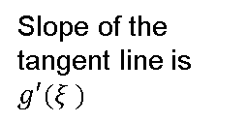

Sec:3.3 Fixed- Point Iteration
The derivative mean-value theorem states that if a function $g(x)$ and its first derivative are continuous over an interval $a ≤ x ≤ b$, then there exists at least one value of $x= ξ$within the interval such that
$$g′(ξ ) = \frac{g(b) − g(a)}{b − a }$$
The right-hand side of this equation is the slope of the line joining $g(a)$ and $g(b)$.
$$g\left(b\right)− g\left(a\right)=g^{′}\left(ξ \right)(b−a)$$
Slope of the tangent line is
$g′(ξ )$
Slope of this line is
$$\frac{g(b) − g(a)}{b − a }$$
$$ξ$$

Slide 10











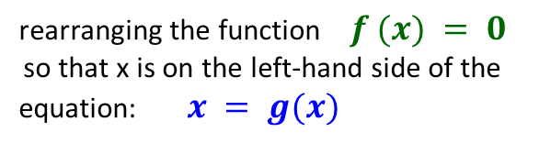



Convergence
Sec:3.3 Fixed- Point Iteration
Suppose that the true solution is
$$\left|E_{n+1}\right|=\left|g′\left(ξ\right)\right|∙\left|E_{n}\right|$$
$p=g(p)$
the iterative equation is
$$<k\left|E_{n}\right|$$
( If $\left|g\left(ξ\right)\right|≤k$, $k<1$ )
$p_{n+1}=g(p_{n})$
the errors decrease with each iteration
Subtracting these equations yields
$$\left|E_{n+1}\right|<\text{k}\left|E_{n}\right|$$
$p−p_{n+1}=g\left(p\right)−g(p_{n})$
$$\left|E_{10}\right|<k\left|E_{9}\right|<⋯<k^{9}\left|E_{1}\right|<k^{10}\left|E_{0}\right|$$
The derivative mean-value theorem gives
$$\left|E_{n}\right|<k^{n}\left|E_{0}\right|$$
$p−p_{n+1}=g′\left(ξ\right)($ $p−p_{n}$)
where $ξ$ is somewhere between $p$ and $p_{n}$
Step 1
rearranging the function $f (x) = 0$
so that x is on the left-hand side of the equation: $x = g(x)$
If the true error for iteration n is defined as
$$E_{n}=p−p_{n}$$
$$E_{n+1}=g′\left(ξ\right)E_{n}$$
Select $g\left(x\right) so that$
$\left|g′\left(ξ\right)\right|<1$
$$\left|E_{n+1}\right|=\left|g′\left(ξ\right)\right|∙\left|E_{n}\right|$$

Slide 11

Sec:3.3 Fixed- Point Iteration
Theorem 2.4 (Fixed-Point Theorem)
Let g ∈ C[a, b] be such that g(x) ∈ [a, b], for all x in [a, b]. Suppose, in addition, that g’ exists on (a, b) and that a constant 0 < k < 1 exists with
|g(x)| ≤ k, for all x ∈ (a, b).
Then for any number p0 in [a, b], the sequence defined by
pn = g( pn−1), n ≥ 1,
converges to the unique fixed point p in [a, b].
Corollary 2.5
If g satisfies the hypotheses of Theorem 2.4, then bounds for the error involved in using pn to approximate p are given by
| pn − p| ≤ $k^{n}$max{ p0 − a, b − p0} (2.5)
and
| pn − p| ≤ $\frac{k^{n}}{1−k}$| p1 − p0|, for all n ≥ 1. (2.6)
Two important error equation

Slide 12

Sec:3.3 Fixed- Point Iteration
Corollary 2.5
If g satisfies the hypotheses of Theorem 2.4, then bounds for the error involved in using pn to approximate p are given by
| pn − p| ≤ $k^{n}$max{ p0 − a, b − p0} (2.5)
and
| pn − p| ≤ $\frac{k^{n}}{1−k}$| p1 − p0|, for all n ≥ 1. (2.6)
Remark 1
The smaller the value of k, the faster the convergence, which may be very slow if k is close to 1,
Remark 2
the rate at which { pn } converges

Slide 13
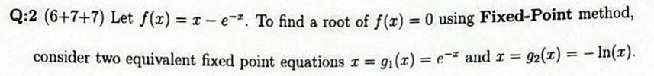
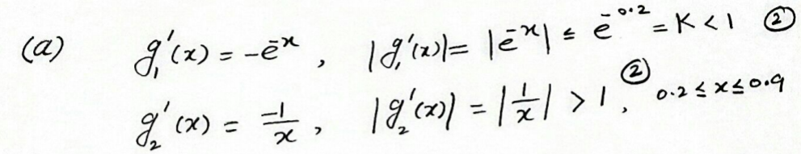



Sec:3.3 Fixed- Point Iteration
The function g(x) is decreasing
$$g\left(0.2\right)=0.8187$$
$$\left[0.407, 0.8187\right]⊂[0.2, 0.9]$$
$$g\left(0.9\right)=0.407$$
g(x) ∈ [a, b], for all x in [a, b]

Slide 14
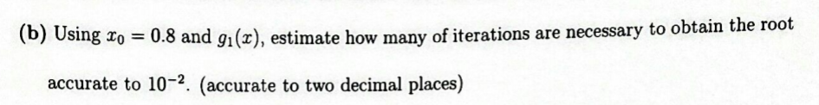


















Sec:3.3 Fixed- Point Iteration
| pn − p| ≤ $k^{n}$max{ p0 − a, b − p0} (2.5)
| pn − p| ≤ $\frac{k^{n}}{1−k}$| p1 − p0|, for all n ≥ 1. (2.6)
| pn − p| ≤ ${(e^{−0.2})}^{n}$max{ 0.8 − 0.2, 0.9 − 0.8}
| pn − p| ≤ $\frac{{(e^{−0.2})}^{n}}{1−e^{−0.2}}\left|0.449328964117222−0.8\right|$
| pn − p| ≤ ${(e^{−0.2})}^{n}${ 0.6 }
| pn − p| ≤ $\frac{{(e^{−0.2})}^{n}}{1−e^{−0.2}}$ {0.350671035882778}
$$≤{10}^{−2}$$
| pn − p| ≤ ${(e^{−0.2})}^{n} \{ 0.6 \}$
$$≤{10}^{−2}$$
$$e^{−0.2 n}≤\frac{{10}^{−2}(1−e^{−0.2})}{\text{0.350671035882778}}$$
$$e^{−0.2 n}≤\frac{{10}^{−2}}{0.6}$$
$$−0.2 n≤ln(\frac{{10}^{−2}(1−e^{−0.2})}{\text{0.350671035882778}})$$
$$→ n≥26.3251$$
$$−0.2 n≤ln(\frac{{10}^{−2}}{0.6})$$
$$→ n≥20.4717$$
$$→ n=27$$
$$→ n=21$$

Slide 15
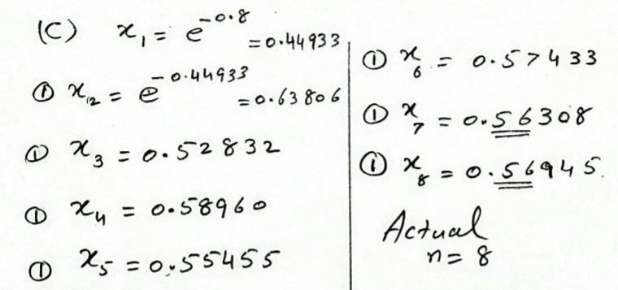
Sec:3.3 Fixed- Point Iteration
0.800000000000000
0.449328964117222
0.638056166582019
0.528318389507880
0.589595606670415
0.554551496322640
0.574329792464196
0.563082124256065
0.569451236849996
0.565835863387710
0.567885273811935
0.566722635580408
0.567381912159020
0.567007973831140
0.567220039492037
0.567099764353053
0.567167976458056
0.567129290055947
0.567151230672109
0.567138787161161
0.567145844402776
0.567141841931644
0.567144111905037
0.567142824504454
0.567143554644927
0.567143140550615
0.567143375401412
0.567143242207354
0.567143317747469
0.567143274905399
0.567143299202992
0.567143285422775
0.567143293238132
0.567143288805705
0.567143291319526
0.567143289893829
0.567143290702404
0.567143290243826
0.567143290503906
0.567143290356403
0.567143290440058

