Slide 1
Analytical Geometry and Linear Algebra 1
Cross product
Dot product

Slide 2
Цели пары
6ая задача решается так же, если возвести все то выражение в квадрат и заметить, что она собирается как нам надо (a+b+c)^2 в конце дас ab+bc+...
Так же ее можно решить графически (там получается равносторонний треугольник с 60 градусами углом (не 60 а 180 - 60 если точнее).

Slide 3
Questions from the class
No questions for today

Slide 4
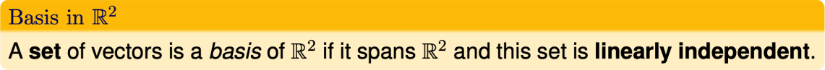
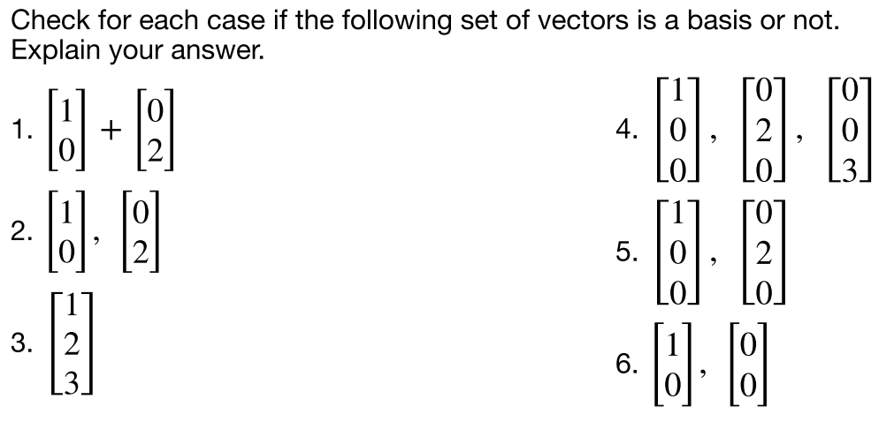
Lab 1, Task 3: answers
—
—
—
—

Slide 5
Lab objectives, 1st part
What does cross product mean?
How to calculate it?
What the properties of cross product, how to use it?

Slide 6
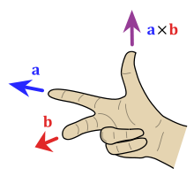
Cross product: Definition
a × b is defined as a vector c that is
perpendicular (orthogonal) to both a and b, with:
direction given by the right-hand rule
magnitude equal to the area of the parallelogram that the vectors span

Slide 7
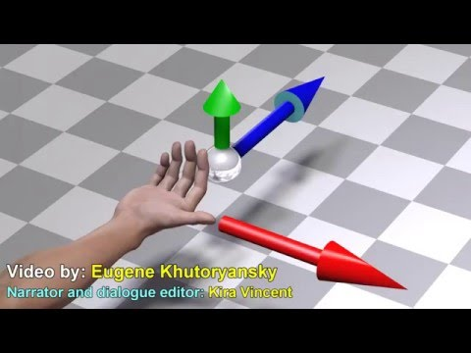

Slide 8
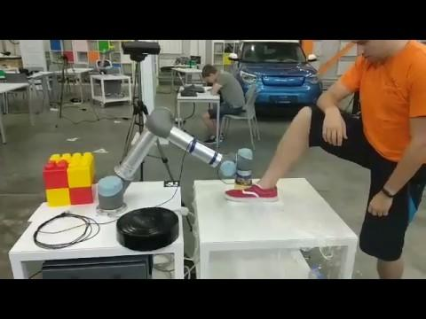

Slide 9
Cross product: where it can be used?
Physics: angular velocity, torque
Find a vector, which are perpendicular to the plane
Find a square of parallelogram

Slide 10
How to calculate it?
2 Approaches for full vector:
Classical one
Using skew-symmetric matrix
1 Approach for only magnitude:
Geometrical representation

Slide 11
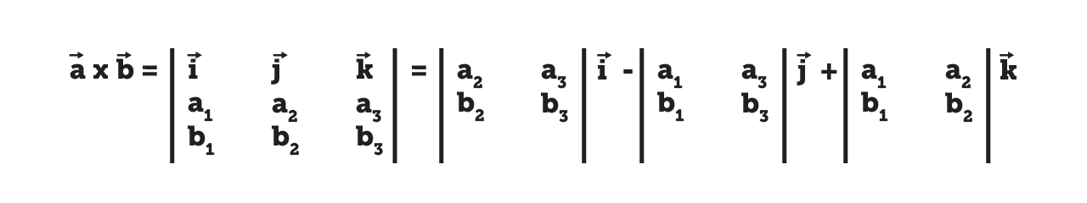
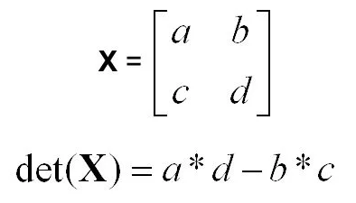
Classical one

Slide 12
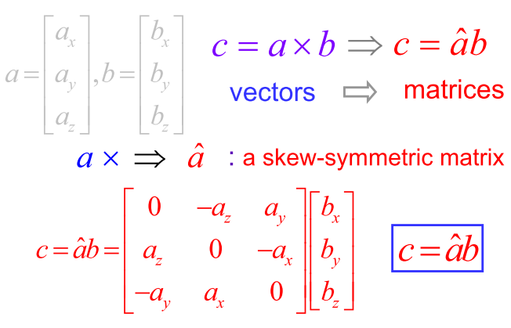
Skew-symmetric matrix

Slide 13
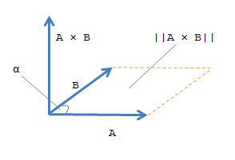
Geometrical representation
||A×B||=||A|| ||B|| sinα
||A×B|| - area
||A|| - length of the vector

Slide 14
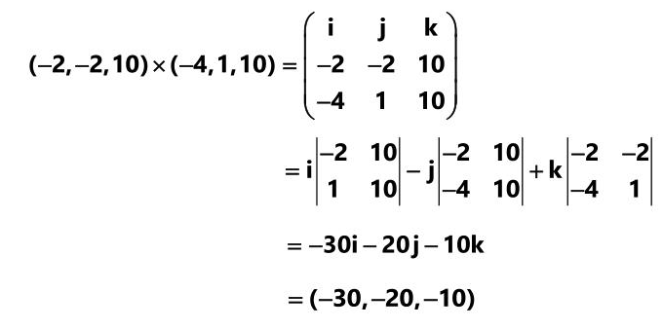
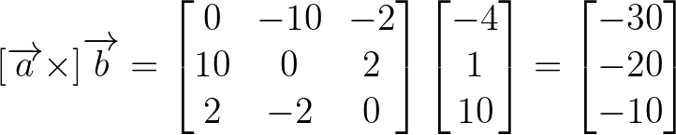
Case study
Calculate cross product between a and b
a =[-2;-2;10]
b=[-4;1,10]
Classic
Skew-symmetric

Slide 15
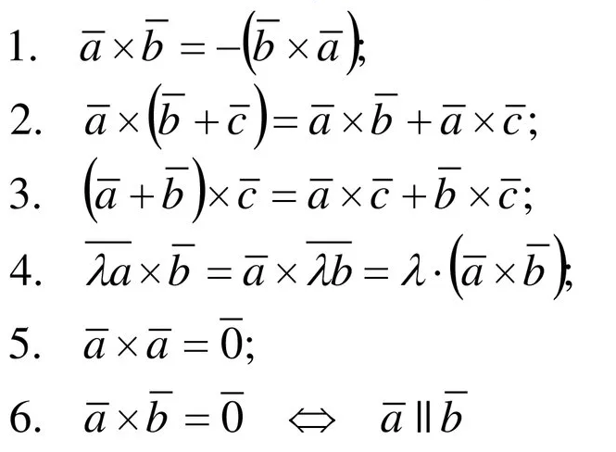
Cross product properties

Slide 16
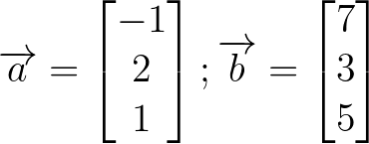
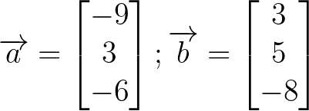
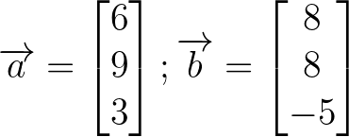
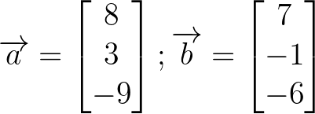
Task 1
Find cross product, if
VAR1
VAR3
VAR2
VAR4

Slide 17
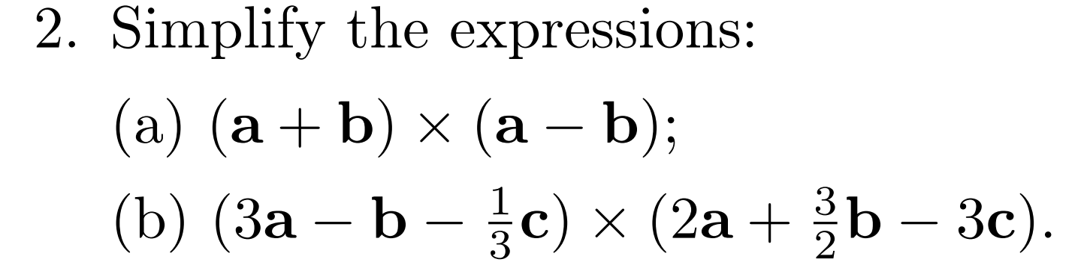
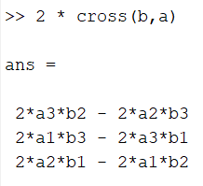
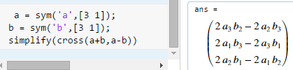
Task 2

Slide 18
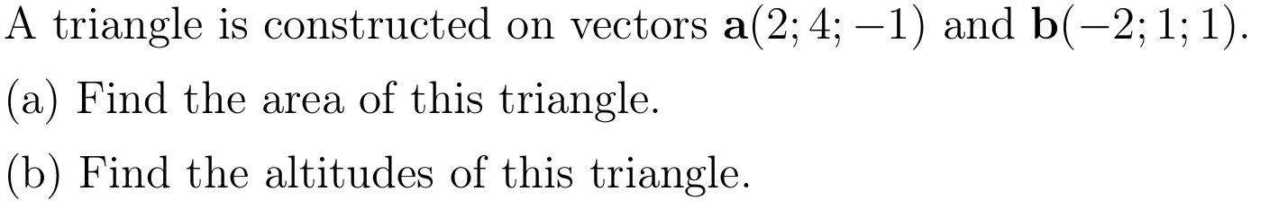
Task 3

Slide 19
Lab objectives, 2nd part
What does dot product mean?
How to calculate it?
How to use it?

Slide 20
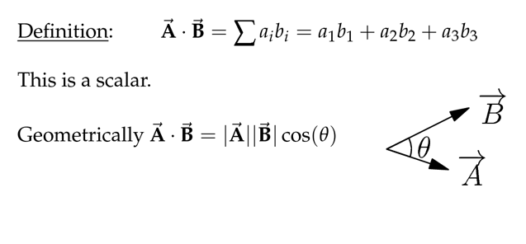
Dot product: Definition

Slide 21
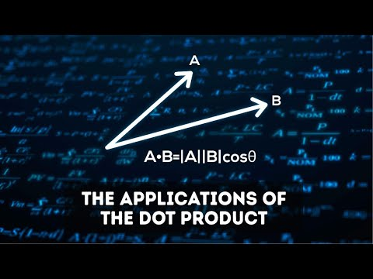

Slide 22
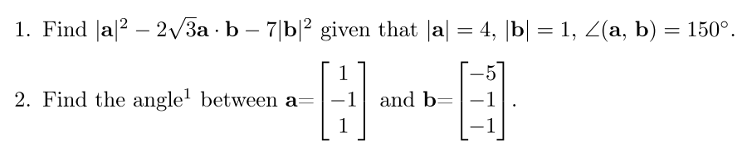
Task 4 and 5

Slide 23
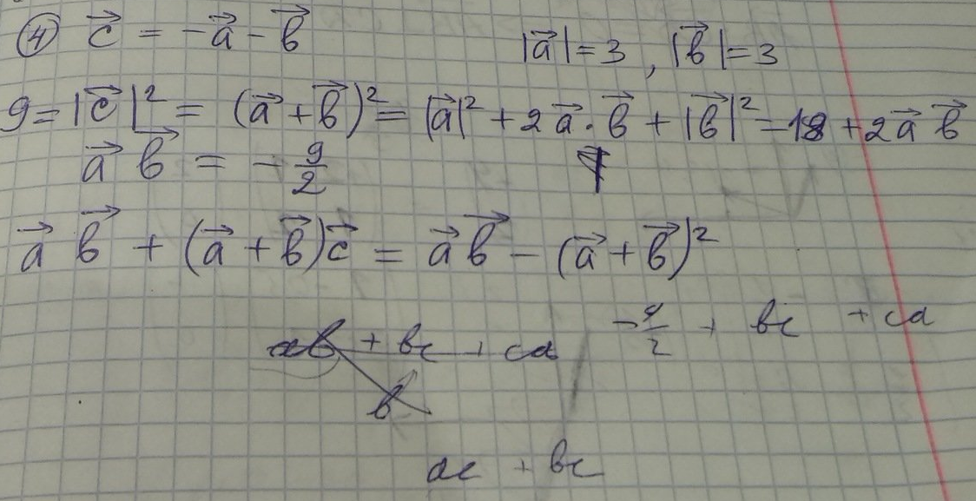
Task 6

Slide 24


Slide 25
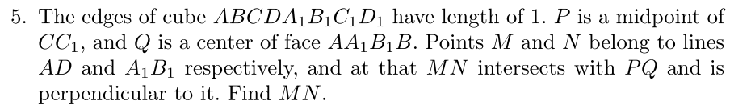
Task 7 (1)

Slide 26
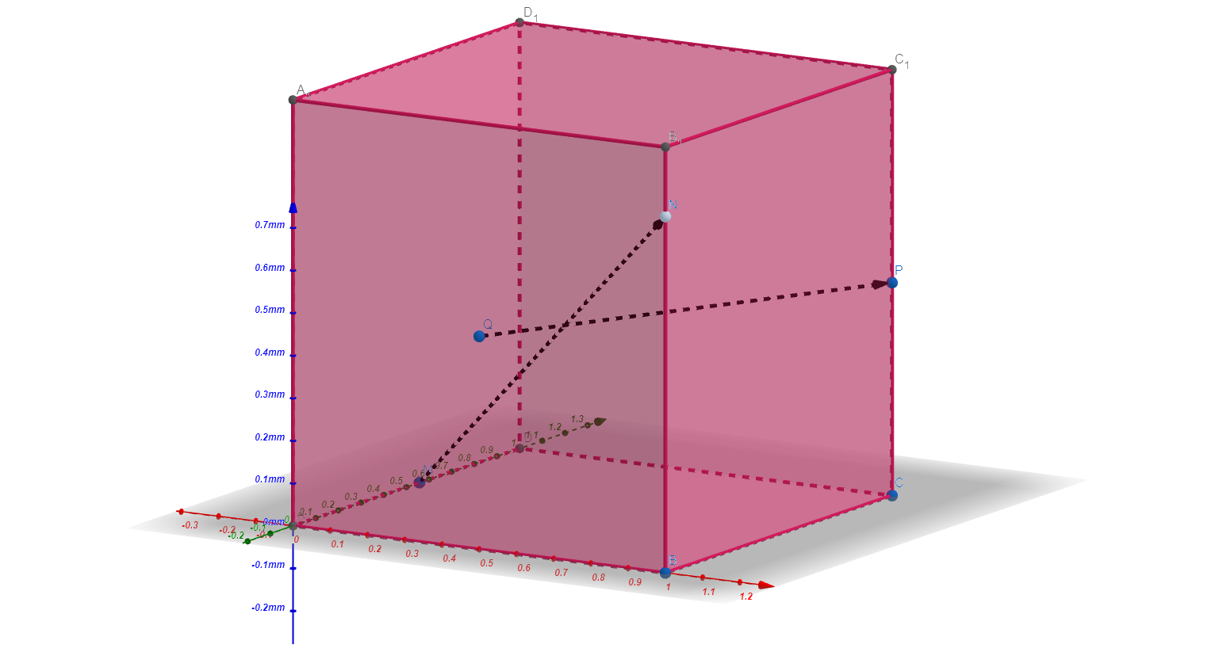
Task 7 Geogebra (2)

Slide 27
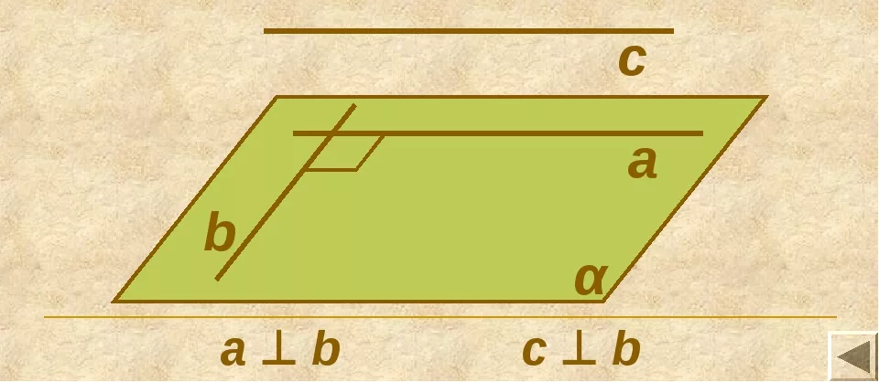
Task 7 (3)
It is needed to make 2 equations: 1 for perpendicularity, 2nd - intersection

Slide 28
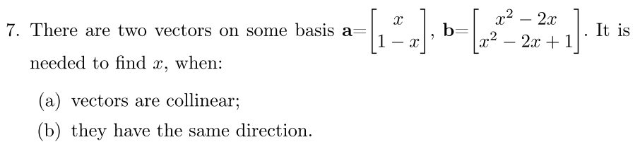
Task 8

Slide 29
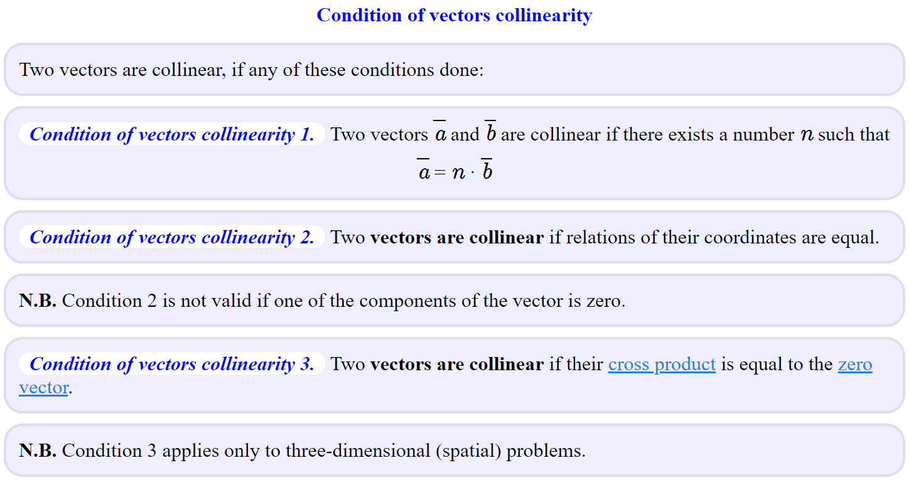
Task 8

Slide 30
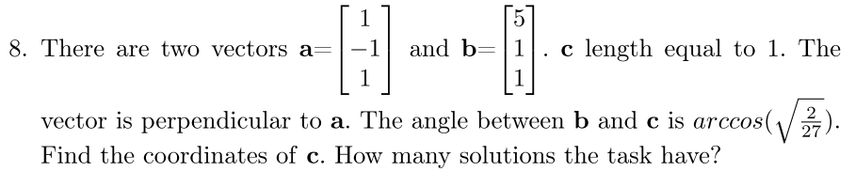
Task 9

Slide 31
Best extra extra materials
1) RUS - Матпрофи
2) ENG - OnlineMSchool - not only explanation, but also online calculators
3) ENG Videos - 3Blue1Brown
4) ENG Lectures - Gilbert Strang - AGLA2 based on the course

Slide 32
Deserve “A” grade!
– Oleg Bulichev

