Slide 1
Mechanics and Machines
Lecture 2
Types of machine parts
joining and assembly
Alexander Maloletov
University Innopolis
a.maloletov@innopolis.ru

Slide 2
Resources and reference material

Slide 3
Resources and reference material
Main textbook:
Richard G. Budynas and J. Keith Nisbett Shigley’s Mechanical Engineering Design, 2011
Michael M. Stanišic Mechanisms and Machines: Kinematics, Dynamics, and Synthesis, 2015
Dietmar Gross et al. Engineering Mechanics 2: Mechanics of Materials, 2018
Other reference material:
Габибов И.А., Меликов Р.Х. Инженерная графика, 2011
Vitor Dias da Silva Mechanics and Strength of Materials, 2006
Фролов К.В. и др. Теория механизмов и машин, 1987
Артоболевский И.И. Теория механизмов и машин, 1988
Артоболевский И.И., Эдельштейн Б.В. Сборник задач по теории механизмов и машин, 1975
Жуков В.Г. Механика. Сопротивление материалов, 2012
Вольмир А.С. и др. Сборник задач по сопротивлению материалов, 1984
Mary Kathryn Thompson, John Martin Thompson ANSYS Mechanical APDL for Finite Element Analysis, 2017
Alawadhi, Esam M. Finite element simulations using ANSYS, 2016
Федорова Н.Н. Основы работы в ANSYS 17, 2017

Slide 4
Classification of joining and assembly

Slide 5
Classification of joining and assembly
Methods of joining and assembly
Joints
Fixed connections
Prismatic
Detachable
Non-detachable
Rotational
Threaded
(резьбовое)
Riveting
(заклёпочное)
Spherical
Threaded
(резьбовое)
Keyed
(шпоночное)
Welding
(сварочное)
Other types
Splined
(шлицевое)
Brazing&soldering
(паечное)
Flanged
(фланцевое)
Glue
(клеевое)
Pin
(штифтовое)
Split pin
(шплинтовое)

Slide 6
Shafts and axles. Bearings

Slide 7
Shafts and axles. Bearings
Axles are used to support the rotating parts of machines and mechanisms. Distinguish between rotating and non-rotating axles.
Shafts are used to transmit torque. Shafts can also support rotating parts, but can only transmit torque.
Devices that provide rotation of some parts relative to others are called bearings.

Slide 8
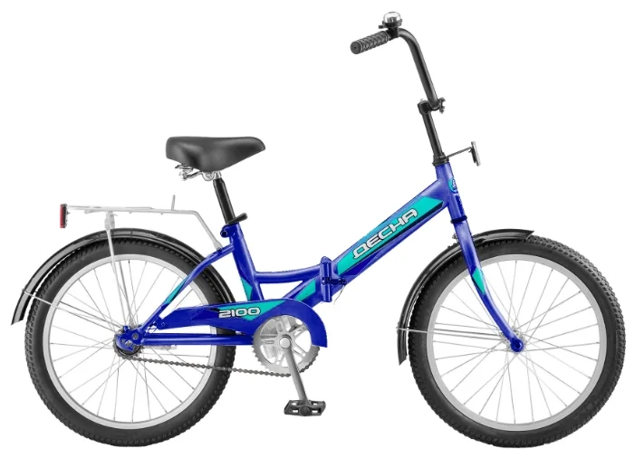
Shafts and axles. Bearings
Identify the axles and shafts in the picture

Slide 9
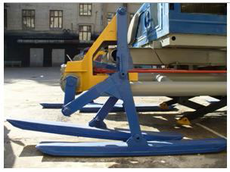
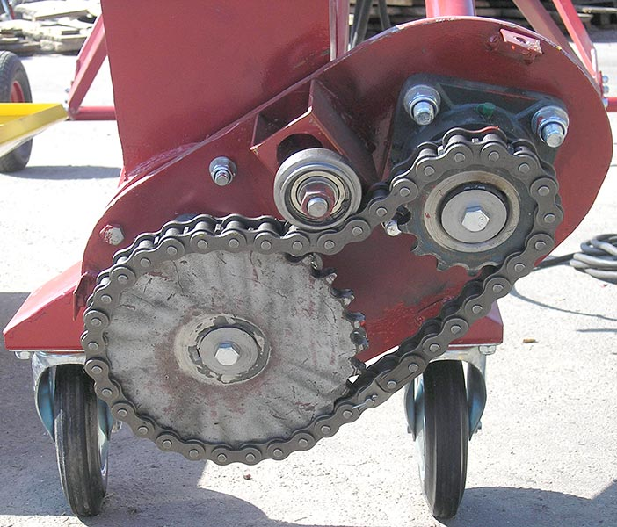
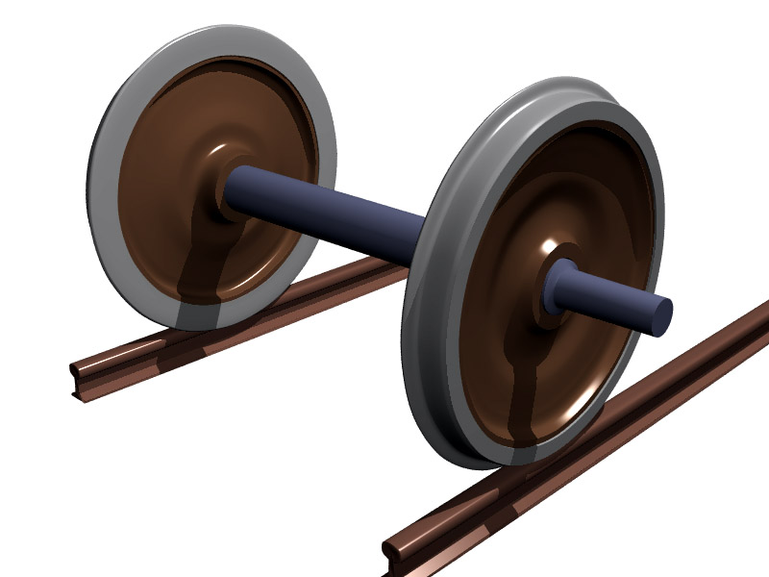
Shafts and axles. Bearings
Identify the axles and shafts in the pictures

Slide 10
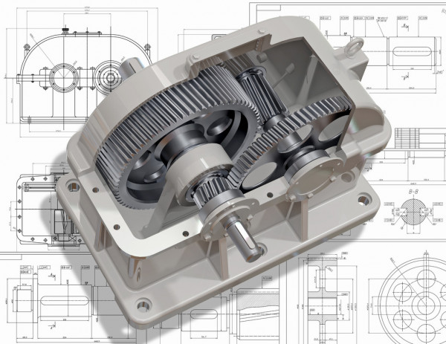
Shafts and axles. Bearings

Slide 11
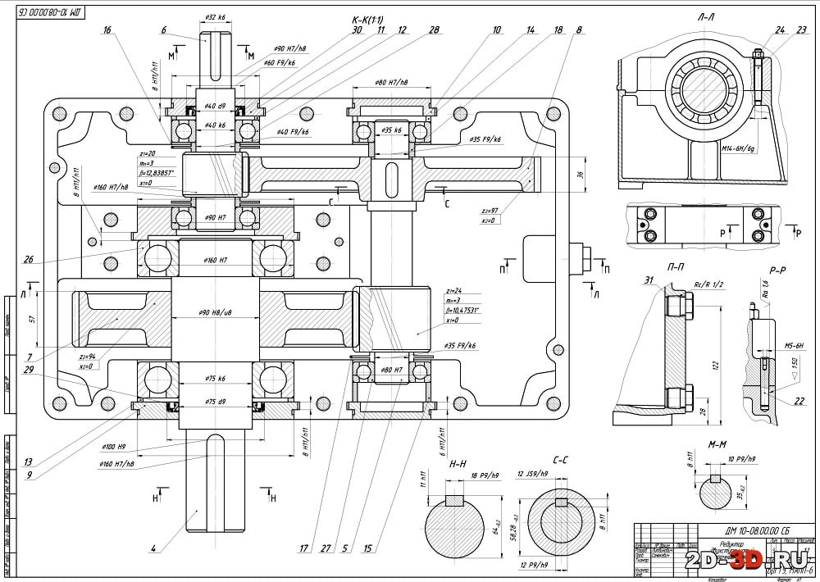
Shafts and axles. Bearings

Slide 12
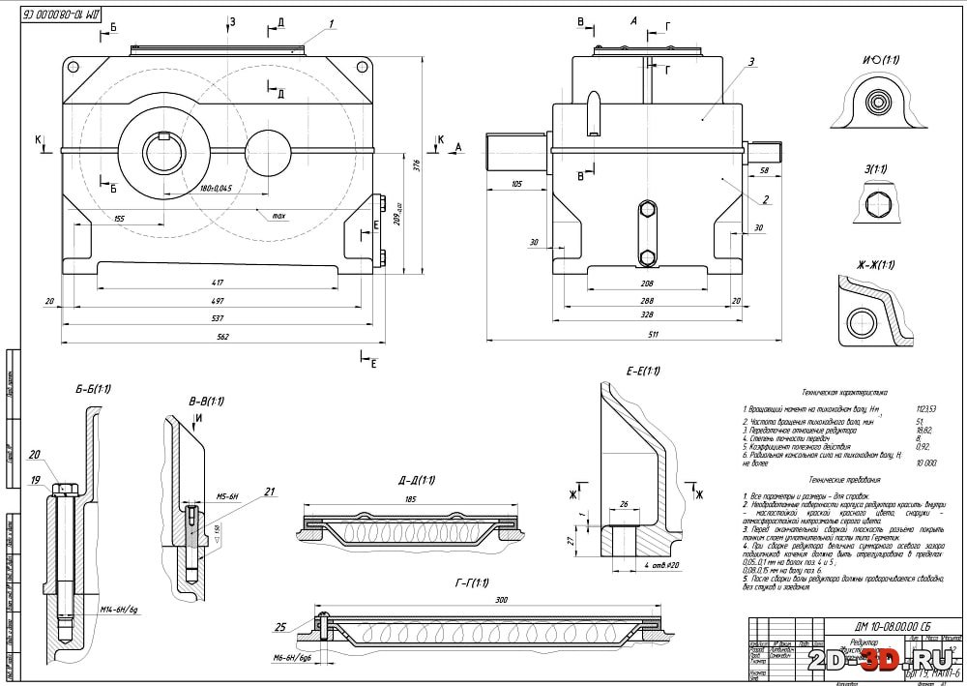
Shafts and axles. Bearings

Slide 13
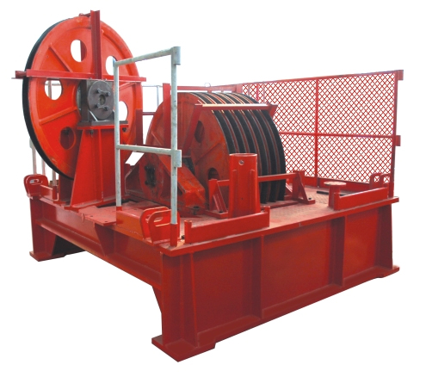
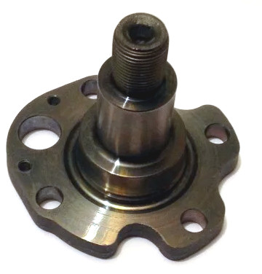
Shafts and axles
Non-rotating axles
Rig hoist system
An example of non-rotating axle

Slide 14
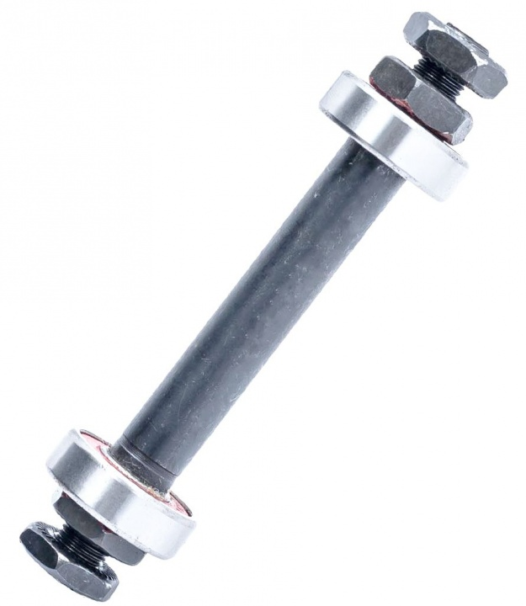
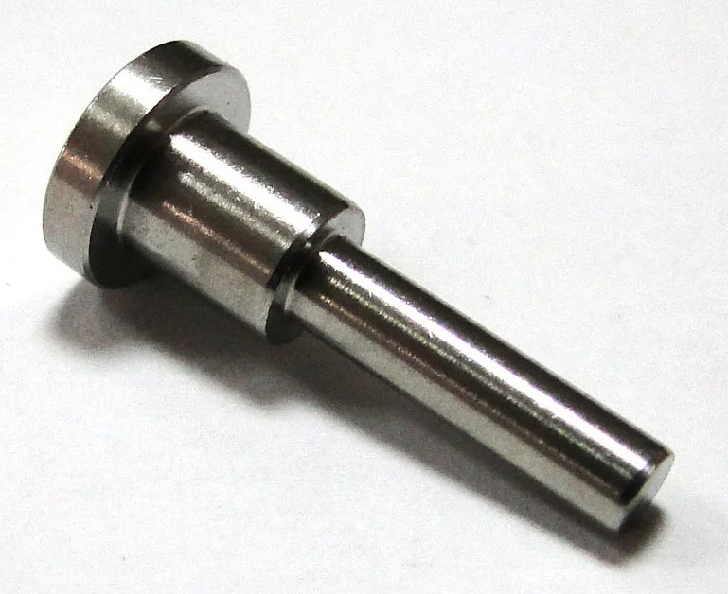
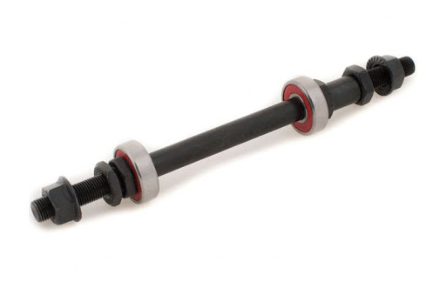
Shafts and axles
Rotating axles

Slide 15


Shafts and axles
Shafts. Gear shafts and main shafts. Shafts are straight and cranked. Flexible shafts.

Slide 16
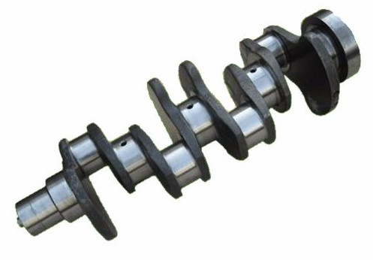
Shafts and axles
Shafts. Gear shafts and main shafts. Shafts are straight and cranked. Flexible shafts.

Slide 17
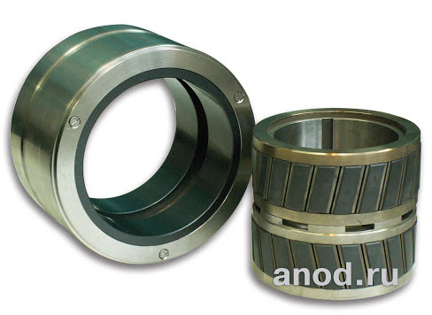
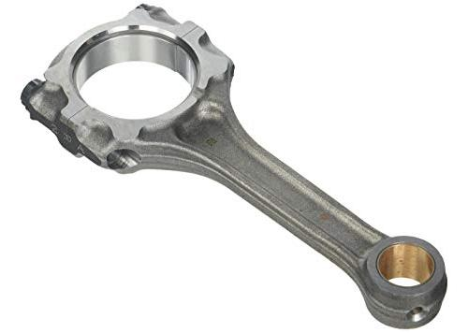
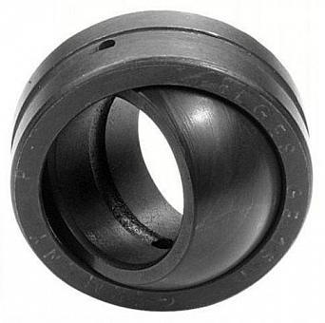
Bearings
Plain bearing

Slide 18
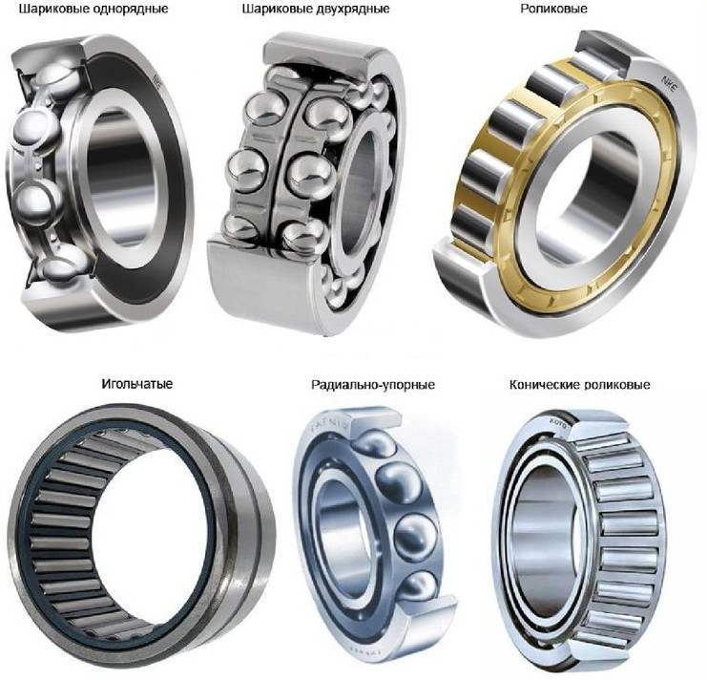
Bearings
Rolling bearings (rolling-element bearings)
single row ball bearing
double row ball bearing
roller bearing
needle bearing
angular contact bearing
double row tapered roller bearing

Slide 19
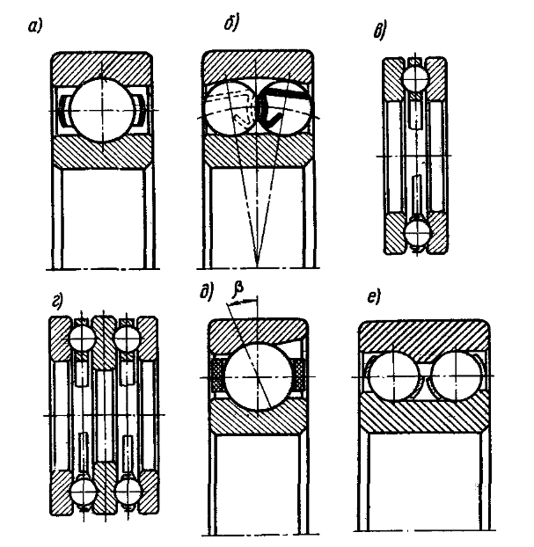
Bearings

Slide 20
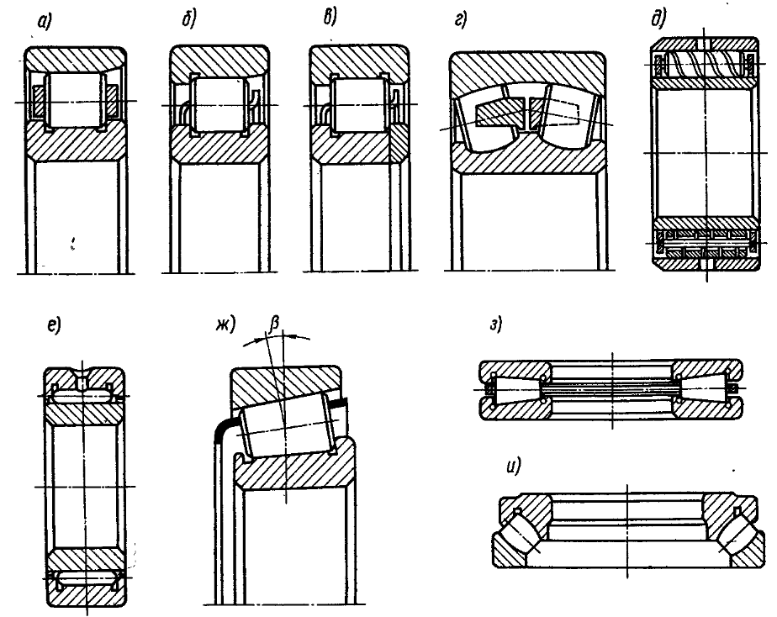
Bearings

Slide 21
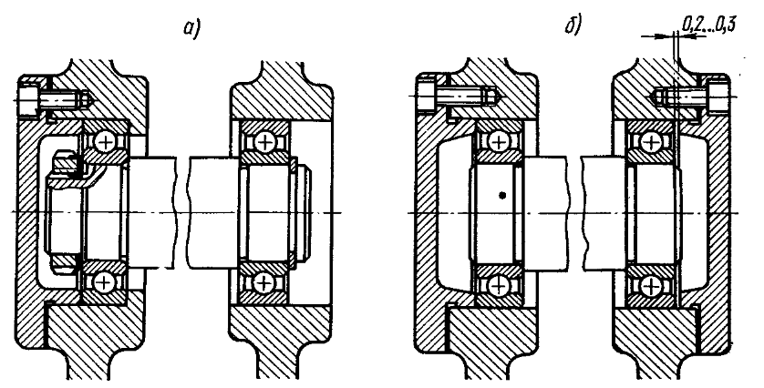
Bearings

Slide 22
Threaded connections

Slide 23
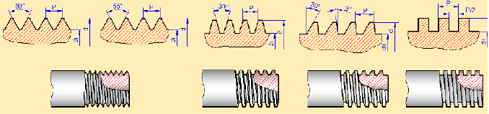
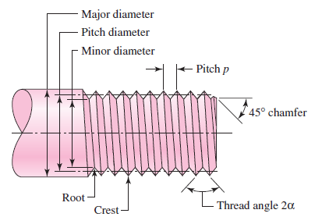
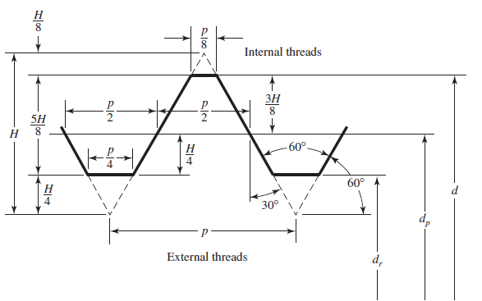
Threaded joint
triangular threads
trapezoidal (acme) threads
square threads

Slide 24
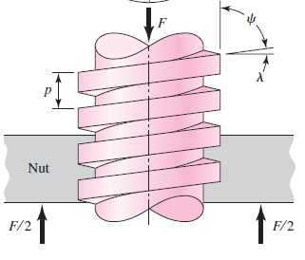
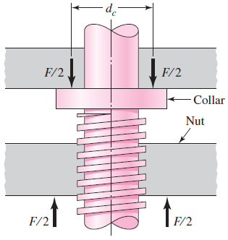
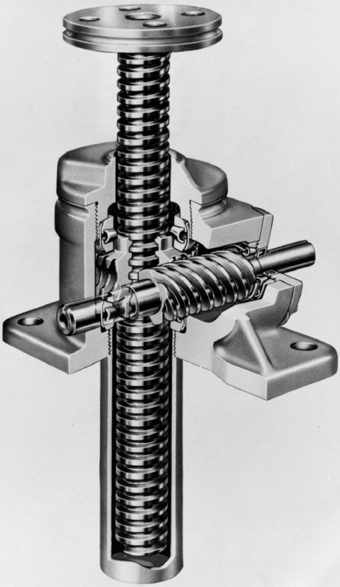
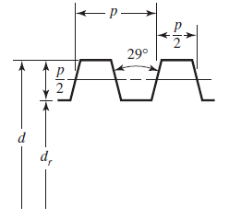
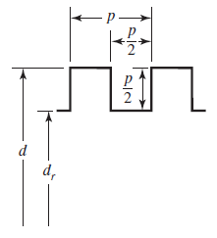
Threaded joint
The Joyce worm-gear screw jack

Slide 25
Threaded joint
A square-thread power screw has a major diameter of 32 mm and a pitch of 4 mm, and it is to be used in an application similar to that in the previous slide.
The given data include f = 0.08, d = 40 mm, and F = 6.4 kN per screw.
(a) Find the thread depth, thread width, pitch diameter, minor diameter, and lead.
(b) Find the torque required to raise and lower the load.
(c) Find the efficiency during lifting the load.

Slide 26


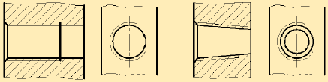

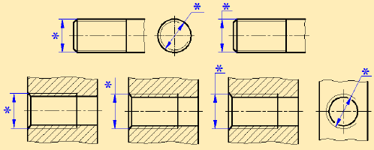
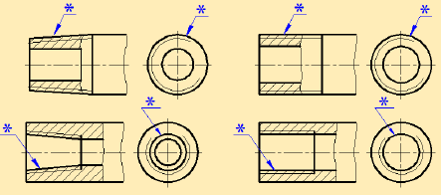
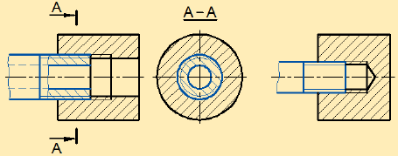
Threaded joint
Examples of indications
Metric threads: М8х1.25; М8; M8х1-LH
British Standard Pipe: G 1.1/8″; G 1.1/8″-LH
Thrust thread: S 80.10; S 80.10LH; S 80.20(Р 10)
Conical pipe thread: R ½; Rc 1/2

Slide 27
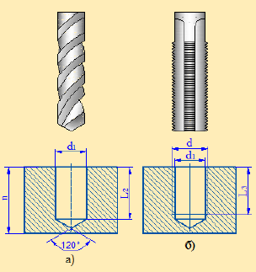
Threaded joint

Slide 28
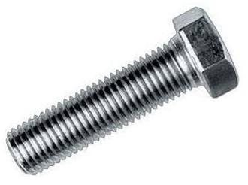
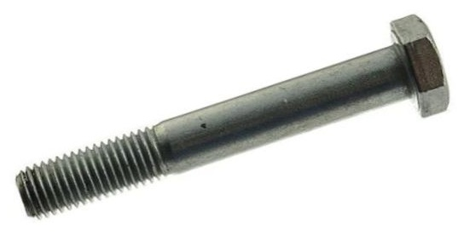
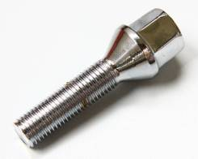
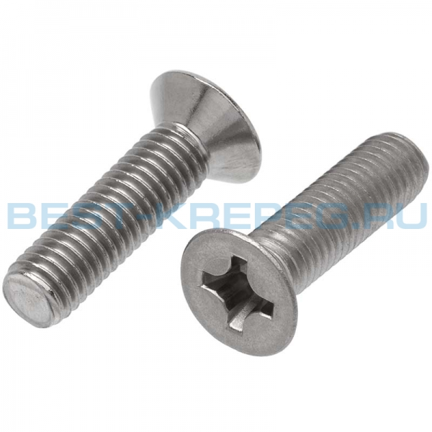
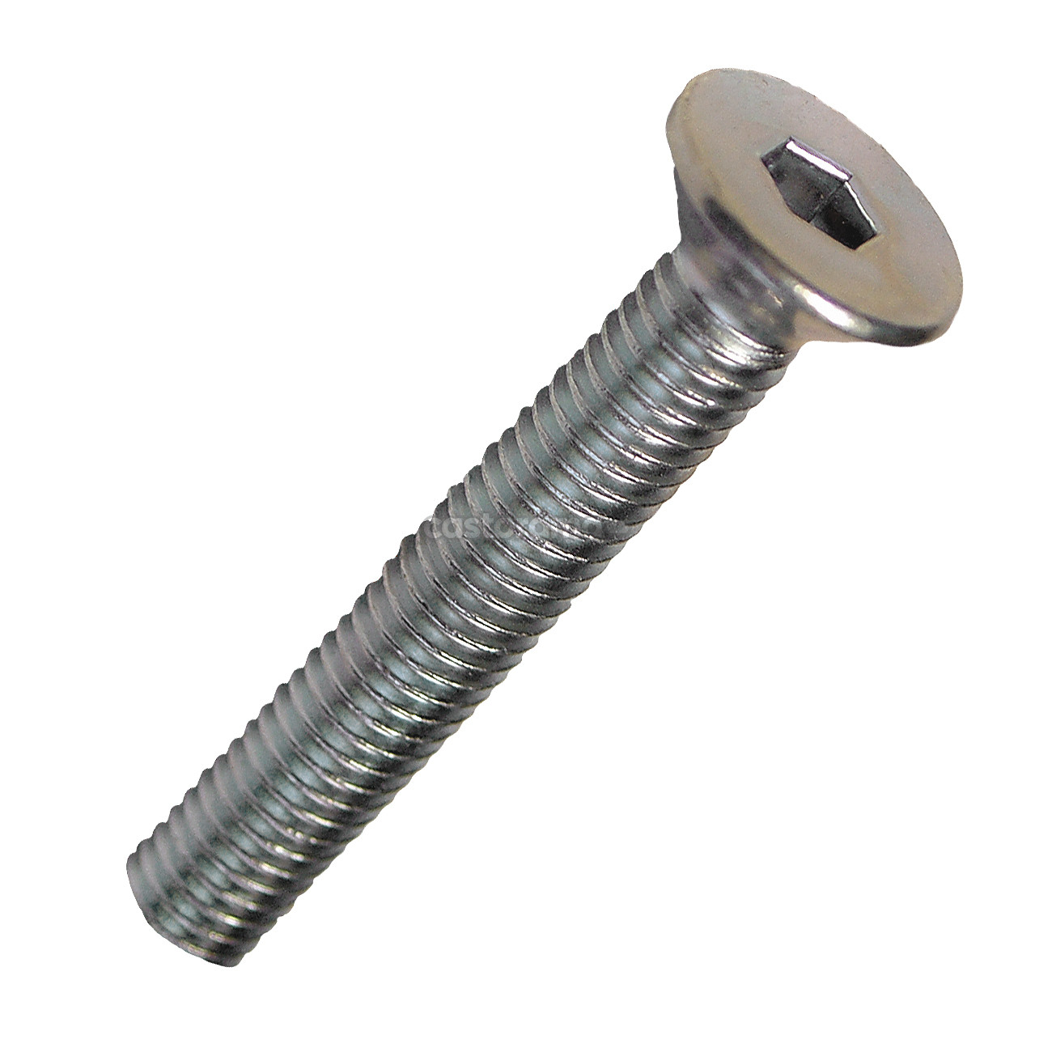
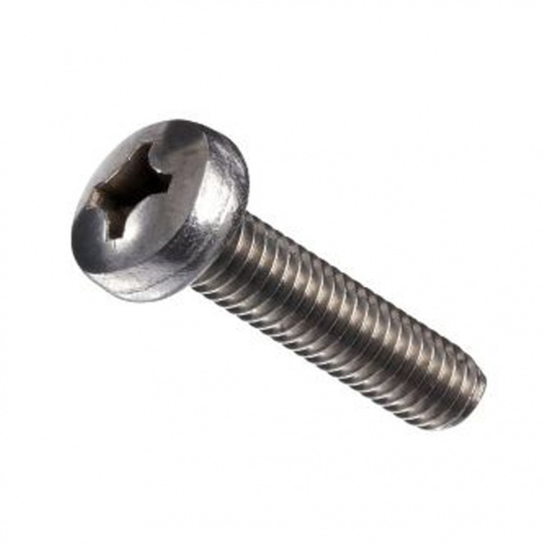
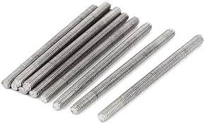
Bolts and screws

Slide 29
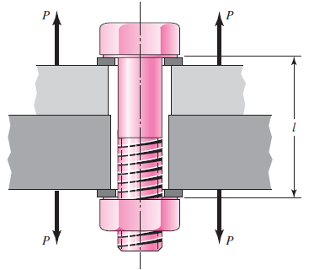
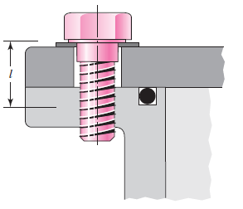
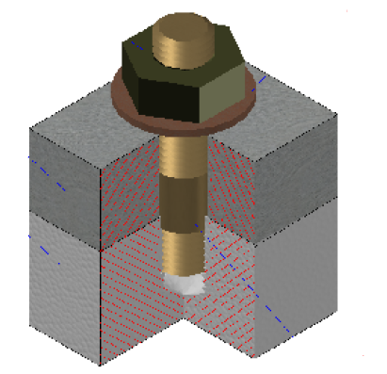
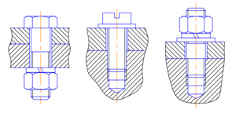
Bolted and screw connections
Bolted connection
Screw connection
Thread rod connection

Slide 30
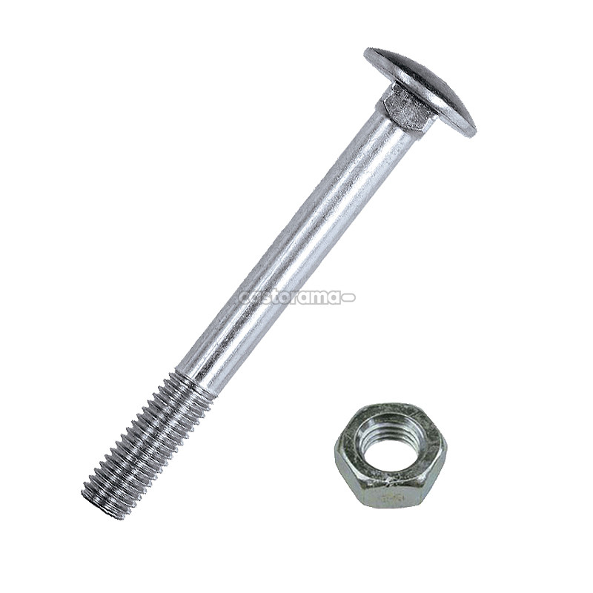
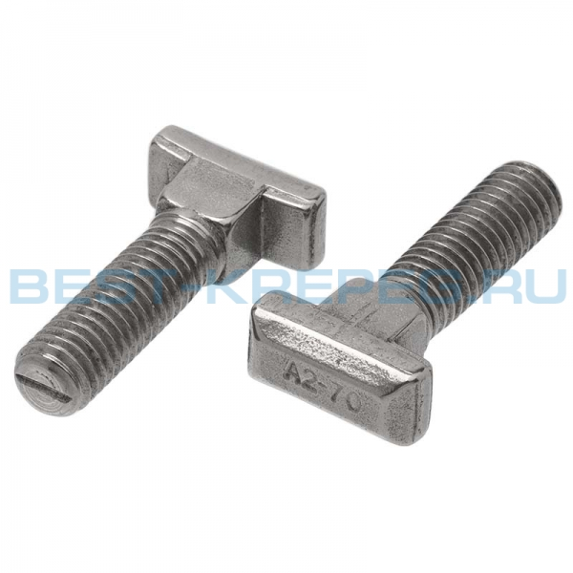
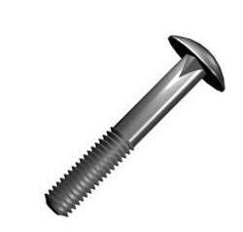
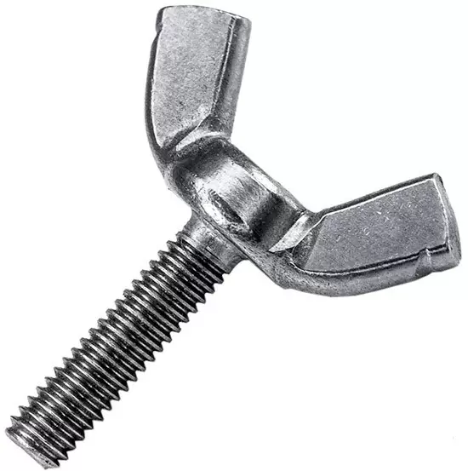
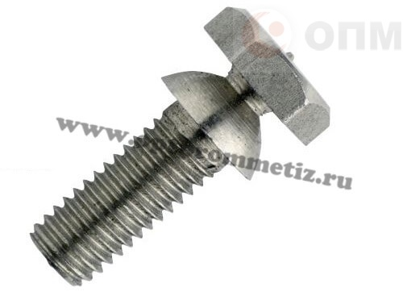
Bolts and screws

Slide 31
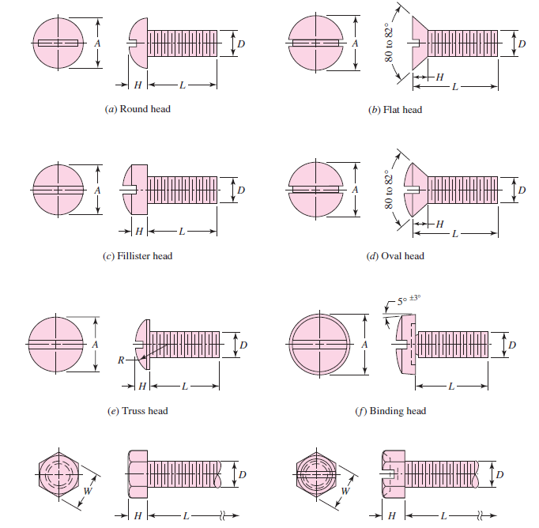
Types of heads used on machine screws

Slide 32
Bolted and screw connections
Advantages and disadvantages of these connection types?

Slide 33

Multi-start thread

Slide 34
Multi-start thread
https://www.youtube.com/watch?v=cDfMI5ahbJI

Slide 35





Washers
See the following lecture slides
Plain washer
Fender washer
Split washer

Slide 36









Washers
Belleville washer /
cupped spring washer /
conical washer
Wave washer
Curved disc spring
See the following lecture slides
Toothed lock washer
Tab washer
Wedge lock washer

