Slide 1
Mechanics and Machines
Lecture 3
Types of machine parts
joining and assembly. Part 2
Alexander Maloletov
University Innopolis
a.maloletov@innopolis.ru

Slide 2
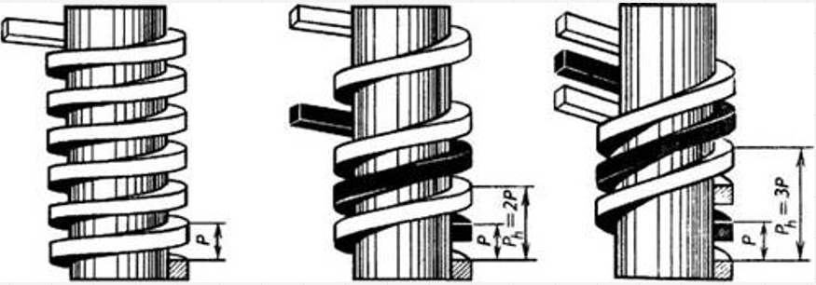
Multi-start thread
Advantages and disadvantages of multy-start thread?

Slide 3
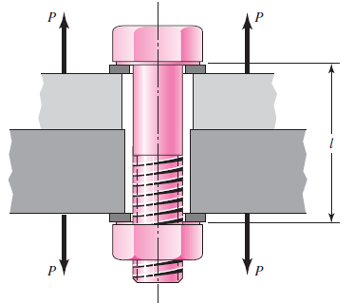
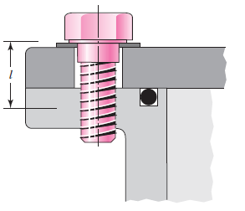
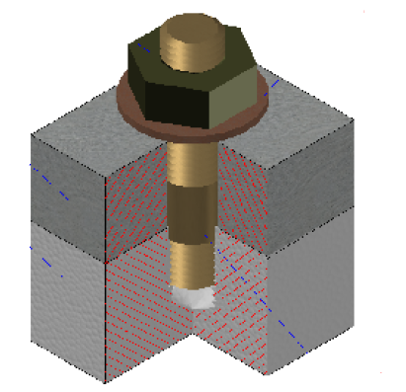
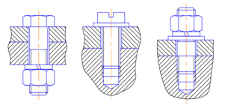
Bolted and screw connections
Bolted connection
Screw connection
Thread rod connection
Advantages and disadvantages
of these connection types?

Slide 4
Washers

Slide 5
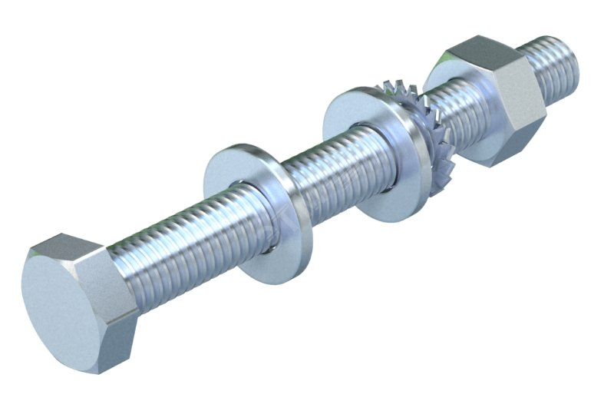
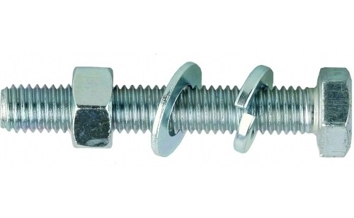
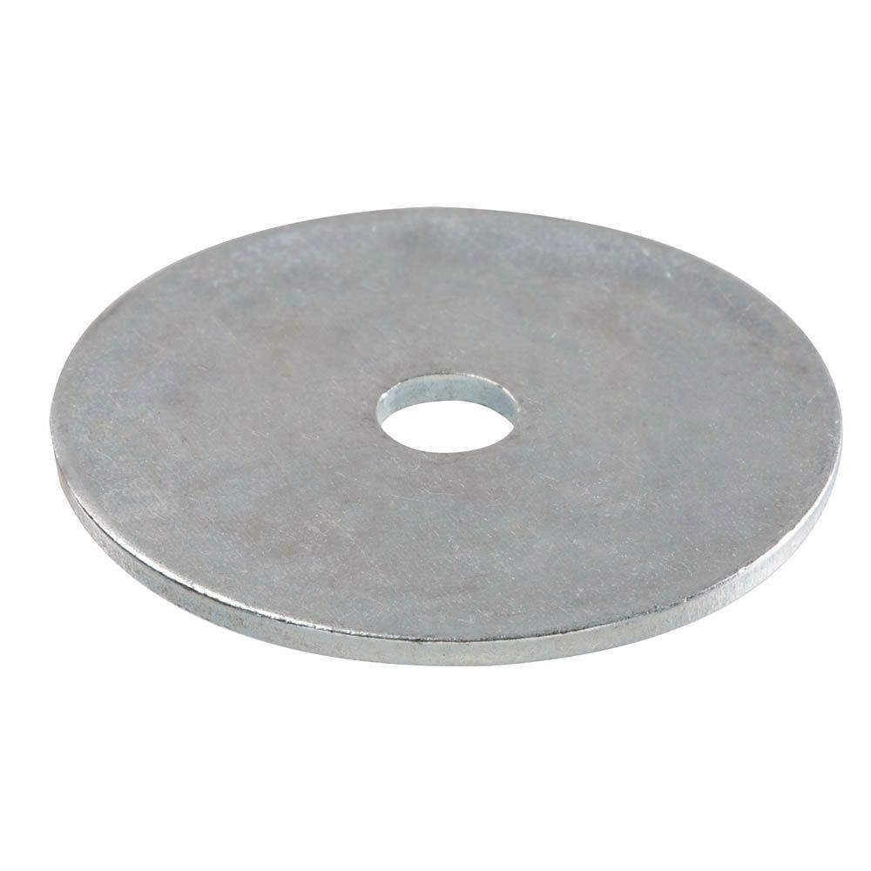
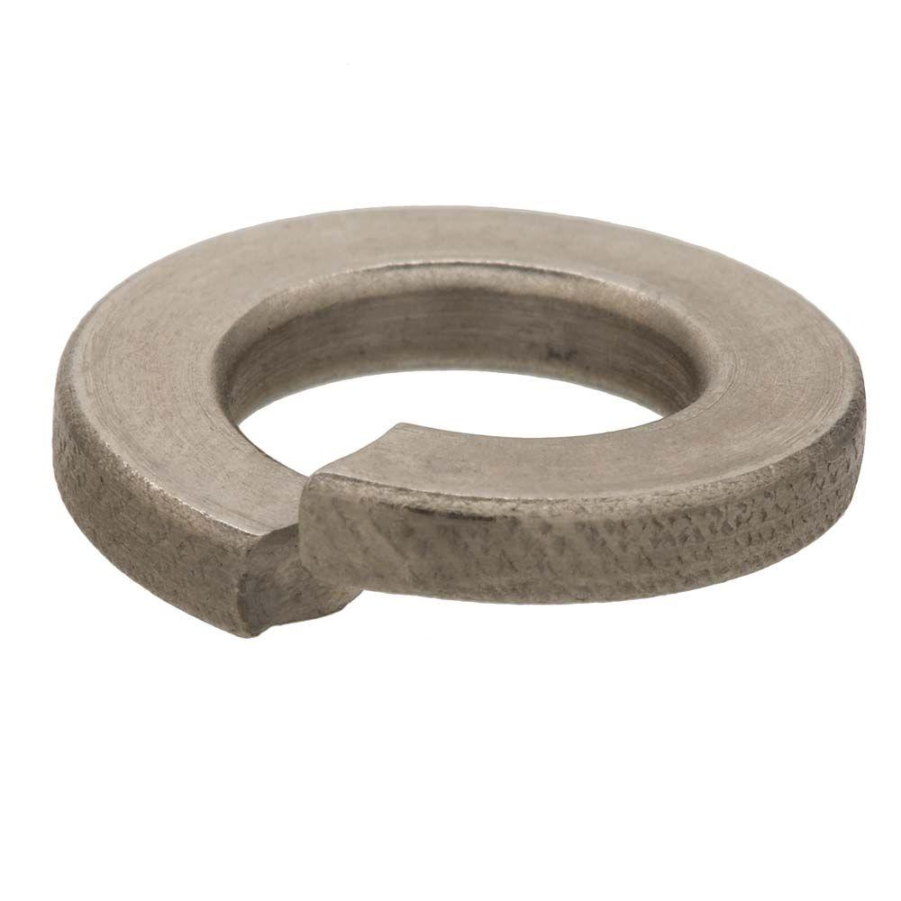
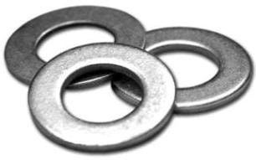
Washers
Plain washer
Fender washer
Split washer

Slide 6
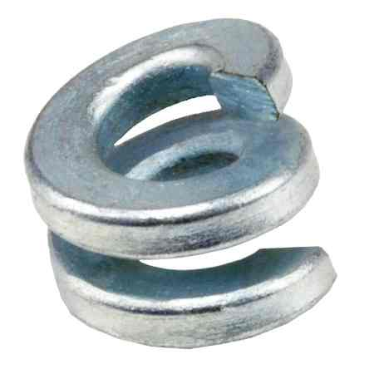
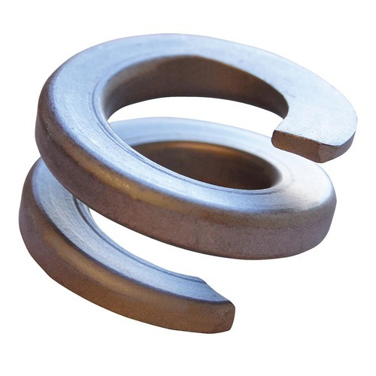
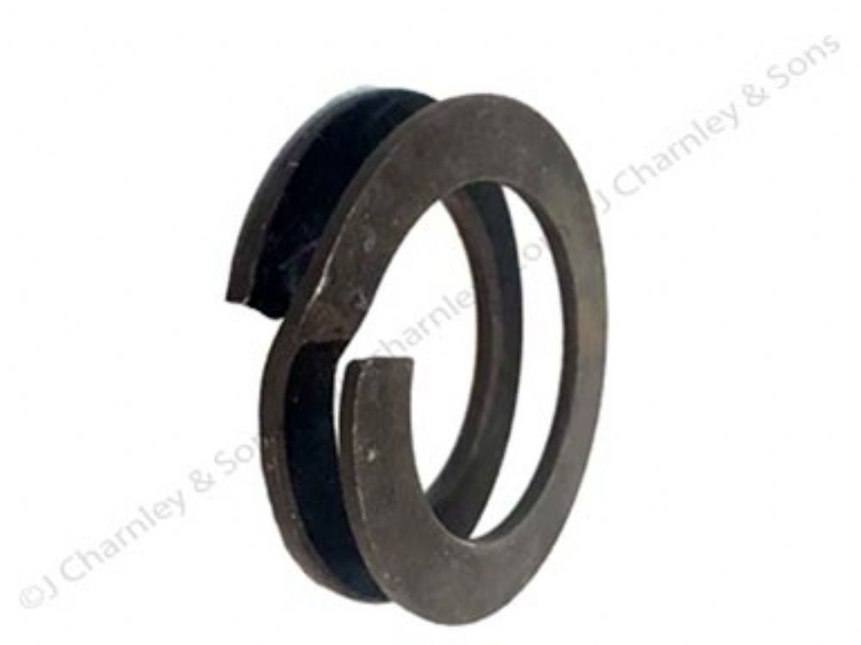
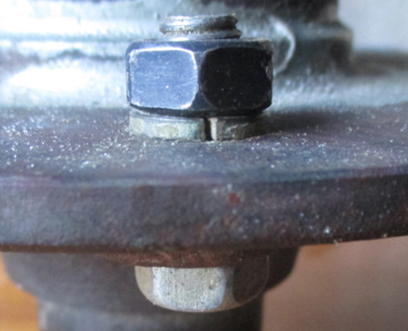
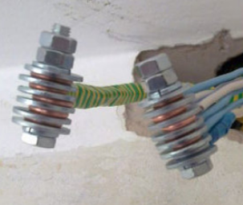
Split washers

Slide 7
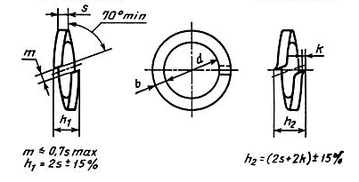
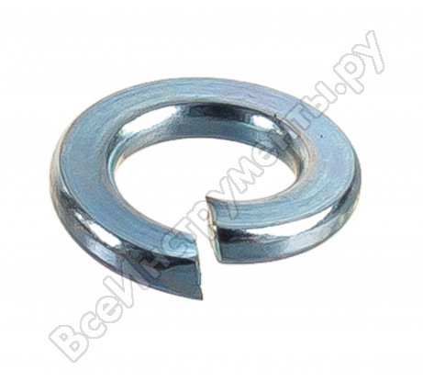
Split washers

Slide 8
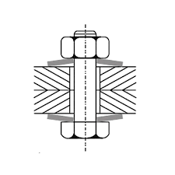
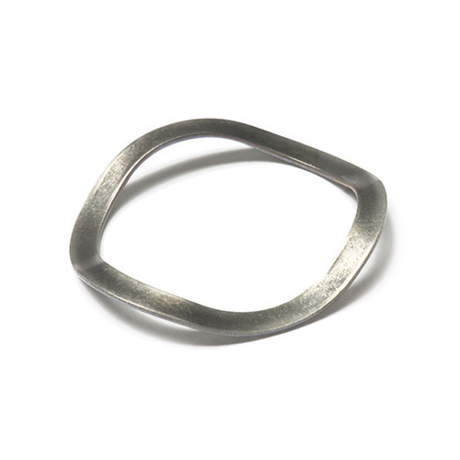
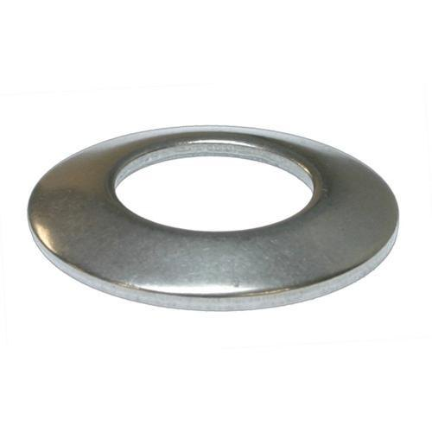
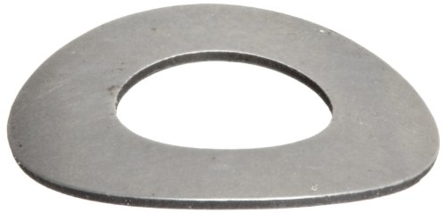
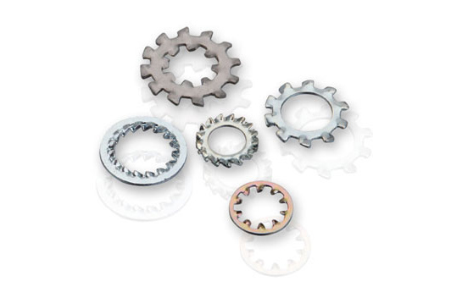
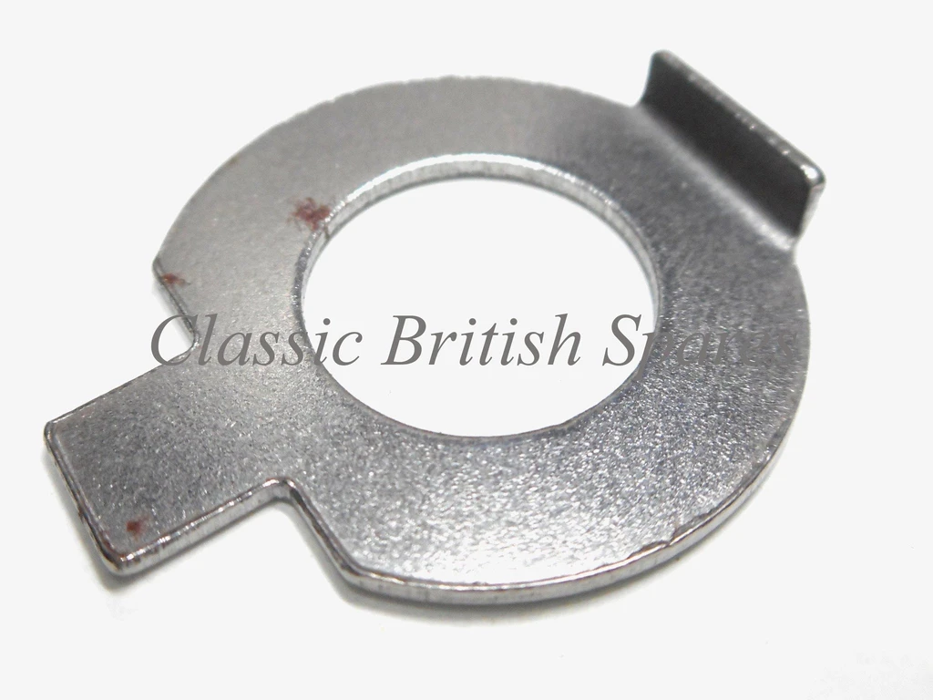
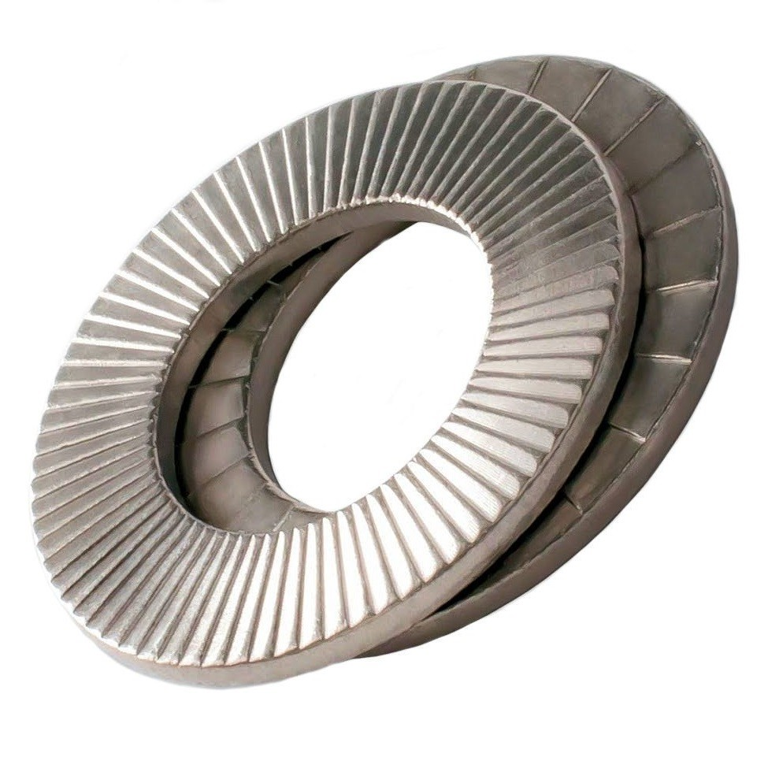
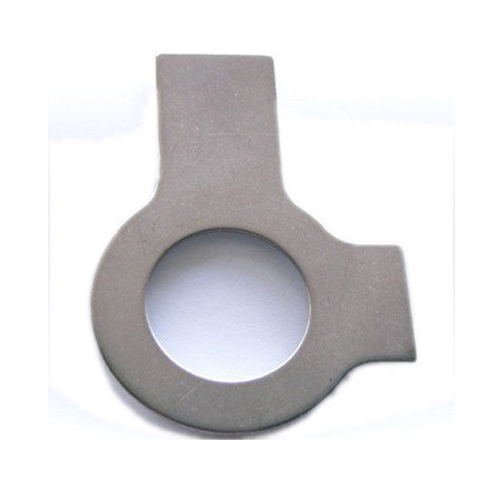
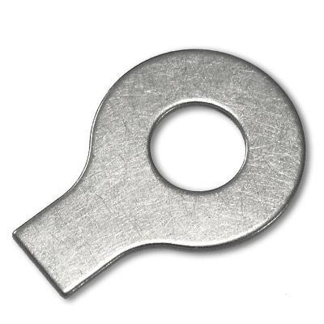
Washers
Belleville washer /
cupped spring washer /
conical washer
Wave washer
Curved disc spring
Toothed lock washer
Tab washer
Wedge lock washer
(with notches)

Slide 9
Static and quasistatic examples

Slide 10
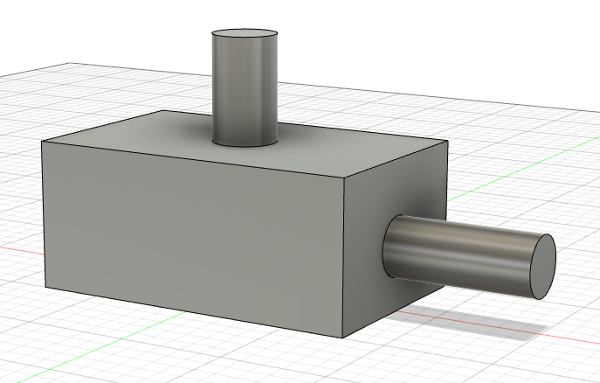
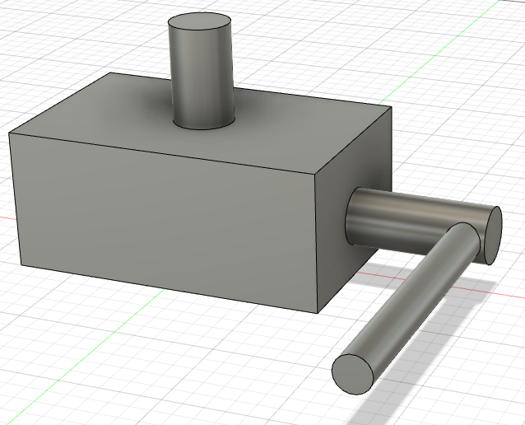
Examples
F
V
Given a transmission. It is known that when the input link rotates with angular velocity ω, the output link moves at a speed V. The force applied to the output link is F. Find the torque applied to the input link.
M
Black box
ω
F
V
The same problem. But now you have to find force P applied to the input link with known moment arm r.
ω
P

Slide 11
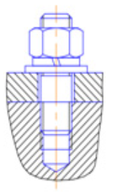
Examples
M
Find the torque applied to the nut, if you have to provide given clamping force F.
Thread pitch p, coefficient of friction f, average diameter d and pitch diameter d_{p} of the nut are given.
F
пример самотормозящейся передачи - гайка как самотормозящаяся передача - влияние вибрации на раскручивание
Передача винт-гайка, расчёт статической нагрузки и подбор подшипников

Slide 12
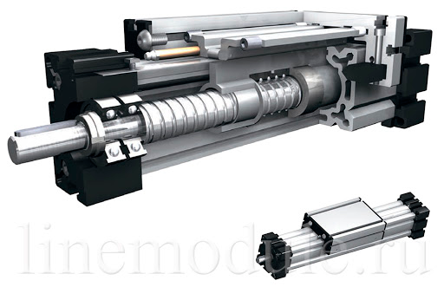
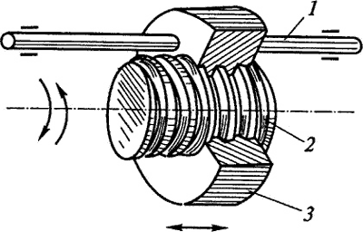
Examples

Slide 13
Examples
F
Find conditions for unscrewing the nut, if there is vibrating force F.
Thread pitch p, coefficient of friction f, average diameter d and pitch diameter d_{p} of the nut are given.

Slide 14
Classification of joining and assembly

Slide 15
Classification of joining and assembly
Methods of joining and assembly
Joints
Fixed connections
Prismatic
Detachable
Non-detachable
Rotational
Threaded
(резьбовое)
Riveting
(заклёпочное)
Spherical
Threaded
(резьбовое)
Keyed
(шпоночное)
Welding
(сварочное)
Other types
Splined
(шлицевое)
Brazing&soldering
(паечное)
Flanged
(фланцевое)
Glue
(клеевое)
Pin
(штифтовое)
Split pin
(шплинтовое)

Slide 16
Other detachable connections

Slide 17
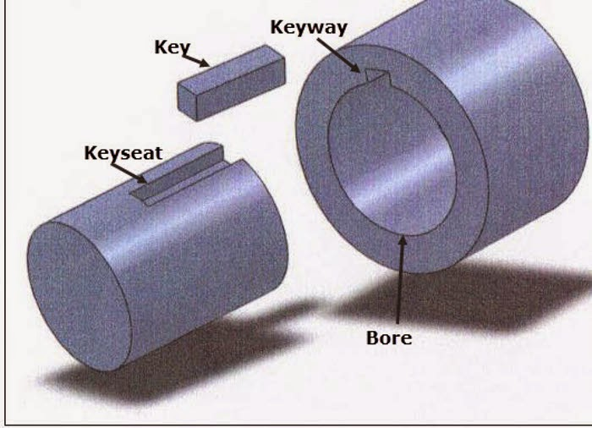
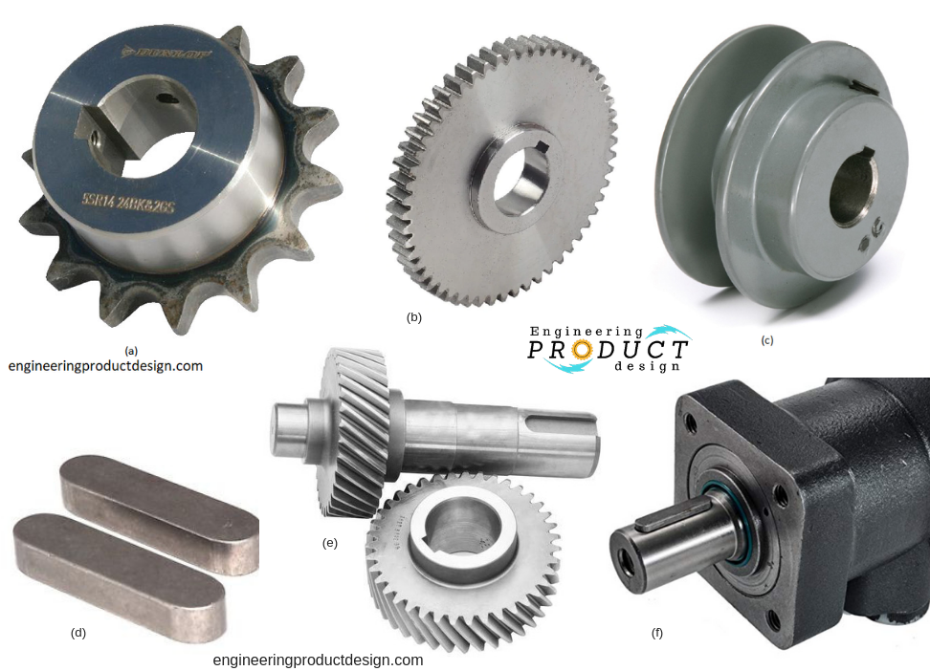
Keyed connections

Slide 18
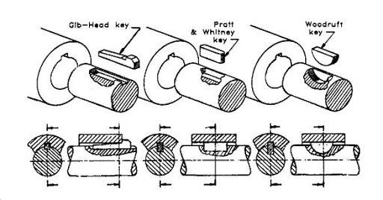
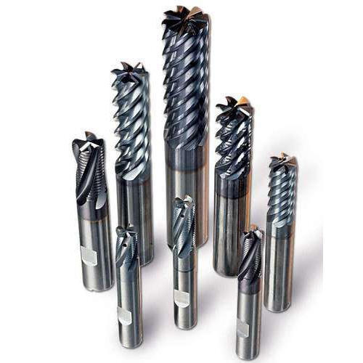
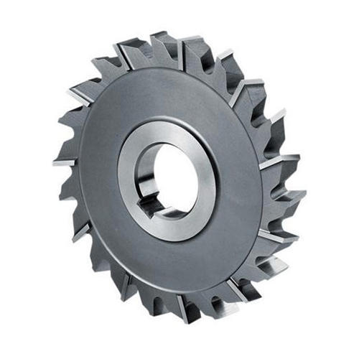
Keyed connections

Slide 19
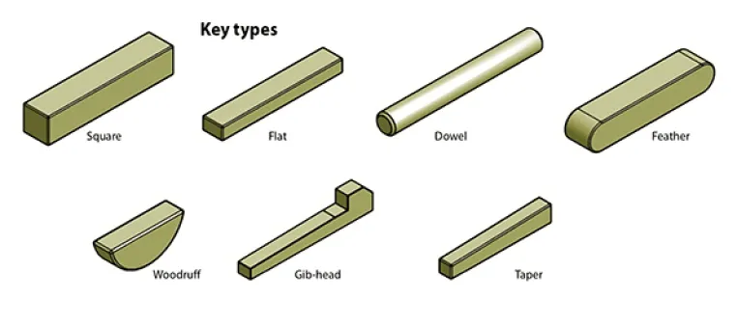
Keyed connections

Slide 20
Keyed connections
Milling of a keyseat
https://www.youtube.com/watch?v=8qjYbs_Mvw4
Milling of a keyseat using a lathe (turning machine)
https://www.youtube.com/watch?v=dIDMcWHweI4
Slotting of a keyseat using a manual slotter
https://www.youtube.com/watch?v=UCDUz9ovvac
Slotting of a keyseat using an automated slotter
https://www.youtube.com/watch?v=ka3shL8MLEY

Slide 21
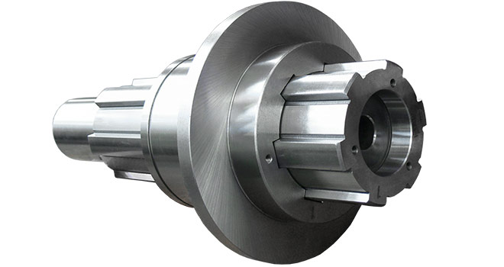
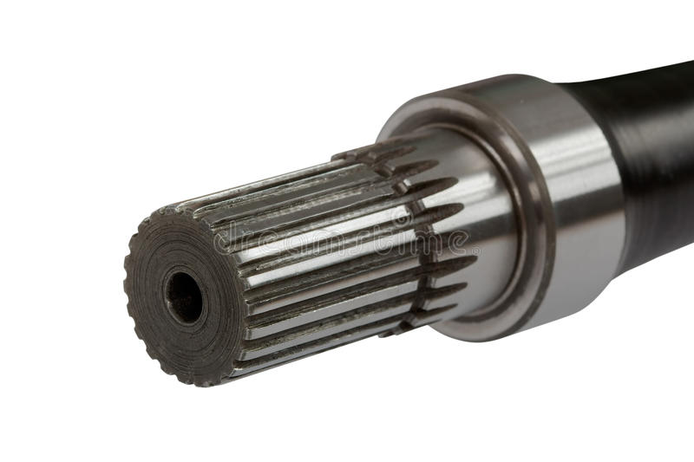
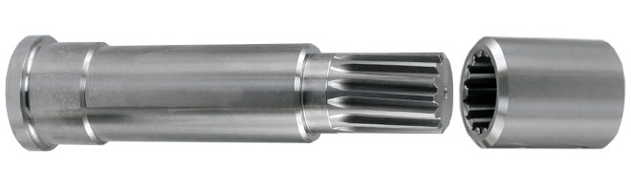
Splined connections

Slide 22
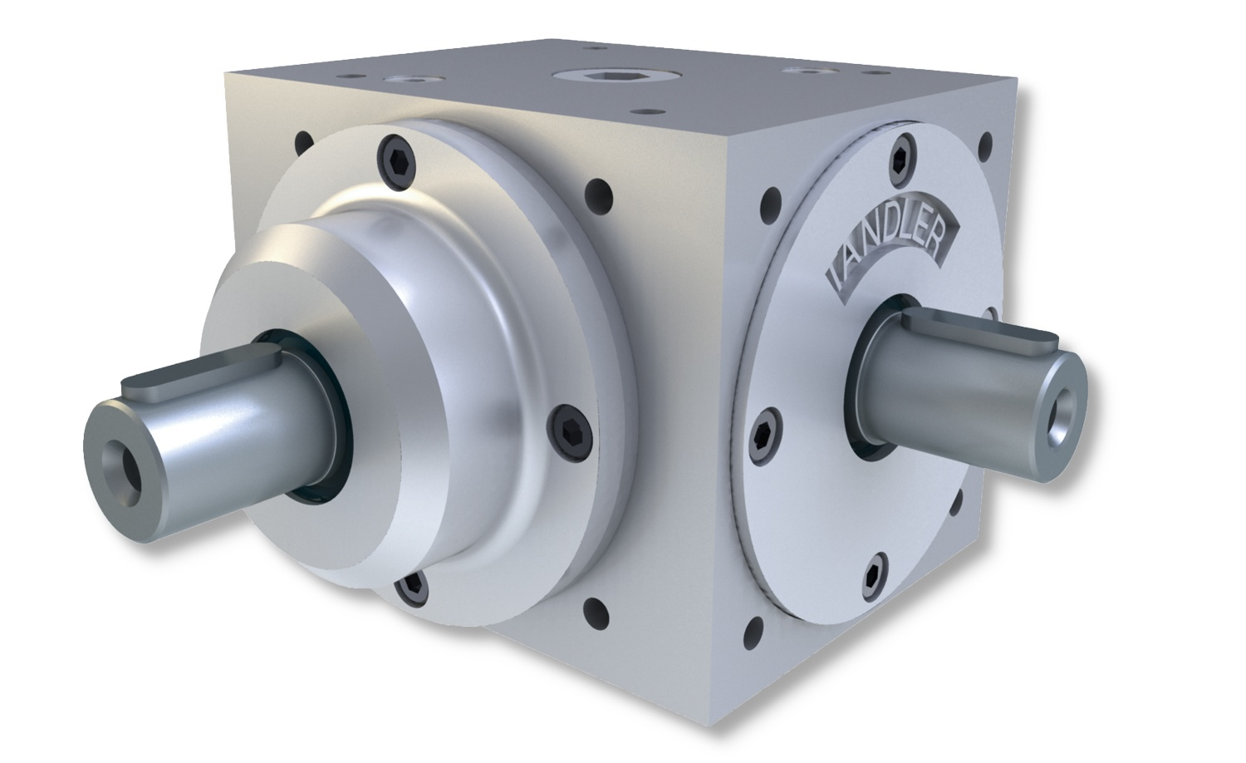
Splined connections
Advantages and disadvantages of these connection types?

Slide 23
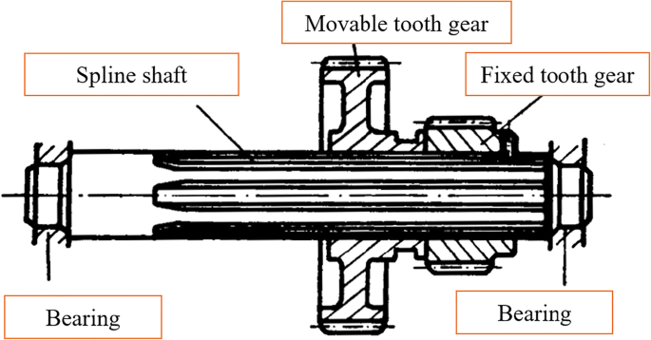
Detachable connections

Slide 24
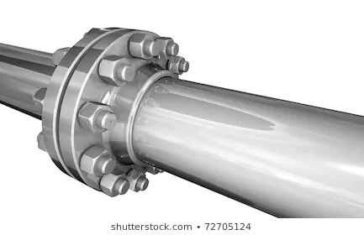
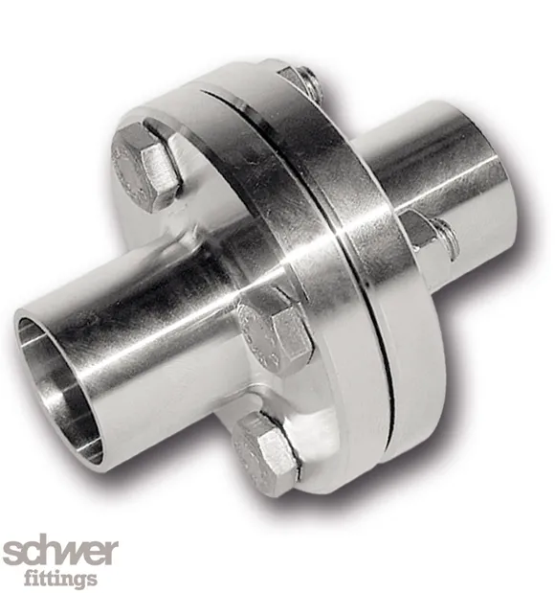
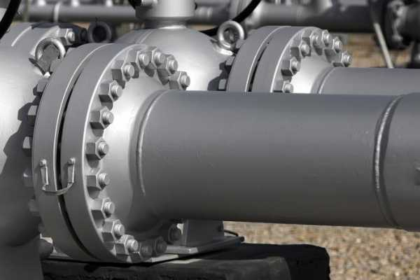
Flanged connections

Slide 25
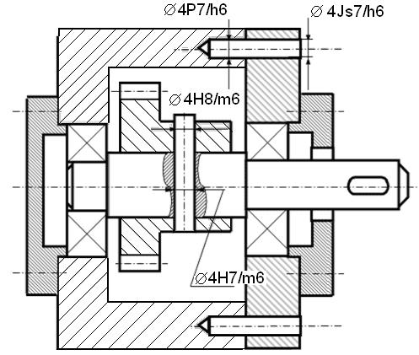
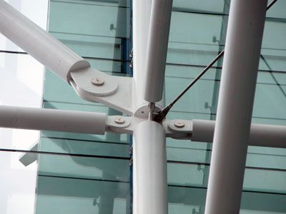
Pin connections

Slide 26
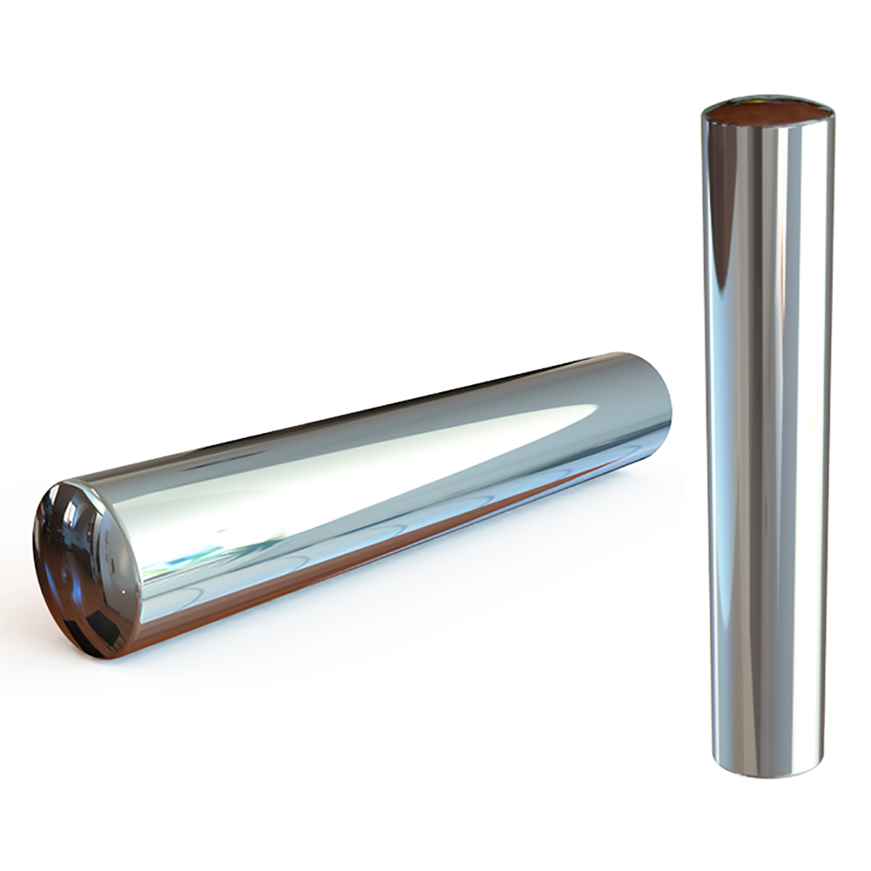
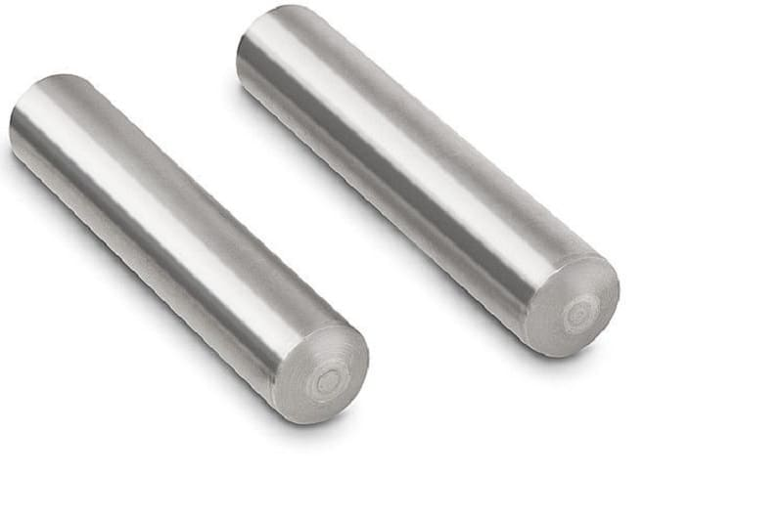
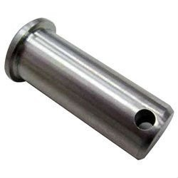


Pin connections

Slide 27



Split pin connections

