Slide 1
Mechanics and Machines
Lectures 5-6
Non-detachable joints.
Structural analysis. Kinematic analysis
Alexander Maloletov
University Innopolis
a.maloletov@innopolis.ru

Slide 2
Non-detachable joints

Slide 3
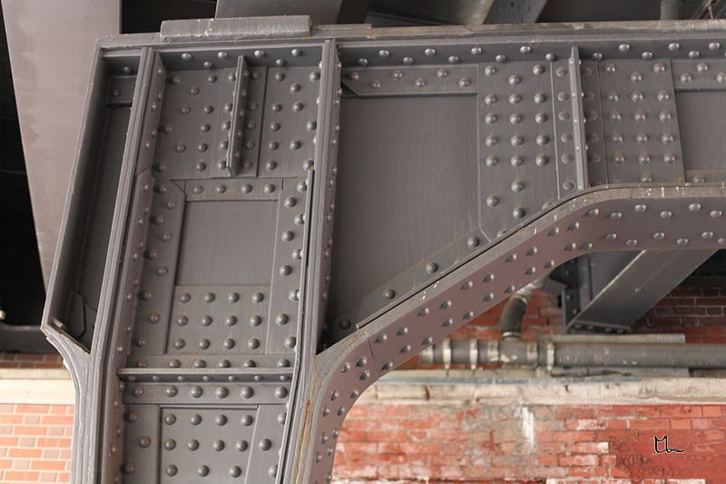
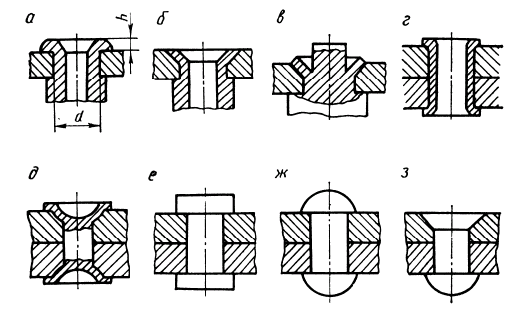
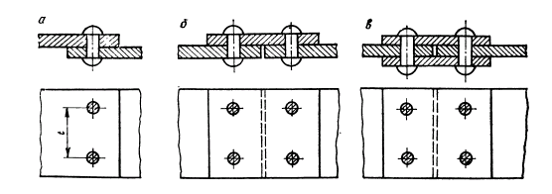
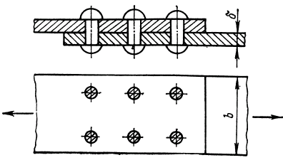
Riveting
https://www.youtube.com/watch?v=mGOiPPM6pKM
Attention! The author of this video is crazy and I don't recommend listening to his ideas.
But he collected some interesting photos and videos, so this video is useful.

Slide 4
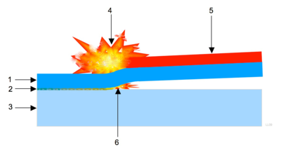
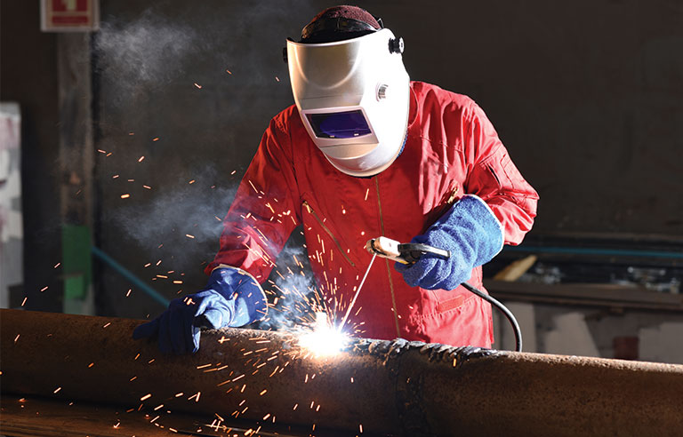

Welding
Arc welding
Gas welding
Resistance welding (spot welding, seam welding)
Energy beam welding (laser and electron beam welding)
Forge welding
Friction welding
Explosion welding
Ultrasonic welding

Slide 5
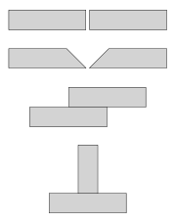
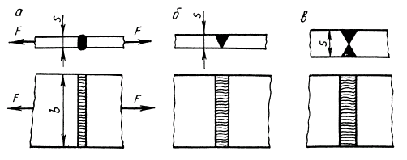
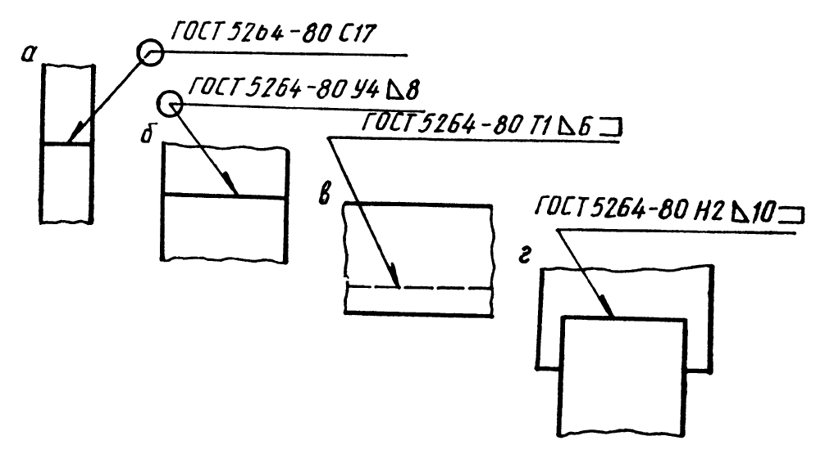
Welding

Slide 6
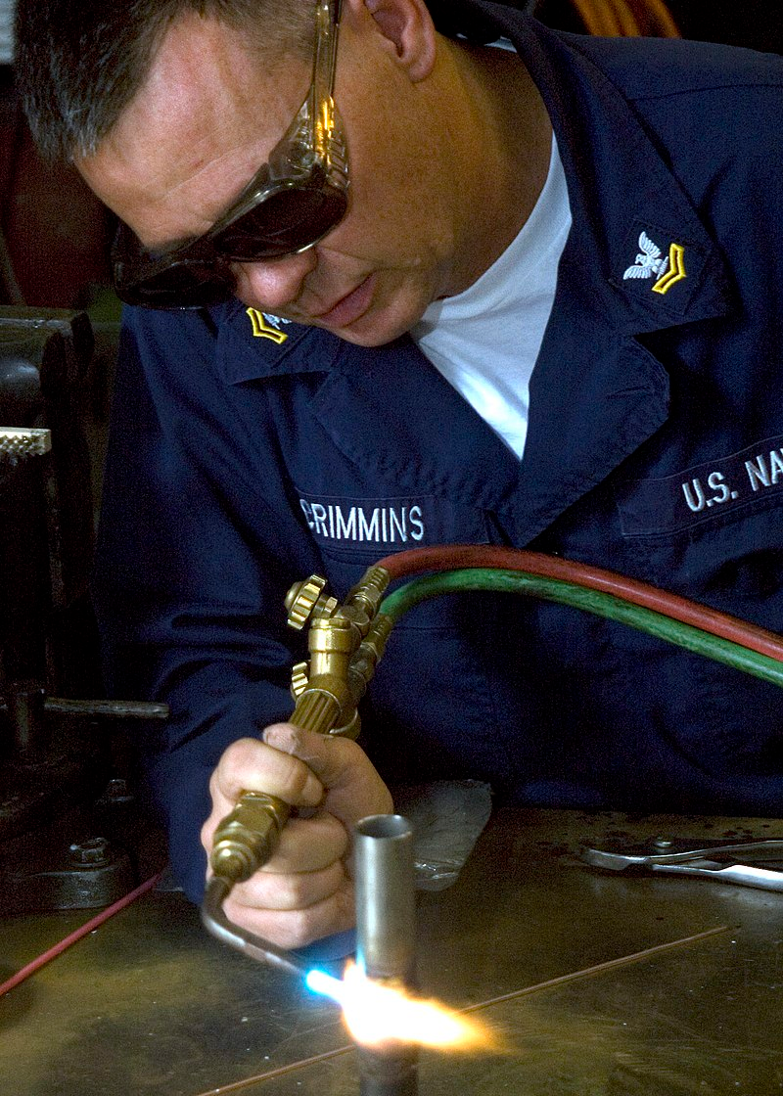
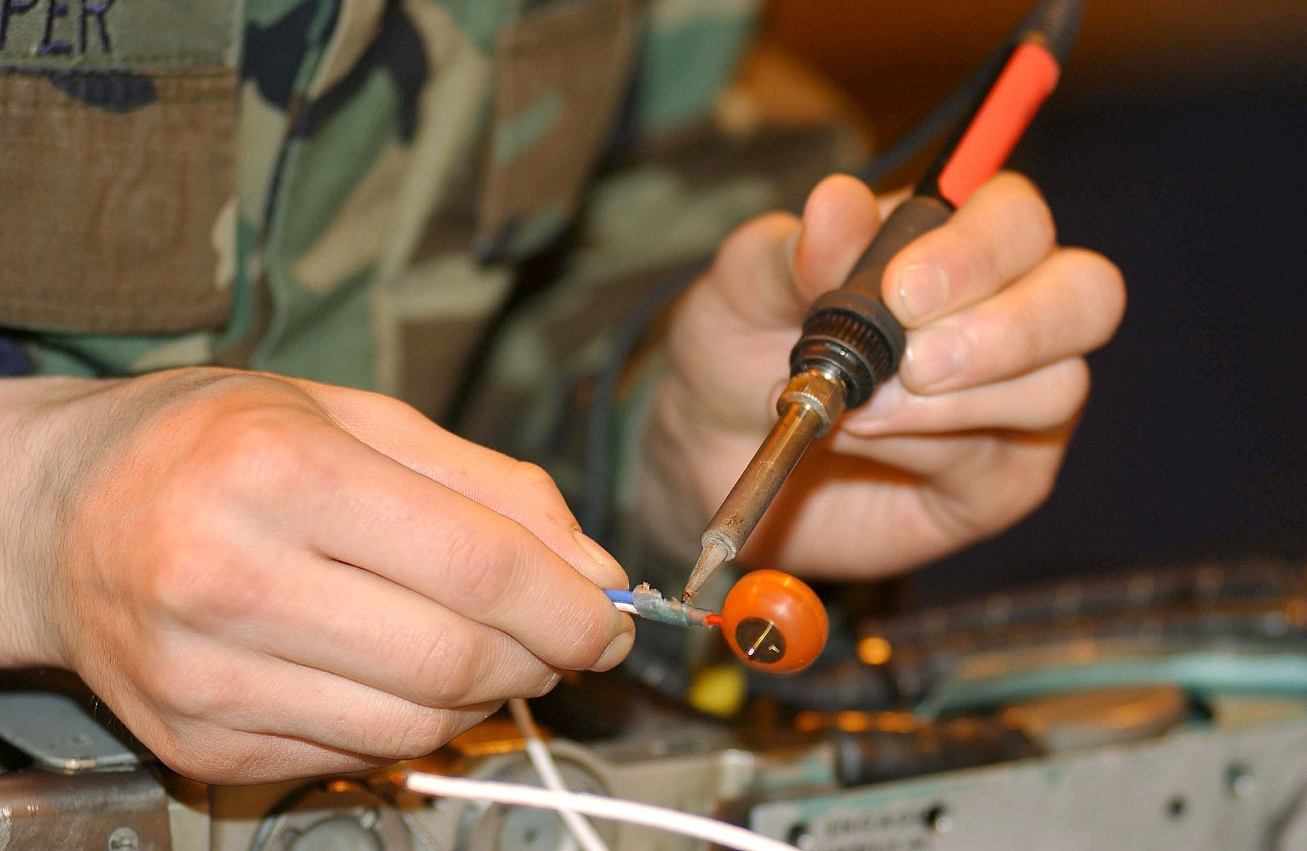
Brazing&soldering

Slide 7
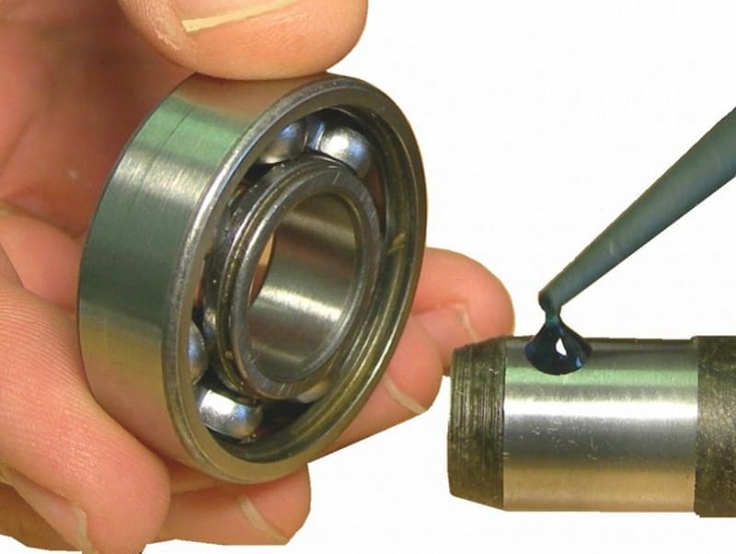
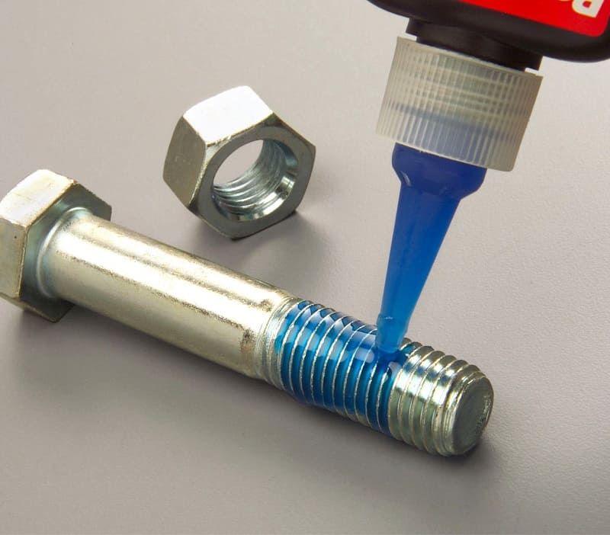
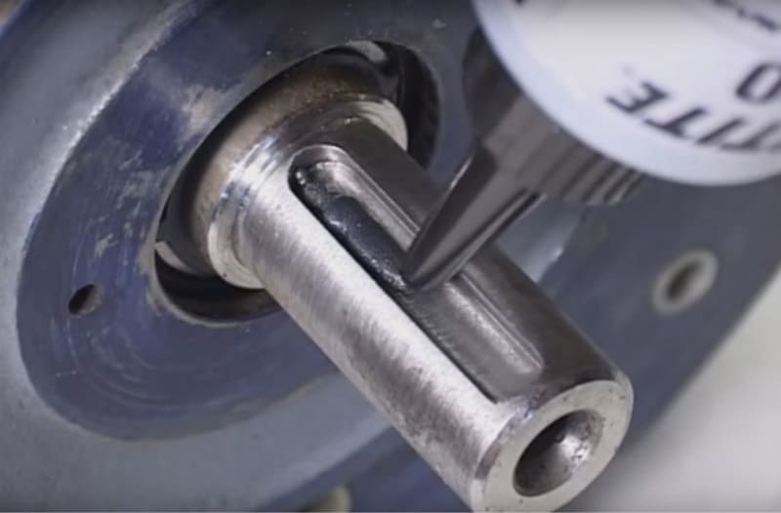
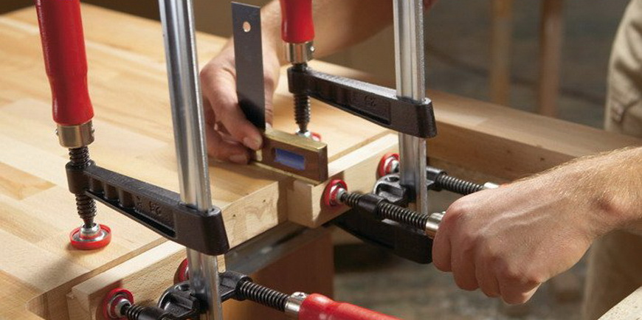
Glue

Slide 8
Introduction
to Theory of Mechanisms and Machines

Slide 9
Mechanisms and their Elements
A mechanism is an artificially created system of bodies designed to transform the movement of one or several bodies into the required movements of other bodies.
One or more rigidly connected solids that make up the mechanism is called a link, a kinematic link or an element.
One of the mechanism links is a fixed link, called a frame.

Slide 10
Mechanisms and their Elements
The links of the mechanism, whose positions are assigned directly by the value of selected independent parameters — generalized coordinates, are called leading ones.
The links of the mechanism, whose positions and displacements uniquely depend on the positions and displacements of the leading links, are called the followers.

Slide 11
Types of Links
In order to transmit motion, the driver and the follower may be connected by the following types of links :
1. Rigid link. A rigid link is one which does not undergo any deformation while transmitting motion. Strictly speaking, rigid links do not exist. However, if we can neglect the deformation of the links, such links can be considered rigid.
2. Flexible link. A flexible link is one which is partly deformed in a manner not to affect the transmission of motion. For example, belts, ropes, chains and wires are flexible links and transmit tensile forces only.
3. Elastic link. The elastic link is deformed in the direction of motion transmission. For example: springs, tensile cables, flexible beams.
4. Fluid link. A fluid link is one which is formed by having a fluid in a receptacle and the motion is transmitted through the fluid by pressure or compression only, as in the case of hydraulic presses, jacks and brakes.
5. Gas link. A gas link is one which is formed by having a gas in a receptacle and the motion is transmitted through the gas by pressure or compression.

Slide 12
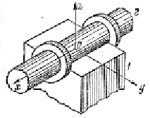
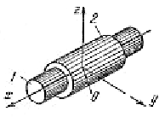
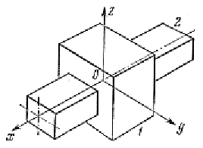
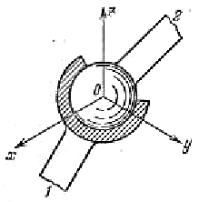
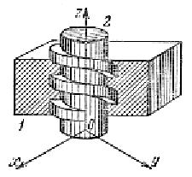
Kinematic pairs
A kinematic pair is a combination of two contiguous links, allowing their relative movement. Surfaces, lines, points of a link along which it can come into contact with another link, forming a kinematic pair, are called elements of a kinematic pair.
The class number of a kinematic pair is determined by the number of coupling conditions that are imposed on the movement of one link of the pair relative to another.

Slide 13
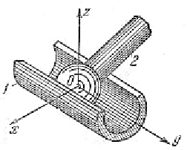
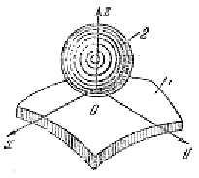
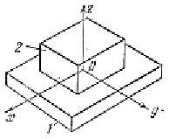
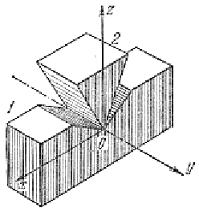
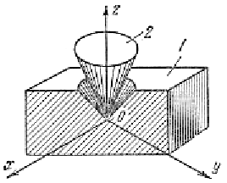
Kinematic pairs

Slide 14
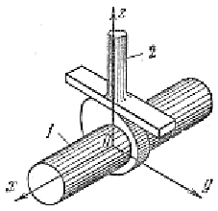
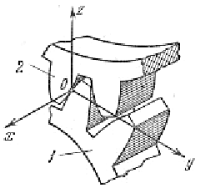
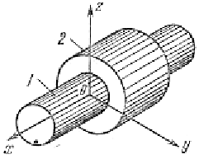
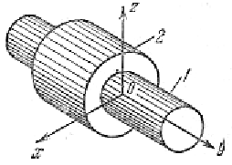
Kinematic pairs
Sometimes additional conditions are imposed on the movement of the links of the mechanism. For example, let the links make a plane-parallel movement in the yz plane. These restrictions must be considered when determining the class of a pair.

Slide 15
Kinematic pairs
Let us fill in the table
 | no translational constraints | 1 translational constraint | 2 translational constraints | 3 translational constraints
no rotational constraints
1 rotational constraint
2 rotational constraints
3 rotational constraints

Slide 16
Kinematic pairs
Let us fill in the table
 | no translational constraints | 1 translational constraint | 2 translational constraints | 3 translational constraints
no rotational constraints | no kinematic pair, free bodies | I class | II class | III class
1 rotational constraint | impossible | II class | III class | IV class
2 rotational constraints | impossible | III class | IV class | V class
3 rotational constraints | impossible | impossible | V class | fixed joining

Slide 17
Kinematic pairs
The kinematic pairs according to the type of contact between the elements may be classified as discussed below:
(a) Lower pair. When the two elements of a pair have a surface contact when relative motion takes place and the surface of one element slides over the surface of the other, the pair formed is
known as lower pair. It will be seen that sliding pairs, turning pairs and screw pairs form lower pairs.
(b) Higher pair. When the two elements of a pair have a line or point contact when relative motion takes place and the motion between the two elements is partly turning and partly sliding,then the pair is known as higher pair. A pair of friction discs, toothed gearing, belt and rope drives, ball and
roller bearings and cam and follower are the examples of higher pairs.

Slide 18
Kinematic pairs
The kinematic pairs according to the type of closure
between the elements may be classified as discussed below :
(a) Self closed pair. When the two elements of a pair are connected together mechanically in such a way that only required kind of relative motion occurs, it is then known as self closed pair. The lower pairs are self closed pair.
(b) Force - closed pair. When the two elements of a pair are not connected mechanically but are kept in contact by the action of external forces, the pair is said to be a force-closed pair. The cam and follower is an example of force closed pair, as it is kept in contact by the forces exerted by spring and gravity.

Slide 19
Kinematic chains
A kinematic chain is a connected system of links that form kinematic pairs between them. Kinematic chains are divided into simple and complex, closed and open.
A simple kinematic chain is a chain in which each link is not more than two kinematic pairs.
A complex kinematic chain is a chain that has at least one link that is included in more than two kinematic pairs.
A closed kinematic chain is a chain, each link of which is included in at least two kinematic pairs.
An unclosed kinematic chain is a chain that has links that belong to only one kinematic pair.

Slide 20
Kinematic chains
The vast majority of mechanisms used in engineering practice are formed by closed kinematic chains. Therefore, the mechanism (consisting only of solids) can also be defined as follows.
A mechanism is a kinematic chain in which, with a given movement of one or several links (leading) relative to any of them (frame), all other links (driven) make uniquely determined movements.
The number of degrees of freedom of the mechanism relative to the rack is called the degree of mobility. The simplest mechanisms have a degree of mobility equal to one. But often mechanisms with two or more degrees of mobility are used.

Slide 21
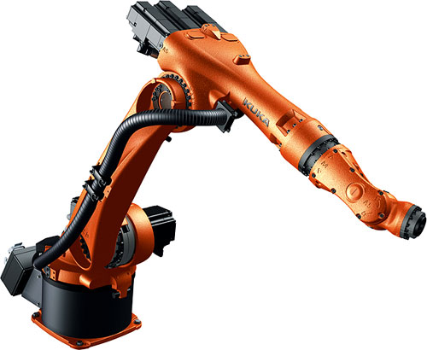
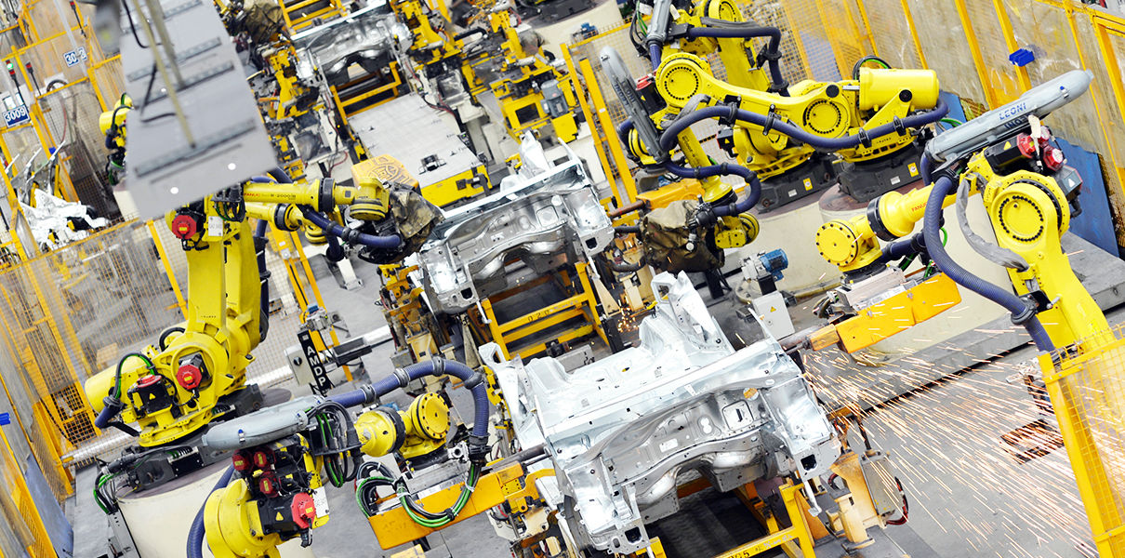
Kinematic chains

Slide 22
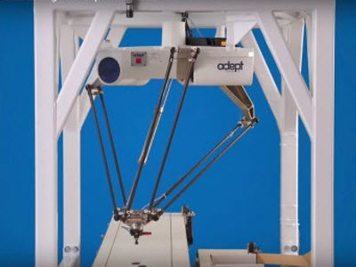
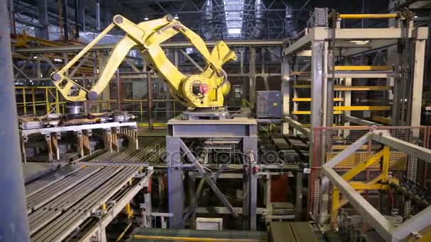
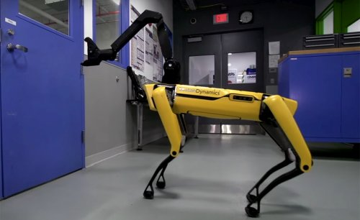
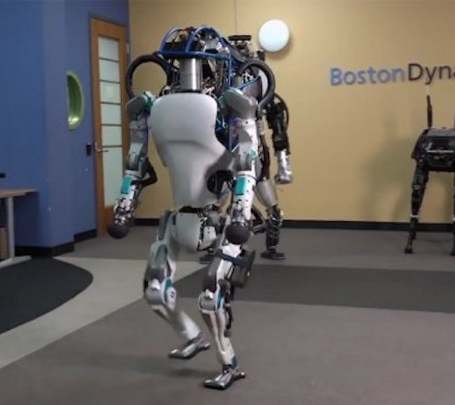
Kinematic chains

Slide 23
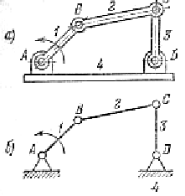
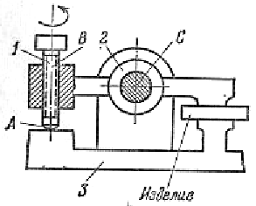
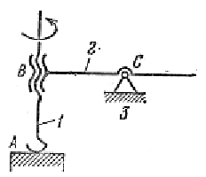
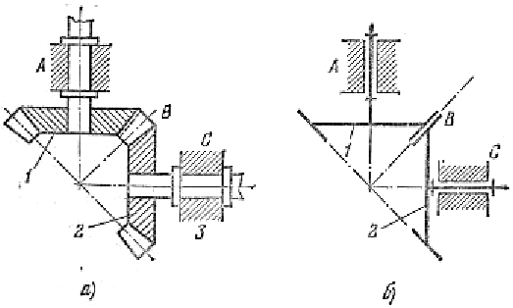
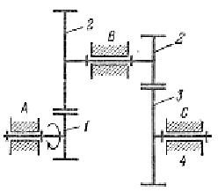
Mechanisms and Machines

Slide 24
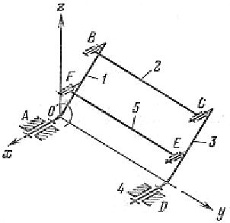
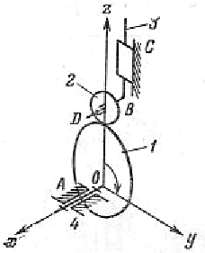
Mechanisms and Machines

Slide 25
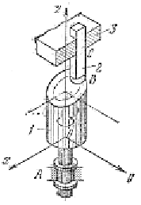
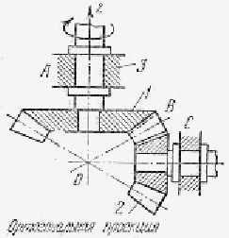
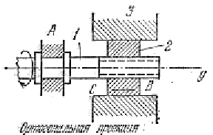
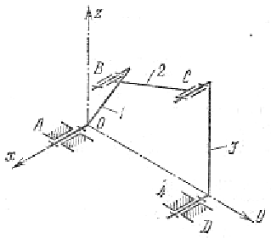
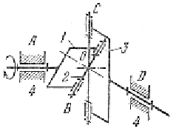
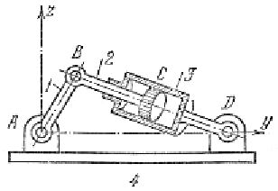
Mechanisms and Machines

Slide 26
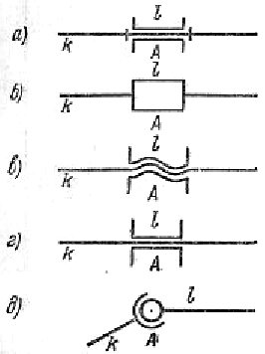
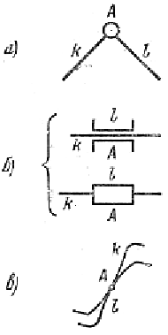


Mechanisms and Machines

Slide 27






Mechanisms and Machines

Slide 28



Mechanisms and Machines

Slide 29

Mechanisms and Machines

Slide 30

Mechanisms and Machines

Slide 31

Mechanisms and Machines

Slide 32

Mechanisms and Machines

Slide 33

Mechanisms and Machines

Slide 34






Mechanisms and Machines

Slide 35




Mechanisms and Machines

Slide 36






Mechanisms and Machines

Slide 37



Mechanisms and Machines

