Slide 1
Mechanics and machines, HW CAD1
Simple Detail

Slide 2
Short task description
Description: make CAD model of the detail
Artefacts: NX detail file (.prt)

Slide 3
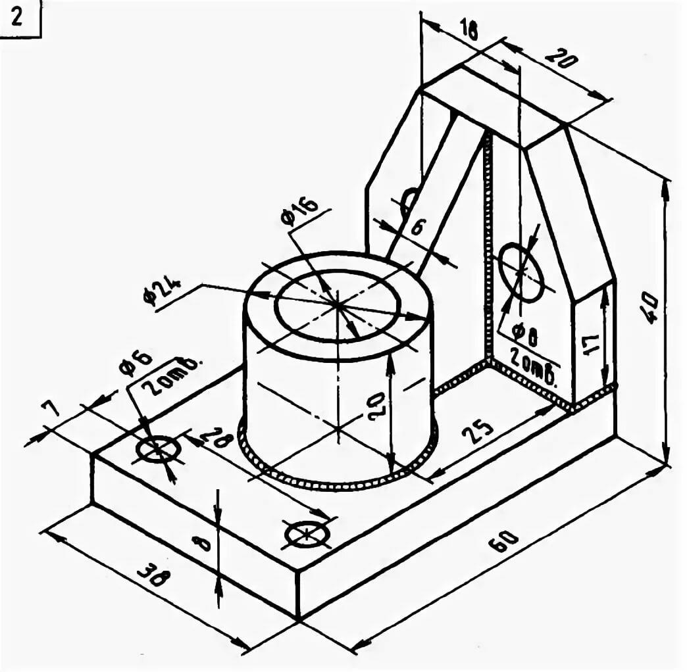
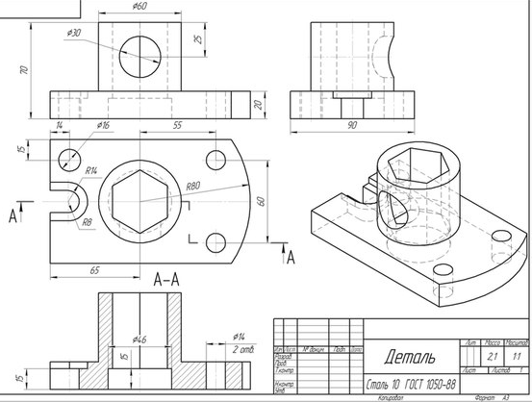
Var 1
Var 2

Slide 4
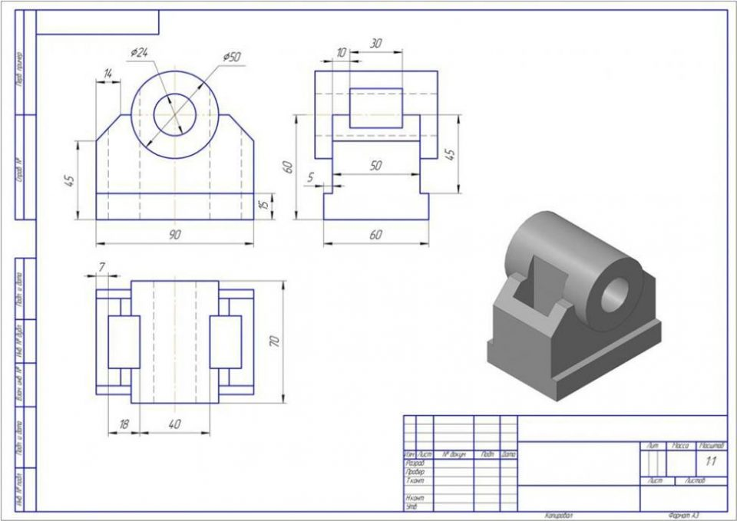
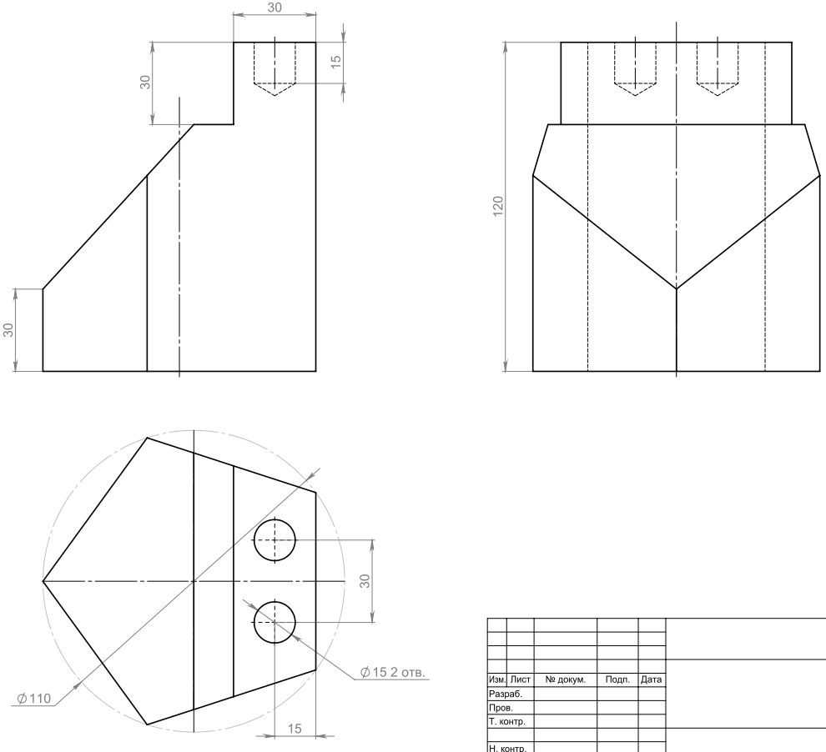
Var 3
Var 4

Slide 5
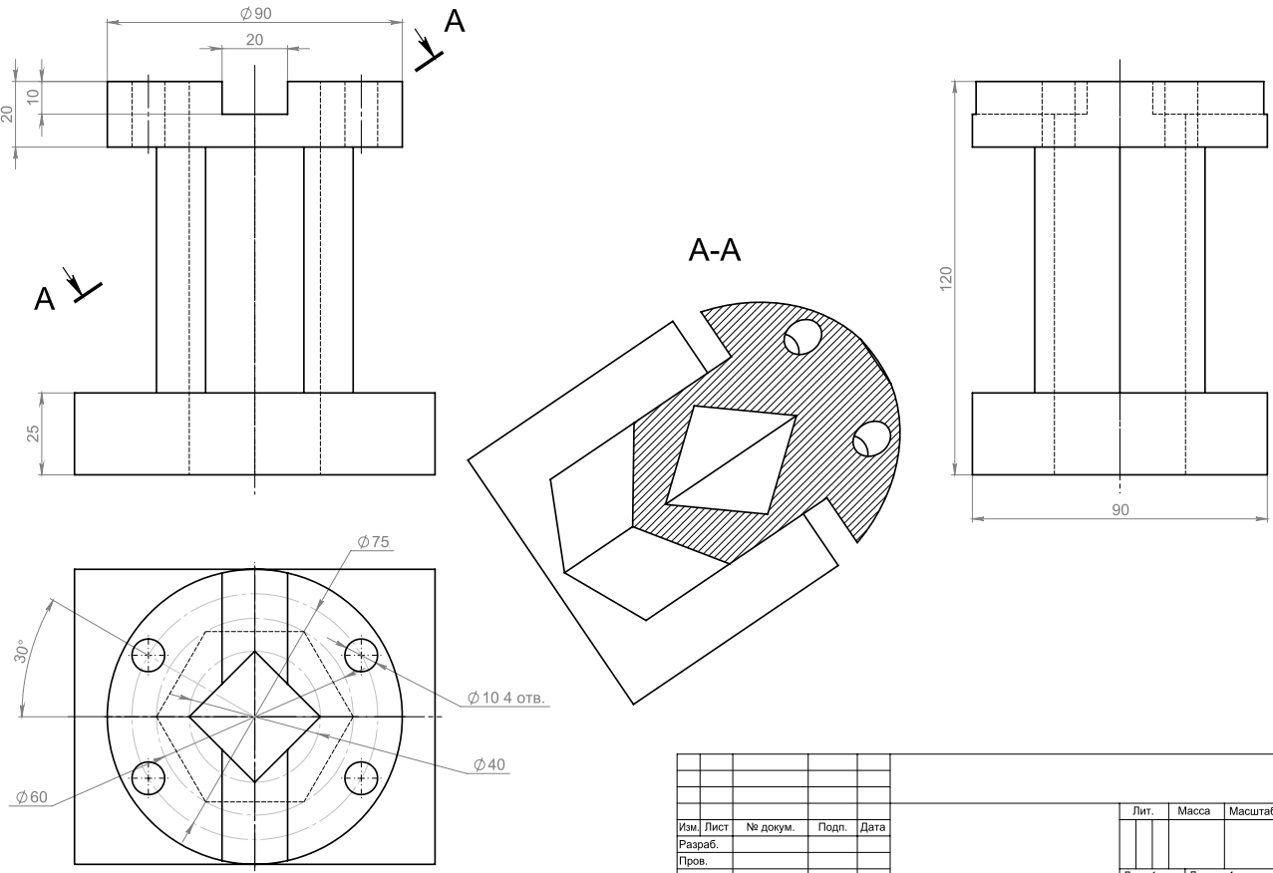
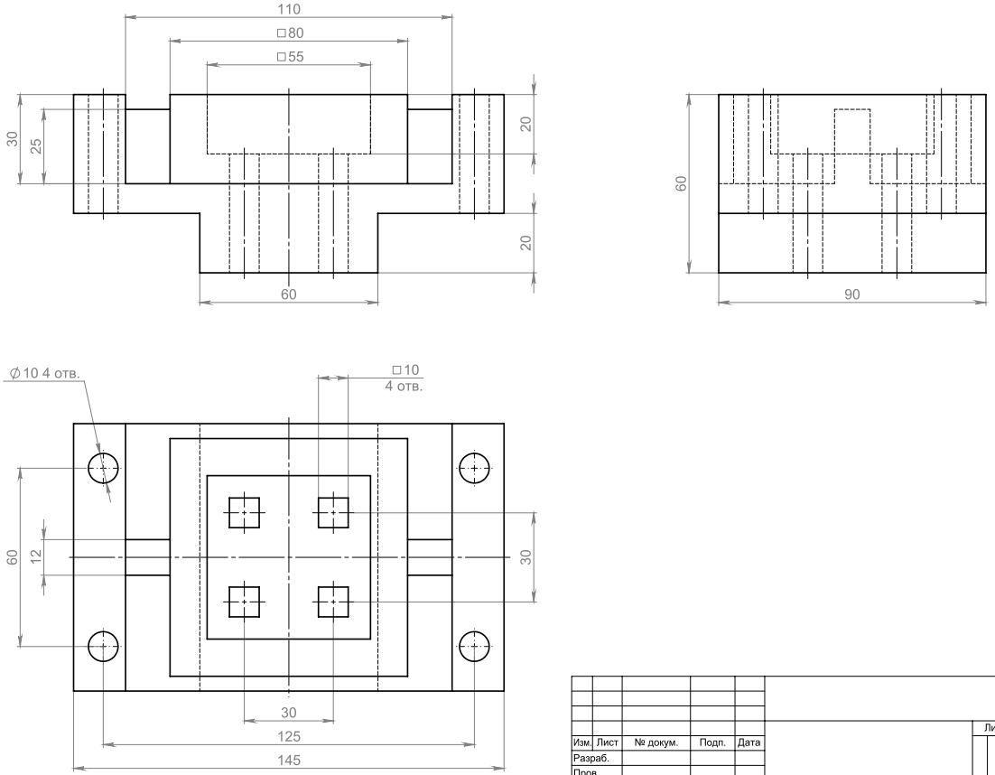
Var 5
Var 6

Slide 6
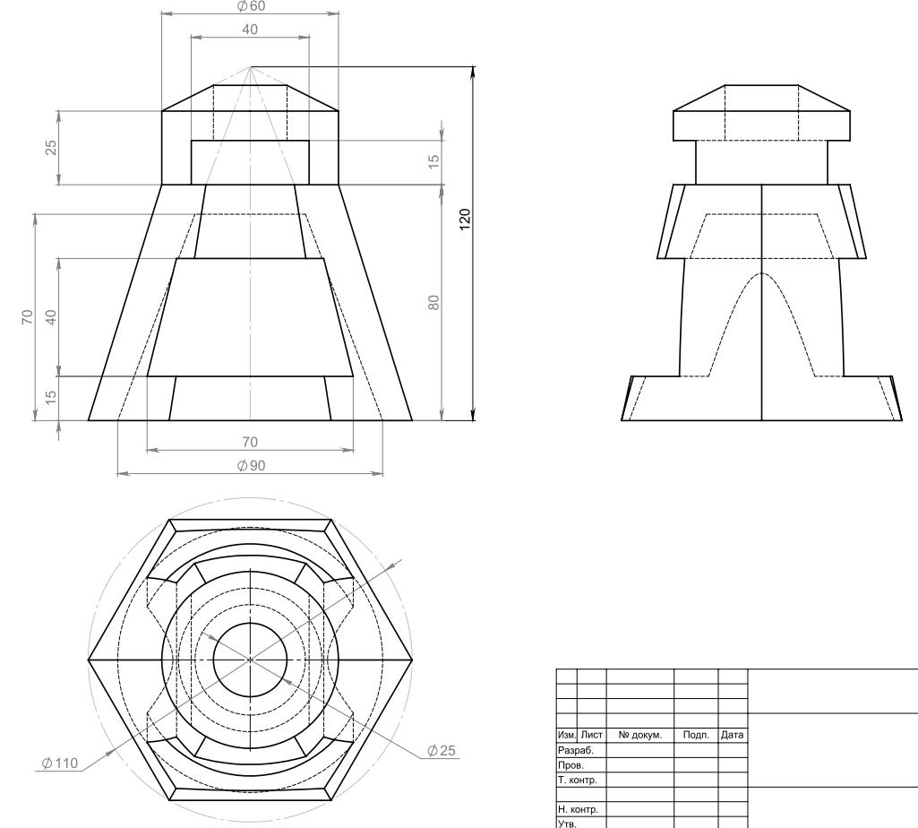
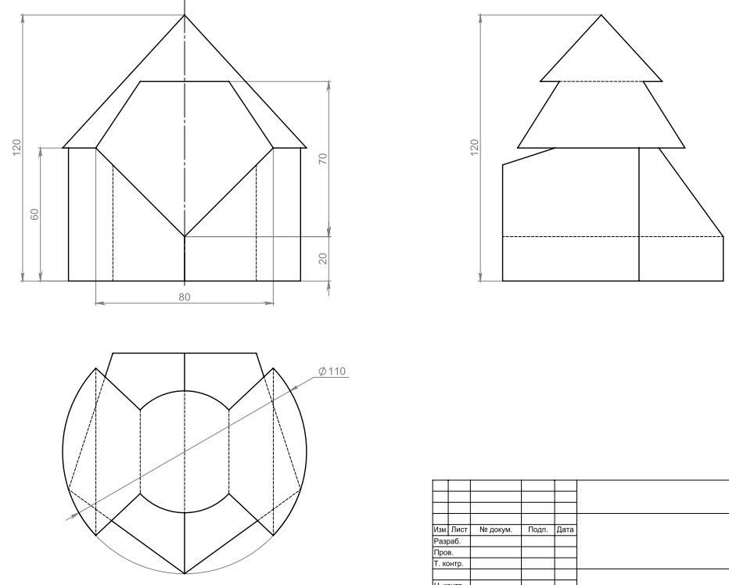
Var 7
Var 7
Var 8

