Slide 1
Mechanics and machines, HW CAD2
Complex details

Slide 2
Short task description
Description: make CAD model of these 2 details
Artefacts: NX detail file (.prt)

Slide 3
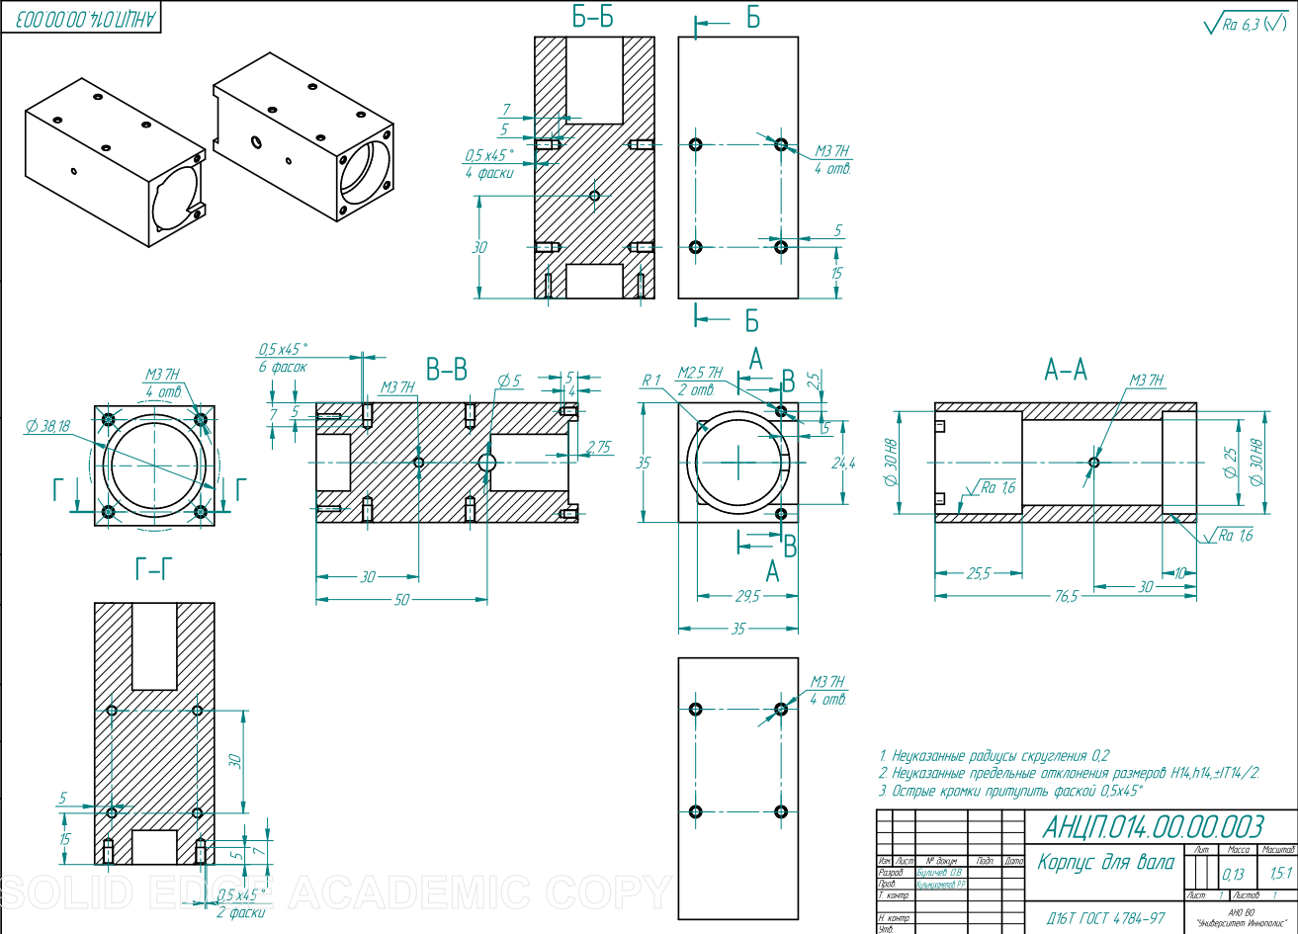
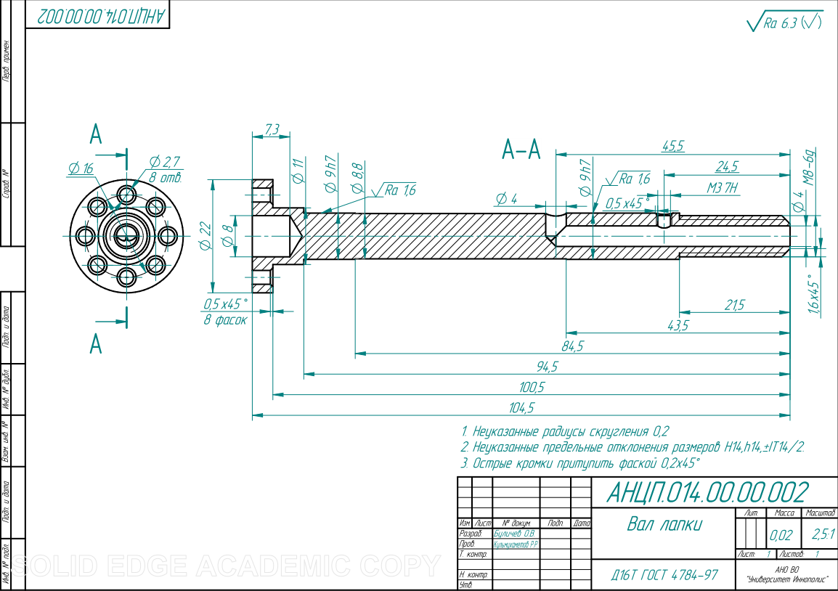
Shaft
Shaft box

