Slide 1
DATA ANALYTICS · 2026
Bank Customer
Churn Analysis
Real bank transaction data · 3 ML models · Business retention strategy
28,382
18.5%
0.847
3
Clients
Churn Rate
Best AUC
ML Models

Slide 2
DATASET
Dataset Overview
28,382
Key Variables
age, gender, occupation, city
Demographics
Total Clients
current_balance, avg_monthly_balance
Account state
5,260
current / prev month credit & debit
Transaction activity
Churned (18.5%)
days_since_last_tx ★ engineered
Recency signal
balance_change, avg_balance_trend
Balance momentum
24
low_balance_flag, credit_debit_ratio
Engineered flags
Features After Engineering
vintage
Tenure at bank (days)
churn (0=stayed / 1=left)
Target variable

Slide 3
ML PIPELINE
End-to-End Workflow
1
2
3
4
5
6
7
📥
🧹
⚙️
✂️
🤖
📊
💰
Raw Data
Cleaning
Feature Eng.
Split 70/15/15
3 ML Models
Evaluation
Business
28,382 clients
›
Drop IDs
›
6 new features
›
Train 19,867
›
LR Pipeline
›
ROC-AUC 0.847
›
Risk segments
21 columns
Impute NaN
Label encode
Val 4,257
Random Forest
F1 0.567
Retention sim.
CSV file
Date→integer
NaN sweep
Test 4,258
Grad. Boost
5-fold CV
ROI 428K
churn_prediction.csv → Retention decisions | Net benefit: ~428,000 per test cohort

Slide 4
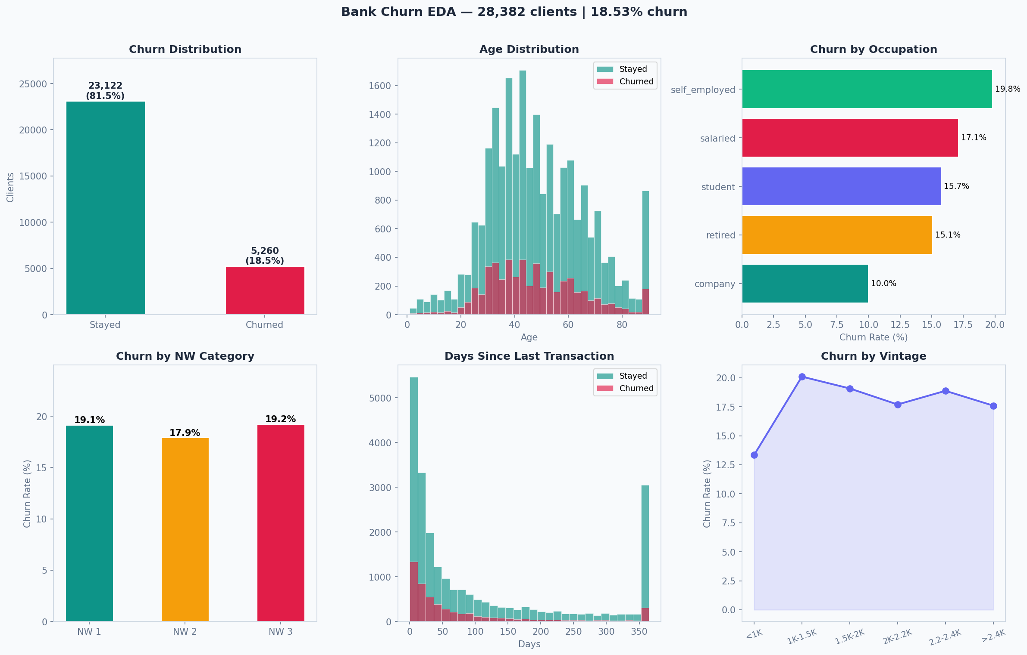
EXPLORATORY ANALYSIS
EDA — Key Patterns in the Data

Slide 5
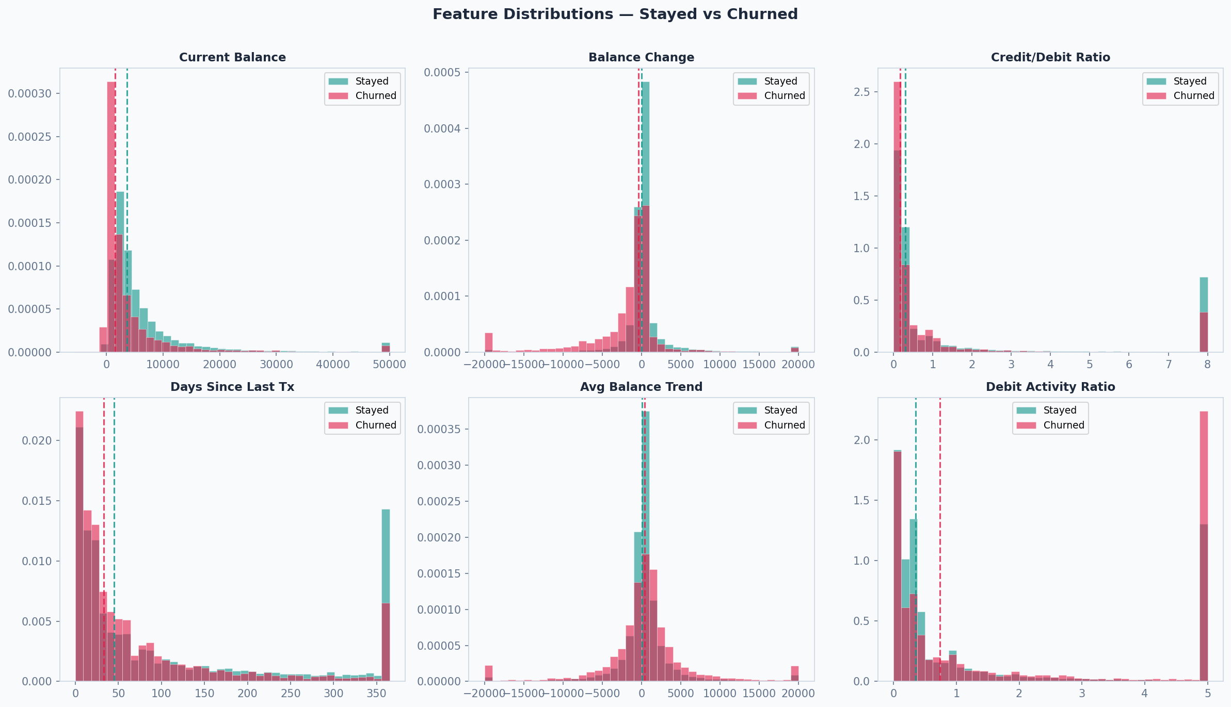
FEATURE ANALYSIS
Key Feature Distributions — Stayed vs Churned

Slide 6
KEY FINDINGS
What the Data Tells Us
01
18.53% Churn Rate
02
Balance = #1 Predictor
5,260 / 28,382 clients left. 5:1 class imbalance → class_weight=balanced applied to all models.
current_balance (RF importance 0.159) and balance_change (0.124) are the top two features. Withdrawing funds = churn signal.
03
25–35 Age Group: 20.5%
04
Self-Employed: 19.8% Churn
Highest churn cohort. Young professionals exploring competitor offers. Target with digital-first loyalty programs.
Highest risk occupation vs company clients at 10.0%. Needs dedicated SME product offering and pricing.
05
Transaction Recency Signal
06
NW Category — Flat Pattern
Churned median: 33 days | Stayed: 45 days. Counter-intuitive — clients transact actively to close accounts.
NW-1: 19.1%, NW-2: 17.9%, NW-3: 19.2%. Nearly identical — wealth category alone is NOT a reliable predictor.

Slide 7
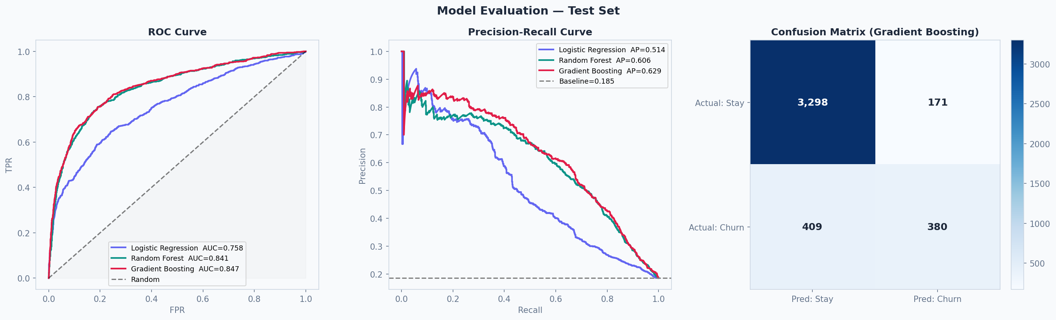
MODEL EVALUATION
Three Models Compared
Verified Metrics (n=4,258)
Metric
LR
RF
GB
Accuracy
77.4%
85.8%
86.4%
Precision
41.8%
63.2%
69.0% ✓
Recall
56.4% ✓
55.8%
48.2%
F1-Score
48.0%
59.3% ✓
56.7%
ROC-AUC
0.758
0.841
0.847 ★
★ Best AUC ✓ Best per metric
GB recommended: best AUC + precision
LR for max recall (fewest missed churners)

Slide 8
TOP DRIVERS
Top 5 Drivers of Churn
1
current_balance
Clients with low / declining balance are most likely to leave. Key risk signal.
RF importance: 0.159 (15.9%)
2
balance_change
Net withdrawal trend (current - prev month). Active outflow = imminent churn.
RF importance: 0.124 (12.4%)
3
current_month_balance
Month-end balance snapshot. Captures short-term financial disengagement.
RF importance: 0.084 ( 8.4%)
4
current_month_debit
High debit + low deposits = net outflow pattern. Client draining the account.
RF importance: 0.067 ( 6.7%)
5
previous_month_debit
Confirms debit trend over two consecutive months. Sustained withdrawal pattern.
RF importance: 0.058 ( 5.8%)

Slide 9
RISK SEGMENTATION
Customer Risk Segments
Gradient Boosting model · P(churn) threshold tiers · test set n=4,258
🟢 LOW
3,365
79.0%
8.0%
👉 Standard service — no intervention needed
P < 0.25
Clients
Share
Churn Rate
🟡 MEDIUM
342
8.0%
40.6%
👉 Soft touch — personalised email / product recommendation
P 0.25–0.50
Clients
Share
Churn Rate
🔴 HIGH
280
6.6%
58.6%
👉 Proactive call — discuss pain points, make tailored offer
P 0.50–0.75
Clients
Share
Churn Rate
🚨 CRITICAL
271
6.4%
79.7%
👉 Urgent: personal manager call + fee waiver + premium upgrade
P > 0.75
Clients
Share
Churn Rate

Slide 10
BUSINESS IMPACT
Retention Economics
Simulation Assumptions
Simulation Results (test set)
• Monthly revenue / client retained: 500
Clients at risk (High+Critical):
551
• Outreach cost per client contacted: 50
Actual churners in those segments:
380
Retained @ 20% success:
76 clients
• Retention success rate: 20%
Annual revenue saved:
456,000
• Segments targeted: High + Critical
Outreach cost:
27,550
Net annual benefit:
428,450 ✓
Net Benefit:
428,450
per test cohort (4,258 clients) · annualised
Cost error analysis: 280 False Positives × 50 = 14,000 wasted outreach | Missed churners (FN): revenue opportunity cost

Slide 11
RECOMMENDATIONS
Business Action Plan
1
Weekly Churn Scoring
2
30-Day Inactivity Trigger
Deploy Gradient Boosting (AUC 0.847) for weekly automated scoring. Flag High+Critical clients (P > 0.50) for outreach.
No transaction in 30+ days → auto email or relationship manager call. Churned median is 33 days — catch them early.
3
Low Balance Intervention
4
Self-Employed Program
Balance < 500 clients → offer savings product, cashback, or fee waiver. Increase their financial stake in the bank.
Develop dedicated SME offering: business credit, separate pricing, premium digital tools. Reduce 19.8% → <17%.
5
25–35 Loyalty Push
6
Estimated Total Impact
Highest-risk cohort (20.5%). Target with digital-first loyalty program, higher savings rate, and referral bonuses.
3pp churn reduction ≈ 850 clients/year saved. At avg. CLV 50K → savings of 42.5M annually across the full portfolio.

Slide 12
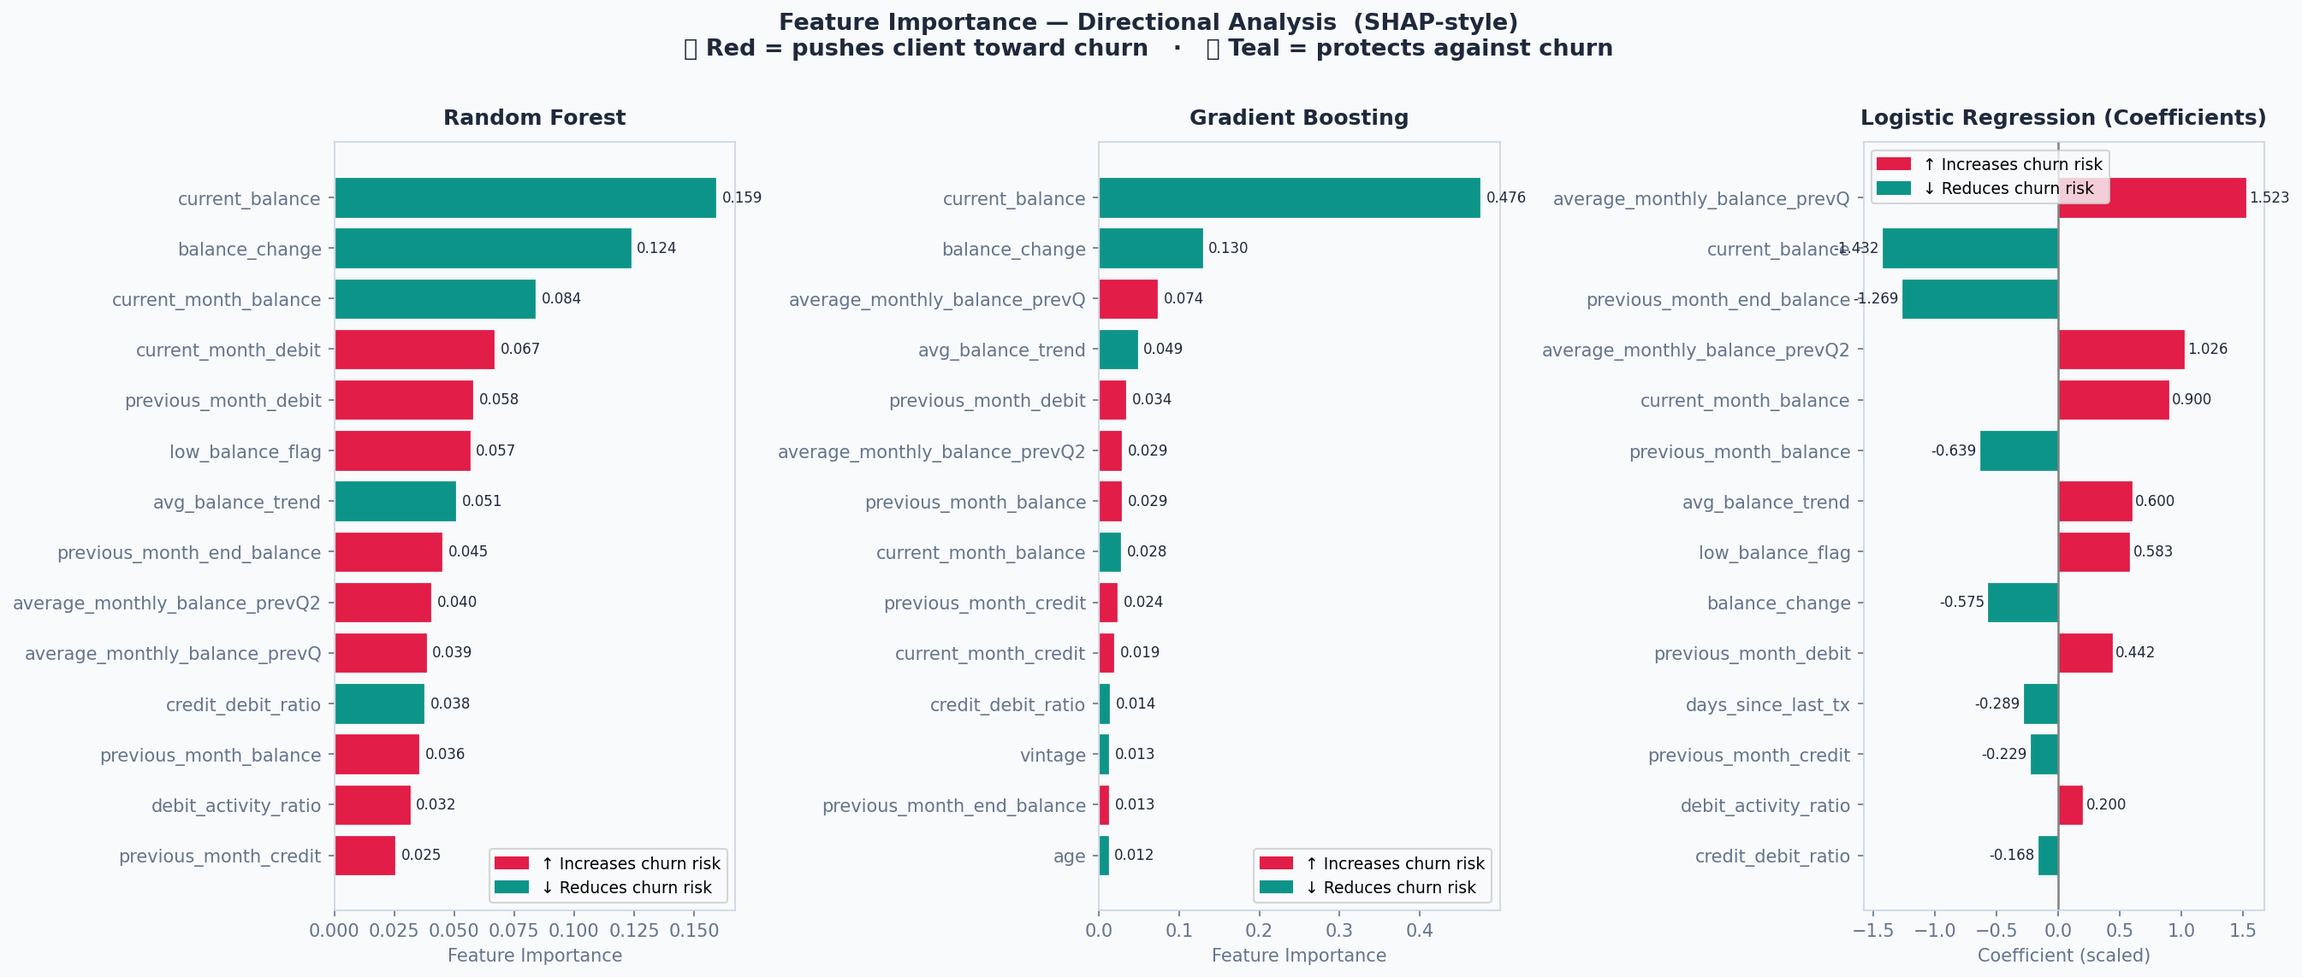
MODEL EXPLAINABILITY
Why Does the Model Predict Churn?
Feature importance with direction — SHAP-style analysis · Red = pushes toward churn · Teal = protects against churn
💡 SHAP package unavailable in this environment — direction encoded via feature–target Pearson correlation. Install shap for full SHAP TreeExplainer output.

Slide 13
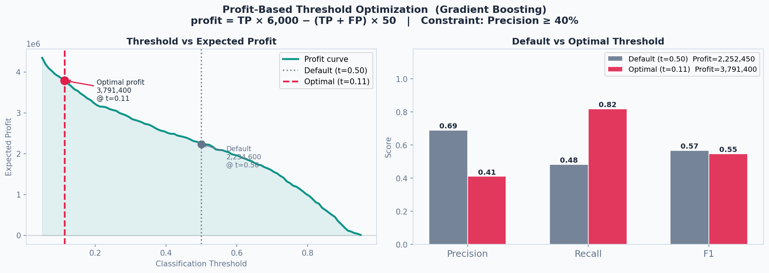
PROFIT OPTIMIZATION
Profit-Based Threshold
Formula: profit = TP × 6,000 − (TP + FP) × 50
Default t=0.50 profit: 2,234,600 → Optimal t=0.11 profit: 3,791,400 (+70%)

Slide 14
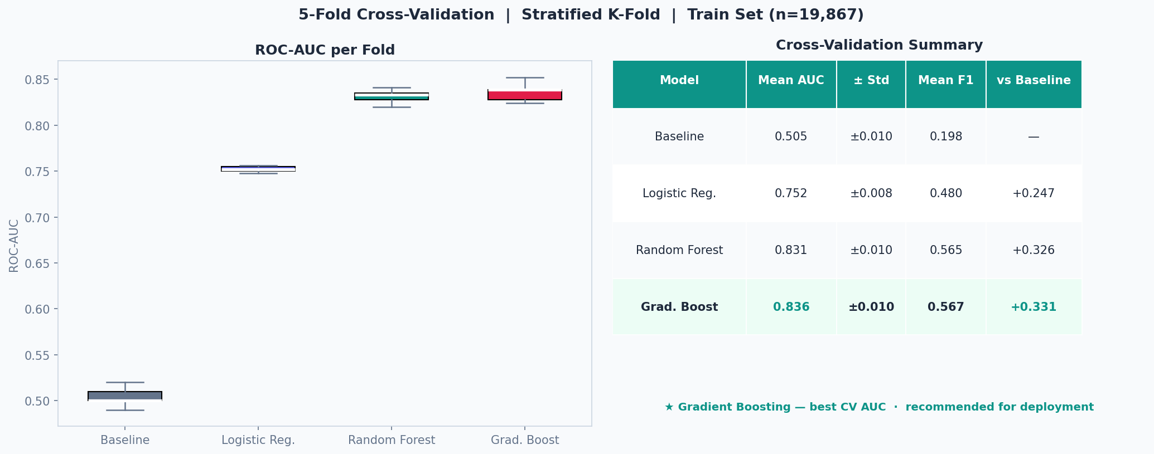
CROSS-VALIDATION
5-Fold Cross-Validation Results
Stratified K-Fold on train set · Ensures stable, unbiased metric estimates · Baseline = random (stratified)
💡 CV removes randomness from a single split. Gradient Boosting wins across all 5 folds — result is robust, not lucky.

Slide 15
SUMMARY
Key Takeaways
✅
28,382 real clients · 18.53% churn · 24 features engineered
✅
Gradient Boosting: best AUC 0.847 · Precision 69% · recommended for deployment
✅
Top drivers: account balance, balance change, debit activity, days since last tx
✅
Risk segmentation: 551 High+Critical clients · 79.7% churn rate in Critical tier
✅
Net retention benefit: 428,450 per cohort at 20% retention success rate
Data Analytics Team · 2026 · churn_prediction.csv

