Slide 1
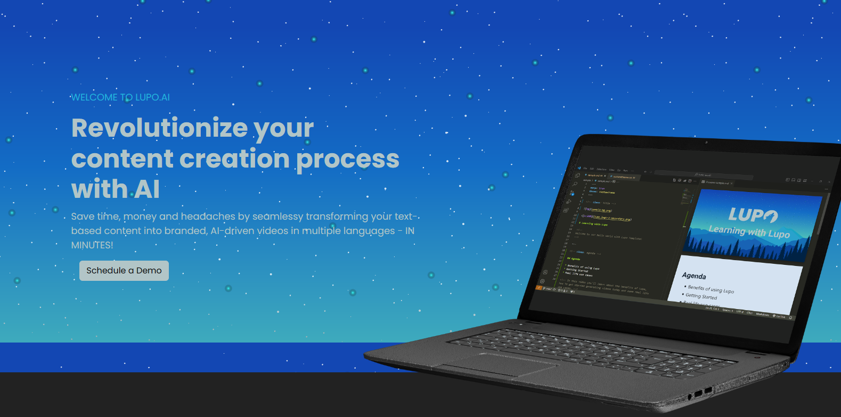
Lupo Demo
Notes:
Save time, money and headaches by seamlessy transforming your text-based content into branded, AI-driven videos in multiple languages, in minutes.

Slide 2
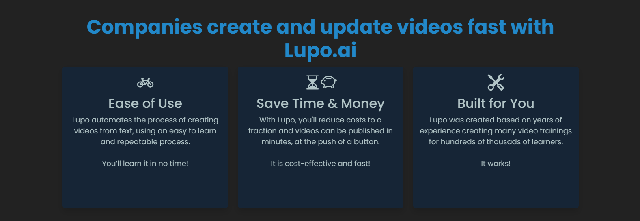
Notes:
Companies create and update videos fast with Lupo.ai

