Slide 1
Flappy Bird Bot
Junhao Wang
Luqi Ye

Slide 2
Introduction
Linear Support Vector Classifier for Flappy Bird Game
Various Fits in Support Vector Classifier
Different Choice of Parameters
Neural Network

Slide 3
Support Vector Classifier
Choice of features and output
X,Y-coordinate of the bird and the pipes, horizontal and vertical velocities of the bird
No significant result leaded to shift to e differences in the x and y coordinates ∆x and ∆y
Output is a boolean “tapped” which is 0 or 1, signifying that the bird has flapped or not

Slide 4
Degree of Polynomial
Finalizing Degree of Polynomial depended on factors like:
Training training data set size
Computational limitations
Overfitting due to large polynomial size
After comparing various degrees, second and third degree polynomial fit gives better results. Chosen third degree polynomial fit as the final fit

Slide 5
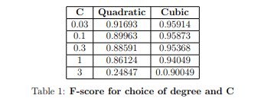
Choice of hyperparameter
Testing on 5 different choices of C, [0.03, 0.1, 0.3, 1, 3] on both polynomials of degree 2 and 3.
Training dataset: 5 million, cross-validation dataset: 1 million
Data set highly skewed (1 in 100 positive examples)
Calculation of micro F-score metric Table:

Slide 6
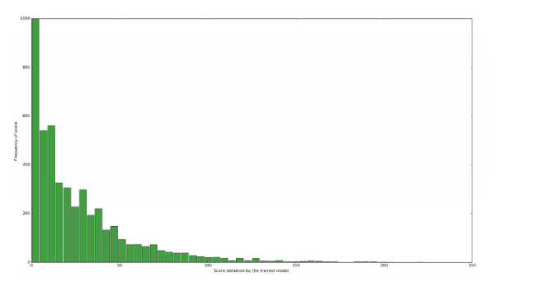
Scores
Collected 4700 scores from the SVC trained with a cubic fit and C = 0.03 on a training set of approx 65 million points. Mean: 26.4295 Standard deviation:28.9981 Max: 223 Min: 0 Histogram: Frequency of score VS Score obtained

Slide 7
Neural Network
Same features as that of Support Vector Classifier
Sufficient features
Neural network “adjust” to give the best fit

Slide 8
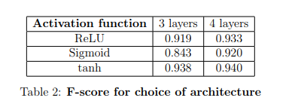
Choice of architecture
Neural nets 3 hidden layers -> 20,30,20 units 4 hidden layers -> 20,30,30,20 units
3 types of activation units - ReLU, tanh, sigmoid functions
Summary f-scores

Slide 9
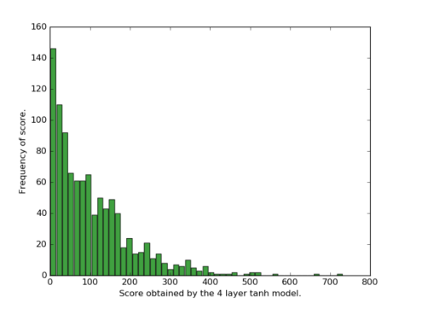
Scores
Best f-score values - 4 layer tanh score stats played over 1000 games. Mean: 106.212 Standard deviation: 100.0684 Max: 731 Min: 1
Histogram: Frequency of score VS Score Obtained by 4 layer tanh model

Slide 10
Conclusion and Further Implementation
From the analysis
better flexibility in Neural Network
neural network performs significantly better than the SVC
Moving ahead we will be using a Q-learning methods to make our bots And compare all the 3 implementations in Final report

