Slide 1






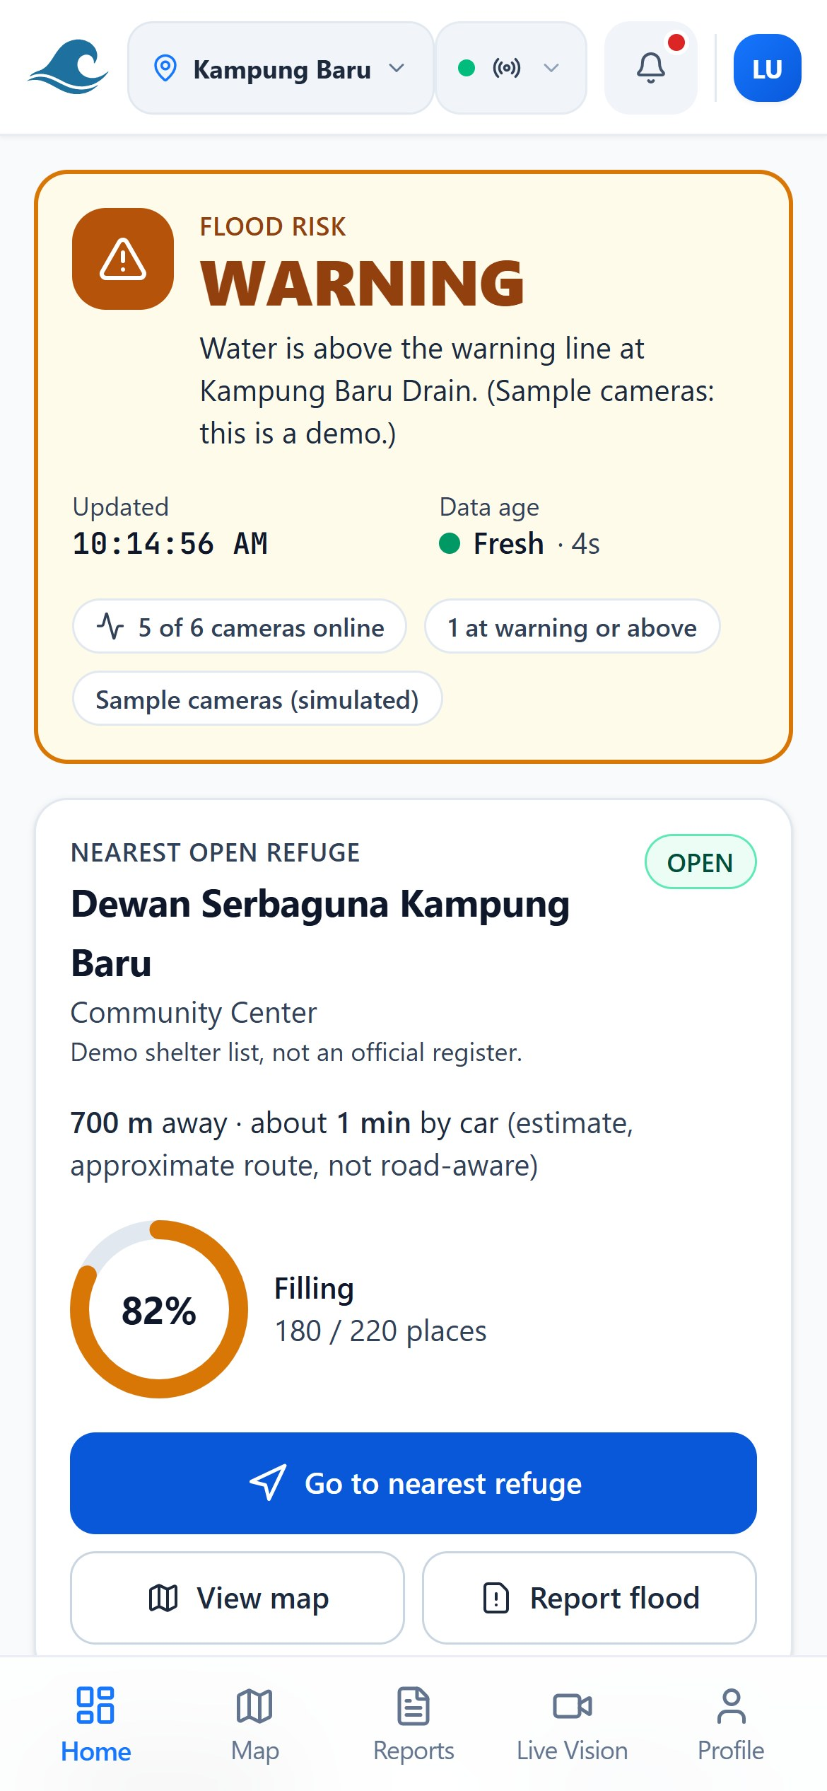
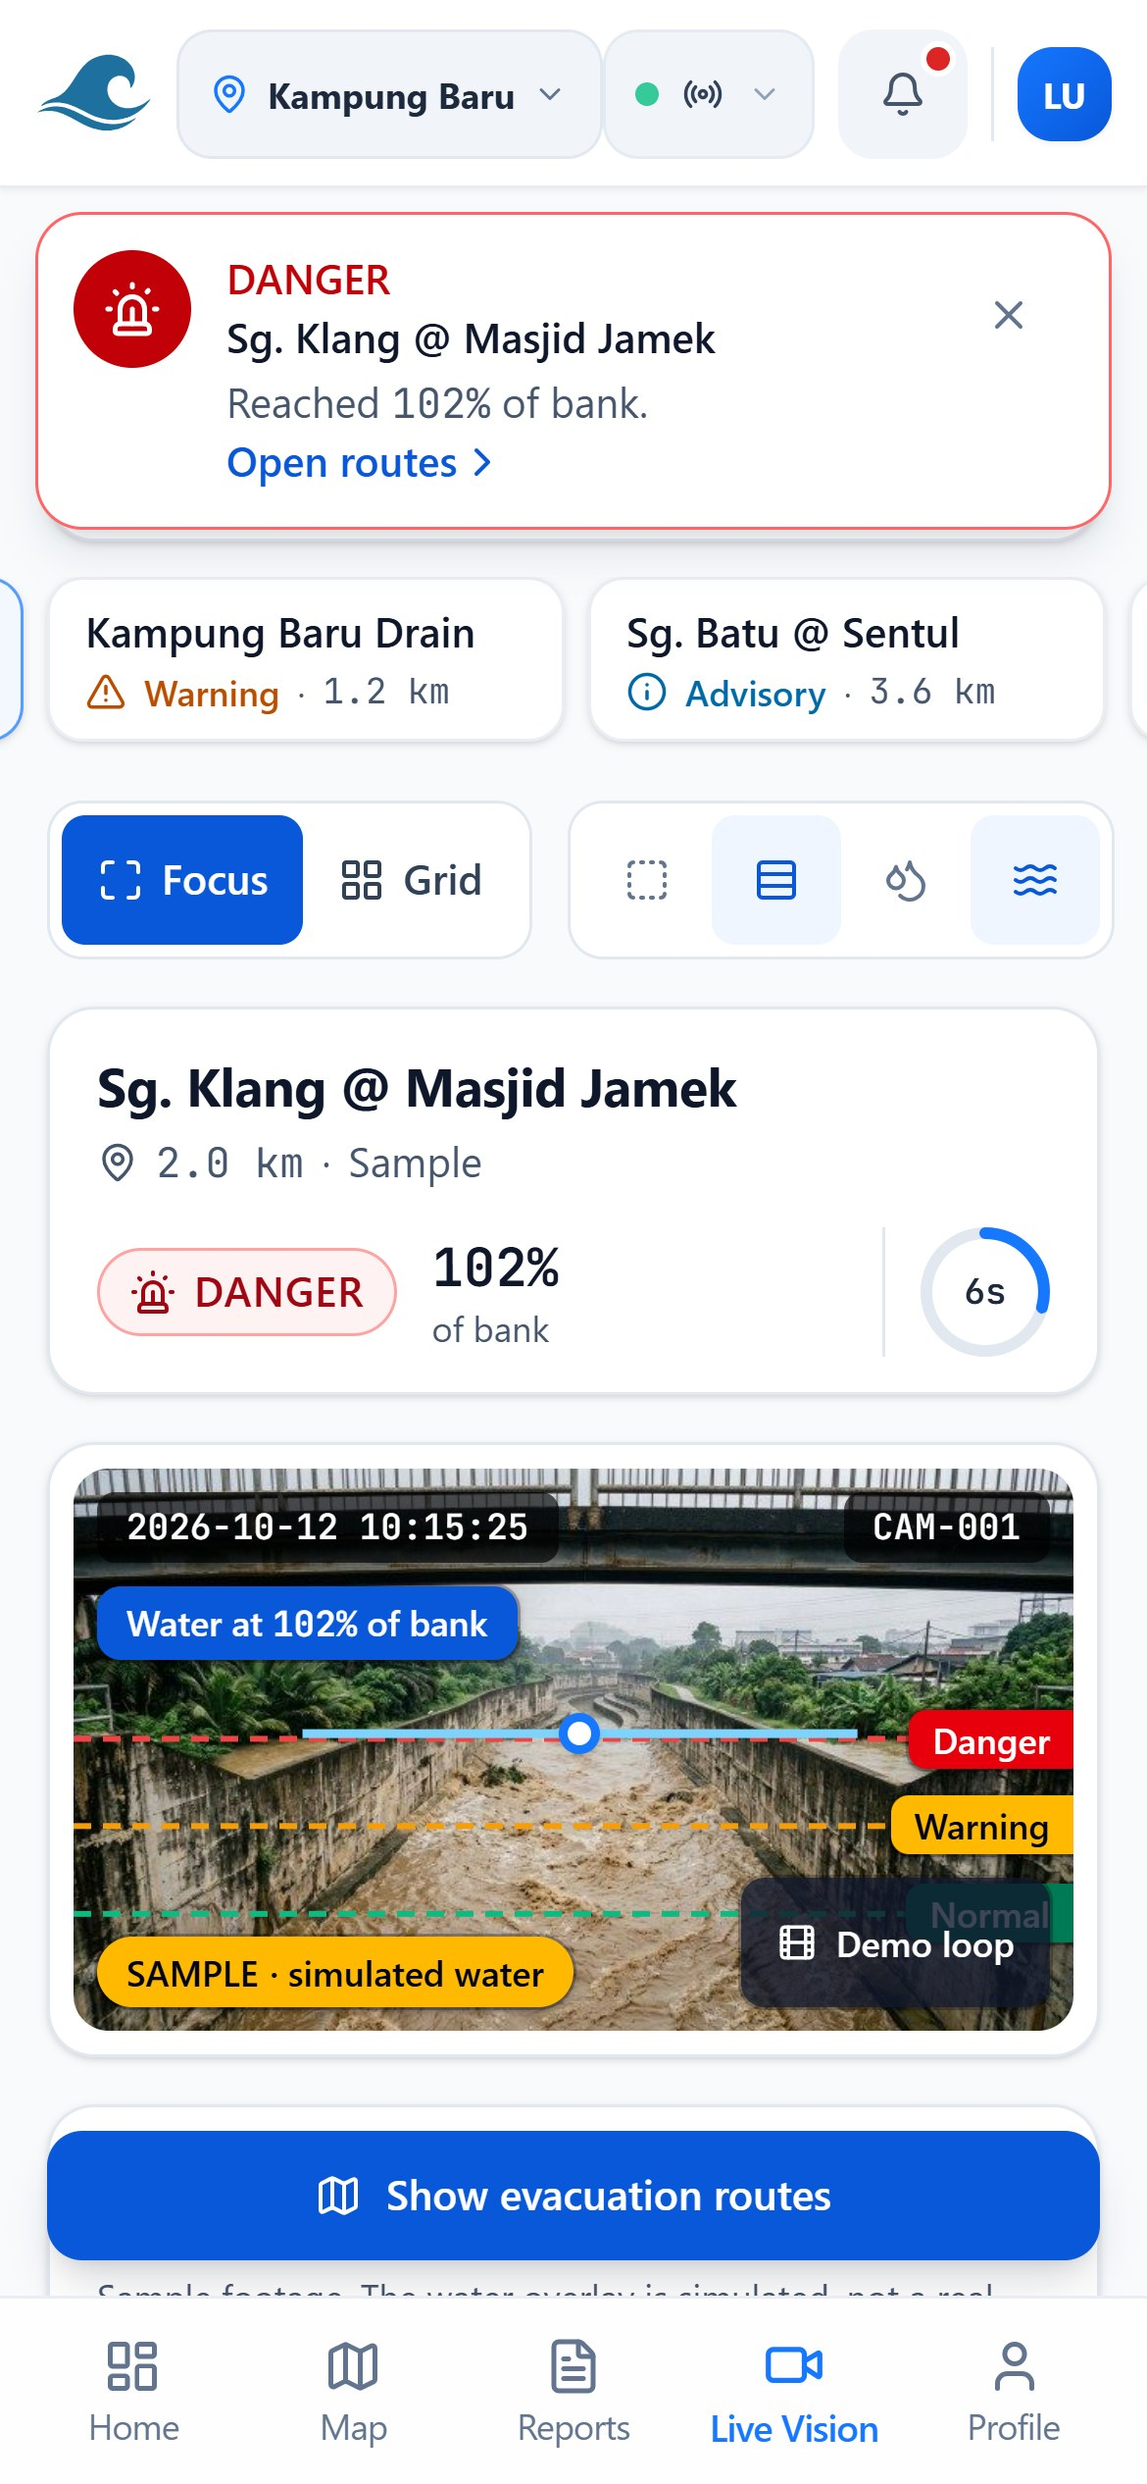
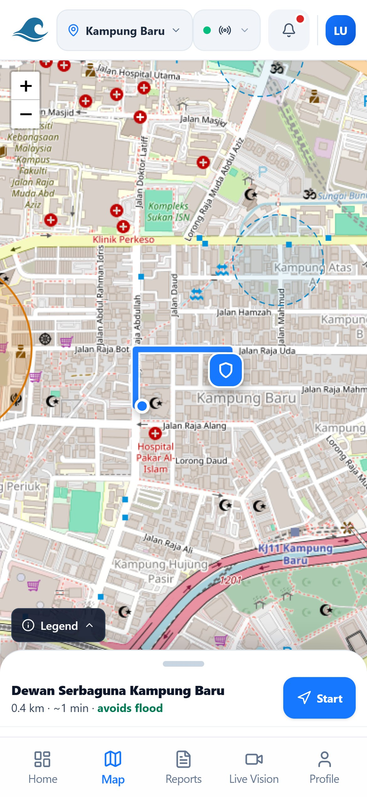






FloodWay
Predict. Verify. Guide. Before the road disappears.
Huawei ICT Competition 2026–2027
Innovation · APAC
Preliminary round
1 · THE PROBLEM
2 · OUR SOLUTION
PROOF, NOT PROMISES
Floods move in minutes. Warnings move in hours.
One glance. One tap.
100%
flood hazard avoidance in 100 simulated scenarios vs 0% for commercial GPS.
<45 min
78%
NEW · REPLACES THE 3D TWIN
95.34%
pixel acc.
86.96%
flood IoU
for a Klang Valley flash flood to turn dangerous
of affected residents never got a local warning
Live Vision
<120 ms
routing
+4.2 min
detour
AI reads the water level from nearby river cameras every few seconds.
Accuracy and IoU: Sen1Floods11 validation split.
KUALA LUMPUR, DECEMBER 2021
380 mm
rain in 24 h
50+
lives lost
125,000
displaced
RM 6.1B
losses
WHY WE WIN
CAPABILITY
TODAY
FLOODWAY
Forecast
None
120-min
Predict
Verify
Guide
Routing
Water-blind
Depth-aware
3 · IMPACT: KAMPUNG BARU
Water stage in +30, +60, +120 min.
Citizen photos pass YOLOv8, then a human.
Routes weighted by water depth vs 0.10 to 0.70 m clearance.
Sensing
Rivers only
Camera AI
The 1:00 AM alert
Shelters
Static list
Live beds
1:00 AM
Yellow alert on the phone, 90 minutes before the water turns dangerous.
Cost
~RM150k/stn
No hardware
Same time
Dry route to an open shelter, a +4.2 min detour around the flood.
We connect JPS, JKM and JKR. Not replace.
Water reaches the house. Everyone is already out.
HUAWEI TECHNOLOGY
2:30 AM
Our Huawei Cloud architecture
ENDORSED AND RECOGNISED
WITHOUT FLOODWAY
No warning. Roads out are already under.
WITH FLOODWAY
Early alert, clear route, all safe.
ModelArts
OBS
ECS
SMN
“Our biggest challenge is families evacuating too late. FloodWay will genuinely save lives.”
Trains and serves the forecast
Camera media and app hosting
Runs Live Vision and routing
SMS and email SOS alerts
Rosli Bin Wahab, Senior Officer, JBPM
Affordable for society: no new sensors, free for citizens, runs on cameras the city already has.
2× 1st Runner-Up: HackWKND, Plan-AI
SDG 11 · 13 · 9
RESQ4ACE · Universiti Teknologi MARA · Muhammad Luqman Nurhakim Rosli · Nadyie Azil Nazeri · Batrisyia Afrina Risamuddin
Instructor: Dr. Azliza Mohd Ali
FloodWay · Real data. Smarter decisions.
Try the live demo: floodway-huawei.pages.dev

