Slide 1
Red Black Trees
Mohsin Abbas

Slide 2
Red-Black Properties
The red-black is a BST such that:
  1. Every node is either red or black
  2. Every NULL pointer is black
    Note: this means every node has 2 children
  3. If a node is red, both children are black
    Note: can’t have 2 consecutive reds on a path
  4. Every path from node to descendent leaf contains the same number of black nodes
  5. The root is always black

Slide 3
Red Black Trees
Let’s do an example from scratch
Always insert nodes as red (except the root)

Slide 4

Insert 1, 2, 3, 4, 5, 6, 7, 8, 9, 10, 11
Always insert nodes as red (except the root)
1. Every node is either red or black
2. Every NULL pointer is black
3. If a node is red, both children are black
4. Every path from node to descendent leaf
contains the same number of black nodes
5. The root is always black

Slide 5
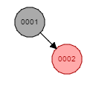
Insert 1, 2, 3, 4, 5, 6, 7, 8, 9, 10, 11
1. Every node is either red or black
2. Every NULL pointer is black
3. If a node is red, both children are black
4. Every path from node to descendent leaf
contains the same number of black nodes
5. The root is always black

Slide 6

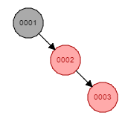
Insert 1, 2, 3, 4, 5, 6, 7, 8, 9, 10, 11
1. Every node is either red or black
2. Every NULL pointer is black
3. If a node is red, both children are black
4. Every path from node to descendent leaf
contains the same number of black nodes
5. The root is always black

Slide 7
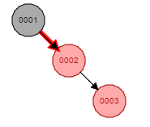
Insert 1, 2, 3, 4, 5, 6, 7, 8, 9, 10, 11
1. Every node is either red or black
2. Every NULL pointer is black
3. If a node is red, both children are black
4. Every path from node to descendent leaf
contains the same number of black nodes
5. The root is always black

Slide 8
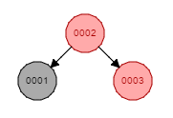
Insert 1, 2, 3, 4, 5, 6, 7, 8, 9, 10, 11
1. Every node is either red or black
2. Every NULL pointer is black
3. If a node is red, both children are black
4. Every path from node to descendent leaf
contains the same number of black nodes
5. The root is always black

Slide 9
Insert 1, 2, 3, 4, 5, 6, 7, 8, 9, 10, 11
Re-colour the tree
1. Every node is either red or black
2. Every NULL pointer is black
3. If a node is red, both children are black
4. Every path from node to descendent leaf
contains the same number of black nodes
5. The root is always black

Slide 10
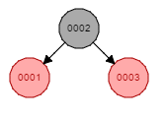
Insert 1, 2, 3, 4, 5, 6, 7, 8, 9, 10, 11
1. Every node is either red or black
2. Every NULL pointer is black
3. If a node is red, both children are black
4. Every path from node to descendent leaf
contains the same number of black nodes
5. The root is always black

Slide 11
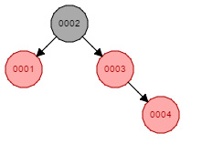
Insert 1, 2, 3, 4, 5, 6, 7, 8, 9, 10, 11
1. Every node is either red or black
2. Every NULL pointer is black
3. If a node is red, both children are black
4. Every path from node to descendent leaf
contains the same number of black nodes
5. The root is always black

Slide 12
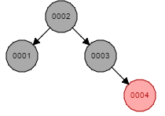
Insert 1, 2, 3, 4, 5, 6, 7, 8, 9, 10, 11
1. Every node is either red or black
2. Every NULL pointer is black
3. If a node is red, both children are black
4. Every path from node to descendent leaf
contains the same number of black nodes
5. The root is always black

Slide 13
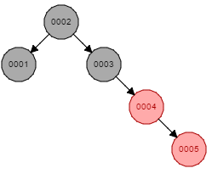
Insert 1, 2, 3, 4, 5, 6, 7, 8, 9, 10, 11
1. Every node is either red or black
2. Every NULL pointer is black
3. If a node is red, both children are black
4. Every path from node to descendent leaf
contains the same number of black nodes
5. The root is always black

Slide 14
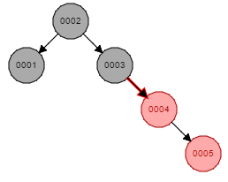
Insert 1, 2, 3, 4, 5, 6, 7, 8, 9, 10, 11
1. Every node is either red or black
2. Every NULL pointer is black
3. If a node is red, both children are black
4. Every path from node to descendent leaf
contains the same number of black nodes
5. The root is always black

Slide 15
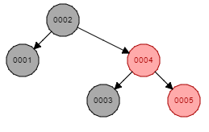
Insert 1, 2, 3, 4, 5, 6, 7, 8, 9, 10, 11
1. Every node is either red or black
2. Every NULL pointer is black
3. If a node is red, both children are black
4. Every path from node to descendent leaf
contains the same number of black nodes
5. The root is always black

Slide 16
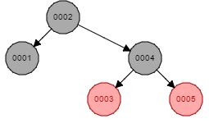
Insert 1, 2, 3, 4, 5, 6, 7, 8, 9, 10, 11
1. Every node is either red or black
2. Every NULL pointer is black
3. If a node is red, both children are black
4. Every path from node to descendent leaf
contains the same number of black nodes
5. The root is always black

Slide 17
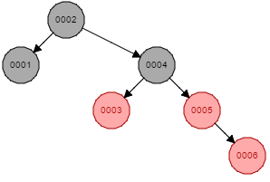
Insert 1, 2, 3, 4, 5, 6, 7, 8, 9, 10, 11
1. Every node is either red or black
2. Every NULL pointer is black
3. If a node is red, both children are black
4. Every path from node to descendent leaf
contains the same number of black nodes
5. The root is always black

Slide 18
Insert 1, 2, 3, 4, 5, 6, 7, 8, 9, 10, 11
1. Every node is either red or black
2. Every NULL pointer is black
3. If a node is red, both children are black
4. Every path from node to descendent leaf
contains the same number of black nodes
5. The root is always black

Slide 19
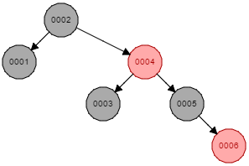
Insert 1, 2, 3, 4, 5, 6, 7, 8, 9, 10, 11
1. Every node is either red or black
2. Every NULL pointer is black
3. If a node is red, both children are black
4. Every path from node to descendent leaf
contains the same number of black nodes
5. The root is always black

Slide 20
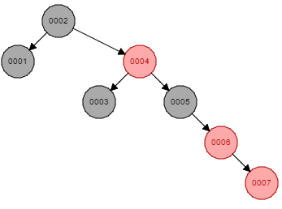
Insert 1, 2, 3, 4, 5, 6, 7, 8, 9, 10, 11
1. Every node is either red or black
2. Every NULL pointer is black
3. If a node is red, both children are black
4. Every path from node to descendent leaf
contains the same number of black nodes
5. The root is always black

Slide 21
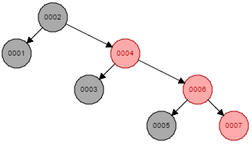
Insert 1, 2, 3, 4, 5, 6, 7, 8, 9, 10, 11
1. Every node is either red or black
2. Every NULL pointer is black
3. If a node is red, both children are black
4. Every path from node to descendent leaf
contains the same number of black nodes
5. The root is always black

Slide 22
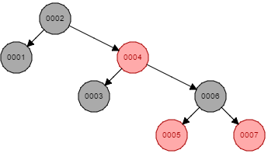
Insert 1, 2, 3, 4, 5, 6, 7, 8, 9, 10, 11
1. Every node is either red or black
2. Every NULL pointer is black
3. If a node is red, both children are black
4. Every path from node to descendent leaf
contains the same number of black nodes
5. The root is always black

Slide 23
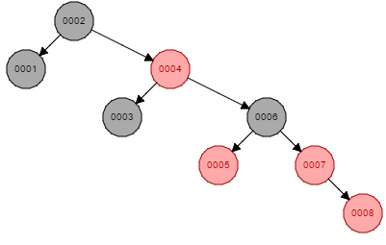
Insert 1, 2, 3, 4, 5, 6, 7, 8, 9, 10, 11
1. Every node is either red or black
2. Every NULL pointer is black
3. If a node is red, both children are black
4. Every path from node to descendent leaf
contains the same number of black nodes
5. The root is always black

Slide 24
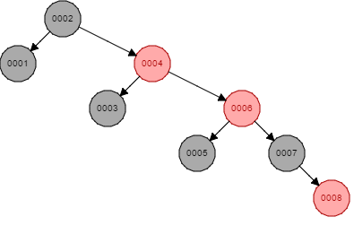
Insert 1, 2, 3, 4, 5, 6, 7, 8, 9, 10, 11
1. Every node is either red or black
2. Every NULL pointer is black
3. If a node is red, both children are black
4. Every path from node to descendent leaf
contains the same number of black nodes
5. The root is always black

Slide 25
Insert 1, 2, 3, 4, 5, 6, 7, 8, 9, 10, 11
1. Every node is either red or black
2. Every NULL pointer is black
3. If a node is red, both children are black
4. Every path from node to descendent leaf
contains the same number of black nodes
5. The root is always black

Slide 26
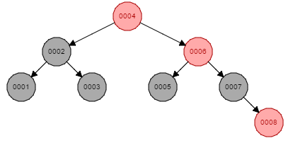
Insert 1, 2, 3, 4, 5, 6, 7, 8, 9, 10, 11
1. Every node is either red or black
2. Every NULL pointer is black
3. If a node is red, both children are black
4. Every path from node to descendent leaf
contains the same number of black nodes
5. The root is always black

Slide 27
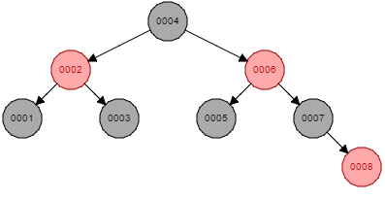
Insert 1, 2, 3, 4, 5, 6, 7, 8, 9, 10, 11
1. Every node is either red or black
2. Every NULL pointer is black
3. If a node is red, both children are black
4. Every path from node to descendent leaf
contains the same number of black nodes
5. The root is always black

Slide 28
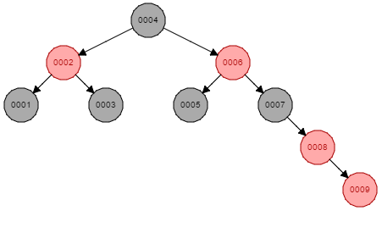
Insert 1, 2, 3, 4, 5, 6, 7, 8, 9, 10, 11
1. Every node is either red or black
2. Every NULL pointer is black
3. If a node is red, both children are black
4. Every path from node to descendent leaf
contains the same number of black nodes
5. The root is always black

Slide 29
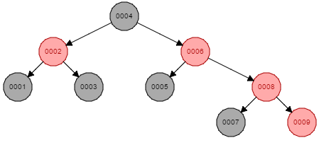
Insert 1, 2, 3, 4, 5, 6, 7, 8, 9, 10, 11
1. Every node is either red or black
2. Every NULL pointer is black
3. If a node is red, both children are black
4. Every path from node to descendent leaf
contains the same number of black nodes
5. The root is always black

Slide 30
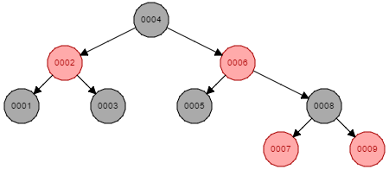
Insert 1, 2, 3, 4, 5, 6, 7, 8, 9, 10, 11
1. Every node is either red or black
2. Every NULL pointer is black
3. If a node is red, both children are black
4. Every path from node to descendent leaf
contains the same number of black nodes
5. The root is always black

Slide 31
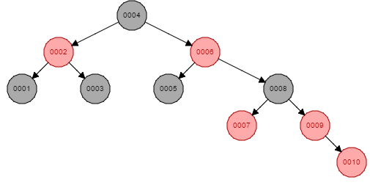
Insert 1, 2, 3, 4, 5, 6, 7, 8, 9, 10, 11
1. Every node is either red or black
2. Every NULL pointer is black
3. If a node is red, both children are black
4. Every path from node to descendent leaf
contains the same number of black nodes
5. The root is always black

Slide 32
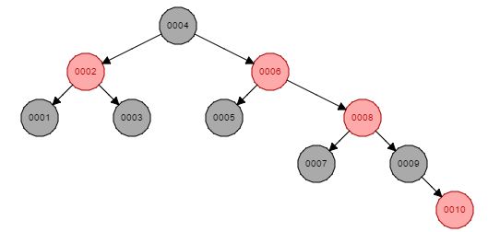
Insert 1, 2, 3, 4, 5, 6, 7, 8, 9, 10, 11
1. Every node is either red or black
2. Every NULL pointer is black
3. If a node is red, both children are black
4. Every path from node to descendent leaf
contains the same number of black nodes
5. The root is always black

Slide 33
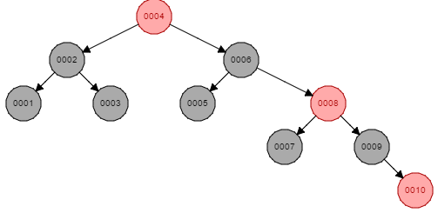
Insert 1, 2, 3, 4, 5, 6, 7, 8, 9, 10, 11
1. Every node is either red or black
2. Every NULL pointer is black
3. If a node is red, both children are black
4. Every path from node to descendent leaf
contains the same number of black nodes
5. The root is always black

Slide 34
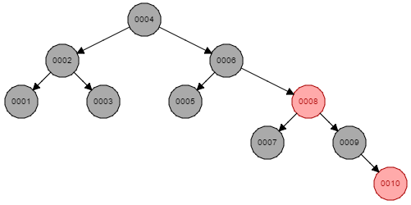
Insert 1, 2, 3, 4, 5, 6, 7, 8, 9, 10, 11
1. Every node is either red or black
2. Every NULL pointer is black
3. If a node is red, both children are black
4. Every path from node to descendent leaf
contains the same number of black nodes
5. The root is always black

Slide 35
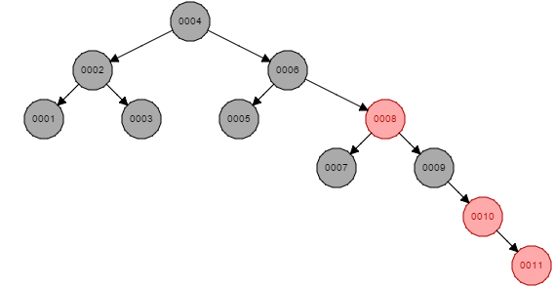
Insert 1, 2, 3, 4, 5, 6, 7, 8, 9, 10, 11
1. Every node is either red or black
2. Every NULL pointer is black
3. If a node is red, both children are black
4. Every path from node to descendent leaf
contains the same number of black nodes
5. The root is always black

Slide 36
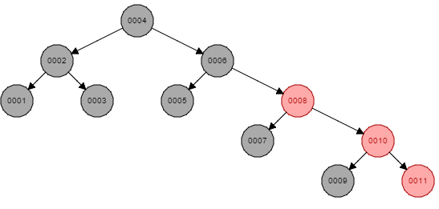
Insert 1, 2, 3, 4, 5, 6, 7, 8, 9, 10, 11
1. Every node is either red or black
2. Every NULL pointer is black
3. If a node is red, both children are black
4. Every path from node to descendent leaf
contains the same number of black nodes
5. The root is always black

Slide 37
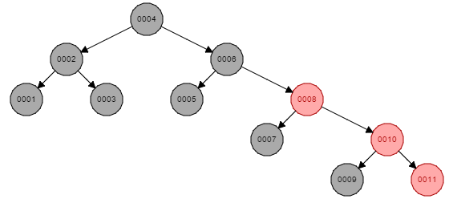
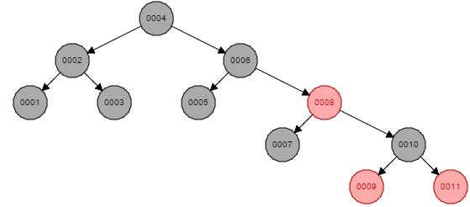
Insert 1, 2, 3, 4, 5, 6, 7, 8, 9, 10, 11
1. Every node is either red or black
2. Every NULL pointer is black
3. If a node is red, both children are black
4. Every path from node to descendent leaf
contains the same number of black nodes
5. The root is always black

Slide 38
DSA Project – 1
Implement red black tree
Your code should include:
  Insert a Node
  Delete a Node
  Search a Node
  Traversals (in-order, pre-order, post-order)
  Copy Tree (using Copy Constructor and a function copyTree)
  Destroy Tree (using Destructor and a function destroy)
Hint: For your ease, the node of R-B trees includes the colour and a pointer to the parent node too.
https://www.cs.usfca.edu/~galles/visualization/RedBlack.html

Slide 39
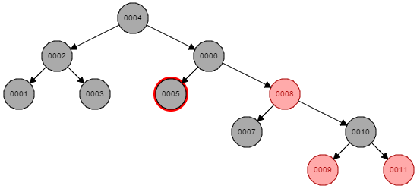
Delete 5, 11
1. Every node is either red or black
2. Every NULL pointer is black
3. If a node is red, both children are black
4. Every path from node to descendent leaf
contains the same number of black nodes
5. The root is always black

Slide 40
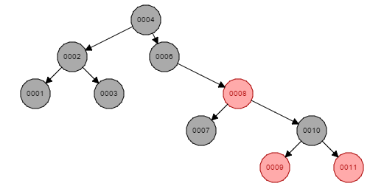
Delete 5, 11
1. Every node is either red or black
2. Every NULL pointer is black
3. If a node is red, both children are black
4. Every path from node to descendent leaf
contains the same number of black nodes
5. The root is always black

Slide 41
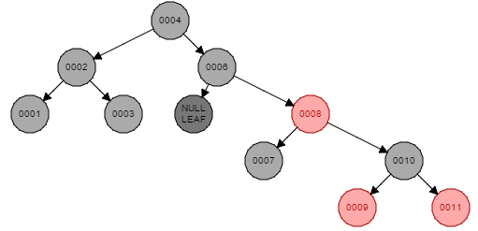
Delete 5, 11
1. Every node is either red or black
2. Every NULL pointer is black
3. If a node is red, both children are black
4. Every path from node to descendent leaf
contains the same number of black nodes
5. The root is always black

Slide 42
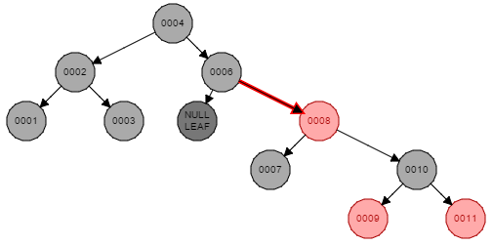
Delete 5, 11
1. Every node is either red or black
2. Every NULL pointer is black
3. If a node is red, both children are black
4. Every path from node to descendent leaf
contains the same number of black nodes
5. The root is always black

Slide 43
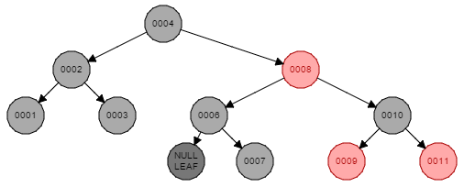
Delete 5, 11
1. Every node is either red or black
2. Every NULL pointer is black
3. If a node is red, both children are black
4. Every path from node to descendent leaf
contains the same number of black nodes
5. The root is always black

Slide 44
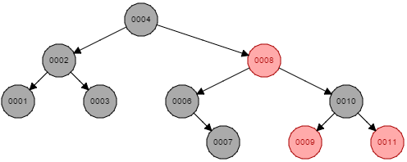
Delete 5, 11
1. Every node is either red or black
2. Every NULL pointer is black
3. If a node is red, both children are black
4. Every path from node to descendent leaf
contains the same number of black nodes
5. The root is always black

Slide 45
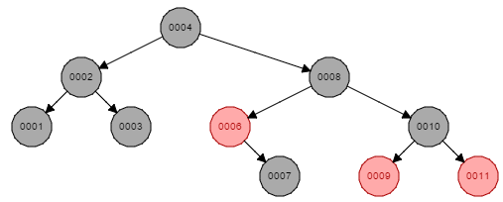
Delete 5, 11
1. Every node is either red or black
2. Every NULL pointer is black
3. If a node is red, both children are black
4. Every path from node to descendent leaf
contains the same number of black nodes
5. The root is always black

Slide 46
Delete 5, 11
1. Every node is either red or black
2. Every NULL pointer is black
3. If a node is red, both children are black
4. Every path from node to descendent leaf
contains the same number of black nodes
5. The root is always black

Slide 47
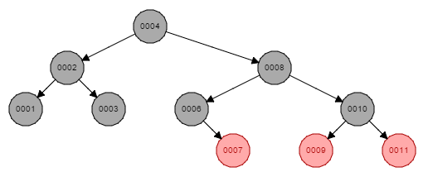
Delete 5, 11
1. Every node is either red or black
2. Every NULL pointer is black
3. If a node is red, both children are black
4. Every path from node to descendent leaf
contains the same number of black nodes
5. The root is always black

Slide 48
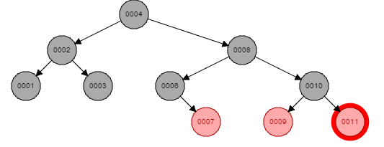
Delete 5, 11
1. Every node is either red or black
2. Every NULL pointer is black
3. If a node is red, both children are black
4. Every path from node to descendent leaf
contains the same number of black nodes
5. The root is always black

Slide 49
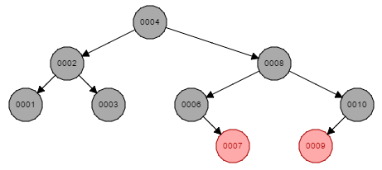
Delete 5, 11
1. Every node is either red or black
2. Every NULL pointer is black
3. If a node is red, both children are black
4. Every path from node to descendent leaf
contains the same number of black nodes
5. The root is always black

Slide 50
Red Black Trees
Insertion

Slide 51
5 Cases of Insertion
All nodes are inserted as red except root
N's parent (P) is black
N's parent (P) and uncle (U) are red
N is added to right of left child of grandparent, or N is added to left of right child of grandparent (P is red and U is black)
N is added to left of left child of grandparent, or N is added to right of right child of grandparent (P is red and U is black)

Slide 52
Case 1
All nodes are inserted as red except root

Slide 53
Insert 1, 2
Always insert nodes as red (except the root)
1. Every node is either red or black
2. Every NULL pointer is black
3. If a node is red, both children are black
4. Every path from node to descendent leaf
contains the same number of black nodes
5. The root is always black

Slide 54
Insert 1, 2
1. Every node is either red or black
2. Every NULL pointer is black
3. If a node is red, both children are black
4. Every path from node to descendent leaf
contains the same number of black nodes
5. The root is always black

Slide 55
Case 2
Insertion Re-visited

Slide 56
Case 2
N's parent (P) is black
No matter how complex the tree already is, if new node’s parent is already black, the tree will always remain a Red-Black tree.

Slide 57
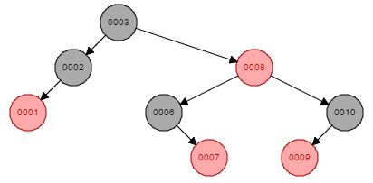
Insert 15, 5
1. Every node is either red or black
2. Every NULL pointer is black
3. If a node is red, both children are black
4. Every path from node to descendent leaf
contains the same number of black nodes
5. The root is always black

Slide 58
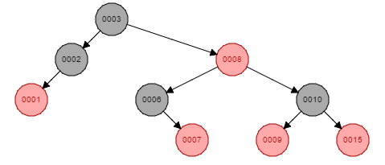
Insert 15, 5
1. Every node is either red or black
2. Every NULL pointer is black
3. If a node is red, both children are black
4. Every path from node to descendent leaf
contains the same number of black nodes
5. The root is always black

Slide 59
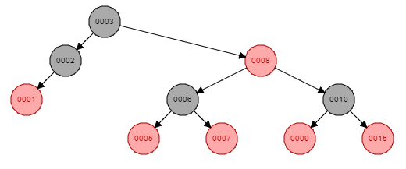
Insert 15, 5
1. Every node is either red or black
2. Every NULL pointer is black
3. If a node is red, both children are black
4. Every path from node to descendent leaf
contains the same number of black nodes
5. The root is always black

Slide 60
Case 3
Insertion Re-visited

Slide 61
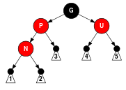
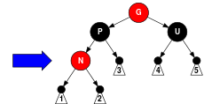
Case 3
N's parent (P) and uncle (U) are red
Solution: Re-colour

Slide 62
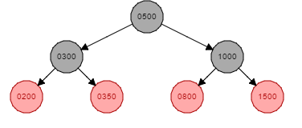
Insert 100, 1800
1. Every node is either red or black
2. Every NULL pointer is black
3. If a node is red, both children are black
4. Every path from node to descendent leaf
contains the same number of black nodes
5. The root is always black

Slide 63
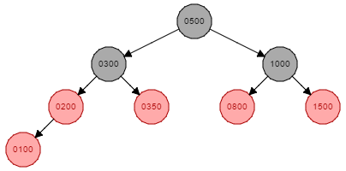
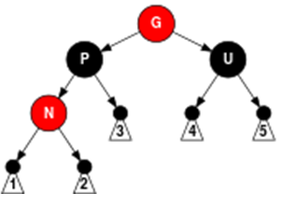
Insert 100, 1800
1. Every node is either red or black
2. Every NULL pointer is black
3. If a node is red, both children are black
4. Every path from node to descendent leaf
contains the same number of black nodes
5. The root is always black

Slide 64
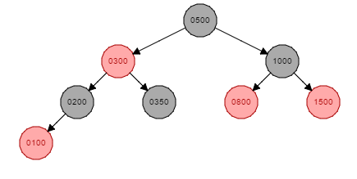
Insert 100, 1800
1. Every node is either red or black
2. Every NULL pointer is black
3. If a node is red, both children are black
4. Every path from node to descendent leaf
contains the same number of black nodes
5. The root is always black

Slide 65

Insert 100, 1800
1. Every node is either red or black
2. Every NULL pointer is black
3. If a node is red, both children are black
4. Every path from node to descendent leaf
contains the same number of black nodes
5. The root is always black

Slide 66

Insert 100, 1800
1. Every node is either red or black
2. Every NULL pointer is black
3. If a node is red, both children are black
4. Every path from node to descendent leaf
contains the same number of black nodes
5. The root is always black

Slide 67

DIY: Insert 350
1. Every node is either red or black
2. Every NULL pointer is black
3. If a node is red, both children are black
4. Every path from node to descendent leaf
contains the same number of black nodes
5. The root is always black

Slide 68

DIY: Insert 350
1. Every node is either red or black
2. Every NULL pointer is black
3. If a node is red, both children are black
4. Every path from node to descendent leaf
contains the same number of black nodes
5. The root is always black

Slide 69

DIY: Insert 350
1. Every node is either red or black
2. Every NULL pointer is black
3. If a node is red, both children are black
4. Every path from node to descendent leaf
contains the same number of black nodes
5. The root is always black

Slide 70
Case 3 (in case of root)
N's parent (P) and uncle (U) are red
Solution: Re-colour
Never forget the root’s case

Slide 71

Insert 4
1. Every node is either red or black
2. Every NULL pointer is black
3. If a node is red, both children are black
4. Every path from node to descendent leaf
contains the same number of black nodes
5. The root is always black

Slide 72

Insert 4
1. Every node is either red or black
2. Every NULL pointer is black
3. If a node is red, both children are black
4. Every path from node to descendent leaf
contains the same number of black nodes
5. The root is always black

Slide 73

Insert 4
1. Every node is either red or black
2. Every NULL pointer is black
3. If a node is red, both children are black
4. Every path from node to descendent leaf
contains the same number of black nodes
5. The root is always black

Slide 74

Insert 4
1. Every node is either red or black
2. Every NULL pointer is black
3. If a node is red, both children are black
4. Every path from node to descendent leaf
contains the same number of black nodes
5. The root is always black

Slide 75
Case 4
Insertion Re-visited

Slide 76


Case 4
N is added to right of left child of grandparent, or N is added to left of right child of grandparent (P is red and U is black)
Intermediate Solution: Rotation of 2 nodes
Move to Case 5

Slide 77

Insert 800
1. Every node is either red or black
2. Every NULL pointer is black
3. If a node is red, both children are black
4. Every path from node to descendent leaf
contains the same number of black nodes
5. The root is always black

Slide 78

Insert 800
1. Every node is either red or black
2. Every NULL pointer is black
3. If a node is red, both children are black
4. Every path from node to descendent leaf
contains the same number of black nodes
5. The root is always black

Slide 79


Insert 800
1. Every node is either red or black
2. Every NULL pointer is black
3. If a node is red, both children are black
4. Every path from node to descendent leaf
contains the same number of black nodes
5. The root is always black

Slide 80

Insert 800
1. Every node is either red or black
2. Every NULL pointer is black
3. If a node is red, both children are black
4. Every path from node to descendent leaf
contains the same number of black nodes
5. The root is always black

Slide 81
Insert 800
1. Every node is either red or black
2. Every NULL pointer is black
3. If a node is red, both children are black
4. Every path from node to descendent leaf
contains the same number of black nodes
5. The root is always black

Slide 82

DIY: Insert 350
1. Every node is either red or black
2. Every NULL pointer is black
3. If a node is red, both children are black
4. Every path from node to descendent leaf
contains the same number of black nodes
5. The root is always black

Slide 83

DIY: Insert 350
1. Every node is either red or black
2. Every NULL pointer is black
3. If a node is red, both children are black
4. Every path from node to descendent leaf
contains the same number of black nodes
5. The root is always black

Slide 84

DIY: Insert 350
1. Every node is either red or black
2. Every NULL pointer is black
3. If a node is red, both children are black
4. Every path from node to descendent leaf
contains the same number of black nodes
5. The root is always black

Slide 85

DIY: Insert 350
1. Every node is either red or black
2. Every NULL pointer is black
3. If a node is red, both children are black
4. Every path from node to descendent leaf
contains the same number of black nodes
5. The root is always black

Slide 86
Case 5
Insertion Re-visited

Slide 87


Case 5
N is added to left of left child of grandparent, or N is added to right of right child of grandparent (P is red and U is black)
Solution: Rotation

Slide 88

Insert 90
1. Every node is either red or black
2. Every NULL pointer is black
3. If a node is red, both children are black
4. Every path from node to descendent leaf
contains the same number of black nodes
5. The root is always black

Slide 89

Insert 90
1. Every node is either red or black
2. Every NULL pointer is black
3. If a node is red, both children are black
4. Every path from node to descendent leaf
contains the same number of black nodes
5. The root is always black

Slide 90

Insert 90
1. Every node is either red or black
2. Every NULL pointer is black
3. If a node is red, both children are black
4. Every path from node to descendent leaf
contains the same number of black nodes
5. The root is always black

Slide 91

Insert 90
1. Every node is either red or black
2. Every NULL pointer is black
3. If a node is red, both children are black
4. Every path from node to descendent leaf
contains the same number of black nodes
5. The root is always black

Slide 92

Insert 90
1. Every node is either red or black
2. Every NULL pointer is black
3. If a node is red, both children are black
4. Every path from node to descendent leaf
contains the same number of black nodes
5. The root is always black

Slide 93

DIY: Insert 83
1. Every node is either red or black
2. Every NULL pointer is black
3. If a node is red, both children are black
4. Every path from node to descendent leaf
contains the same number of black nodes
5. The root is always black

Slide 94

DIY: Insert 83
1. Every node is either red or black
2. Every NULL pointer is black
3. If a node is red, both children are black
4. Every path from node to descendent leaf
contains the same number of black nodes
5. The root is always black

Slide 95

DIY: Insert 83
1. Every node is either red or black
2. Every NULL pointer is black
3. If a node is red, both children are black
4. Every path from node to descendent leaf
contains the same number of black nodes
5. The root is always black

Slide 96


DIY: Insert 83
1. Every node is either red or black
2. Every NULL pointer is black
3. If a node is red, both children are black
4. Every path from node to descendent leaf
contains the same number of black nodes
5. The root is always black

Slide 97

DIY: Insert 83
1. Every node is either red or black
2. Every NULL pointer is black
3. If a node is red, both children are black
4. Every path from node to descendent leaf
contains the same number of black nodes
5. The root is always black

Slide 98

DIY: Insert 83
1. Every node is either red or black
2. Every NULL pointer is black
3. If a node is red, both children are black
4. Every path from node to descendent leaf
contains the same number of black nodes
5. The root is always black

