Slide 1





WORKSHOP
MIKROKONTROLLER
SMART HOME :
ELECTRONIC SAFETY & CONTROL SYSTEM
ENHANCING HOME SAFETY THROUGH SMART TECHNOLOGY

Slide 2





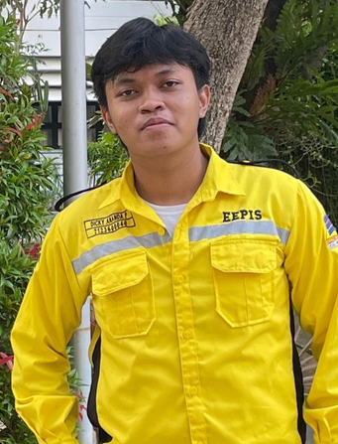
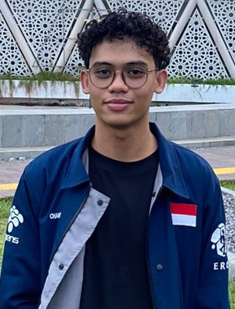
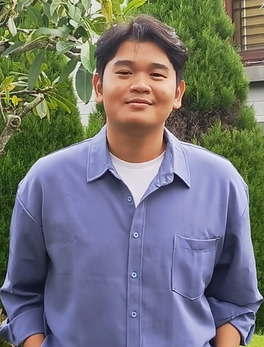

DOSEN PEMBIMBING
AKHMAD HENDRIAWAN, S.T, M.T
197501272002121003
LURCOTTE MEMBER
M. IQBAL HAKIM
AS
PROJECT MANAGER
DICKY ANANDA PRAMUDITA
AS
HARDWARE DEVELOPER
CHANDRA NUR ISMAIL
AS
3D & PCB DESIGNER
MAULANA ACHMAD HIDAYATULLOH AS
SOFTWARE DEVELOPER
MAULYD’DINA NUR MAY FIROH
AS
NON-TECH / UI & UX DESIGNER
ENHANCING
HOME SAFETY
THROUGH SMART TECHNOLOGY

Slide 3

LATAR BELAKANG
Fluktuasi tegangan listrik bisa merusak perangkat elektronik
01
Rumah belum memiliki sistem proteksi otomatis
02
Belum ada pemantauan pemakaian listrik secara real-time
03

Slide 4
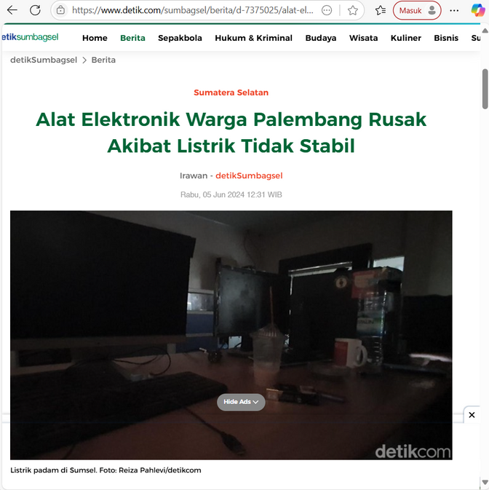
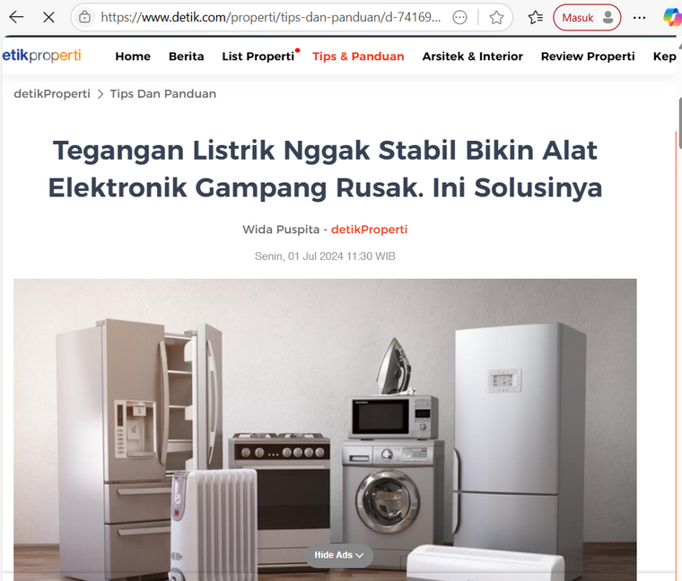
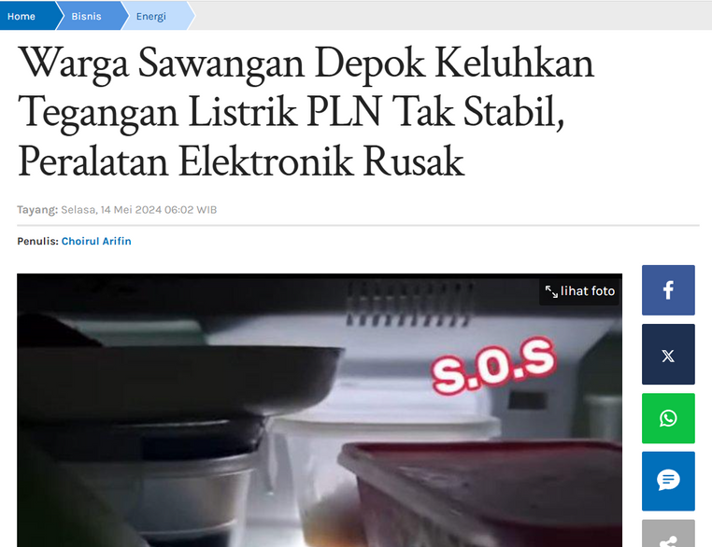
RUMUSAN MASALAH

Slide 5
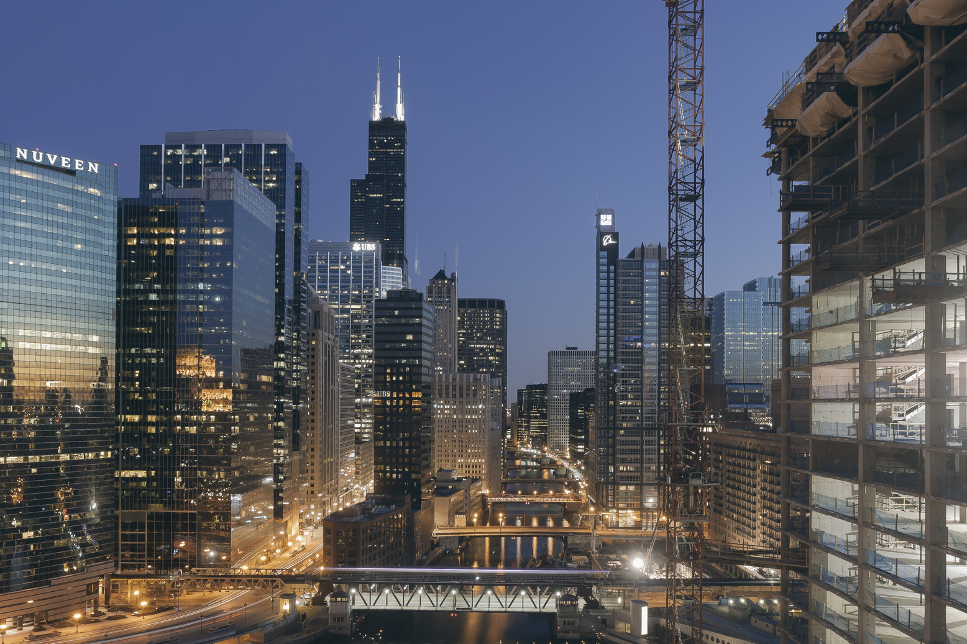
TUJUAN
Mencegah kerusakan akibat tegangan tidak stabil
01
Monitoring kondisi listrik rumah secara real-time
02
Mengontrol perangkat elektronik secara otomatis
03

Slide 6
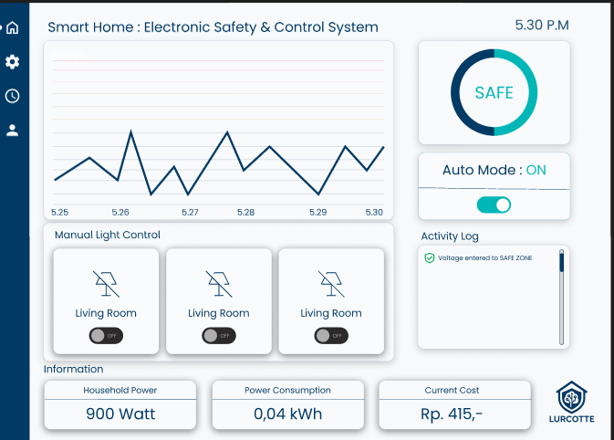
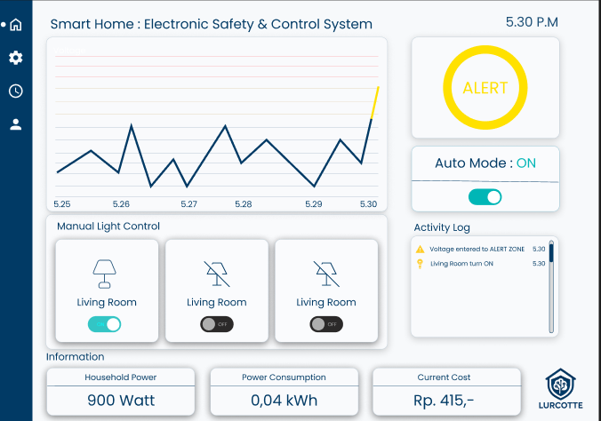
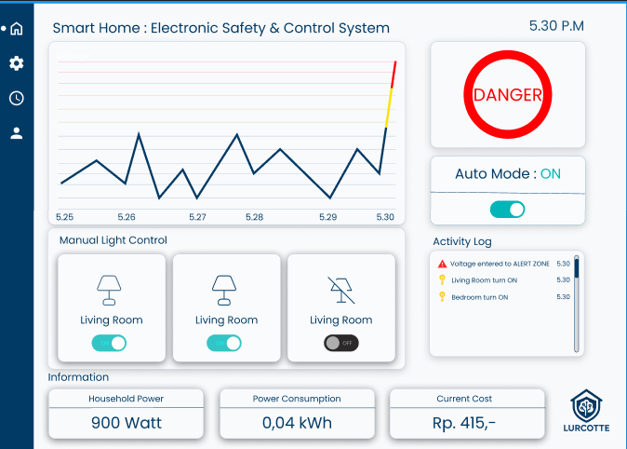
UI/UX DESIGN

Slide 7
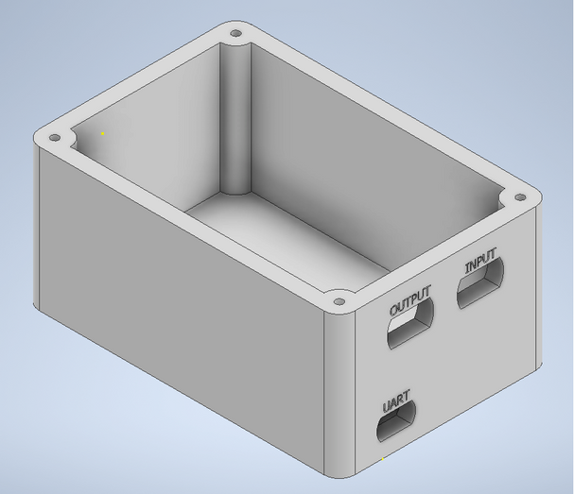
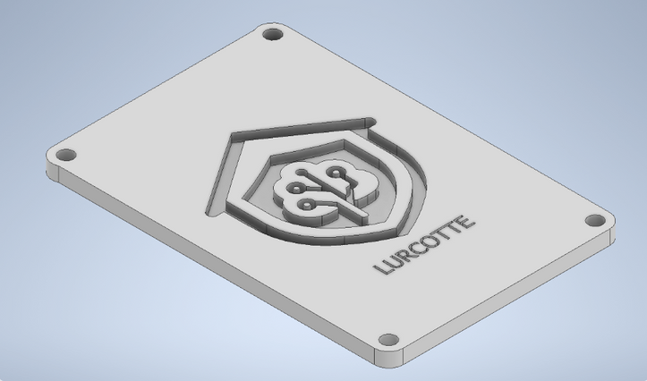
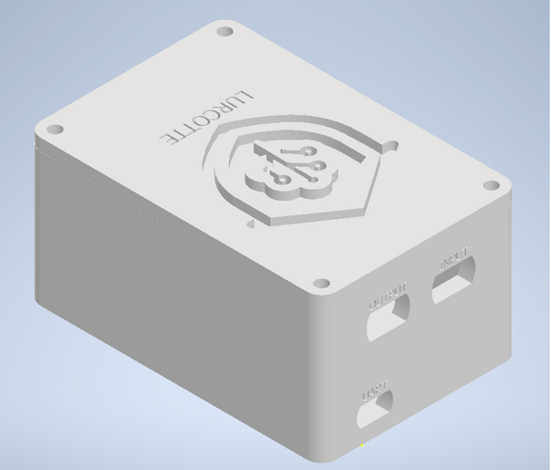
3D DESIGN

Slide 8
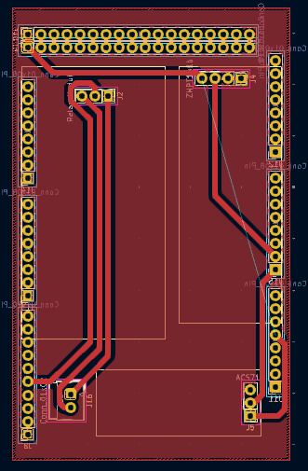
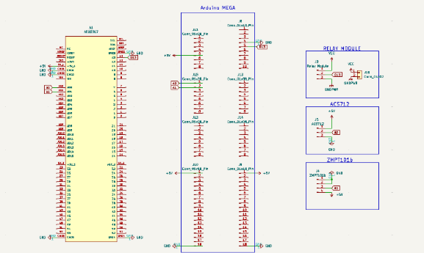
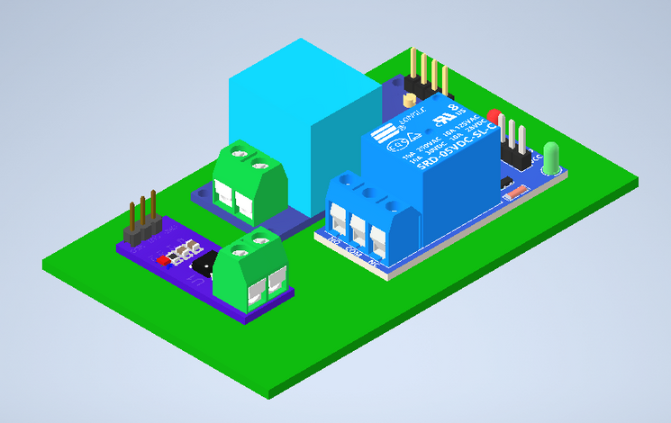
SKEMATIK & PCB DESIGN

Slide 9
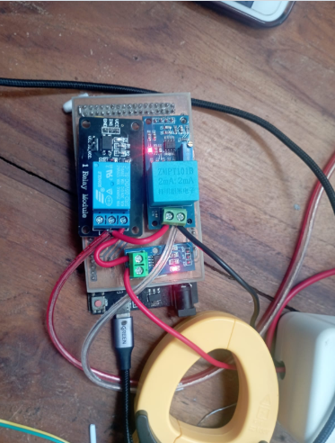
PCB HARDWARE

Slide 10
HASIL PENGUJIAN
01
Sistem berhasil memproteksi & monitoring
02
Efisien dan user-friendly
Bisa dikembangkan ke level smart energy management
03

Slide 11
TERIMA KASIH
Link Video Pendek :
https://drive.google.com/file/d/1bdyQihNFbl6OnL9QvR1Q_Gj12umeS__x/view?usp=drivesdk

