Slide 1
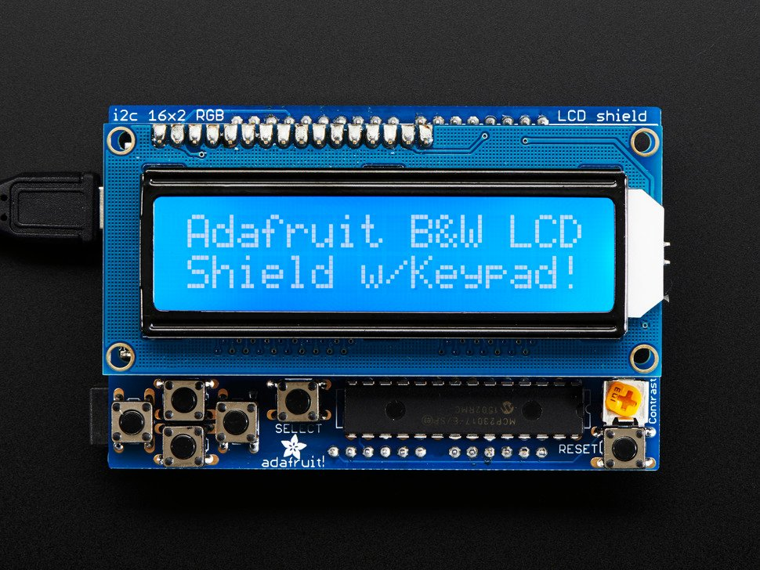
Lur Lab Audio Board Operation
On/Off Start and Stop Audio
Left Move Left to Frequency Menu
Right Move Right to Volume Menu
Up Scroll Up
Down Scroll Down
In Frequency Menu scroll up or down through the following items:
2 kHz Play 2 kHz Tone
4 kHz Play 4 kHz Tone
8 kHz Play 8 kHz Tone
12 kHz Play 12 kHz Tone
16 kHz Play 16 kHz Tone
24 kHz Play 24 kHz Tone
32 kHz Play 32 kHz Tone
Random Play All Tones in Random Order
Noise Play Noise
Left
Up
Down
Right
On/Off
In Volume Menu scroll up or down through the Volume Settings 0-43

