Slide 1
AquaGo
Autonomous Water Transport Vehicle
Automotive Design 2026
XU Xiangxi · 14 September 2026
01
Notes:
XU Xiangxi | Target: 23 seconds
中文提示（不读）：先告诉导师：项目是什么、今天讲什么、重点是什么。
ENGLISH SCRIPT
Good morning. I am Xiangxi Xu. Our vehicle is called AquaGo. Today, I will explain the design and team roles for our autonomous water transport vehicle. Our focus is automation: picking up a full bowl, carrying it outdoors, and putting it down at the destination.
SOURCES / TECHNICAL NOTES

Slide 2
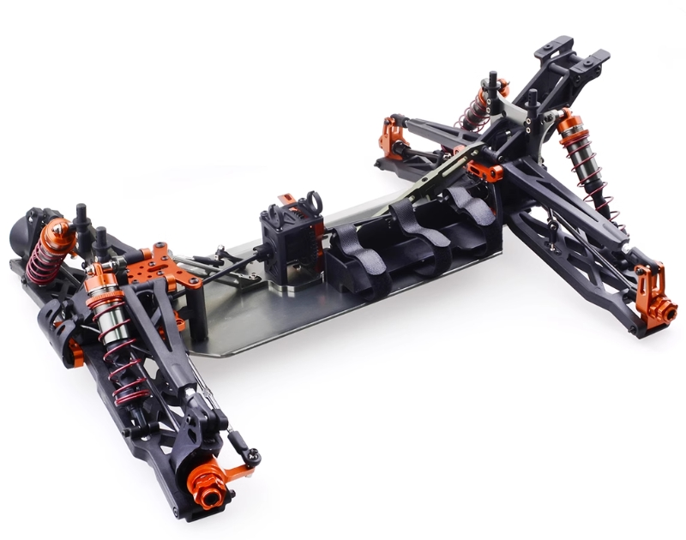
01 / Overall Conception
Locomotion system
Automatically pick up, transport and place an uncovered bowl of water.
ZD9021 chassis
Motor-free version
Feedback-controlled drive
Smooth acceleration and braking
≥35 km/h
ZD9021-V3 product photograph; installed electronics shown are not our final configuration.
Loaded straight-line target.
Continuous grip; retain water.
02
Notes:
XU Xiangxi | Target: 30 seconds
中文提示（不读）：指底盘照片，再指35 km/h；强调载水直线，不是全程高速。
ENGLISH SCRIPT
We plan to buy a ZD9021 chassis without a motor. We will add a drive system with feedback. The vehicle must reach at least thirty-five kilometres per hour on a straight section while holding the full bowl. It can slow down for turns, obstacles, and rough ground. We will choose the motor for the vehicle with all its equipment and load.
SOURCES / TECHNICAL NOTES
Image: https://www.zd-racing.com/home/915-zd-racing-9021-v3-18-24ghz-4wd-rc-car.html

Slide 3
01 / Overall Conception
Motor and steering servo selection
Drive motor + driver
Steering servo
Sensored brushless drive; compatible FOC preferred
Positional digital servo; low gear backlash
Low-speed control
Read wheel speed to move slowly near the platform.
Torque + thermal margin
Steer under tyre and linkage load
Loaded performance
Match torque and speed to the full vehicle
Repeatability + speed
Reduce repeated steering corrections
Smooth braking
Reduce abrupt water motion; handle braking energy
Electrical compatibility
Match supply and interface; avoid overload
Motor speed, gear ratio and wheel size affect vehicle speed.
More gear reduction gives slower wheels but more torque. Test with the full load.
Selection criteria, not achieved specifications. Test creep, braking, steering return and temperature.
03
Notes:
XU Xiangxi | Target: 60 seconds
中文提示（不读）：电机：慢行可控、加减速平顺；舵机：少空动、回中准。
ENGLISH SCRIPT
For driving, we prefer a brushless motor with sensors and a suitable FOC driver. We read wheel speed so the vehicle can move slowly near a platform. Smooth torque and braking can help reduce sudden movement of the water. We will check speed under load, current, and heat. For steering, we need a digital positional servo with low backlash and good return-to-centre accuracy. This helps avoid repeated steering corrections. Its torque and power supply must match the steering load. We will also limit how quickly it turns. These are design needs; we still have to test them. Motor speed, gear ratio, and wheel size affect vehicle speed. More gear reduction makes the wheels turn slower but gives them more torque. We must test the full load.
SOURCES / TECHNICAL NOTES
Technical basis: https://www.st.com/en/embedded-software/x-cube-mcsdk.html ; https://hitecrcd.com/servos/ . These are proposed selection criteria. No model or numeric actuator rating has been selected.

Slide 4
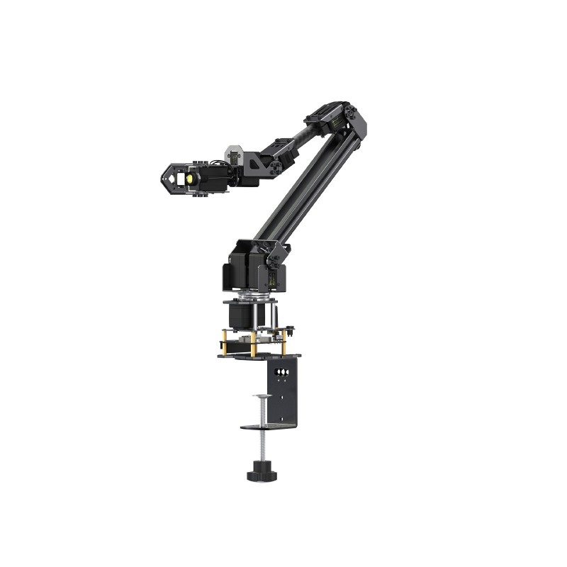
01 / Overall Conception
Robotic arm
Arm model under selection
Buy a semi-finished arm
Design our own connecting parts
and gripper
Joint torque while holding the bowl
Check motor temperature while holding the bowl.
Position feedback + accurate placement
≈650 g
Bowl + water
Up to 156 mm diameter
Arm form-factor reference only: Waveshare RoArm-M3. Pictured model is not selected.
04
Notes:
XU Xiangxi | Target: 47 seconds
中文提示（不读）：半成品机械臂外购，连接件与夹具自主设计；650g仅为碗和水。
ENGLISH SCRIPT
We will buy a semi-finished robotic arm. Our team will design the mounting and connecting parts, as well as the gripper. The bowl and water weigh about six hundred and fifty grams. The arm must also carry the gripper and the parts attached to its end. We will check joint torque, position feedback, and motor temperature while the arm holds the bowl. A small test lift will help check the grip before driving. The bowl has no lid and must stay in the arm throughout the trip. The arm model in this picture has not been selected.
SOURCES / TECHNICAL NOTES
Form-factor reference, NOT a procurement recommendation: https://www.waveshare.com/roarm-m3.htm . RoArm-M3 official effective payload is 0.2 kg at 0.5 m; it has NOT been accepted for this project.

Slide 5
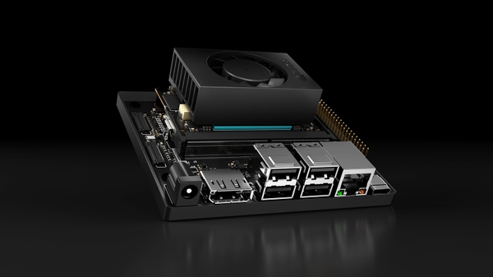
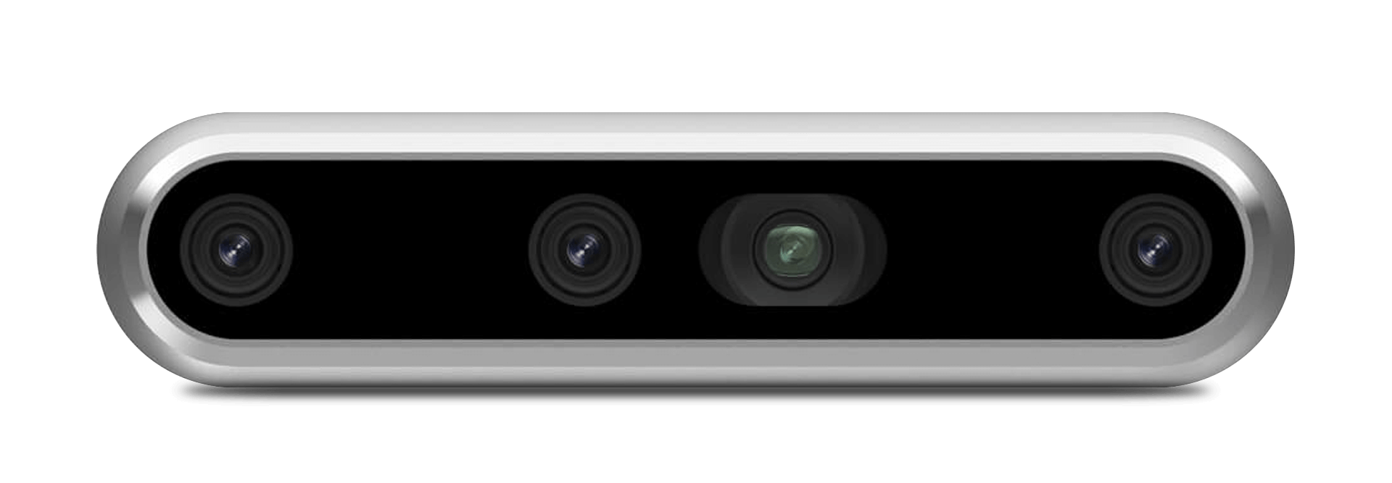
01 / Overall Conception
Vision and onboard computing
RealSense D455
Jetson Orin Nano 8GB
Obstacle, boundary and platform perception
Perception, mission logic and control commands
Previously discussed candidates. Final selection depends on outdoor image quality and measured response time.
05
Notes:
XU Xiangxi | Target: 37 seconds
中文提示（不读）：区分“找到平台”和“知道整条路怎么走”；提前建图是否允许，仍待确认。
ENGLISH SCRIPT
The D455 camera and Jetson Orin Nano eight-gigabyte computer are options we are considering. Vision will detect obstacles, boundaries, and platform markers. Markers help us find the platforms, but they do not show the whole route. We still need to ask whether we can build a map or record the route before the test. We will choose the navigation method after checking the rules. We also need outdoor tests of image quality, detection distance, and response time.
SOURCES / TECHNICAL NOTES
Camera: https://www.realsenseai.com/products/real-sense-depth-camera-d455f/
Compute image: https://nvidianews.nvidia.com/multimedia/autonomous-machines/jetson

Slide 6
01 / Overall Conception
STM32: the low-level control layer
Onboard computer
STM32 controller
Actuator controllers
Vision and localisation
Path + mission planning
↔
Send commands regularly.
Read motor and sensor data.
Stop if commands are lost.
↔
Motor driver · steering servo
Existing arm controller
Commands down. Measured state back.
MCU features
Encoder timers, PWM, ADC, watchdog; interfaces matched to the drivers
Communication
USB/UART or CAN for commands and status; PWM only where appropriate
Fault response
Command timeout and driver faults trigger a defined stop; hardware emergency stop
06
Notes:
XU Xiangxi | Target: 42 seconds
中文提示（不读）：顺着三列讲：判断 → 指令与反馈 → 实际动作。
ENGLISH SCRIPT
We plan to use an STM32 for low-level control. The onboard computer handles vision and planning. The STM32 sends control commands regularly and reads motor and sensor data. If new commands stop arriving, it should trigger the planned stop response. It also checks driver faults. We plan to use a ready-made motor driver and the arm’s own controller. The STM32 sends control signals. It does not supply power directly to the motor. We will test what happens if communication is lost, as well as the hardware emergency stop.
SOURCES / TECHNICAL NOTES
STM32 capabilities vary by device and must be checked at selection. Reference: https://www.st.com/content/st_com/en/ecosystems/stm32-motor-control-ecosystem.html . Proposed partition: MCU supervisory/vehicle control, ready-made motor driver handles commutation/current control.

Slide 7
01 / Overall Conception
Automation connects the two systems
Vehicle motion
Vision + mission control
Bowl handling
Locate → Grip → Navigate → Place
Route guidance
Prior mapping / route recording permission: to be confirmed
Speed choice
Visible free space + measured stopping ability + turns and terrain
07
Notes:
XU Xiangxi | Target: 49 seconds
中文提示（不读）：讲完整取运放，再强调：看得够远、停得下来，才允许相应车速。
ENGLISH SCRIPT
The task starts by finding the first platform. The vehicle stops, the arm grips the bowl, and a small test lift helps check the grip. The vehicle then moves to the destination while the arm keeps holding the bowl. We will choose the speed based on clear space ahead, measured stopping distance, turns, and ground conditions. The vehicle stops again before putting the bowl down. If vision or the grip is not reliable, the task should pause. Remote takeover will be available. The control team will lead system integration. We will test the full task at low speed before raising the speed step by step.
SOURCES / TECHNICAL NOTES
Product photographs reused from the preceding slides. Chassis is selected in principle; arm photo is only a form-factor reference; camera and compute are candidates.

Slide 8
02 / Task Allocation
Control Systems
Responsibilities
Team members
01
STM32, drive and steering control
Name
Name
Lead system integration
Photo
Photo
02
________
________
03
Remote takeover and fault response
Name
Name
Photo
Photo
NEXT DELIVERABLE
________
________
Interface table + actuator bench-test plan
08
Notes:
XU Xiangxi | Target: 19 seconds
中文提示（不读）：控制组牵头集成；讲清近期交付物，不逐个念成员姓名。
ENGLISH SCRIPT
The control team will lead system integration. It will connect the STM32, drive, steering, and arm controls. Its next tasks are to list the control interfaces and plan the bench tests. It will organise full-system tests.
SOURCES / TECHNICAL NOTES

Slide 9
02 / Task Allocation
Vision & Perception
Responsibilities
Team members
01
Obstacle and boundary detection
Name
Name
Marker, bowl and platform localisation
Photo
Photo
02
________
________
03
Calibration and response-time testing
Name
Name
Photo
Photo
NEXT DELIVERABLE
________
________
Marker-localisation + obstacle-detection test plan
09
Notes:
XU Xiangxi | Target: 18 seconds
中文提示（不读）：强调交付的是可用于控制的信息。
ENGLISH SCRIPT
The vision team will work on obstacle and boundary detection, target localisation, and camera calibration. Next, it will plan tests for platform markers and obstacles. The route-planning method still depends on the course rules.
SOURCES / TECHNICAL NOTES

Slide 10
02 / Task Allocation
Mechanical Design
Responsibilities
Team members
01
Chassis, arm and camera mounting
Name
Name
Our own connecting parts and gripper
Photo
Photo
02
________
________
03
Packaging, balance and vibration
Name
Name
Photo
Photo
NEXT DELIVERABLE
________
________
Layout + connecting parts + gripper + load estimate
10
Notes:
XU Xiangxi | Target: 20 seconds
中文提示（不读）：结构简化，仍要负责载荷、安装与稳定性。
ENGLISH SCRIPT
The mechanical team will design the mounting and connecting parts and the bowl gripper. It will fit the arm, camera, and electronics onto the chassis. Next, it will draw the layout, develop the gripper design, and estimate the loads.
SOURCES / TECHNICAL NOTES

Slide 11
02 / Task Allocation
Finance & Procurement
Responsibilities
Team members
01
Component sourcing and purchasing
Name
Name
Course budget: CNY 10,000
Photo
Photo
02
________
________
03
Lead times, spare parts and rework
NEXT DELIVERABLE
Costed parts list + lead times + rework allowance
11
Notes:
XU Xiangxi | Target: 24 seconds
中文提示（不读）：汇报明确说课程预算上限10000元；不能把内部资金预留当成课程额度。
ENGLISH SCRIPT
The finance and procurement team will compare parts, prices, and delivery times. It will keep a parts list and all cost records. The course budget limit is ten thousand yuan. The cost plan must include transport, spare parts, and rework. Parts must meet the agreed technical needs.
SOURCES / TECHNICAL NOTES

Slide 12
One complete autonomous mission.
Pick up. Transport. Place. Retain water.
NEXT
Confirm route rules · Select compatible parts · Begin bench tests
Thank you. Questions & discussion
12
Notes:
XU Xiangxi | Target: 21 seconds
中文提示（不读）：停止展开新技术，留给导师提问。
ENGLISH SCRIPT
Our goal is to pick up, carry, and place the bowl automatically, while keeping as much water as possible. Next, we will check the route rules, choose suitable parts, and start bench tests. Thank you. I am happy to answer your questions.
SOURCES / TECHNICAL NOTES

