Slide 1
Project
Proposal
TrioTech Titans

Slide 2
Table of contents
01
02
03
04
05
06
the project
Key Features
Technology Stacks
Project Goals
NLP
our team

Slide 3
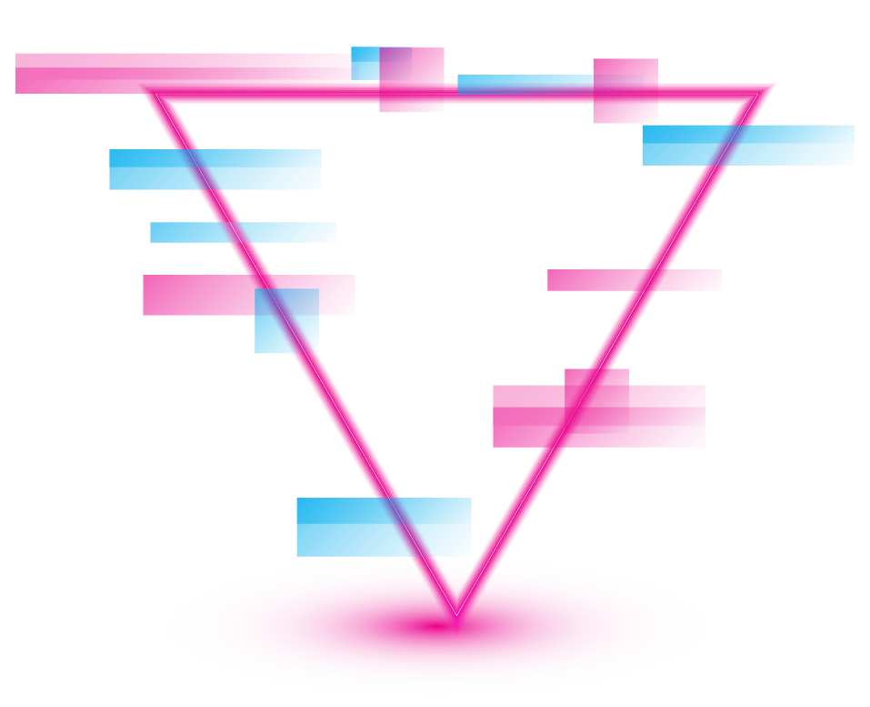
Our team
We are TrioTech Titans, a Team of three tech enthusiast with diverse skills in Machine Learning and UI|Ux Design. Our Combined expertise allow us to tackle complex problem with innovative ideas

Slide 4
01
Linguabridge
Seamless Transition for Inclusive Education

Slide 5
About the project
To develop a high-accuracy translation system named Linguabridge that converts English text into multiple Indian regional languages, reducing the need for human proofreading and enhancing accessibility for non-English speakers

Slide 6
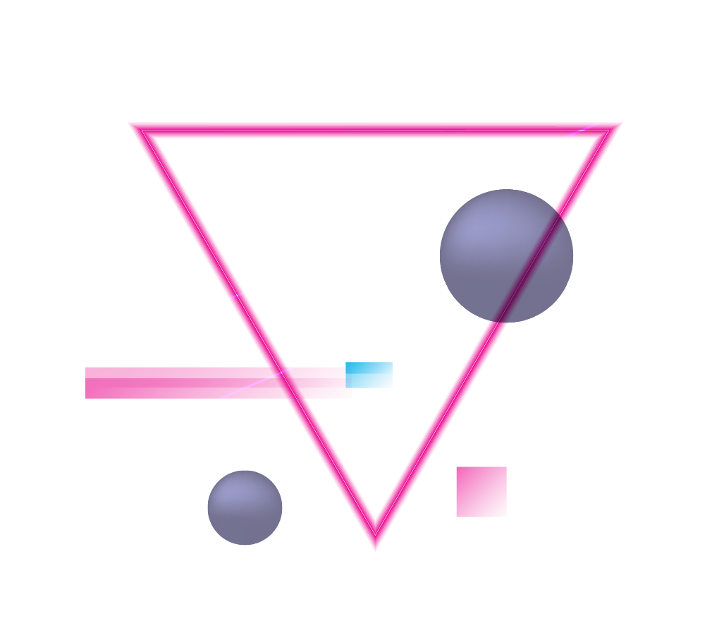
Key Features GOES HERE!
High-Accuracy Translation
Utilisation of NLP
Minimal Human input
Implement auto spell-checking tools
Support of multiple languages
Availability of 22 regional languages
User friendly interface
Developing a Web based application

Slide 7
Technology Stack
Backend
Frontend
Backend : Python,Tensorflow,Pytorch
NLP Models : BERT,mBERT,or other transformer models
Database: MongoDB
FrontEnd: HTML,CSS3
Deployment: Docker,Kubernetes, AWS

Slide 8
Project goals
Goal 1
Goal 2
A robust translation system capable of delivering high accuracy translation
Enhanced accessibility to critical resource material for non english speakers
Goal 3
Significant reduction in time spent on manual translation,allowing to focus on innovation

Slide 9
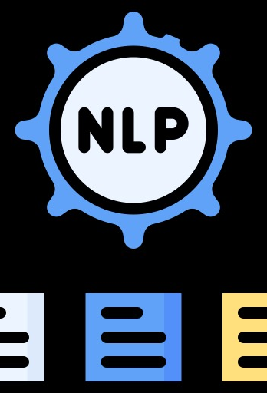
A picture always reinforces the concept
Natural Language Processing is a field of artificial intelligence that focuses on the interaction between computers and human through natural language,enabling machines to understand, interpret, and generate human language.

Slide 10
Our team
Darshan R
Anshuman P.S
Fakrudeen S
23CS1175
23CS1332
23CS1205

