Slide 1
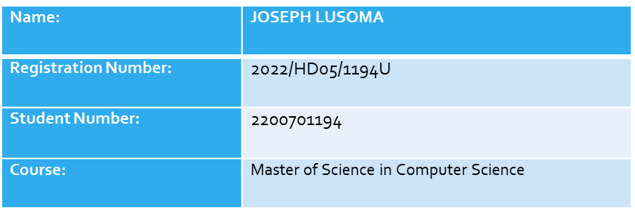
Chest Opacity Model

Slide 2
Libraries used
import tensorflow as tf
from tensorflow.keras.models import Sequential
from tensorflow.keras.layers import Conv2D, MaxPooling2D, Dense, Flatten, Dropout

Slide 3
Hyper Parameters
train_size : val_size : test_size = 70% : 15% : 15%
epochs=20
input_shape=(256,256,3)

Slide 4
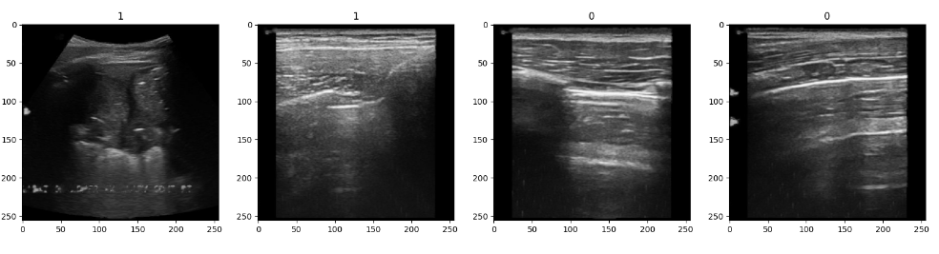
Data Set Preview

Slide 5
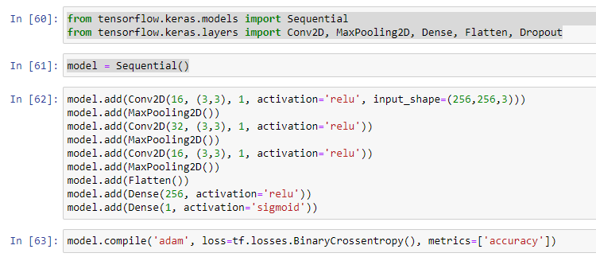
Model Architecture

Slide 6
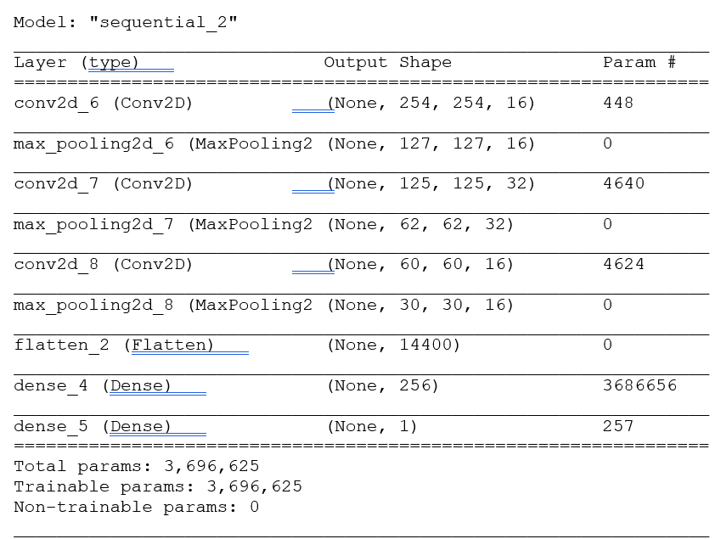
Model Summary

Slide 7
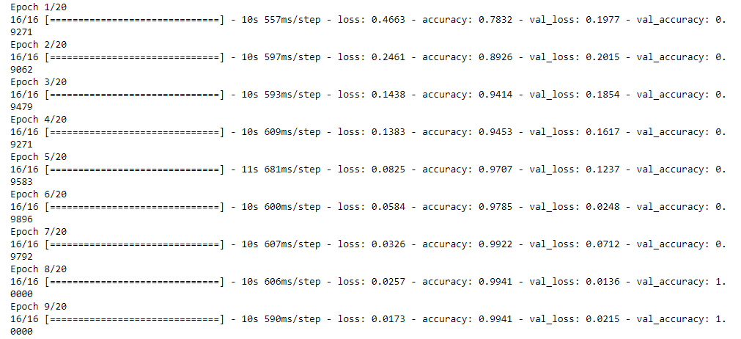
EPOCHS RESULTS

Slide 8
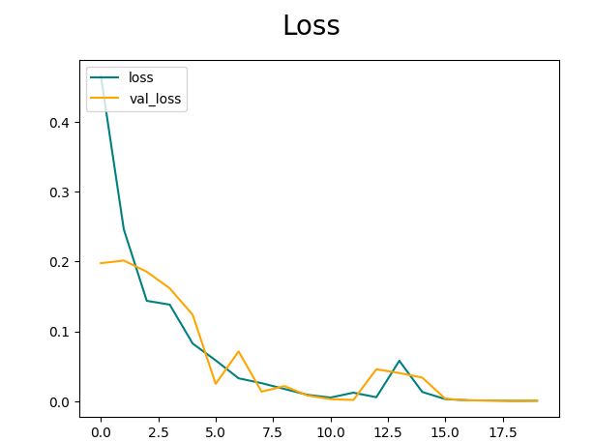
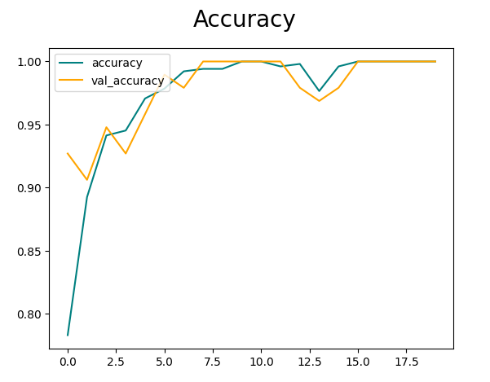
Performance Plots: Loss

Slide 9
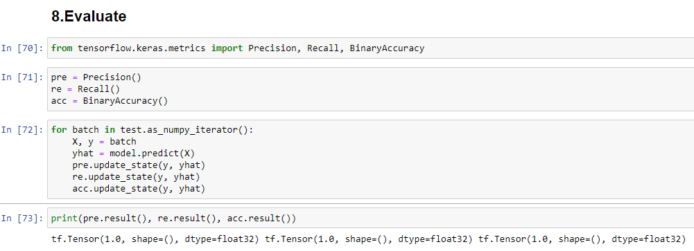
Model Evaluation

Slide 10
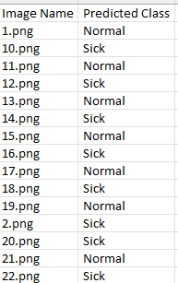
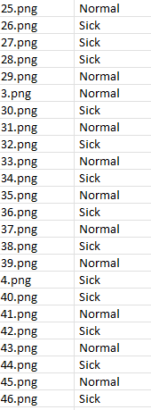
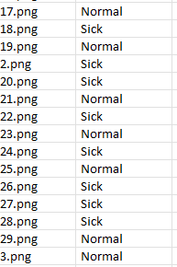
Dataset1: Unknown Images predictions

Slide 11
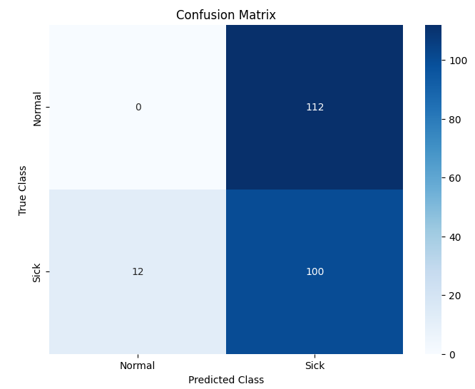
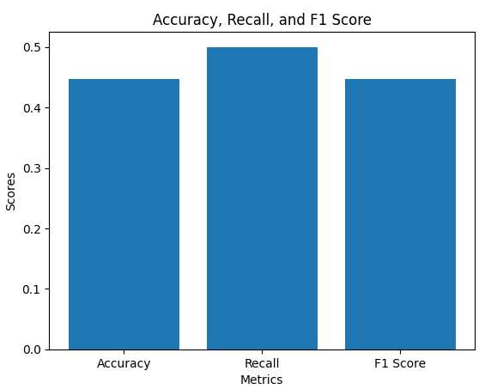
DataSet2: Confusion matrix

