Slide 1
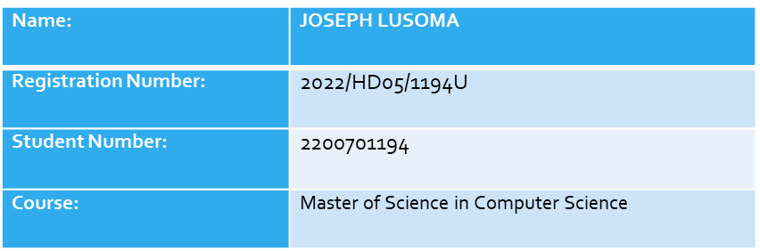
Chest Opacity Model

Slide 2
Dependencies
import tensorflow as tf
from tensorflow.keras.models import Sequential
from tensorflow.keras.layers import Conv2D, MaxPooling2D, Dense, Flatten, Dropout
from tensorflow.keras.optimizers import Adam

Slide 3
Hyper Parameters
train_size : val_size : test_size = 70% : 15% : 15%
epochs=10
input_shape=(256,256,3)
learning_rate = 0.001

Slide 4
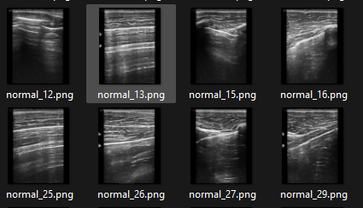
Data Set Preview

Slide 5
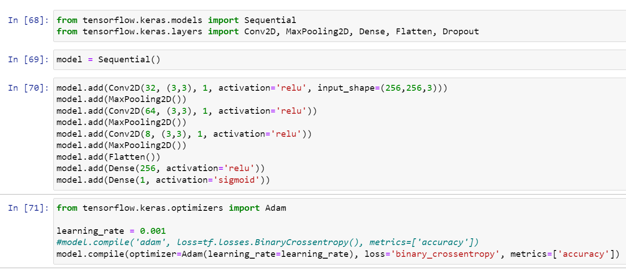
Model Architecture

Slide 6
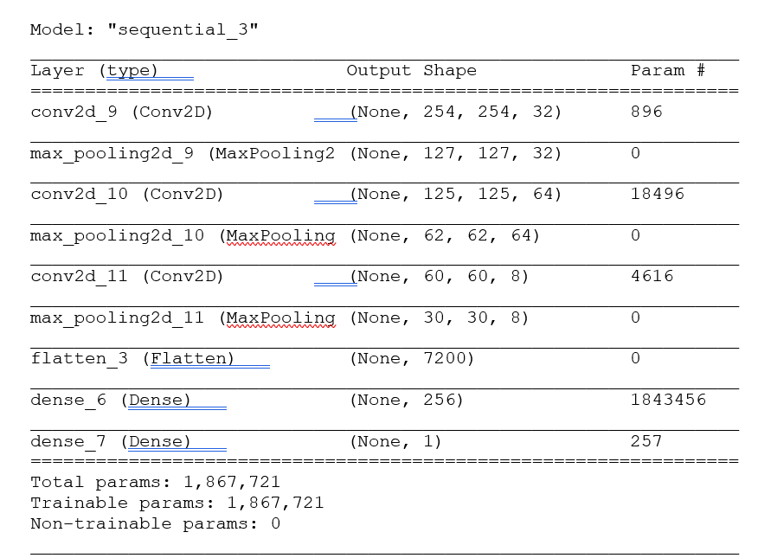
Model Summary

Slide 7
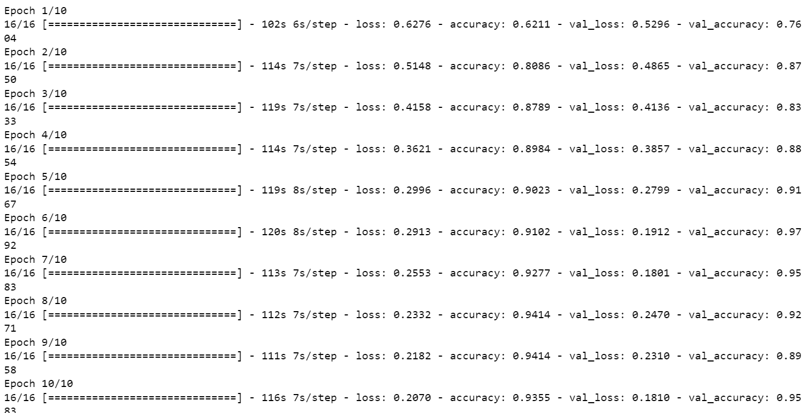
EPOCHS RESULTS

Slide 8
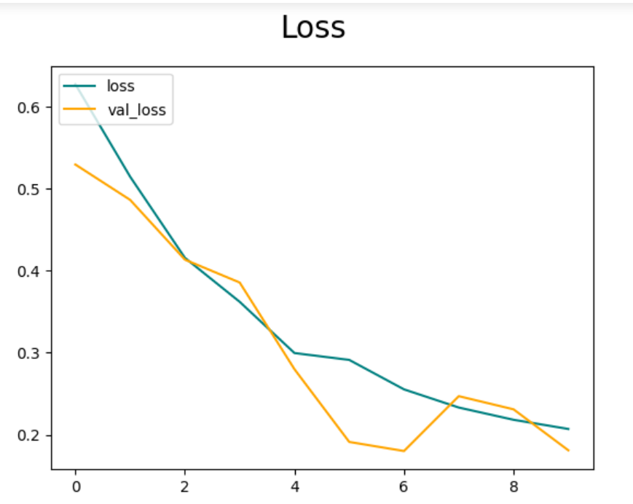
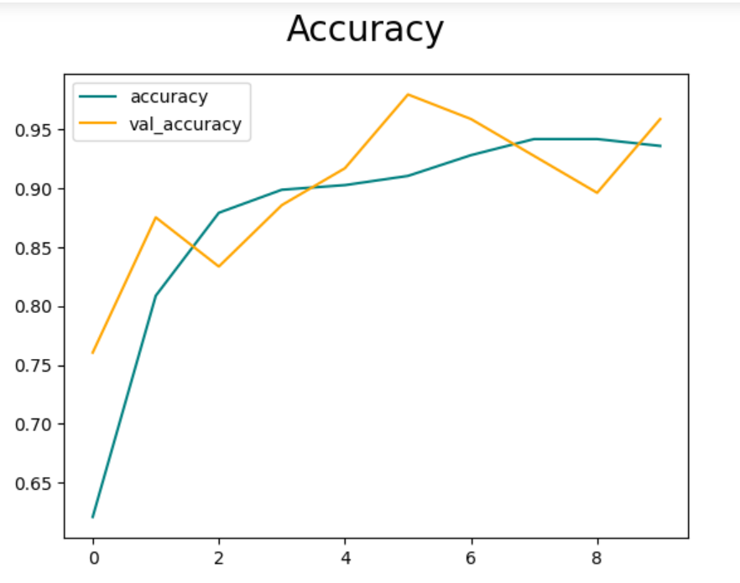
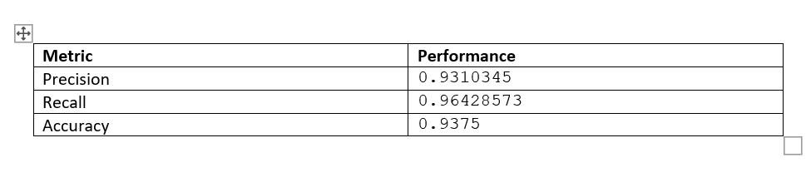
Performance Plots: Loss

Slide 9
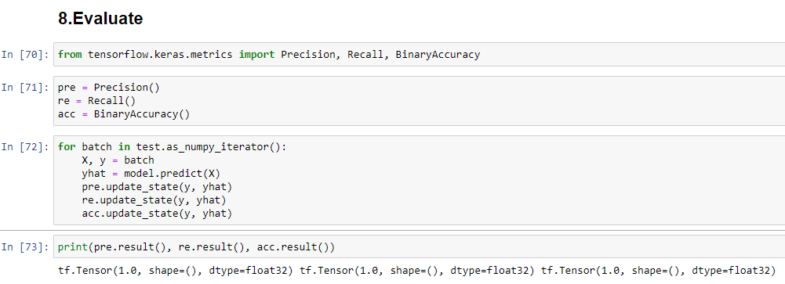
Model Evaluation

Slide 10
Dataset1: Unknown Images predictions
Image Name, Predicted Class
1.png, Normal
10.png, Sick
15.png, Normal
16.png, Sick
17.png, Normal
11.png, Normal
2.png, Sick
20.png, Sick
21.png, Normal
22.png, Sick2
3.png, Normal
12.png, Sick

Slide 11
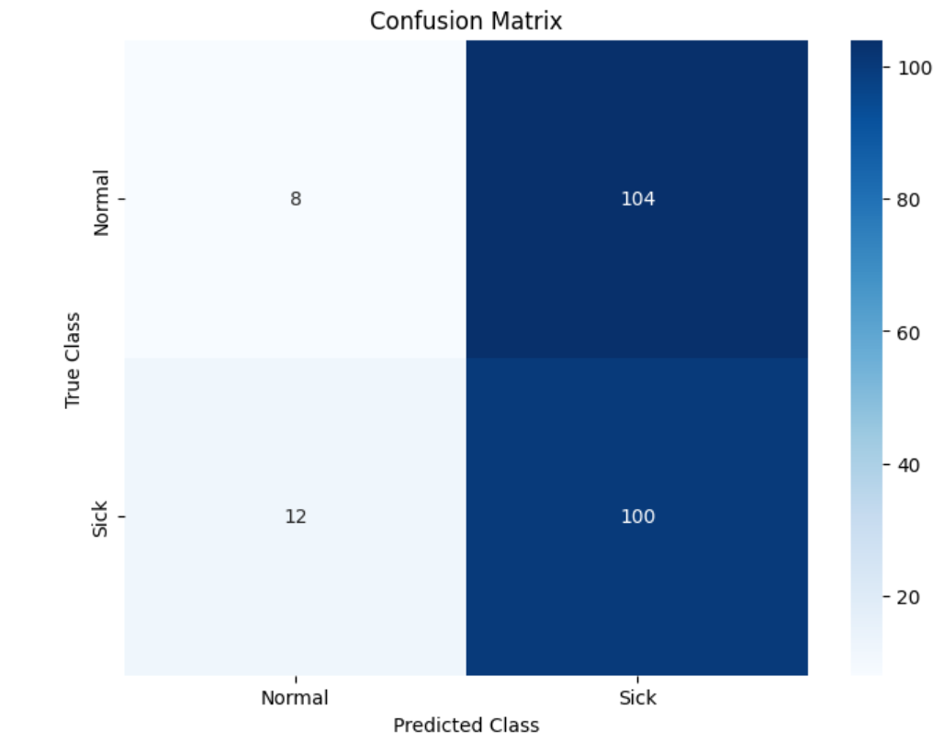
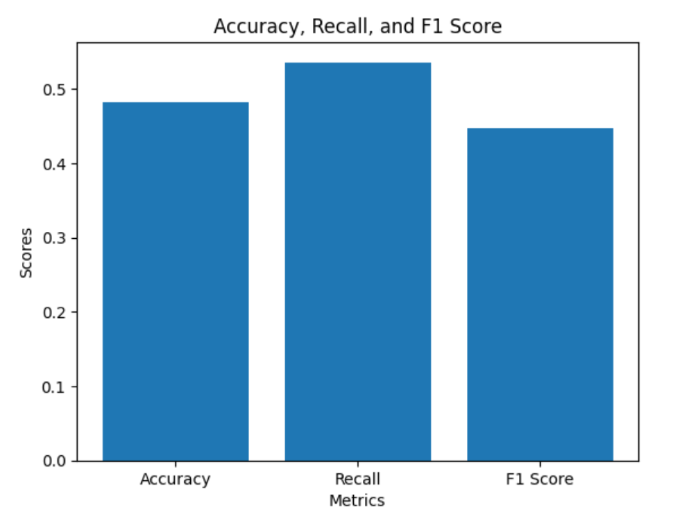
DataSet2: Confusion matrix Results

