Slide 1
Notes
Page 2: Month-on-month summary on the number of jobs (illustrated via left side Bar Graph) and total chargeable weight (illustrated via right side Bar Graph) from January 2016 to August 2016.
Page 3: Summary on carrier usage month-on-month wherein number of shipments/per carrier is illustrated via Line Graph.
Page 4: Summary on carrier usage month-on-month wherein share of wallet/per carrier is illustrated via Line Graph.
4.
5.
6.
7.
8.
9.
10.
11.
12.

Slide 2
Month-on-month summary on the number of jobs and total chargeable weight (January 2016 to August 2016)

Slide 3
Summary on carrier usage month-on-month (January 2016 to August 2016)

Slide 4
Summary on carrier usage month-on-month (January 2016 to August 2016)

Slide 5
Total revenue summary (January 2016 to August 2016)

Slide 6
Top 10 customer list with chargeable weight details (January 2016 to August 2016)

Slide 7
Top 10 customer list with chargeable weight details (January 2016 to August 2016)

Slide 8
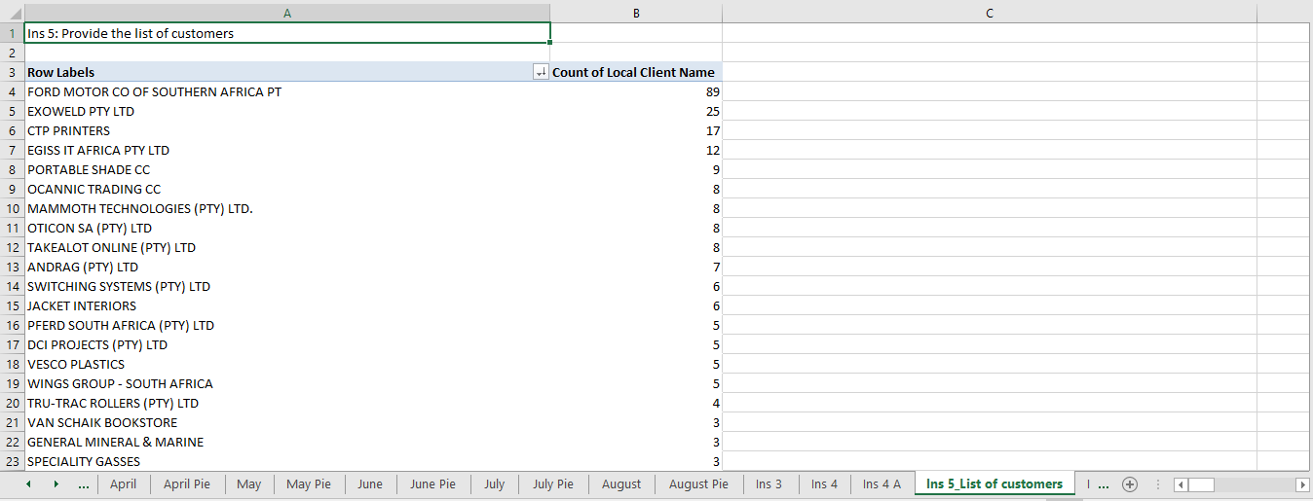
List of customers

Slide 9
List of customers (January 2016 to August 2016)

Slide 10
Overview of chargeable weight per consignor code

Slide 11
Incoterm details plugged in main database

