Slide 1
Chapter 1 Foundation
Computer Networks: A Systems Approach, Release Version 6.1
Peterson and Davie
November 2019

Slide 2
Problems
What is a network?
What is a computer network?
How to build a scalable network that will support different applications?
How is a computer network different from other types of networks?
What is a computer network architecture?

Slide 3
Network
A network is a set of serial lines used to attach dumb terminals (or individual computers) to mainframe computers
Important networks include the telephone network and the cable TV network
The main things every day in these networks are that they are specialized to handle one particular kind of data (either keystrokes, voice, or voice/video), and
they typically connect to special-purpose devices (terminals, hand receivers, and television sets).
Mainframe computers are high-performance computers with large amounts of memory and processors that process billions of simple calculations and transactions in real-time.
The mainframe is critical to commercial databases, transaction servers, and applications that require high resiliency, security, and agility
Courtesy: https://www.ibm.com/topics/mainframe

Slide 4
Computer Network
What distinguishes a computer network from other types of networks?
Computer networks are built primarily from general-purpose programmable hardware, and they are not optimized for a particular application
like making phone calls or delivering television signals.
Computer networks can carry many different types of data, and they support a wide and ever-growing range of applications
Applications such as teleconferencing, video on demand, electronic commerce, distributed computing, digital libraries, etc.

Slide 5
Network Architecture
A network architecture shows how the available hardware and software components can be arranged to form a complete network system.
In addition to understand how networks are built, it is important to understand the following:
how they are operated or managed and
how network applications are developed.

Slide 6
Network Architecture
To understand how to build, operate, and program a computer network, the following four things need to be considered:
First, it explores the requirements for different network applications and communities.
Second, it introduces the idea of a network architecture.
Third, it introduces some key elements in implementing computer networks.
Fourth, it identifies the key metrics that are used to evaluate the performance of computer networks.

Slide 7
Network Applications
Internet:
Most people know the Internet through its applications:
World Wide Web (www), email, social media, streaming music or movies, videoconferencing, instant messaging, file-sharing, etc.
Users interact with the Internet as a global network.
Internet users represent the largest class of people who interact with the Internet in some way:
There is a group of people who create the applications.
Then some operate or manage networks.
some design and build the devices and protocols.

Slide 8
Network Applications
The World Wide Web (or Web or WWW) is the most famous Internet application that catapulted (fastest delivery) the Internet from a somewhat obscure tool to today’s mainstream phenomenon.
The World Wide Web has become such a powerful platform that many confuse it with the Internet; it is just a single application.
In its basic form, the Web presents an intuitively simple interface:
Users view web pages full of textual and graphical objects and click on objects they want to learn more about, and a corresponding new page appears.

Slide 9
Uniform Resource Locator
A Uniform Resource Locator (URL), provides a way of identifying all the possible objects that can be viewed from your web browser. For example,
http://www.cs.princeton.edu/llp/index.html is the URL for a page providing information about one of this book’s authors:
the string http indicates that the Hypertext Transfer Protocol (HTTP) should be used to download the page, www.cs.princeton.edu is the name of the server machine that serves the page,
and /llp/index.html uniquely identifies Larry’s home page at this site.

Slide 10
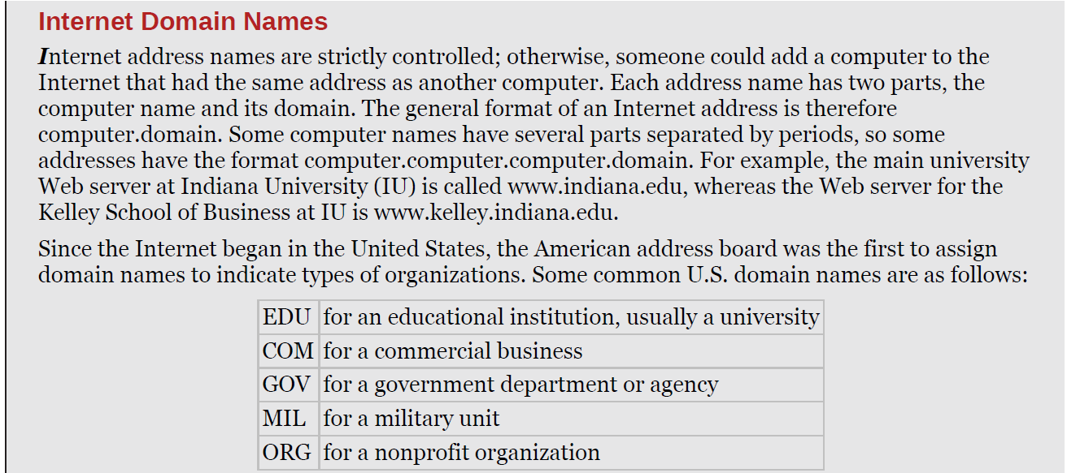
Internet Domain Names

Slide 11
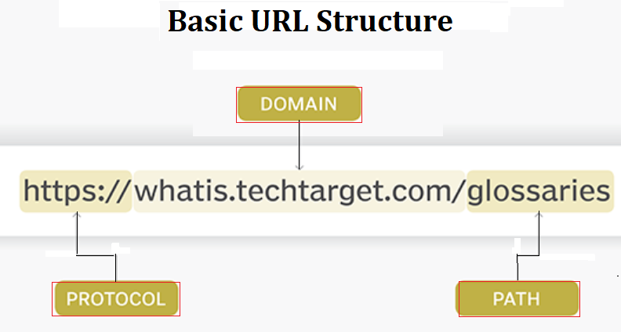
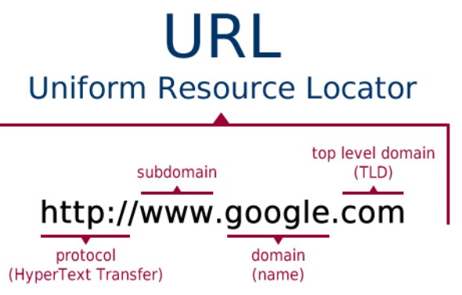
Uniform Resource Locator https://www.techtarget.com/searchnetworking/definition/URL
A URL (Uniform Resource Locator) is a unique identifier to locate a resource on the Internet (also called a web address). URLs consist of multiple parts -- including a protocol and domain name -- that tell a web browser how and where to retrieve a resource.

Slide 12
Uniform Resource Locator
by clicking on just one such URL over a seventeen messages may be exchanged over the Internet:
Six messages to translate the server name (www.cs.princeton.edu) into its Internet Protocol (IP) address (128.112.136.35).
Three messages to set up a Transmission Control Protocol (TCP) connection between your browser and the server (www.cs.princeton.edu).
Four messages for your browser to send the HTTP “GET” request and the server to respond with the requested page (and for each side to acknowledge receipt of that message).
Four messages to tear down the TCP connection.

Slide 13
Audio and Video Streaming
Another widespread application of the Internet is audio and video “streaming”:
Streaming audio and video implies a more timely transfer of messages from sender to receiver, and the receiver displays the video with its audio it arrives.
A regular application (non-streaming such as traditional delivery of text) can be delivered and read in bits and pieces.
This difference affects how the network supports various classes of applications.

Slide 14
Real-time Application
Real-time audio and video application:
These applications have considerably tighter timing constraints than streaming applications.
When using a voice-over-IP application such as Skype or a videoconferencing application such as MS Teams or Zoom, the interactions among the participants must be timely.
When a person at one end gestures, then that action must be displayed at the other end as quickly as possible.
A real-time Videoconferencing tool that run over the Internet since the early 1990s.
An example real-time Videoconferencing system is shown in Figure 1.1.
Fitting the video content into a relatively low bandwidth network, ensuring the video and audio remain in sync and arrive in time for a good user experience.

Slide 15
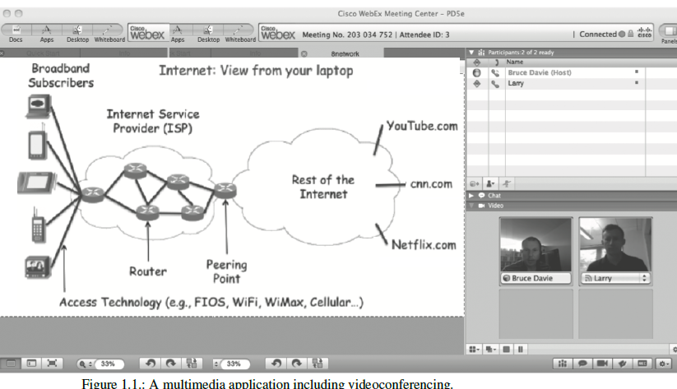
Real-time Application

Slide 16
Stakeholders
Three stakeholders listed here are required for the development of a network:
An application programmer would list the services that their application needs:
guarantee that the application’s message will be delivered without error within a specific time.
A network operator would list the characteristics of a system that is easy to administer and manage:
faults can be easily isolated, new devices can be added to the network and configured correctly, and it is easy to account for usage.
A network designer would list the properties of a cost-effective design:
network resources are efficiently utilized and fairly allocated to different users.

Slide 17
Connectivity
A network must provide connectivity among a set of computers:
for reasons of privacy and security, many private (or corporate) networks have the explicit goal of limiting the set of machines that are connected.
Networks, including the Internet, are designed to grow in a way that allows them the potential to connect all the computers in the world.
A system designed to support growth to an arbitrarily large size is said to scale.

Slide 18
Connectivity
Connectivity occurs at many different levels:
At the lowest level, a network can consist of two or more computers directly connected by some physical medium, such as a coaxial cable or an optical fiber.
We call such a physical medium a link and refer to the computers it connects as nodes.
Physical links are sometimes limited to a pair of nodes (such a link is said to be point-to-point).
In other cases more than two nodes may share a single physical link (such a link is said to be multiple-access). See Figure 1.2.
multiple-access links are limited in size, in terms of both the geographical distance and the number of nodes.
Wireless links, such as those provided by cellular networks and Wi-Fi networks are multiple-access links

Slide 19
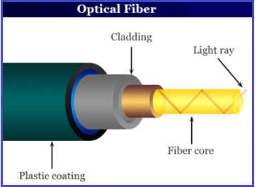
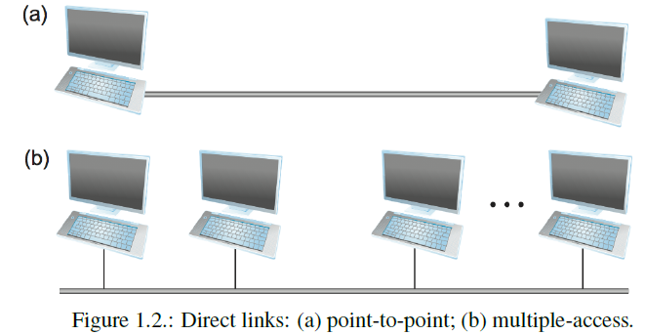
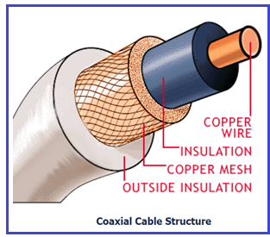
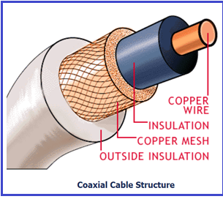

Slide 20
Connectivity
Connectivity between two nodes does not necessarily imply a direct physical connection.
Figure 1.3 shows a pair of shows a set of nodes (computers), each of which is attached to one or more point-to-point links:
Those nodes attached to links run software that forwards data received on one link out on another.
If organized systematically, these forwarding nodes form a switched network:
The two types of switched networks are:
circuit-switched and packet-switched.
The Circuit-switched is the most notably employed by the telephone system
The packet-switched is used for most computer networks.

Slide 21
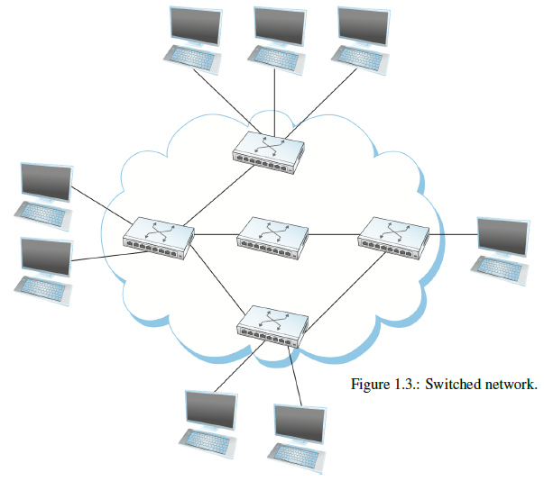

Slide 22
Connectivity
A second way in which a set of computers can be indirectly connected is shown in Figure 1.4:
In this situation, independent networks (called clouds) are interconnected to form an internetwork or internet.
A node plays as a switch connected to two or more networks via a router or gateway.
it forwards messages from one network to another.
Note that the internet can be viewed as another kind of network, which means the internet can be built from a set of internet.
Recursively build arbitrarily large networks by interconnecting clouds to form larger clouds.

Slide 23
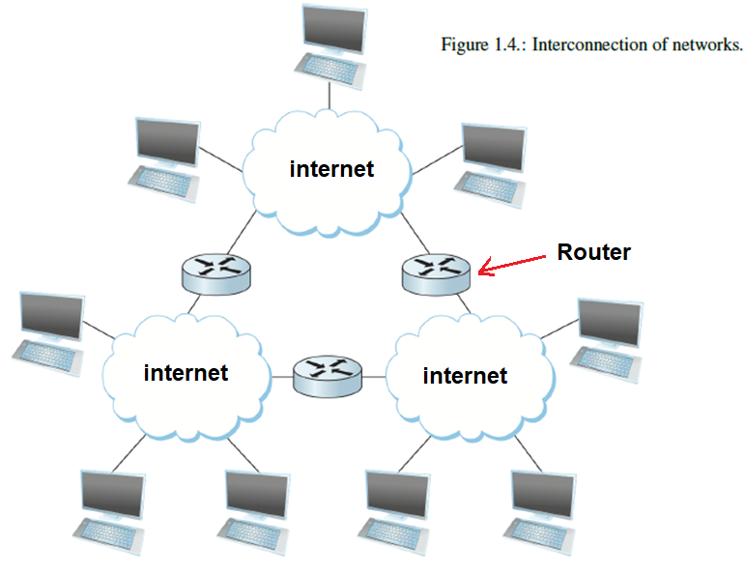

Slide 24
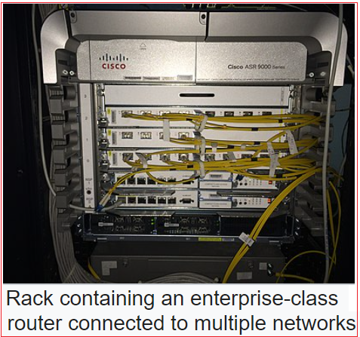
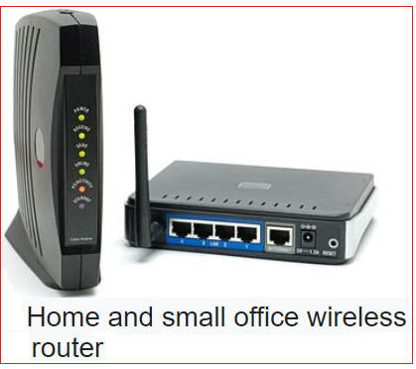
Router https://en.wikipedia.org/wiki/Router_(computing)
A router is a networking device that forwards data packets between computer networks.
Routers perform the traffic directing functions between networks and on the global Internet.
Data sent through a network, such as a web page or email, are packets.
A packet is typically forwarded from one router to another through the networks that constitute an internetwork (e.g. the Internet) until it reaches its destination node.

Slide 25
Connectivity
A set of hosts (accessing devices/computers) are directly or indirectly connected to each other does not mean that providing host-to-host network connectivity:
The requirement is that each node must be able to say which of the other nodes on the network it wants to communicate with.
This is done by assigning an address to each node:
An address is a byte string that identifies a node;
The network can use a node’s address to distinguish it from the other nodes in the network.
When a source node wants the network to deliver a message to a certain destination node, it specifies the address of the destination node.

Slide 26
Connectivity
If the sending and receiving nodes are not directly connected, then the switches/routers of the network use the address to decide how to forward the message toward the destination:
The process of determining how to forward messages toward the destination node based on its address is called routing.
This brief introduction to addressing and routing has presumed that the source node wants to send a message to a single destination node (called unicast).
it is possible that the source node wants to broadcast a message to all the nodes on the network Or, a source node wants to send a message to some subset of the nodes in the network (called multicast).

Slide 27
Key Takeaway
Statistical multiplexing defines a cost-effective way for multiple users to share network resources (such as links and nodes) in a fine-grained manner
It defines the data packet as the granularity with which the network links are allocated to different flows, able to schedule the use of the physical links it is connected to on a per-packet basis.
Fairly allocating link capacity to different flows and dealing with congestion when it occurs are the key challenges of statistical multiplexing.

Slide 28
Support for Common Services
The challenges involved in providing cost-effective connectivity among a group of hosts in a network, it is a simplistic way of delivering packets among a collection of host computers
It is like a network providing a set of application processes distributed over those computers to communicate.
a computer network requires that the application programs running on the hosts connected to the network must be able to communicate in a meaningful way.

Slide 29
Support for Common Services
When two application programs need to communicate with each other, a lot of complicated things must happen from one host to another:
One option would be for application designers to build all that complicated functionality into each application program.
Since many applications need standard services, it is much more logical to implement them once and then let the designer build the application using them.
The goal is to hide the complexity of the network from the application without overly constraining the designer.

Slide 30
Support for Common Services
View the network as providing logical channels over which application-level processes can communicate with each other:
each logical channel provides the set of services required by that application, just as a cloud abstractly represents connectivity among a set of computers,
a channel is connecting a link from one process to another.
Figure 1.7 shows a pair of application-level processes communicating over a logical channel that is implemented on top of a network cloud that connects a set of hosts:
We can think of the channel as a pipe connecting two applications so that a sending application can put data on one end and expect that data to be delivered by the network to the host at the other end of the pipe.

Slide 31
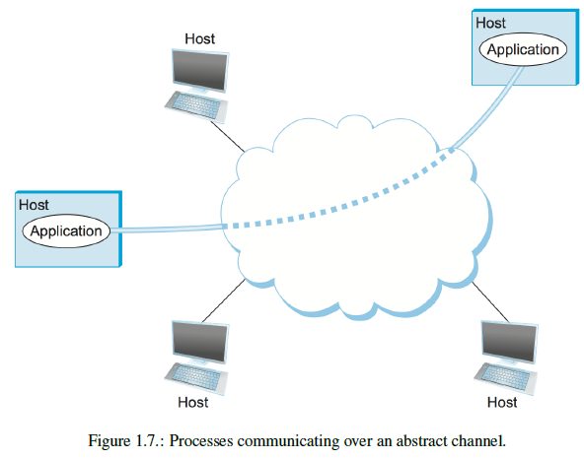
Support for Common Services

Slide 32
Support for Common Services
Like any abstraction, logical process-to-process channels are implemented on top of a collection of physical host-to-host channels
The challenge is to recognize what functionality the channels should provide to application programs:
does the application require a guarantee that messages sent over the channel are delivered?
Is it necessary that messages arrive at the recipient process in the same order in which they are sent, or
does the recipient not care about the order in which messages arrive?
Does the network need to ensure that no third parties can eavesdrop (spy) on the channel, or is privacy, not a concern?

Slide 33
Identify Communication Patterns
Designing an abstract communication channel involves the following steps:
First, understanding the nature of communication for a particular application,
then extracting their common communication requirements,
finally incorporating the functionality that meets these requirements in the network.
Earliest applications on the network are file access programs like the File Transfer Protocol (FTP) or Network File System (NFS)
whether whole files are transferred across the network or
only single blocks of the file are transferred at a given time
The process that requests access to the file is called the client.
The process that supports access to the file is called the server.

Slide 34
Identify Common Communication Patterns
Reading a file involves:
the client sending a small request message to a server and the server responding with a large message that contains the data file.
Writing a file involves:
the client sends a large message containing the data to be written to the server, and the server responds with a small message confirming that the write has taken place
A digital library is a more sophisticated application than a simple file transfer.
For example, ACM operates a large digital library of computer science literature at http://portal.acm.org/dl.cfm

Slide 35
Identify Common Communication Patterns
The digital library and video streaming applications need two types of channels for file access:
Request/reply channels and
message stream channels.
The digital library uses the request/reply channel for file transfer applications:
It would guarantee that the other side receives every message one side sends.
The request/reply channel might protect the privacy and integrity of the data that flows through the channel.
Unauthorized parties cannot access the data exchanged between the client and server processes.

Slide 36
Identify Common Communication Patterns
The message stream channel is used by the video streaming applications such as video on demand and videoconferencing:
The message stream channel might not need to guarantee that all messages are delivered since a video application can operate adequately even if some video frames are not received.
It would need to ensure that those delivered messages arrive in the same order they were sent.
Like the request/reply channel, the message stream channel ensures the privacy and integrity of the video data.
Finally, the message stream channel supports multicast, so that multiple parties can participate in the videoconference.

Slide 37
Reliable Message Delivery
Reliable message delivery is one of the most important functions that a network can provide
It is difficult to determine how to provide reliability, without understanding how networks fail.
The first thing to recognize is that perfect computer networks do not exist due to the:
Machines crash, system reboot, fibers are cut, electrical interference can cause bits corruption, switches run out of buffer space, etc.
Hardware may contain bugs and sometimes forwards packets into oblivion.

Slide 38
Reliable Message Delivery
There are three general classes of failure that network designers need to worry about:
First, as a packet is transmitted over a physical link, bit errors may be expected; that is, a one is turned into a zero or vice versa
Bit errors typically occur because outside forces, such as lightning strikes, power surges, etc., interfere with data transmission.
Once the error is detected, it is possible to correct such errors
if we know which bit or bits are corrupted, we can flip them
Sometimes, discarding the entire packet and asking the sender to retransmit it is necessary.

Slide 39
Reliable Message Delivery
The second type of failure is at the packet, rather than the bit level; the network loses a complete packet:
One reason this can happen is that the packet contains an uncorrectable bit error and therefore must be discarded.
A more likely reason is that a switch forwarding the packet from one link to another is overloaded and therefore is forced to drop it.
Less commonly, the software running on one of the nodes that handle the packet makes a mistake
For example, it might incorrectly forward a packet to the wrong link.
One of the main difficulties in dealing with lost packets is distinguishing between a lost packet and one late at the destination.

Slide 40
Reliable Message Delivery
The third class of failure is at the node and link level;
A physical link is cut, or the computer crashes:
This can be caused by a software error, a power failure, or due to misconfiguration of a network.
In a packet-switched network, for example, it is sometimes possible to route around a failed node or link
One of the difficulties in dealing with the third class of failure is distinguishing between a failed computer and one that is merely slow in a link.

Slide 41
Manageability
A final requirement, is that networks need to be managed properly:
Managing a network includes:
upgrading equipment as the network grows to carry more traffic or more users,
troubleshooting the network when things go wrong, or performance isn’t as desired, and
adding new features in support of new applications.
Network management has historically been a human-intensive aspect of networking, and, now it is involved with automation and self-healing designs.

Slide 42
Manageability
The Internet has scaled up to support billions of users and at least hundreds of millions of hosts.
The challenges of keeping the whole thing running correctly and configuring new devices as they are added to the network.
Configuring a single router in a network is often a task for a trained expert;
configuring thousands of routers and figuring out why a network of such a size is not behaving as expected can become a task beyond any human.

Slide 43
Network Architecture
A computer network must provide general, cost-effective, fair, and robust connectivity among many hosts (computers/devices).
Network designers have developed general blueprints for this called network architectures
that guide the design and implementation of networks.
The central ideas that are common to all network architectures are based on the two most widely referenced architectures:
the OSI 7-layer architecture and
the Internet architecture.

Slide 44
Layering and Protocols
Abstraction is the hiding of implementation details behind a well-defined interface
It is the fundamental tool to manage network complexity.
The idea of abstraction is to define a model that can capture some important aspects of the system:
Encapsulate this model in an object providing an interface other system components can manipulate.
Hide the details of how the object is implemented from the users.
Providing an abstraction that hides the complexity of the network details.

Slide 45
Layering and Protocols
Abstractions naturally lead to layering in network design:
The general idea is to start with the services offered by the underlying hardware and then add a sequence of service layers, on top, each providing a higher level of services.
The services provided at the high layers are implemented in terms of the services provided by the lower layers
for example, a simple network with two layers of abstraction sandwiched between the application program and the underlying hardware, as illustrated in Figure 1.8.

Slide 46
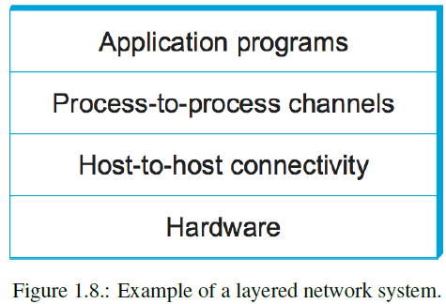
Layering and Protocols

Slide 47
Layering and Protocols
The layer immediately above the hardware provides host-to-host connectivity (see Figure 1.8):
abstracting away the fact that an arbitrarily complex network topology may exist between any two hosts.
The next layer up builds on the available host-to-host communication service and provides support for process-to-process channels,
abstracting away the fact that the network occasionally loses messages, for example.

Slide 48
Layering and Protocols
Layering in network design provides two useful features:
First, it decomposes the problem of building a network into more manageable components
Rather than implementing a monolithic piece of software that does everything you will ever want.
Second, it provides a more modular design
If you add some new service, you only need to modify the functionality at the corresponding layer.
Consider the request/reply and the message stream channels discussed before:
These two channels offer a multilevel networking system at some level, as illustrated in Figure 1.9.

Slide 49
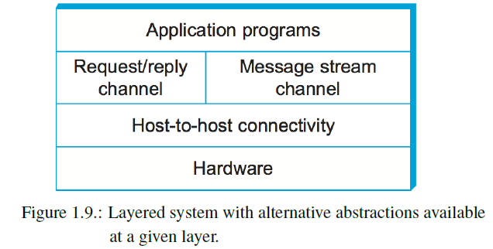
Layering and Protocols

Slide 50
Layering and Protocols
The abstract objects that make up the layers of a network system are called protocols.
A protocol provides a communication service to higher-level abstract objects
such as application processes used to exchange messages.
For example, a network that supports a request/reply and a message stream protocol, corresponding to the request/reply and message stream channels.

Slide 51
Layering and Protocols
A protocol has two different interfaces:
The First interface defines a service interface to the same computer that wants to use its communication services to other devices
This service interface defines the operations performed on the communication service protocols
For example, a request/reply protocol would support operations by which an application can send and receive messages.
An implementation of the HTTP protocol could support an operation to fetch a page of hypertext from a remote server.
An application such as a web browser would invoke an operation like browsing a new web page.

Slide 52
Layering and Protocols
The Second interface defines a peer interface to its counterpart on another machine:
A peer link is a direct aggregated link between two devices configured
The peer interface exchanged messages between protocol peers to maintain the communication service.
The request/reply protocol on one machine communicates with its peer on another machine
In the case of HTTP, the protocol specification defines the communication services in detail:
how a GET command is formatted,
what arguments can be used with the command, and
how a web server should respond when it receives such a command.

Slide 53
Layering and Protocols
Communication service interface that it exports locally a set of rules governing the messages that are exchanged with its peer(s) to implement the peer interface service (see Figure 1.10).
Except at the hardware level, where peers directly communicate over a physical medium, peer-to-peer communication is direct.
Each protocol communicates with its peer by passing messages to some lower-level protocol, which delivers the message to its indirect peer.

Slide 54
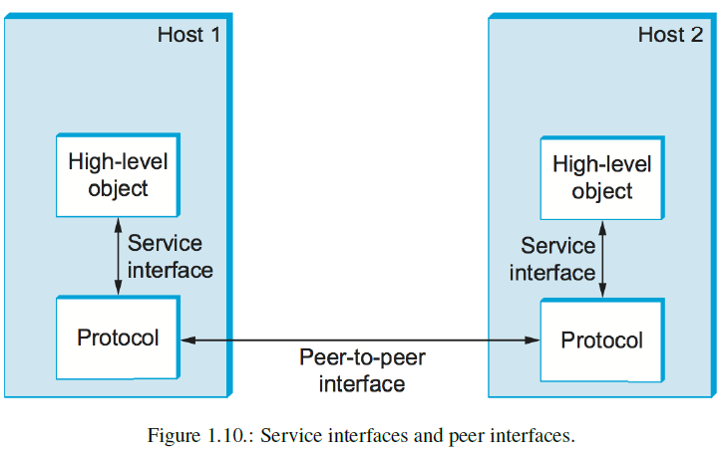
Layering and Protocols

Slide 55
Peer-to-peer Network
In a peer-to-peer (P2P) network, a group of computers is linked with equal permissions and responsibilities for processing data.
No devices in a P2P network are designated solely to serve or to receive data (there is no client and server discrimination among computers) unlike traditional client-server networking, https://www.webroot.com/
P2P computing or networking is a distributed application architecture that partitions tasks or workloads between peers.
Peers are equally privileged, equipotent participants in the application. They are said to form a peer-to-peer network of nodes https://en.wikipedia.org/wiki/Peer-to-peer

Slide 56
Layering and Protocols
There is potentially more than one protocol at any given level, each providing a different communication service
A suite of protocols that make up a network system with a protocol graph.
The nodes of the graph correspond to protocols, and the edges represent a relation
Figure 1.11 illustrates a protocol graph for the hypothetical layered system:
RRP (Request/Reply Protocol) and MSP (Message Stream Protocol) implement two different types of process-to-process channels, and
both depend on the Host-to-Host Protocol (HHP) which provides a host-to-host connectivity service.

Slide 57
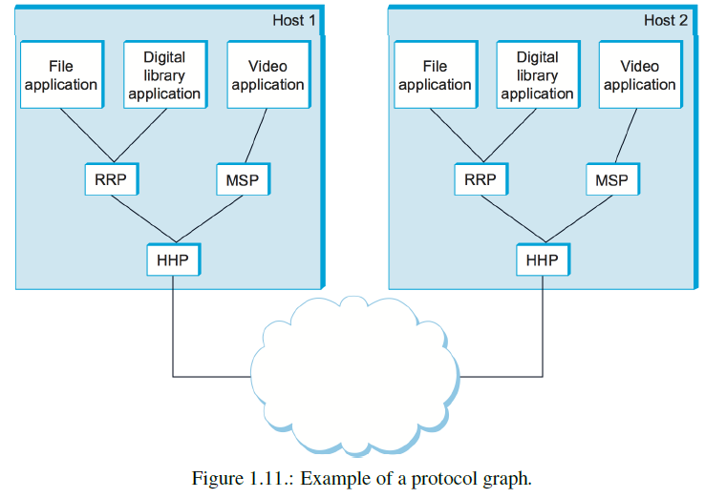
Layering and Protocols

Slide 58
Layering and Protocols
In Figure 1.11, suppose that the file application on host1 wants to send a message to its peer on host2 using the service offered by RRP.
In this case, the file application asks RRP to send the message on its behalf.
To communicate with its peer, RRP invokes the services of HHP, which transmits the message to its peer on the other machine.
Once the message has arrived on host2, HHP passes it to RRP, which delivers it to its file application.
In this particular case, the application is said to employ the protocol stack RRP/HHP services.

Slide 59
Encapsulation
What happens when one of the application programs sends a message to its peer by passing it to RRP (Request/Reply Protocol)?
From RRP’s perspective, the application’s message is an uninterpreted string of bytes.
RRP does not care that these bytes (whether it is an array of integers, an email message, a digital image, or whatever);
it is simply charged with sending them to its peer via its HHP.
RRP must communicate control information to its peer, instructing it on handling the message when it is received.
RRP does this by attaching a header (control data) to the message.

Slide 60
Encapsulation
A header is a small data structure (from a few bytes to a few dozen bytes) used to control data flow among peers:
headers are usually attached to the front of a message. Sometimes, the header is sent at the end of the message, called a trailer.
The exact format for the header attached by RRP is defined by its protocol specification.
The rest of the message after the header is the data being transmitted, called the message’s body or payload.
RRP encapsulates the application’s data transmission as [header + body (payload)].

Slide 61
Encapsulation
Assume that HHP (Host-to-Host Protocol) sends the message to its peer over a network (Figure 1.12):
The message arrives at the destination peer; HHP first interprets the HHP header at the front of the message and passes only the body of the message (not the HHP header) to RRP, which takes action indicated by the RRP header that its peer attached and passes the body of the message to the application program.
The message passed up from RRP to the application on host2 is exactly the same message as the application passed down to RRP on host1
Note that in this example, nodes in the network (e.g., switches and routers) may inspect the HHP header at the front of the message.

Slide 62
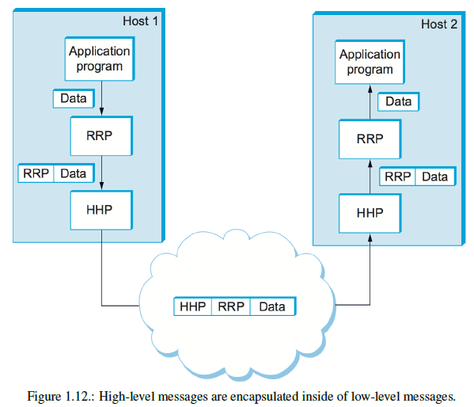
Encapsulation

Slide 63
Multiplexing and Demultiplexing
A fundamental idea of packet switching is to multiplex multiple data flows over a single physical link.
In Figure 1.11, RRP implements a logical communication channel, with messages from two applications multiplexed over this channel at the source host and then demultiplexed back to the application at the destination host.

Slide 64
Multiplexing and Demultiplexing
At the source the header that RRP attaches to its messages contains an identifier that records the application to which the message belongs
This identifier is called RRP’s demultiplexing key (demux key).
At the source host, RRP includes the appropriate demux key in its header.
When the message is delivered to RRP on the destination host, it strips its header, examines the demux key, and demultiplexes the message to the correct application.

Slide 65
7-Layer OSI Model
The ISO was one of the first organizations to formally define a common way to connect computers:
Their architecture, called the Open Systems Interconnection (OSI) 7-layer architecture (see Figure 1.13a)
A 7-layer supported network connection is illustrated in Figure 1.13,
where one or more protocols implement the functionality assigned to a given layer.
This OSI 7-layer schematic is act as a reference model for a protocol graph.
Because there is no OSI-based network running today!
Internet protocol layers are based on this OSI 7-layer architecture.

Slide 66
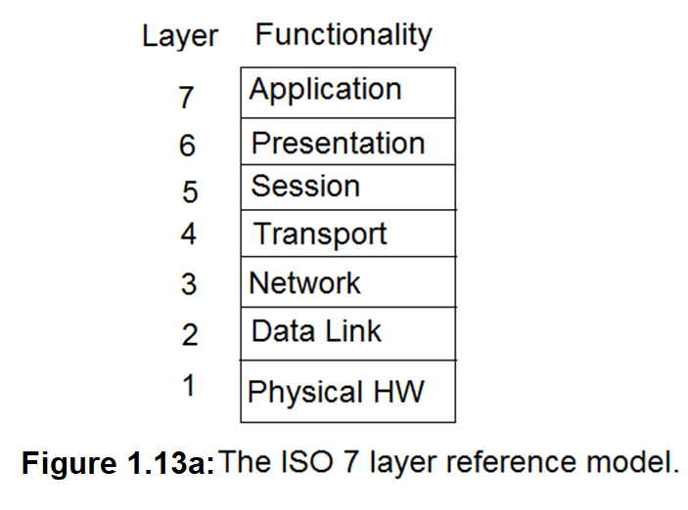
7-Layer OSI Model

Slide 67
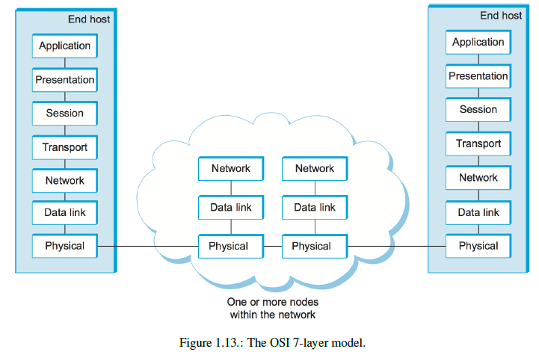

Slide 68
7-Layer OSI Model
The Physical layer (hardware) handles the transmission of bits over a communications link.
The Data link layer collects a stream of bits into a larger aggregate form called a frame.
Network adaptors, including device drivers running in the node’s OS, are typically in the data link level.
The Network layer handles the routing of data in the form of packets among nodes (called packet-switching)
At this layer, the unit of data exchanged among nodes is typically called a packet rather than a frame (although they are the same).

Slide 69
7-Layer OSI Model
The Transport layer implements what we have up to this point been calling a process-to-process channel
At this layer level, the unit of data exchanged is commonly called a message rather than a packet or a frame.
The transport and higher layers typically run only on the end hosts, not intermediate switches or routers.
The Application layer maintains message transmission protocols including:
The Hypertext Transfer Protocol (HTTP) is the basis of the World Wide Web (WWW) and enables web browsers to request pages from web servers.

Slide 70
7-Layer OSI Model
The Presentation layer is concerned with the format of data exchanged between peers:
for example, whether an integer is 16, 32, or 64 bits long, whether the most significant byte (MSB) is transmitted first or last, or how a video stream is formatted.
The Session layer provides a namespace to tie together different transport streams that are part of a single application.
For example, it manages audio and video streams combined in a teleconferencing application.

Slide 71
Internet Architecture
The Internet architecture, sometimes called the TCP/IP architecture, is depicted in Figure 1.14.
An alternative representation of Internet architecture is given in Figure 1.15.
The Internet architecture evolved from experiences with an earlier packet-switched network called the ARPA-NET.
Both the Internet and the ARPA-NET were funded by the Advanced Research Projects Agency (ARPA), one of the research development funding agencies of the U.S. Department of Defense.
The Internet and ARPA-NET were around before the OSI architecture, and the experience gained from building them was a major influence on the OSI reference model.

Slide 72
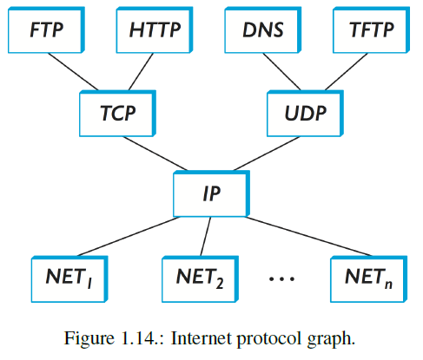
Internet Architecture

Slide 73
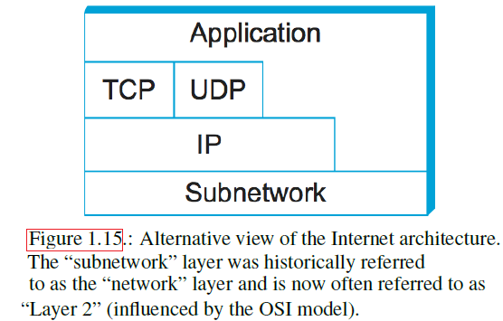
Internet Architecture

Slide 74
Internet Architecture
The lowest level of the Internet architecture is the Subnetwork, which has a wide variety of network protocols, denoted as NET1, NET2, and so on (see Figure 1.14).
In practice, these protocols are implemented by hardware (e.g., a network adaptor) and software (e.g., a network device driver).
For example, you might find Ethernet or wireless protocols (such as the 802.11 Wi-Fi standards) at this layer.
The next layer consists of a single protocol the Internet Protocol (IP)
This protocol supports the interconnection of multiple networking technologies into a single, logical internetwork.

Slide 75
Internet Architecture
The layer on top of the IP contains two main protocols:
the Transmission Control Protocol (TCP) and
the User Datagram Protocol (UDP)
TCP and UDP provide alternative logical channels to application programs:
TCP provides a reliable byte-stream channel, and UDP provides an unreliable datagram delivery channel (datagram).
In the Internet language, TCP and UDP are sometimes called end-to-end protocols (it is equally correct to refer to them as transport protocols).

Slide 76
Internet Architecture
Running above the transport layer (see Figure 1.15a) is a range of application protocols, such as HTTP, FTP, Telnet (remote login), and the Simple Mail Transfer Protocol (SMTP) enables the popular Internet mail applications
To understand the difference between an application layer and an application layer protocol, consider all the different World Wide Web browsers available (e.g., Firefox, Google Chrome, Safari, Netscape, Mosaic, Internet Explorer).
HTTP confusingly applies to both an application and its application layer protocol.
FTP is often used as the name of an application that implements the FTP protocol.

Slide 77
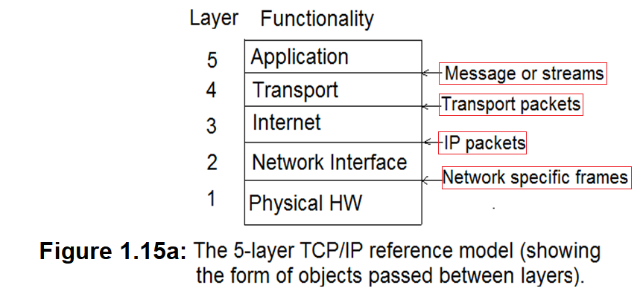
Internet Architecture

Slide 78
Internet Architecture
Application layer:
At the application layer, users invoke application programs that access services available across a TCP/IP network (Internet).
An application interacts with the transport layer protocols for send/receive data packets:
Which can be either a sequence of individual messages or a continuous stream of bytes
The application program passes data in the required form to the transport layer for delivery.

Slide 79
Internet Architecture
Transport Layer:
The primary duty of the transport layer is to provide communication from one application program to another.
Such communication is called end-to-end because it involves applications on two endpoints (hosts) rather than intermediate routers.
The transport layer ensures that data arrives without error and in sequence.
The transport layer divides the stream of data being transmitted into small units (called packets) and passes each packet along with a destination address to the next layer
Transport protocol sends back acknowledgments (ACK) to the receiving side and retransmits lost packets (if any) to the sending side.
Transport layer protocols also use a checksum to protect against errors that cause bits to change.

Slide 80
Internet Architecture
Internet layer:
The internet layer handles communication from one computer to another
It accepts a request to send a packet from the transport layer along with an identification of the computer to which the packet will be sent.
Internet layer encapsulates the transport layer packet in an IP packet format by filling in the header and
either sends the IP packet directly to the destination (if the destination is on the local network)
or sends it to a router to be forwarded across the Internet (if the destination is remote).
Internet layer also handles incoming IP packets, checking their validity and using the forwarding algorithm to decide whether the packet should be processed locally or forwarded to the next.

Slide 81
Internet Architecture
Network Interface Layer:
The network interface layer is the lowest layer of TCP/IP that comprises a network interface layer, responsible for accepting IP packets and transmitting them over a specific network.
The network layer may consist of a device driver or a complex subsystem that implements a data link protocol.
In practice, the TCP/IP is much more complex than the simple 5-layer model which is just described.
The conceptual diagram in Figure 1.15b shows the network complexity in a real internet system.

Slide 82
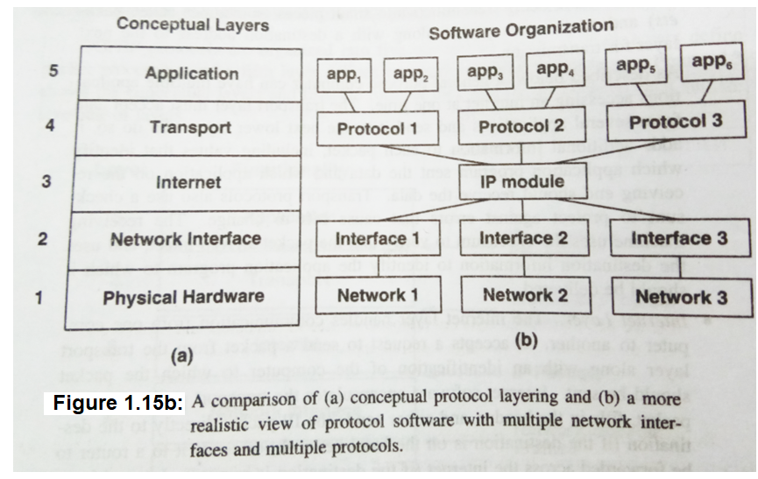
Internet Architecture

Slide 83
Application Programming Interface (Sockets)
Since most network protocols are in software, and nearly all computer systems implement their network protocols as part of the OS:
The interface the OS provides for application developers is often called the network application programming interface (API).
Although each OS is free to define its own network API, over time, certain APIs have become widely supported.
The socket interface is a network API provided by Berkeley Unix, which is now supported in virtually all popular OSs and supports Java or Python socket library.

Slide 84
Application Programming Interface (Sockets)
The main abstraction of the socket interface, is the socket.
A good way to think of a socket is as the point where a local application process attaches to the network.
The interface defines operations for creating a socket, attaching the socket to the network, sending/receiving messages through the socket, and closing the socket.
The first step is to create a socket, which is done with the following operation:
int socket(int domain, int type, int protocol)

Slide 85
Application Programming Interface (Sockets)
The domain argument specifies the protocol family that is going to be used:
PF_INET denotes the Internet family, PF_UNIX denotes the Unix pipe facility, and PF_PACKET denotes direct access to the network interface.
The type argument indicates the semantics of the communication:
SOCK_STREAM is used to denote a byte stream. SOCK_DGRAM is an alternative that denotes a message-oriented service, such as that provided by UDP.
The protocol argument identifies the specific protocol that is going to be used.
This argument is UNSPEC because the combination of PF_INET and SOCK_STREAM implies TCP.
Finally, the return value from socket is a handle for the newly created socket
that is, an identifier by which we can refer to the socket in the future. It is given as an argument to subsequent operations on this socket.

Slide 86

Application Programming Interface (Sockets)
The next step depends on whether you are a client or a server
On a server machine, the application process performs a passive open—the server says that it is prepared to accept connections, but it does not actually establish a connection.
The server does this by invoking the following three operations:

Slide 87
Application Programming Interface (Sockets)
The bind operation, binds the newly created socket to the specified address.
This is the network address of the local participant (the server).
Note that when used with the Internet protocols, the address includes the server’s IP address and a TCP port number.
Ports are used to identify processes indirectly.
They are a form of demux keys.
The port number is usually some well-known number specific to the service offered; for example, web servers commonly accept connections on port 80.

Slide 88
Application Programming Interface (Sockets)
Once a connection is established, the application processes invoke the following two operations to send and receive data:
The first operation sends the given message over the specified socket,
while the second operation receives a message from the specified socket into the given buffer.
Both operations take a set of flags that control certain details of the operation.

Slide 89
Bandwidth and Latency
Network performance is measured in two fundamental ways: bandwidth (also called throughput) and latency (also called delay)
The bandwidth of a network is given by the number of bits that can be transmitted over the network in a certain period of time.
For example, a network might have a bandwidth of 10 million bits/second (Mbps), meaning it can deliver 10 million bits every second.
bandwidth is sometimes useful regarding how long it takes to transmit each bit of data. On a 10-Mbps network, it takes 0.1microsecondsd (𝜇s) to transmit each bit.
bandwidth is a measure of the width of a frequency band
For example, voice-grade telephone lines supported a frequency band ranging from 300 to 3300 Hz; it was said to have a bandwidth of 3300 Hz - 300 Hz = 3000 Hz.

Slide 90
Bandwidth and Latency
The word throughput refers to the measured performance of a system.
Due to various inefficiencies of implementation, a pair of nodes connected by a link with a bandwidth of 10 Mbps might achieve a throughput of only 2 Mbps.
This would mean that an application on one host could send data to another host at 2 Mbps.
Assume that each bit on a 1-Mbps link is 1 𝜇s wide, while each bit on a 2-Mbps link is 0.5 𝜇s wide, and is illustrated as in Figure 1.16
the narrower each bit can become the higher the bandwidth.

Slide 91
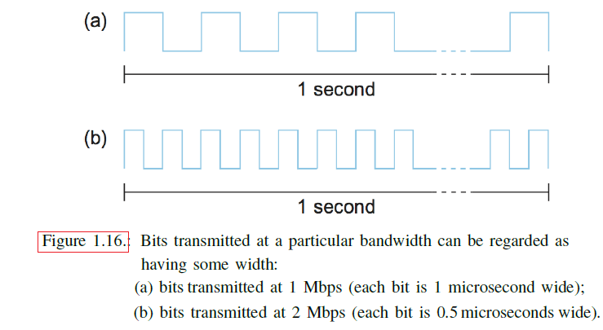
Bandwidth and Latency

Slide 92
Bandwidth and Latency
The second performance metric is latency, which corresponds to how long it takes a message to travel from one end of a network to the other
Latency is measured strictly in terms of time. For example, a transcontinental network might have a latency of 24 milliseconds (ms);
it takes a message 24 ms to travel from one coast of North America to the other.
There are many situations in which it is more important to know how long it takes to send a message from one end of a network to the other and back; this is called the network’s round-trip time (RTT).

Slide 93
Bandwidth and Latency
The network latency has three components:
First, there is the speed-of-light propagation delay. This delay occurs because a bit on a wire can travel faster than the speed of light.
If you know the distance between two points, you can calculate the speed-of-light latency, because light travels across different media at different speeds: It travels at 3.0 × 10⁸ m/s in a vacuum, 2.3 × 10⁸ m/s in a copper cable, and 2.0 × 10⁸ m/s in an optical fiber.
Second, there is the amount of time it takes to transmit a data unit.
This is a function of the network bandwidth and the packet size in which the data is carried.
Third, there may be queuing delays inside the network, since packet switches generally need to store packets for some time before forwarding them on an outbound link.

Slide 94
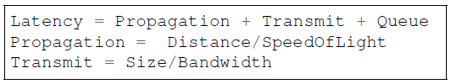
Bandwidth and Latency
So, the total latency can be defined as:
where Distance is the length of the wire over which the data will travel,
SpeedOfLight is the effective speed of light over that wire,
Size is the size of the packet, and
Bandwidth is the bandwidth at which the packet is transmitted.

Slide 95
Bandwidth and Latency
In contrast, consider a digital library program being asked to fetch a 25MB size.
the more bandwidth available, the faster it can return the image to the user.
Here, the bandwidth of the channel dominates performance.
To see this, suppose that the channel has a bandwidth of 10 Mbps.
Transmission time = data size/ bandwidth
= 25 × 10⁶ × 8-bits / 10 × 10⁶ = 20s
That is it will take 20s to transmit the image through the channel

Slide 96
Bandwidth and Latency
Figure 1.17 gives you a sense of how latency or bandwidth can dominate performance in different circumstances.
The graph shows how long it takes to move objects of various sizes (1 byte, 2 KB, 1 MB) across networks with RTTs ranging from 1 to 100 ms and link speeds of either 1.5 or 10 Mbps.
We use logarithmic scales to show relative performance.
For a 1-byte object (say, a keystroke), latency remains almost exactly equal to the RTT, so that you cannot distinguish between a 1.5-Mbps network and a 10-Mbps network.
For a 2-KB object (say, an email message), the link speed makes quite a difference on a 1-ms RTT network but a negligible difference on a 100-ms RTT network.
And for a 1-MB object (say, a digital image), the RTT makes no difference—it is the link speed that dominates performance across the full range of RTT.

Slide 97
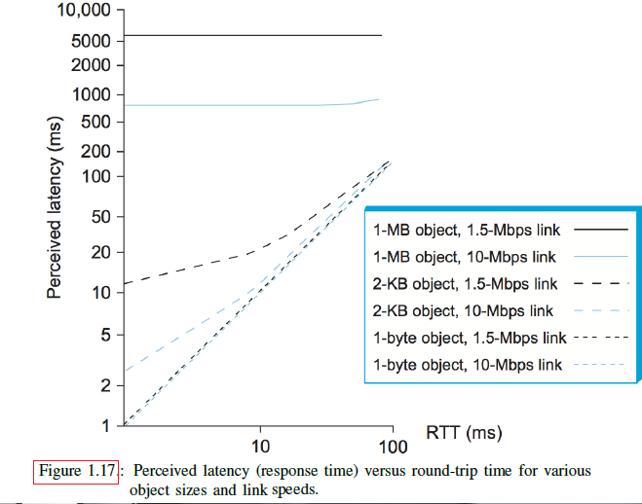

Slide 98
Delay x Bandwidth Product
The terms latency and delay in a generic way denote how long it takes to perform a particular function, such as delivering a message or moving an object.
When referring to the specific amount of time it takes a signal to propagate from one end of a link to another, we use the term propagation delay.
It is also useful to talk about the product of bandwidth and latency metrics, often called the delay × bandwidth product.
Assume a channel as a hollow pipe shown in Figure 1.18, where the latency corresponds to the length and the bandwidth gives the diameter of the pipe, then the delay × bandwidth product gives the volume of the pipe
is the maximum number of bits that could be transported through the pipe at any given instant.

Slide 99
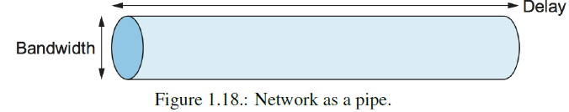
Delay x Bandwidth Product
A transcontinental channel with a one-way latency of 50 ms and a bandwidth of 45 Mbps, its delay × bandwidth product can be calculated as 50 x 10⁻³ x 45 x 10⁶ = 2.25 x 10⁶ bits.
The delay × bandwidth product is important when constructing high-performance networks because it corresponds to how many bits the sender must transmit before the first bit arrives at the receiver.
If the sender expects the receiver to signal the bits starting to arrive. That is it propagates back the signal to the sender; then the sender can send up one RTT × bandwidth data bits before hearing from the receiver.

Slide 100
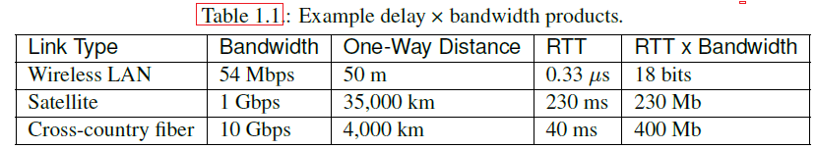
Bandwidth and Latency
Usually, whether the “delay” in delay × bandwidth means one-way latency or RTT is made clear by the context.
Table 1.1 shows some examples of RTT × bandwidth products for some typical network links.
The effective end-to-end throughput that can be achieved over a network is given by the simple relationship :
Throughput = TransferSize / TransferTime
TransferTime = RTT + 1/Bandwidth x TransferSize

