Slide 1
Chapter 2 Direct Links
Computer Networks: A Systems Approach, Release Version 6.1
Peterson and Davie
November 2019

Slide 2
Problem: Connecting to a Network
Chapter 1 has shown that links interconnect nodes.
One of the fundamental problems is connecting two nodes to form a network.
The “cloud” abstraction represents a network without revealing all of its internal complexities.

Slide 3
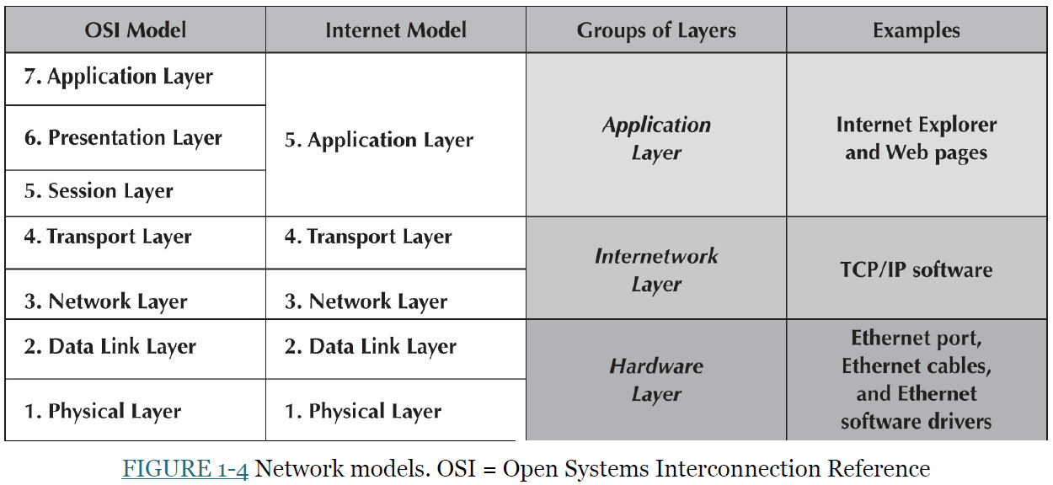

Slide 4
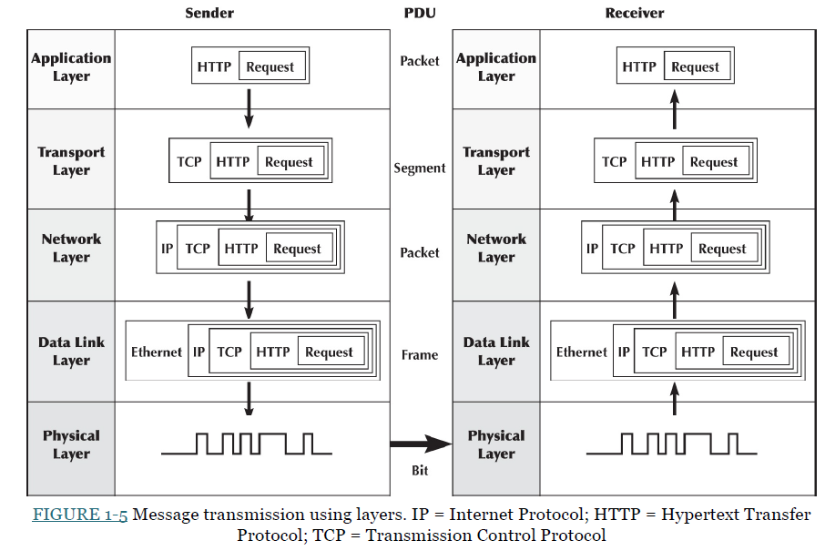
PDU = Protocol Data Unit

Slide 5
Problem: Connecting to a Network
Whether to construct a trivial two-node network with one link or connect multiple hosts to an existing network, we need to address the following issues:
First, we need some physical medium to make the connection
The physical medium may be a length of wire, a piece of optical fiber, or a tangible medium (such as air) through which data bits are transmitted via electromagnetic (EM) radiation (e.g., radio waves).
It may cover a small area (e.g., an office building) or a wide area (e.g., transcontinental).

Slide 6
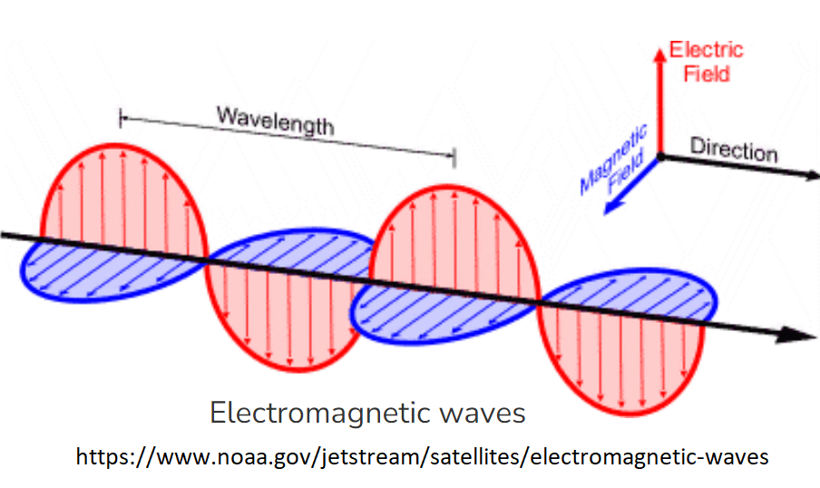
Electromagnetic (EM)Waves
Electromagnetic waves are a form of radiation that travels through the universe.
They are formed when an electric field (red arrows) couples with a
magnetic field (blue arrows).

Slide 7
Problem: Connecting to a Network
Connecting two nodes with a suitable medium is only the first step.
Five additional problems must be addressed before the nodes can successfully connect and exchange packets (as per layer 2 terminology of the OSI architecture):
First is encoding bits onto the transmission medium so that a receiving node can understand them.
Second is delineating the sequence of bits transmitted over the link into a complete message that can be delivered to the end node.
This is the framing problem, and the messages delivered to the end hosts are often called frames (or sometimes packets).

Slide 8
Problem: Connecting to a Network
Third, because frames are sometimes corrupted during transmission, detecting them and taking the appropriate action is necessary; this is the error detection problem.
Fourth issue is how to link appear reliable even though it corrupts frames from time to time.
Fifth issue is that in cases where multiple hosts share the link, it is necessary to mediate access to it. This is the media access control problem.
The goal is to survey the available link-level technology to solve these five fundamental issues of nod connection.

Slide 9
Technology Landscape
At the other end of the network spectrum, a typical user encounters links to connect a computer to the existing Internet
Sometimes link will be a wireless (Wi-Fi) link;
it is an Ethernet link (LAN) in an office building;
it is a smartphone hotspot connection;
it is a fiber optic link provided by an ISP (Internet Service Provider), and many others connect with copper wire or cable.
Figure 2.1 illustrates various links that might be found on today’s Internet.

Slide 10
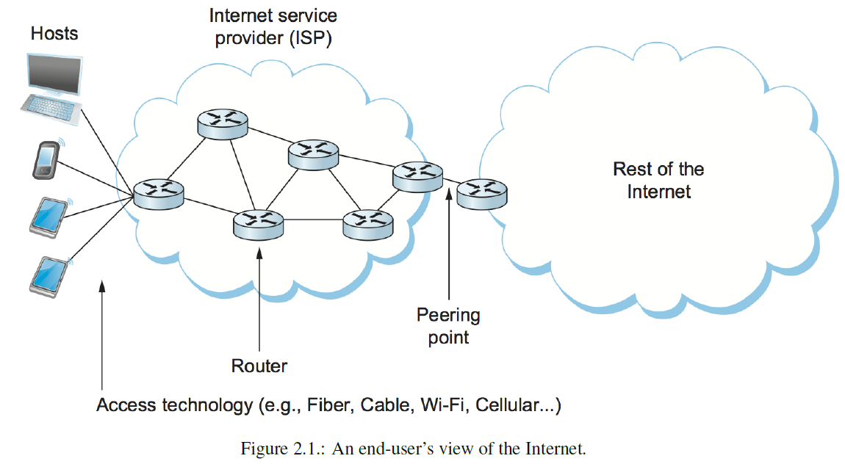

Slide 11
Technology Landscape
On the left of Figure 2.1 shows a variety of end-user devices ranging from smartphones to tablets to computers connected by various means to an ISP.
While those links might use different technologies, they all look the same in this picture as a straight line connecting a device to a router.
some links connect routers together inside the ISP, as well as links that connect the ISP to the “rest of the Internet,”
which consists of many other ISPs and the hosts to which they connect.

Slide 12
Technology Landscape
in Figure 2.1, the links all look alike because a network architecture is to provide a common abstraction of a complex network and its links.
The idea is that a laptop or smartphone doesn’t have to care what link it is connected to—the only thing matters is that it has a link to the Internet.
Similarly, a router doesn’t have to care what sort of link connects it to other routers
it sends data packets on the link, expecting the packet to reach the other end.
How do we make all these links to end-users and routers look sufficiently alike?

Slide 13
Technology Landscape
How do we make all these links to end-users and routers look sufficiently alike?
First, deal with all the physical limitations and shortcomings of links in the real world.
typically, copper wire in some form, such as shielded or unshielded twisted pair cables (Ethernets and landline phones) and coaxial cable; optical fiber, or air/free space wireless links.
All of these links are made to propagate electromagnetic (EM) signals, such as radio waves, but here we talk about data bits.
Secondly, the important link characteristic is the frequency (in hertz) with which the electromagnetic (EM) waves oscillate.
EM wave ranging between 300 Hz and 3300 Hz

Slide 14
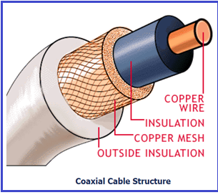
Technology Landscape

Slide 15
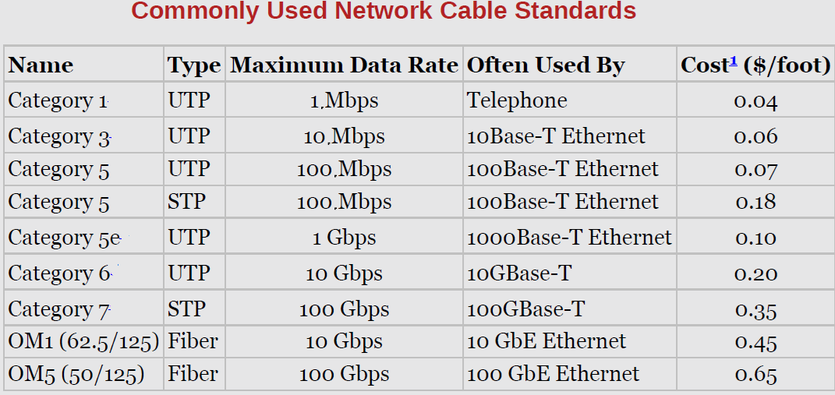
Technology Landscape

Slide 16
Technology Landscape
The distance between a pair of adjacent maxima or minima of a wave, measured in meters, is called the wavelength.
Since all EM waves travel at the speed of light (depending on the medium), the speed of light divided by the wave’s frequency is equal to its wavelength (see the Figure on the next slide).
For example, a 300-Hz EM wave traveling through a copper cable would have a wavelength of 667 × 10³ 𝑚𝑒𝑡𝑒𝑟𝑠 (Speed-Of-Light-In-Copper is 2.001 x 10⁸).
Figure 2.2 depicts the electromagnetic spectrum and shows which media are commonly used to carry which frequency bands.

Slide 17
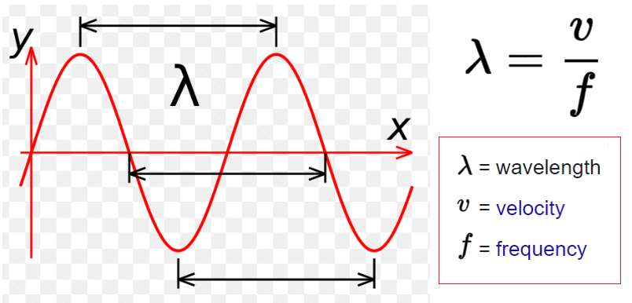
Wave Length https://scied.ucar.edu/learning-zone/atmosphere/wavelength
The wavelength (λ) of a wave describes how long the wave is.
The wavelength is the distance from the "crest" (top) of one wave to the crest of the next wave.
Alternately, we can measure from the "trough" (bottom) of one wave to the trough of the next wave and get the same value for the wavelength.

Slide 18
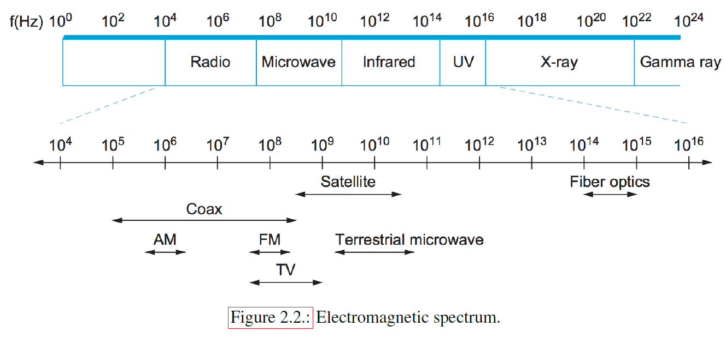
Technology Landscape

Slide 19
Technology Landscape
The high-level summary is that traditional cellular phone technologies range from 700-MHz to 2400-MHz, with new mid-spectrum allocations at 6-GHz, and millimeter-wave (mmWave) allocations opening above 24-GHz.
This mmWave (> 24-GHz) band will likely become essential to the 5G mobile network.
A network link is a physical medium carrying signals in the form of electromagnetic (EM) waves.
Such links provide the foundation for transmitting all sorts of information in binary (1s and 0s), and the binary data is encoded into a signal before its transmission in the form of an EM wave.

Slide 20
Technology Landscape
Consumers interact with the Internet through wireless networks (Wi-Fi) or last-mile links (access networks) provided by an ISP (see Figure 2.1)
These link types are summarized in Table 2.1:
DSL (Digital Subscriber Line) is an old technology in which an Internet link at home or office is established via already existing copper telephone cables/services via a MODEM;
G. Fast is a copper cable-based technology typically used within multi-dwelling apartment buildings, and
PON (Passive Optical Network) is a newer technology that connects homes and businesses over recently deployed fiber cables.

Slide 21
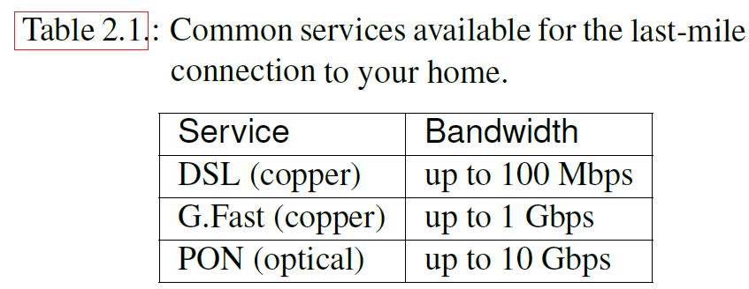
Technology Landscape

Slide 22
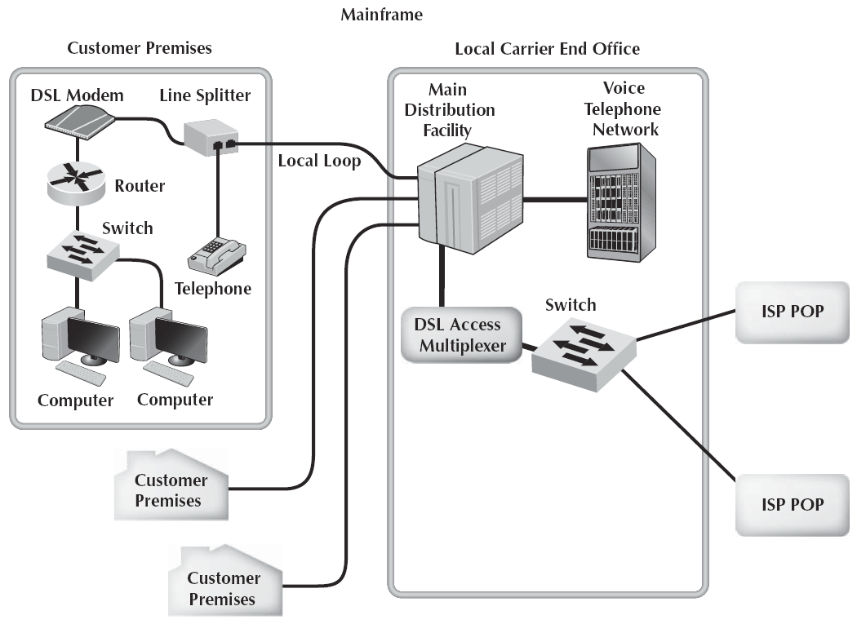
Technology Landscape: DSL Architecture
A modem (modulator-demodulator) is
a computer hardware device that
converts data from a digital format
into a format suitable for an analog
transmission medium such as a telephone
or radio.
https://en.wikipedia.org/wiki/Modem
FIGURE DSL architecture. DSL = digital subscriber line;
ISP = Internet service provider; POP = point of presence

Slide 23
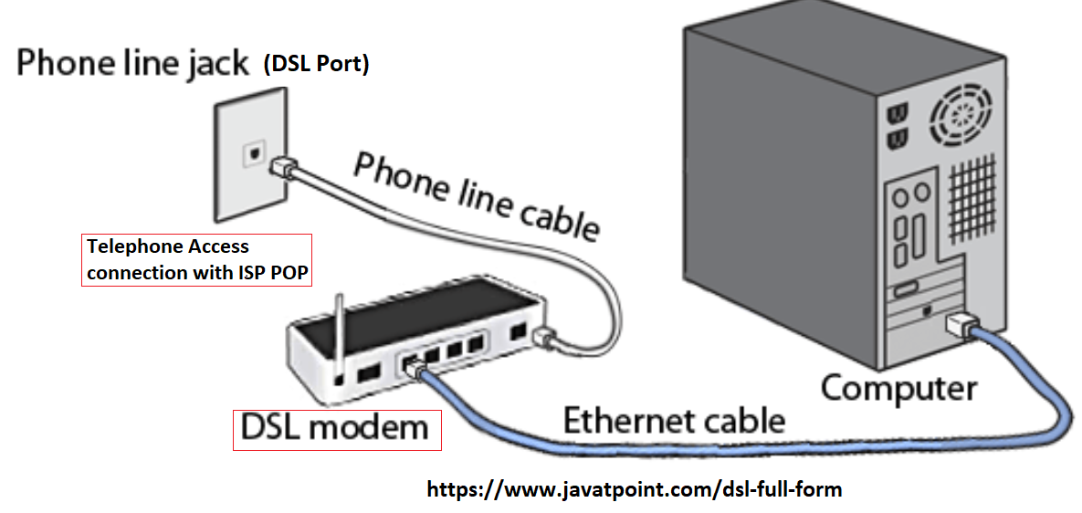
Technology Landscape

Slide 24
Data Encoding
How can a link transmit binary data from the sender node to the receiver node?
Network signals propagate over physical links:
Sending-node encodes the binary data into the signals (encoded binary data) and then send it via a physical link as an EM wave.
Receiver node decodes the signal back into the original binary data.
In practice, binary signals might correspond to two different voltages on a copper-based link, two different power levels on an optical link, or different amplitudes on a radio transmission.
A network adaptor is a piece of HW essential to all networks that connects a node to a link.

Slide 25
Non-Return to Zero Encoding
The network adaptor contains a signaling component that encodes bits into signals at the sending node and decodes signals into bits at the receiving node:
As in Figure 2.3, signals travel over a link between two signaling components, and bits flow between network adaptors
The problem of encoding bits onto signals is to map the data value 1 onto the high signal and 0 onto the low signal.
This type of bit mapping is used by an encoding scheme called, non-return to zero (NRZ).
Figure 2.4 depicts the NRZ-encoded signal corresponding to transmitting a sequence of bits.

Slide 26
Non-Return to Zero Encoding

Slide 27
Non-Return to Zero Encoding
The first problem with NRZ is that a sequence of several consecutive 1s means that the signal is high on the link for an extended period of time; similarly, several consecutive 0s mean that the signal stays low for a long time.
In decoding the digital signal, the receiver calculates the average power of the received signal, and this power average is called the baseline.
The receiver uses a baseline to distinguish between the low and high values of the signals:
A long string of 0s and 1s can cause a drift in the baseline (called baseline wandering) and make it difficult for a receiver to decode correctly:
Whenever the signal is lower than the baseline, the receiver concludes that it has a 0; likewise, a higher signal is interpreted as a 1.

Slide 28
Non-Return to Zero Encoding
The second problem with NRZ is that frequent transitions of high to low bit signals over a communication channel must be free from the clock recovery problems.
What is the clock recovery problem?
A channel clock drives both the encoding and decoding processes—the sender transmits a bit every clock cycle, and the receiver recovers a bit at the same clock.
The sender’s and the receiver’s clock signals must be precisely synchronized for the receiver to recover the same bits the sender transmits.
If the receiver’s clock is slightly faster/slower than the sender’s, it cannot decode the signal correctly; this is the Clock recovery problem!

Slide 29
Non-Return to Zero Inverted Encoding
One of the approaches to address this clock recovery problem is to use a non-return to zero inverted (NRZI) encoding:
To illustrate the NRZI encoding, consider the following I/P data: 11001100
NRZI concept: For bit 1, there will be a change in the voltage level, and for bit 0, there won’t be any change in the voltage level (where bit 1 is the positive voltage and bit 0 is the negative voltage) https://www.section.io/engineering-education/different-techniques-of-encoding-data-for-transmission/
Steps of NRZI conversion:
For the first bit 1, we know there will be a change in the signal level. Therefore, the signal will shift to a negative level (1 → 0).
Notes:
It

Slide 30
NRZI Encoding
For the second bit 1, there is a change in the signal level. After the previous 1 → 0 conversions, the current bit in the channel is 0. Hence Convert the 0 bit into 1 for the second data bit (which is 1): (1 →1)
For the third bit 0, there is no change needed in the data bit, therefore the previous positive bit (bit 1) will continue: (0 →1)
For the fourth bit 0, no change is needed in the signal, hence, the previous positive bit (bit 1) will continue: (0 →1)
For the fifth bit 1, change the previous positive bit (1) to a negative bit (bit 0): (1 →0)
For the sixth bit 1, change the previous negative bit (bit 0) to a positive bit (bit 1): (1 →1)
For the seventh bit 0, no change is needed in the signal level. Therefore, the previous positive bit (bit 1) will continue: (0 →1)
For the eighth bit 0, no change is needed in the signal level. Therefore, the previous positive bit (bit 1) will continue: (0 →1)

Slide 31
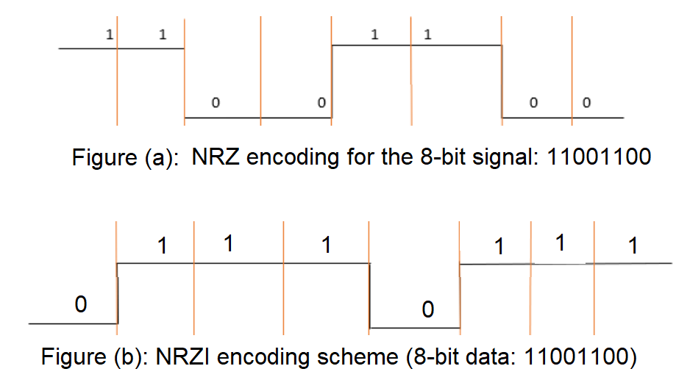
NRZI Encoding

Slide 32
Manchester Encoding
An alternative to NRZ encoding is called the Manchester encoding, in which the channel clock is merged with the data by the XOR (Exclusive OR) operation:
The local clock is an internal signal alternating from low to high; a low/high pair is one clock cycle.
The Manchester encoding is illustrated in Figure 2.5 and Figure (c).
Observe that the Manchester encoding results in 0 being encoded as a low-to-high transition and 1 as a high-to-low transition.
Because 0s and 1s result in a transition to the signal, the clock can be effectively recovered at the receiver.

Slide 33
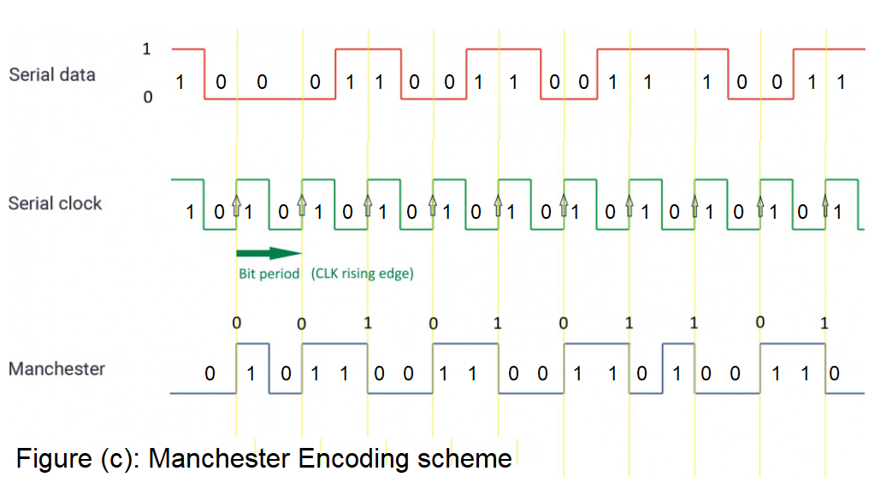
Manchester Encoding

Slide 34
Manchester Encoding
The problem with the Manchester encoding scheme is that it doubles the rate at which signal transitions
which means the receiver has half the time to detect each signal pulse.
The rate at which the signal changes is called the link’s baud rate.
Baud rate measures the number of changes to the signal (per second) propagating through a transmission medium.
bit rate is the number of bits per second the user can push through the transmission system.
In the case of the Manchester encoding, the bit rate is half the baud rate, so the encoding is only 50% efficient.
If The receiver can keep up with the faster baud rate required by the Manchester encoding in Figure 2.5, then both NRZ and NRZI could have been able to transmit twice as many bits in the same time period.

Slide 35
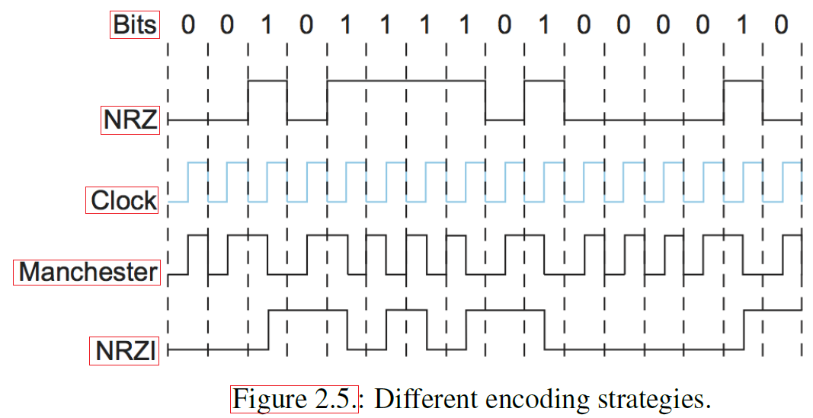
Encoding-NRZI and Manchester

Slide 36
4B/5B Encoding
A final encoding, called 4B/5B encoding, attempts to address the inefficiency of the Manchester encoding
suffering from the problem of having extended durations of high or low signals - baud rate issue.
The idea of 4B/5B encoding is to insert extra bits into the bit stream to break up long sequences of 0s or 1s:
Every 4 bits of actual data are encoded in a 5-bit code and then transmitted to the receiver; hence, the name 4B/5B.
The 5-bit codes are selected so that each has no more than one starting 0, two trailing 0s, and not more than four trailing 1s.
The resulting 5-bit codes are then transmitted using the NRZI encoding,
Table 2.2 gives the 5-bit codes corresponding to the 16 possible 4-bit data symbols.
Note that the 4B/5B encoding scheme is fixed and results in 80% efficiency.

Slide 37
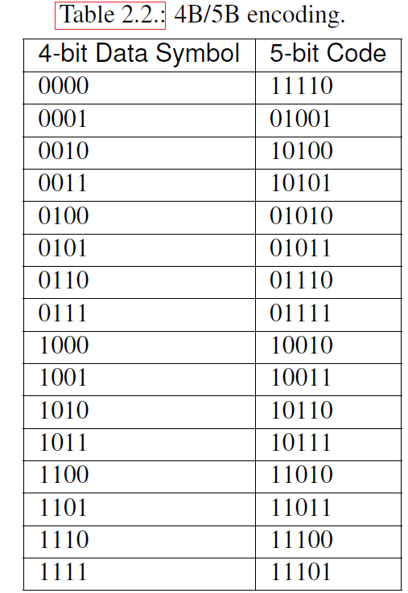

Slide 38
Framing
Figure 2.6 shows how to transmit a block of bits (called frame) over a point-to-point link via an adaptor-to-adaptor connection.
Packet-switched networks exchange blocks of data called frames.
The network adaptor enables the exchange of frames between nodes.
When node A wishes to transmit a frame to node B, it tells its adaptor to transmit a frame from the node’s memory.
This results in a sequence of bits (frame) sent over the link.
The adaptor on node B then collects the sequence of bits arriving on the link and deposits the corresponding frame in B’s memory.

Slide 39
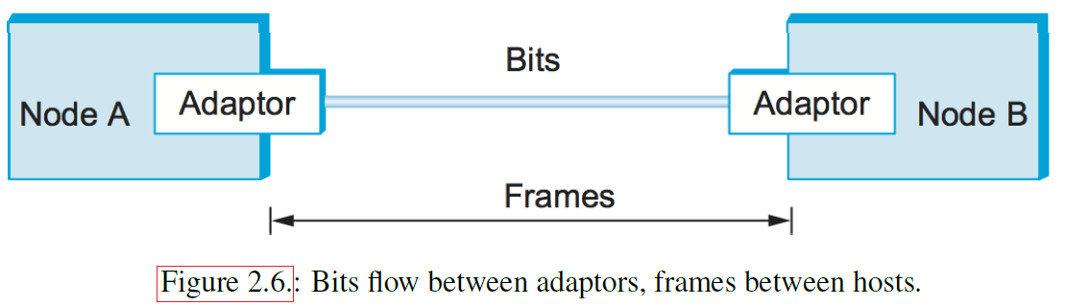
Framing
Recognizing exactly what set of bits constitutes a frame, that is determining where the frame begins and ends is the main challenge.

Slide 40
Framing
There are several ways to detect the start and end of a frame.
There are three different protocols used to address this framing issue:
Byte-Oriented Protocols
Example: Point-to-Pont Protocol (PPP)
Bit-Oriented Protocols
Example: High-level-data Link Control (HDLC) protocol
Clock-Based Framing (or SONET)
The framing problem is a fundamental one that must also be addressed in multiple-access networks like Ethernet and Wi-Fi.

Slide 41
Byte-Oriented Protocols
One of the oldest approaches to framing is to view each frame as a collection of bytes (characters)
Early examples of such byte-oriented protocols are the Binary Synchronous Communication (BISYNC) protocol developed by IBM in the late 1960s.
The Digital Data Communication Message Protocol (DDCMP) used in Digital Equipment Corporation’s DECnet.
The widely used Point-to-Point Protocol (PPP) is a recent example of a byte-oriented frame approach.

Slide 42
Byte-Oriented Protocols
At a high level, there are two byte-oriented framing approaches:
The first one is to use special characters known as sentinel characters to indicate the start and end of frames
The beginning of a frame is indicated by sending a special SYN (synchronization) character.
The data portion of the frame is contained between two special characters: STX (start of text) and ETX (end of text).
This is called a BISYNC (SYN + two special characters) approach.
The problem with the sentinel character approach is that one of the special characters might appear in the data portion of the frame.
The standard way to overcome this problem is by “escaping” the sentinel character with a DLE (data-link-escape) character;
the DLE character is also escaped (by preceding it with an extra DLE) in the frame body.

Slide 43
Byte-Oriented Protocols
The Second approach is to detect the End of a Frame (EoF) with a sentinel value
This approach is supported by Digital Data Communication Message Protocol (DDCMP).
One drawback with this approach is that a transmission error could occur if the EoF would not correctly detected.
A similar problem exists with the sentinel-based approach if the ETX (end of text) field is corrupted.
The receiver will use an error detection field to determine framing error.

Slide 44
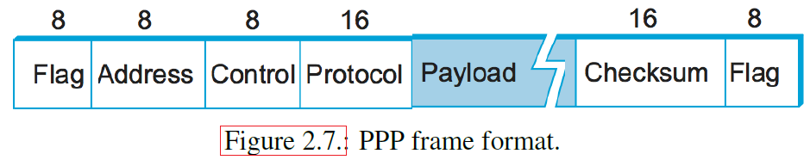
Byte-Oriented Protocols
During a framing error, the receiver will wait until to see the next SYN character (indicating the beginning of the next frame).
A framing error will cause frames to be incorrectly received.
The Point-to-Point Protocol (PPP), commonly used to carry Internet Protocol packets (IP packets) over point-to-point links, uses sentinels and character stuffing.
The field format of a PPP frame is shown in Figure 2.7.

Slide 45
Byte-Oriented Protocols
The special start-text character, denoted as the Flag field is 01111110.
The Address and Control fields usually contain default values.
The Protocol-field is used for demultiplexing;
it identifies the high-level protocol, such as IP.
The payload size can be 1500 bytes by default.
The Checksum field is either 2 or 4 bytes long.
This field is a CRC-supported one.
The field sizes of the PPP frame format are estimated by another protocol called Link Control Protocol (LCP).

Slide 46
Byte-Oriented Protocols
The PPP and LCP work together:
LCP sends control messages encapsulated in PPP frames
Control messages are denoted by an LCP identifier in the PPP’s Protocol field
then changes PPP’s frame format based on the control messages.
LCP is also involved in establishing a link between two peers:
when both sides detect that communication over the link is possible
when each optical receiver detects an incoming signal from the fiber to which it connects.

Slide 47
Bit-Oriented Protocols
A bit-oriented protocol is not concerned with byte boundaries
It simply views the frame as a collection of bits.
These bits might come from:
some character set, such as ASCII;
might be pixel values in an image, or
could be instructions from an executable file.
The Synchronous Data Link Control (SDLC) protocol developed by IBM is an example of a bit-oriented protocol;
the ISO later standardized SDLC as the High-Level Data Link Control (HDLC) protocol.
The HDLC frame format is given in Figure 2.8.

Slide 48
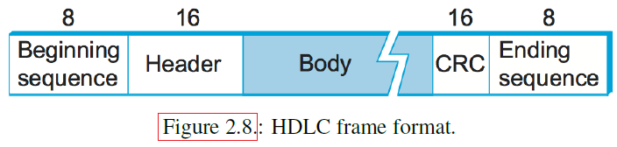
Bit-Oriented Protocols
HDLC denotes a frame’s beginning and end with the distinguished bit sequence, for example, 01111110.
These sequences are transmitted when the link is idle so that the sender and receiver can synchronize their clocks.
Both PPP and HDLC protocols use the sentinel approach.
Because this bit sequence might appear anywhere in the body of the frame.
Bit-oriented protocols use the Data Link Escape (DLE) character, a technique known as bit stuffing.
In data communication, ASCII code 16 is the DLE character (bit stuffing character)

Slide 49
Bit-Oriented Protocols
Bit stuffing in the HDLC protocol works as follows:
On the sending side, any time five consecutive 1s have been transmitted from the body of the message before a send (i.e., excluding when the sender tries to transmit the distinguished 01111110 sequences), the sender inserts a 0 (stuffed) before transmitting the next five bits.
On the receiving side, should five consecutive 1s arrive, the receiver decides based on the next bit it sees (i.e., following the five 1s).
If the next bit is a 0, it must have been stuffed, so the receiver removes it.
If the next bit is a 1, then one of two things is true: Either this is the end-of-frame, or an error in the bit stream has occurred.

Slide 50
Error Detection
Bit errors are sometimes introduced into frames.
This happens because of electrical interference or thermal noise.
Although errors are rare, especially on optical links, some mechanism is needed to detect these errors so that corrective action can be taken
Otherwise, the end-user is wondering why the cloud-based C program that was successfully compiled just a moment ago now suddenly has a syntax error in it
when all that happened in the interim (temporary) is that it was copied across a network file system.

Slide 51
Error Detection
In networking, detecting errors is only one part of the problem.
The other part is correcting errors once the error is detected.
Two basic approaches can be taken when the recipient of a message detects an error:
One is to notify the sender that the message was corrupted so that the sender can retransmit a copy of the message.
If bit errors are rare, then the retransmitted copy will probably be error-free.
Alternatively, some types of error detection algorithms allow the recipient to reconstruct the correct message even after it has been corrupted;
such algorithms rely on error-correcting codes.

Slide 52
Error Detection
The basic idea behind any error detection scheme is to add redundant information to a frame that can be used to determine if errors have been introduced.
Imagine transmitting two complete copies of the data:
If the two copies are identical at the receiver, then it is the case that both are correct without any error.
If they differ, an error was introduced into one (or both) of them, and they must be discarded.
This multiple-copy transmission scheme is a poor error detection scheme for two reasons.
First, it sends 𝑛 redundant bits for an 𝑛-bit message.
Second, many errors will go undetected—any error that happens to corrupt the same bit positions in the first and second copies of the message.

Slide 53
Error Detection
In general, error-detecting codes aim to provide a high probability of detecting errors combined with a relatively low number of redundant bits.
We can provide quite strong error detection capability while sending only 𝑘 redundant bits for an 𝑛-bit message, where 𝑘 < 𝑛.
One of the most common techniques for detecting transmission errors is the Cyclic Redundancy Check (CRC).
It is used in nearly all link-level protocols.

Slide 54
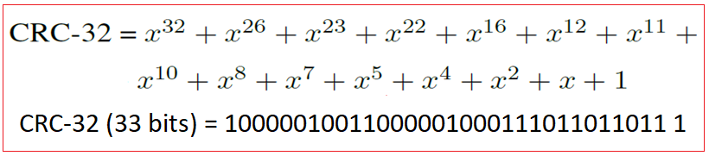
CRC Error Detection
On an Ethernet, a frame carrying up to 12,000 bits of data requires only a 33-bit CRC code, called CRC-32
Such a code will catch the majority of errors, such as:
We say that the extra bits we send are redundant because they add no new information to the message.
Instead, they are derived directly from the original message using some well-defined algorithm.
Both the sender and the receiver know exactly what that well-defined algorithm is.

Slide 55
CRC Error Detection
The sender applies the algorithm to generate the CRC redundant bits
Then transmits both the message and redundant bits together
When the receiver applies the same algorithm to the received message, it should (in the absence of errors) come up with the same result as the sender.
It compares the result with the one sent to it by the sender.
If they match, the message has no errors during transmission.
If they do not match, the message or the redundant bits were corrupted, discarding or correcting the message if possible.

Slide 56
CRC Error Detection
The extra bits transmitted with the message are called error-detecting codes.
In specific cases, when the algorithm performs addition based on the extra bit (error-detecting code), it may be called a checksum.
The Internet checksum is an error check using a summing algorithm.
Unfortunately, the word checksum is often used imprecisely to mean any error-detecting code, including CRCs.
The word checksum only applies to codes that do use addition.

Slide 57
Internet Checksum Algorithm
Here the first approach to error detection is exemplified by the Internet checksum.
It is not used at the link level but provides the same functionality as CRCs.
The idea behind the Internet checksum is very simple—you add up all the transmitted words and then transmit the result of that sum. The result is the checksum.
The receiver performs the same calculation on the received data and compares the result with the received checksum.
If any transmitted data, including the checksum itself, is corrupted, the results will not match, so the receiver knows that an error occurred.

Slide 58
Internet Checksum Algorithm
Many modified variations of the checksum are available from its basic idea.
The same checksum scheme used by the Internet protocols works as follows:
Consider the data being check-summed as a sequence of 16-bit integers.
Add them together using 16-bit ones’ complement arithmetic (explained below) and then take the ones ’complement of the result.
That 16-bit number is the checksum.

Slide 59
Internet Checksum Algorithm
In one’s complement arithmetic, a negative integer is represented as its one’s complement of bits.
When adding numbers to one’s complement arithmetic, a carryout from the most significant bit (MS bit) must be added to the result.
for example, adding two 4-bit integers 5 and 3 in one’s complement arithmetic: +5 is 0101, so -5 is 1010; +3 is 0011, so -3 is 1100.
If we add 1010 and 1100, with the carry bit, we get 10110.
Finally, the checksum is the one’s complement of the result and is 01001.
In one’s complement arithmetic, the fact is that an operation caused a carry from the most significant bit causes us to increment the result.

Slide 60
Cyclic Redundancy Check (CRC)
A major goal in designing error detection algorithms is to maximize the probability of detecting errors using a small number of redundant bits.
Cyclic redundancy checks (CRC) use fairly powerful mathematics to achieve this goal
For example, a 32-bit CRC protects against common bit errors in messages that are thousands of bytes long.
The theoretical foundation of the cyclic redundancy check (CRC) is rooted in a branch of mathematics called finite fields.

Slide 61
Cyclic Redundancy Check (CRC)
Assume an (n+1) bit message is represented by an 𝑛 degree polynomial, that is, a polynomial whose highest-order term is 𝑥^{𝑛}.
The message is represented by a polynomial by using the value of each bit in the message as the coefficient in the polynomial, starting with the most significant bit to represent the highest-order term.
For example, an 8-bit message consisting of the bits 10011010 (coefficient) corresponds to the polynomial: x⁷ + x⁴ + x³ + x¹
We can thus think of a sender and a receiver as exchanging polynomials with each other.

Slide 62
Cyclic Redundancy Check (CRC)
To calculate a CRC, sender, and receiver have to agree on a divisor polynomial, 𝐶(𝑥)
A divisor polynomial is a polynomial that never causes a remainder when dividing a polynomial
𝐶(𝑥) is a divisor polynomial of degree 𝑘.
For example, suppose 𝐶(𝑥) = 𝑥³+𝑥²+1. In this case, degree 𝑘 = 3.
The choice of 𝐶(𝑥) significantly impacts what types of errors can be reliably detected.
There are divisor polynomials that are excellent choices for protocol design.
For example, the Ethernet standard uses a well-known polynomial of degree 32 (CRC-32).

Slide 63
Cyclic Redundancy Check
The sender message 𝑀(𝑥) combined with 𝑘 extra bits:
This final transmitting message is P(x) and it is generated from M(x), k extra bits, and divisor polynomial C(x).
The next is to make the transmitting polynomial P(𝑥) exactly divisible by 𝐶(𝑥).
If P(𝑥) is transmitted over a link, and there are no errors during transmission, then the receiver should be able to divide P(𝑥) by 𝐶(𝑥) leaving a remainder of zero.
If there is an error in the P(𝑥) during transmission, then the received polynomial will no longer be exactly divisible by 𝐶(𝑥),
Thus the receiver will obtain a nonzero remainder indicating an error in the message.

Slide 64
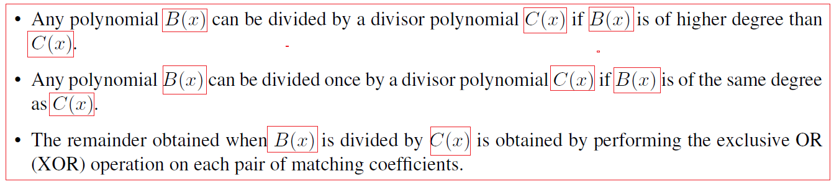
Cyclic Redundancy Check
The CRC deals with a special class of polynomial arithmetic, where coefficients may be only one or zero, and operations on the coefficients are performed by “modulo 2 arithmetic”.
The key properties of “modulo 2 polynomial arithmetic” can be given as:

Slide 65
Cyclic Redundancy Check
For example, the polynomial (𝑥³ + 1) can be divided by another polynomial (𝑥³ + 𝑥² + 1) (because they are both of degree 3) and the remainder would be 0 × 𝑥³ + 1 × 𝑥² + 0 × 𝑥¹ + 0 × 𝑥⁰ = 𝑥² (obtained by XORing the coefficients of each term).
x³ + 1 = 1 ∗ x³ + 0 ∗ x² + 0 ∗ x¹ + 1 ∗ x⁰
𝑥³ + 𝑥² + 1 = 1 ∗ x³ + 1 ∗ x² + 0 ∗ x¹ + 1 ∗ x⁰
0 × 𝑥³ + 1 × 𝑥² + 0 × 𝑥¹ + 0 × 𝑥⁰
= 𝑥²
In terms of messages, we could say that 1001 (x³ + 1) can be divided by 1101 (𝑥³ + 𝑥² + 1) and leaves a remainder of 0100 (𝑥²).
You should be able to see that the remainder is just the bitwise exclusive OR of the two messages.

Slide 66
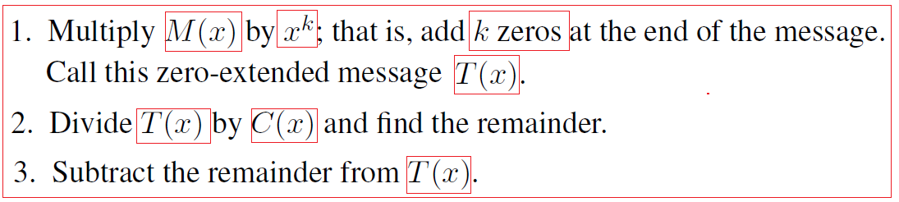
Cyclic Redundancy Check
We wanted to create a polynomial for transmission that is derived from the original message 𝑀(𝑥), is 𝑘 bits longer than 𝑀(𝑥), and is exactly divisible by 𝐶(𝑥). We can do this in the following way:
It should be obvious that what is left at this point is a message that is exactly divisible by 𝐶(𝑥).
Note that the resulting message consists of𝑀(𝑥) followed by the remainder obtained in step2 because when we subtracted the remainder (which can be no more than 𝑘 bits long), we were XORing it with the 𝑘 zeros added in step 1.

Slide 67
Cyclic Redundancy Check
Consider an 8-bit message 𝑥⁷ + 𝑥⁴ + 𝑥³ + 𝑥¹ = 10011010.
Next is to find k, and it is log₂(message size) = log₂(8) =3 = k, so add 3 zeros in the Least Significant bit position of the message and called as T(x): 10011010000
Divide T(x) by 𝐶(𝑥), which is 1101 (from the previous example). Figure 2.12 shows the polynomial long-division operation.
Thus, in the first step of the example, we see that the divisor 𝐶(𝑥) = 1101 divides once into the first four bits of the message (1001) since they are of the same degree and leaves a remainder of 100 (1101 XOR 1001).
The next step is to bring down a digit from the message polynomial until we get another polynomial with the same degree as 𝐶(𝑥), in this case, 1001.
We calculate the remainder again (1000) and continue until the calculation is complete.

Slide 68
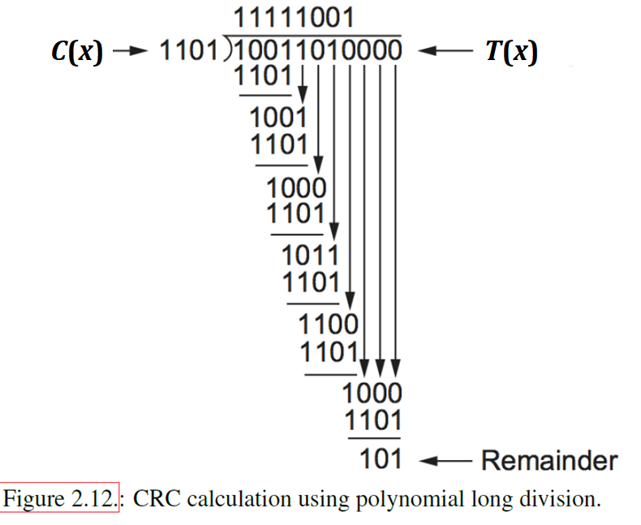

Slide 69
Cyclic Redundancy Check
Figure 2.12 shows that the remainder is 101.
Next: The final sending message P(x) = T(x) – remainder = 10011010000 ⊕ 101 = 10011010101 = P(x)
The minus operation in polynomial arithmetic is the logical XOR operation.
And the sending polynomial is P(x), 10011010101 and its divisible polynomial is 𝐶(𝑥), 1101.
That is P(x) % C(x) = 0000 = 10011010101 % 1101 = 0000
The recipient divides the received polynomial P(x) by 𝐶(𝑥), and if the result is 0, it concludes that there were no errors.
If the result is nonzero, discard the corrupted message.

Slide 70
Cyclic Redundancy Check
Where does the polynomial 𝐶(𝑥) come from?
Intuitively, the idea is to select this polynomial so that it is very unlikely to divide evenly into a message that has errors introduced into it.
Divide evenly means one number can be divided by another without anything left over; in other words, no remainder.
If the transmitted message is 𝑃(𝑥)introduced errors, the addition of another polynomial 𝐸(𝑥) into the message, the recipient sees: 𝑃(𝑥) + 𝐸(𝑥).
The only way that an error is undetected if the received message can be evenly divided by 𝐶(𝑥), 𝑃(𝑥) also can be evenly divided by 𝐶(𝑥), and 𝐸(𝑥) can be divided evenly by 𝐶(𝑥).
The trick is to pick 𝐶(𝑥) so that this is very unlikely for common errors.

Slide 71
Cyclic Redundancy Check
There is a downside to correction, as it generally requires a greater number of redundant bits to send an error-correcting code that is as strong (that is, able to cope with the same range of errors) as a code that only detects errors.
Error detection requires more bits to be sent when errors occur, and error correction requires more bits to be sent constantly.
As a result, error correction tends to be most useful when
(1) errors are quite probable, as they may be, for example, in a wireless environment, or
(2) the cost of retransmission is too high, for example, because of the latency involved in retransmitting a packet over a satellite link.

Slide 72
Cyclic Redundancy Check
Figure 2.13 shows the CRC hardware used for the generator 𝑥³ +𝑥² +1 from our previous example.
The message is shifted in from the left, beginning with the most significant bit and ending with the string of 𝑘 zeros attached to the message, just as in the long division example.
When all the bits have been shifted in and appropriately XORed, the register contains the remainder—the CRC (the most significant bit on the right).
The position of the XOR gates is determined as follows: If the bits in the shift register are labeled 0 through 𝑘 − 1, left to right, then put an XOR gate in front of bit 𝑛 if there is a term 𝑥^{𝑛} in the generator polynomial.
Thus, we see an XOR gate in front of positions 0 and 2 for the generator 𝑥³ + 𝑥² + 𝑥⁰.

Slide 73
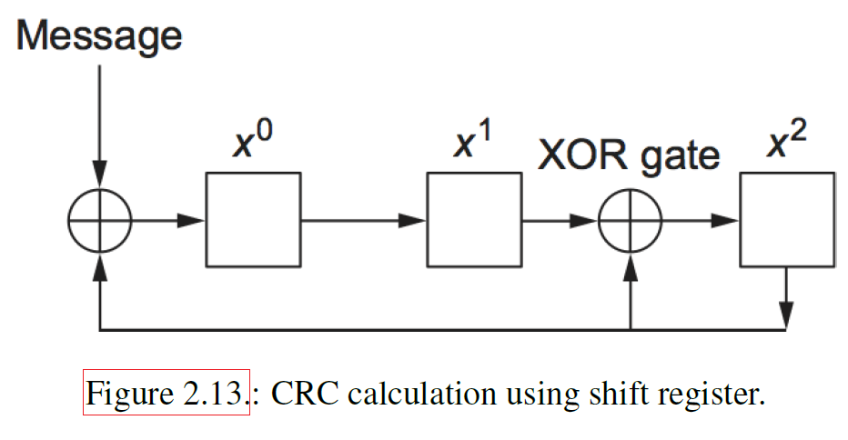
Cyclic Redundancy Check

