Slide 1
Internet Addressing
Reference: Internetworking with TCP/IP: Principles, Protocol, and Architecture, Douglas E. Comer 6th Edition, 2017,, Pearson, ISBN 978-93-325-5010-0

Slide 2
Introduction
The traditional Internet addressing scheme, introduced with version 4 of the Internet Protocol (IPv4), is widely used.
The new version is version 6 of the Internet Protocol (IPv6).

Slide 3
Universal Host Identifiers
TCP/IP uses the term host to refer to an end system that attaches to the internet
A host can be a large, powerful general-purpose computer.
A host may have an interface that humans use (screen, keyboard, etc.) or a network printer.
A host can use wired or wireless network technology.
The Internet divides all machines into two classes:
Routers and
Hosts
Any device that is not a router is classified as a host on the Internet.

Slide 4
Universal Host Identifiers
A communication system is said to supply universal communication service if the system allows an attached host to communicate with any other attached host
To make a communication system universal, it needs a globally accepted method of identifying each host that is attached to it.
The host identifiers are classified as names, addresses, and routes:
A name identifies what an object is,
An address identifies where it is, and
A route tells how to get there.

Slide 5
Universal Host Identifiers
Names, addresses, and routes refer to lower-level representations of host identifiers,
unlike other networks, the Internet is a virtual structure imagined by its designers and implemented by layered protocol SW running on hosts and routers.
Because the Internet is virtual, its designers can choose packet formats, sizes, addresses, delivery techniques, etc.
There is nothing dedicated by network HW.

Slide 6
Universal Host Identifiers
The designers of TCP/IP chose an addressing scheme in which each host on the Internet is assigned a unique integer address called its Internet Protocol address (IP address).
An IP address is divided into two parts:
A prefix of the address identifies the network
A suffix of the address identifies a specific host on the network.
All hosts attached to the same network share a common prefix.

Slide 7
Universal Host Identifiers
An IP address is a number identifying a user’s computer or another device (called a host) on the Internet
It is similar to a mailing address, which identifies where postal mail comes from and where it should be delivered.
IP addresses uniquely identify the source and destination of data transmitted with the Internet Protocol (IP).

Slide 8
IPv4 and IPv6 Addressing Scheme
IPv4 addresses are 32 bits long (have four octets).
An example of an IPv4 address is 216.58.216.164.
The maximum number of IPv4 addresses, called its address space, is about 4.3 billion (2³², or 4,294,967,296).
A significant advantage of IPv6 is that it uses 128 bits of data to store an address, permitting 2¹²⁸ unique addresses, or the size of its address space is 340 duodecillion.
Is much more significant than IPv4.

Slide 9
IPv4 and IPv6 Addressing Scheme
The designers also decided to make IP addresses fixed size (32-bit for IPv4 and 128-bit for IPv6).
Decisions are made to use fixed-size IP addresses and divide each address into a network ID (netId) and a host ID (hostId) sections:
Each IP address is a pair <netId (prefix), hostId (suffix)>
netId identifies a network and hostId identifies a host on that network.
Allocating many bits to the prefix (netId)allows the Internet to contain many networks.
Allocating many bits to a suffix (hostId) means a network with many hosts,
It limits the number of networks on the internet.

Slide 10
IPv4 Classful Addressing Scheme
To accommodate various network systems, the IP address designers did not choose a single division of the address, instead they:
invented a classful addressing scheme allowing a given network to be large, medium, or small.
Figure 5.1 illustrates how the original classful addressing scheme divided each IPv4 address into two parts
Although most of the classful addressing scheme is no longer used, it explains how the IPv4 multicast address space was chosen.

Slide 11
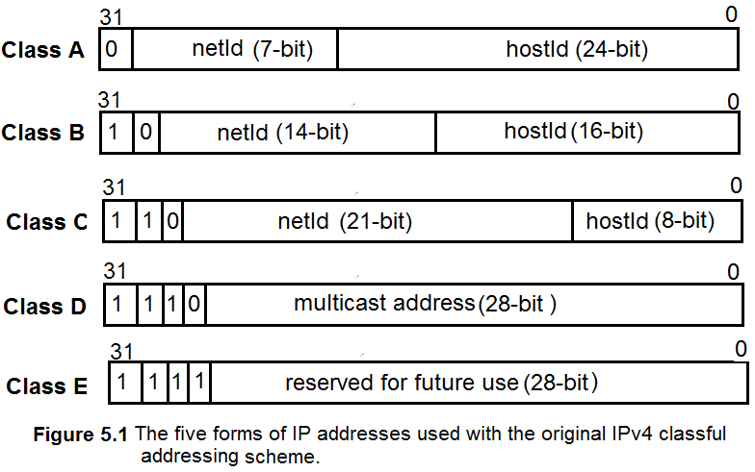
IPv4 Classful Addressing Scheme

Slide 12
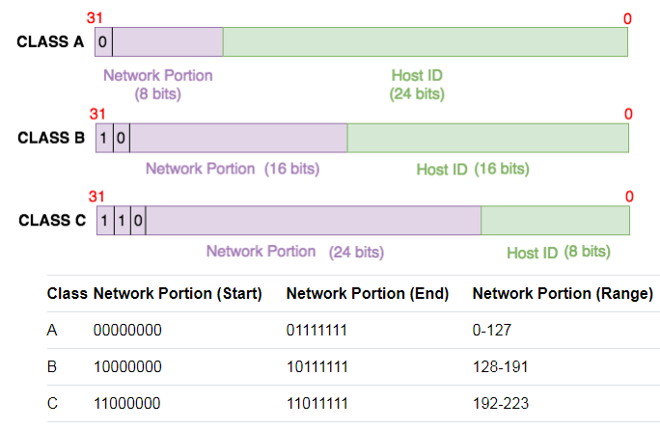
IPv4 Classful Addressing Scheme
Courtesy : https://www.ittsystems.com/introduction-to-subnetting/

Slide 13
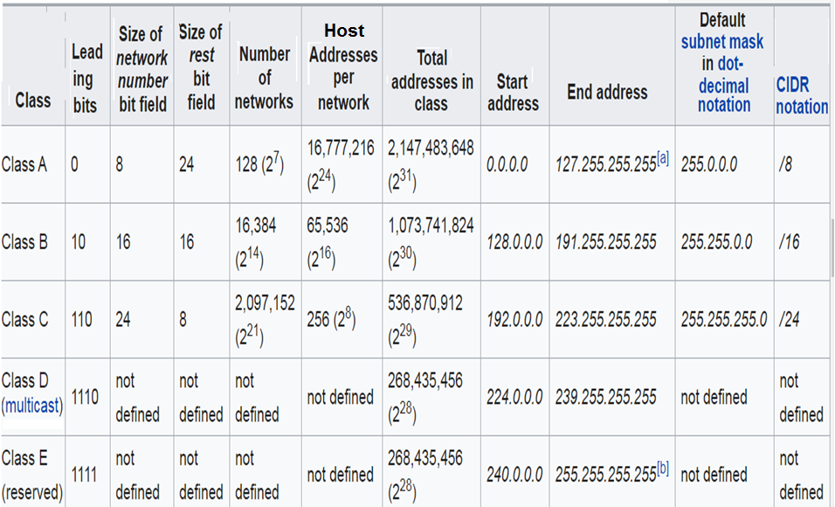

Slide 14
IPv4 Classful Addressing Scheme
Bit-wise representation of IPv4 classful addresses:
In the following bit-wise representation (see Figure on the next slide),
n is the network ID
H is the host ID, and
X is a bit and has no specified purpose.
The number of addresses usable for hosts in each network is always (2^{N} − 2), where N is the number of host field bits, and the subtraction of 2 bits adjusts for the use of the all-bits-zero host portion for the network address and the all-bits-one host portion as a broadcast address.

Slide 15
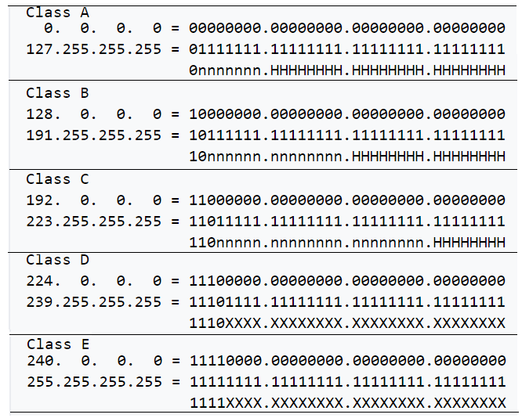
Courtesy : Wikipedia

Slide 16
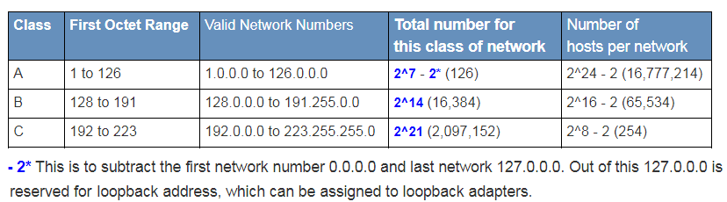
IPV4 Classful Addressing Scheme
Courtesy : https://learningnetwork.cisco.com/docs/DOC-12872

Slide 17
IPv4 Classful Addressing Scheme
The network address range of the Class A scheme is 1-126 (00000001 – 01111110) because 0. x.x.x and 127. x.x.x addresses are reserved.
0 = 00000000 and 127 = 011111111
With these classes, a computer/device can look at the first three bits of any IP address and determine what class it belongs to.
For example, the 192.168.1.250 IP address falls into the Class C because 192 = 11000000₂
Looking at the Host ID portion of each class, we can determine how many hosts (or number of individual IP addresses) in a network
For example, a Class C network will support up to 254 hosts i.e. host addresses 00000000 (0) and 11111111 (255) are used for network and broadcast addresses. So the total hosts are 256-2 = 254.

Slide 18
IPv4 Classful Addressing Scheme
Two host addresses (such as 00000000 and 11111111) in Class C cannot be assigned to hosts because all 0s represents the network address and all 1s represents the broadcast address.
This leaves with 254 (2⁸-2) host IDs.
A simple formula calculates the number of hosts supported by a network is:
No. of usable IP addresses (host addresses) = 2^{host_bits} − 2
Anyone who needed a network that supports up to 254 hosts can use a Class C network.
What if you only need just 10 IP addresses (host addresses)?
You still get a Class C network. This wastage of IP addresses. It is even worse for Class B (65,534 usable IP addresses per network) and Class A (16,777,214 usable IP addresses per network)!

Slide 19
IPv4 Classful Addressing Scheme
In the classful addressing scheme, each address is said to be self-identifying because the boundary between prefix and suffix can be computed from the address itself
Class A addresses are used for networks with large hosts (it has a 7-bit networkID and 24-bit hostID).
Class B addresses used for medium size networks (it allocates 14 bits to the networkID and 16 bits to the hostID).
Class C addresses are used for networks with less than 2⁸(256) hosts (it allocates 21 bits to the networkID and 8 bits to hostID).

Slide 20
Dotted Decimal Address with IPv4
IPv4 addresses are written as four decimal integers separated by decimal points:
A 32-bit binary IP address can be given as
10000000 00001010 00000010 00011110 and is written as dotted decimal integers 128.10.2.30 (a Class B address)
Application programs such as web browsers allow users to enter a dotted decimal value instead of a computer name.

Slide 21
IPv4 Subnet Addressing
How can internet technology accommodate growth without abandoning the original classful addressing scheme?
A technique called subnet addressing or subnetting allows a single network prefix to be used for multiple physical networks
To understand subnetting, it is important to consider individual sites connected to the Internet.
A subnet is a logical partition of an IP network into multiple, smaller network segments.
Subnetting is typically used to subdivide large networks into smaller, more efficient sub-networks.

Slide 22
IPv4 Subnet Addressing
For example, a university started with a single LAN and obtained an IPv4 prefix (network-ID).
If the university adds another LAN, the original addressing scheme would require the university to obtain a second network-ID for the second LAN.
Suppose the university has only a few computers. It can assign host addresses and arrange internal forwarding .
That is a site can choose and use IPv4 addresses in unusual ways internally as long as all hosts and routers within the site agree to honor the site’s addressing scheme.
Subnet addressing takes advantage of the freedom by allowing a site to divide the host portion of their addresses among multiple networks.

Slide 23
IPv4 Subnet Addressing
How subnet addressing works?
Suppose a site has been assigned a single class B prefix, 128.10.0.0 (it has 16-bit networkID and 16-bit hostID).
The rest of the Internet assumes each address at the site has one physical network with the 16-bit networkID (128.10).
If the site obtains a second physical network, the site can use subnet addressing by using a portion of the hostID field(0.0) to identify which physical network to use
Only hosts and routers at the site will know that multiple physical networks exist and how to forward traffic among them.
Figure 5.3 shows an example using the third octet (3rd 8-bit of the addresses) of the class B address, 128.10.0.0 as a subnet.

Slide 24
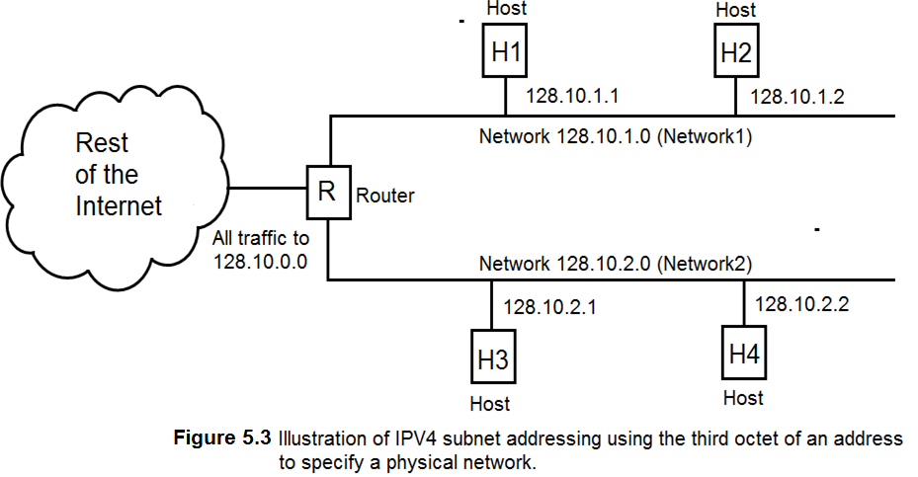
IPv4 Subnet Addressing

Slide 25
IPv4 Subnet Addressing
In Figure 5.3, shows how the subnetting is possible on a network with a Class B address, 128.10.0.0 :
All hosts on the Network1 (net-address: 128.10.1 .0) have IP addresses of the form: 128.10.1.∗
Two hosts with IP addresses 128.10.1.1 and 128.10.1.2.
Similarly, hosts on Network2 (net-address: 128.10.2 .0) have IP addresses of the form: 128.10.2. ∗
Two hosts with IP addresses 128.10.2.1 and 128.10.2.2.
If R receives a packet, it checks the destination address:
If the address starts with 128.10.1, the R delivers the packet to a host on Network1.
If the address starts with 128.10.2, the R delivers the packet to a host on Network2.

Slide 26
IPv4 Subnet Addressing
Instead of dividing the 32-bit IPv4 address into a network prefix and host suffix, subnetting divides the IPv4 address into an internet portion and a local portion:
The internet portion remains the same for networks that do not use subnetting.
where the internet portion identifies a site, possibly with multiple physical networks,
and the local portion identifies a physical network and host at that site (see Figure 5.3).
Figure 5.4 illustrates how the example divides the IPv4 address for subnetting.

Slide 27
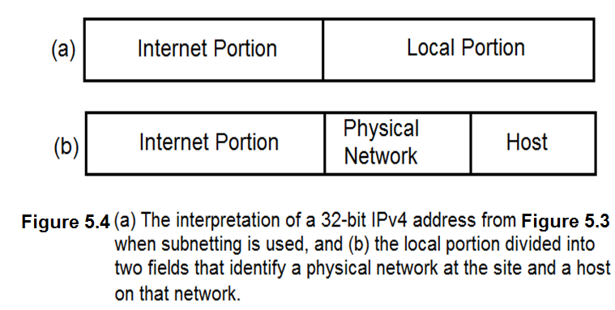
IPv4 Subnet Addressing

Slide 28
IPv4 Subnet Addressing
Routers throughout the Internet use the top level of the hierarchy to forward a packet to the correct site:
Once the packet enters the site, local routers use the physical network octet to identify the correct network.
Hence the packet reaches the correct network; a router uses the host portion to identify a particular host (see Figure 5.3).

Slide 29
Fixed Length IPv4 Subnets
In the example in Figure 5.3 shows a site was assigned a 16-bit network prefix and used the third octet of the address to identify a physical network at the site and the fourth octet for the host on that network.
The TCP/IP standard for subnet addressing recognizes that not every site will have a 16-bit prefix, and not every site needs the same addressing hierarchy.
Figure 5.3 represents a site that only has two physical networks.
Imagine a company that owns 20 large buildings and has deployed 20 LANs in each building. Suppose the site has a single 16-bit network prefix and wants to use subnetting for all its local networks.

Slide 30
Fixed Length IPv4 Subnets
How should the Class B address's 16-bit local (host) portion be divided into fields for a physical network and host?
ANS: The 16-bit host portion of the Class B address is shown in Figure 5.4(b)
I6-bit host portion has an 8-bit physical network identifier and an 8-bit host identifier.
Using 8-bit to identify a physical network means a manager can generate up to 254 unique physical network IDs (or LAN IDs).
With an 8-bit host portion, a manager can generate up to 254 host IDs for each network. Unfortunately, the company has 400 (20 x 20) local networks, which exceeds the 254 (2⁸-2) possible numbers.

Slide 31
Fixed Length IPv4 Subnets
To permit flexibility, the subnet standard does not specify that a site must always use the third octet to specify a physical (local) network as in a Class-B address system (see Figure 5.4(b)).
Instead a site can choose how many bits of the local portion (Figure 5.4(a) to dedicate to the physical (local) network, and how many to dedicate to the host
The example company with 400 local networks might choose the division.
Figure 5.5 illustrates because a 10-bit field allows up to 1024 local networks.

Slide 32
Fixed Length IPv4 Subnets
The example company with 400 local networks might
choose the division that Figure 5.5 illustrates because
a 10-bit field allows up to 1024 local networks (LANs).
What are the 400 LAN addresses if you are using the following
Class B address: 128.10.0.0

Slide 33
Fixed Length IPv4 Subnets
As per Figure 5.5, the 10-bit network field allows 1024 LANs, and the 1024 LAN addresses can be shown based on the Class B address 128.10.0.0 (this way of network addressing is called fixed-length subnetting):
128.10. [00000000 00] 000000 = 128.10.0.0 [not a valid Address]
128.10. [00000000 01] 000000 = 128.10.0.64
128.10. [00000000 10] 000000 = 128.10.0.128
128.10. [00000000 11] 000000 = 128.10.0.192
128.10. [00000001 00] 000000 = 128.10.1.0
128.10. [00000001 01] 000000 = 128.10.1.64
………………………………………………………….
128.10. [11111111 10] 000000 = 128.10.255. 128
128.10. [11111111 11] 000000 = 128.10.255. 195 [not a valid address]

Slide 34
Fixed Length IPv4 Subnets
The idea of allowing a site to choose a division for its address's local portion (host portion) and then using the division throughout the site (see Figure 5.5) is known as fixed-length subnetting.
Fixed-length subnetting is easy to understand because it partitions the local portion of an address between networks and hosts.
A manager can choose how many networks the site can have and determine the number of hosts on each network.
Figure 5.6 illustrates the possible network choices if a site uses fixed-length subnetting with a 16-bit local portion (in class B addressing scheme shown in Figure 5.5)
From the 16-bit local portion of the class B scheme, if network bit = 0, then 2⁰ = 1 network, and it is possible, and there are 65534 hosts (16 – 0 = 16, 2¹⁶ – 2 = 65534) likely.
If 3-bit is for the network, then only six networks (2³-2 = 6)can be recognized. That is 16-3 = 13 and 2¹³ -2 = 8190 host are possible

Slide 35
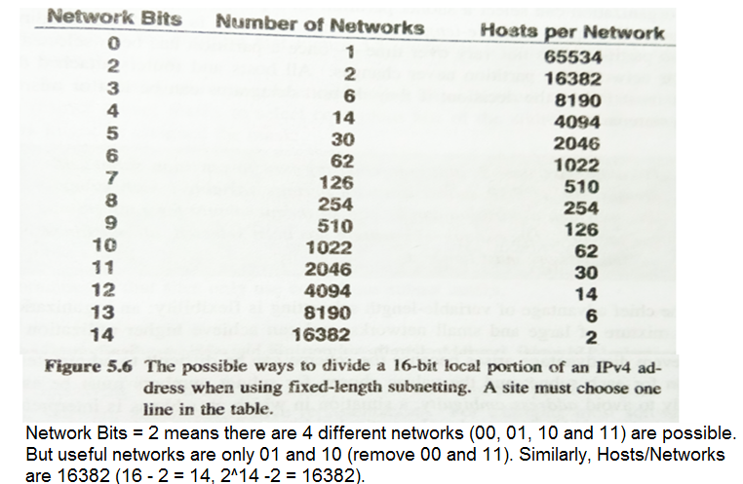
Fixed Length IPv4 Subnets

Slide 36
Fixed Length IPv4 Subnets
As Figure 5.6 illustrates, an organization that adopts fixed-length subnetting must choose a compromise:
If the organization opts for a large no. of physical networks, none of the networks can contain many hosts;
If the organization expects to connect many hosts to a network, the number of physical networks must be small.
For example, allocating 3 bits to identify a physical network results in up to 6 networks supporting up to 8190 hosts (see Figure 5.6).
Allocating 12 bits results in up to 4094 networks but restricts the size of each to 14 hosts (see Figure 5.6).

Slide 37
Fixed Length IPv4 Subnets
It should be clear why the designers did not choose a specific division for subnetting.
No single portion of the local part of the address works for all organizations:
Some need many networks with few hosts per network, while others need a few with many hosts attached to each.
Sits do not all receive a 16-bit local portion, so the subnetting standard handles cases where a site is dividing fewer bits.

Slide 38
Variable Length IPv4 Subnet
Most sites use fixed-length subnetting because it is straightforward to understand and administer.
Problem with fixed-length subnetting: When the designers invented subnetting, they realized it would not suffice for all sites.
The standard specifies that an organization can select a subnet partition from any octets of the address is called variable-length subnetting:
Once a partition has been selected for a particular network, the section never changes.
All hosts and routers attached to that network must follow the decision; if not, the datagram can be lost or misrouted.

Slide 39
Implementation of IPv4 Subnets with Masks
The subnet technology makes configuration of either fixed or variable length subnets.
A 32-bit mask is used to specify the subnet division.
A site using subnet addressing must choose a 32-bit subnet mask for each network.
The mask covers the Internet portion and the physical network part (local portion) of the address:
Bits in the subnet mask are set to 1 if machines on the network prefix and 0 if the bit is part of the host identifier.

Slide 40
Implementation of IPv4 Subnets with Masks
Example: consider the following 32-bit subnet mask (class C):
11111111 11111111 11111111 00000000
(16-bit Network portion) (8-bit Host portion)
specifies that the first 3 octets identify the network and the fourth identifies a host network.
Corresponds to the portion that Figure 5.5 illustrates where the physical network portion occupies 10 bits.
11111111 11111111 11111111 11000000 = /26
An interesting twist in subnet addressing is that the original standard did not restrict subnet masks to select contiguous address bits.

Slide 41
Implementation of IPv4 Subnets with Masks
For example, a network might be assigned the mask:
11111111 11111111 00011000 01000000
which selects the first two octets, 2 bits from the 3rd octet, and 1 bit from the 4th octet.
Although the standard allows one to arrange addresses like the above, this makes network management almost impossible!
Therefore, it is recommended that sites only use contiguous subnet masks.

Slide 42
IPv4 Subnet Mask Representation and Slash Notation
Specifying subnet masks in binary is prone to errors.
Hence protocol allows alternative masking representation:
Most SW allows managers to use dotted-decimal representation when specifying IPv4 subnet masks.
Dotted decimal works well if a site can align the subnet boundary on octet boundaries.
The example Figure 5.4(b) shows how easy it is to understand subnetting when the 3rd octet of an address is used to identify a physical network and the 4th octet is used to identify a host.

Slide 43
IPv4 Subnet Mask Representation and Slash Notation
Instead of binary, the subnet mask has a dotted decimal representation:
11111111 11111111 11111111 00000000 = 255 . 255 . 255 . 0
Subnet addresses and masks represented in braces as a 3-tuple:
{<network number>, <subnet number>, <host number>}
In this representation, each section can be represented in dotted decimal, and the value -1 means “all ones”. For example, if the subnet mask of a class C network is 255.255.255.0, it can be written as {-1, -1, -1, 0}.

Slide 44
IPv4 Subnet Mask Representation and Slash Notation
The main advantage is that it abstracts away from details of bit fields and emphasizes the values as three parts of the address.
The disadvantage is that it does not accurately specify how many bits are used for each part of the address:
For example, {128.10, -1, 0} denotes an address with a network 128.10, all ones(-1) in the subnet field and all zeros in the host field.
The address could correspond to a subnet where the boundary occurs after the 3rd octet or could correspond to a situation like the one in Figure 5.5
Where the boundary allocates 10 bits to the network and 6 bits to the host.

Slide 45
The Classless IPv4 Addressing Scheme
What is classless addressing?
In place of the three classes addressing schemes (Class A, Class B, and Class C), a new addressing scheme extends the idea used in subnet addressing to permit a network prefix to be an arbitrary length (not fixed) is called classless addressing.
The designers modified forwarding and route propagation techniques to handle classless addresses.
As a result, Internet technology has become known as Classless Inter-Domain Routing (CIDR).

Slide 46
The Classless IPv4 Addressing Scheme
To understand the impact of CIDR (Classless Inter-Domain Routing) in networking, one needs to know three facts:
The classful scheme did not divide network addresses into equal size classes.
Because class C prefixes only small networks and is not amenable to subnetting, the demand for class C prefixes was much smaller than the demand for class B prefixes.
Studies showed that at the rate class B, numbers were being assigned, class B prefixes would be exhausted quickly.

Slide 47
The Classless IPv4 Addressing Scheme: Supernetting
One of the first uses of classless addressing was known as supernetting:
To understand how supernetting works, consider a medium-sized organization that joins the Internet.
Under a classful addressing scheme, an organization would request a class B prefix.
The supernetting scheme allows an ISP to assign the organization a block of class C addresses instead of a single class B number.
The block must be large enough to number all the networks in the organization and lie on a boundary of a power of 2.

Slide 48
The Classless IPv4 Addressing Scheme: Supernetting
Suppose an organization expects to have 200 networks:
Supernetting can assign the organization a block of 256 contiguous Class C numbers (see it on the next slide)
Although the first intended use of CIDR in blocks of class C addresses, the designers realized that CIDR could be applied in a much broader context:
They envisioned a hierarchical addressing model in which each commercial ISP could be given a large block of IP addresses that the ISP could then allocate to subscribers.

Slide 49
The Classless IPv4 Addressing Scheme
Like subnet addressing, CIDR uses a 32-bit addressing mask to specify the boundary between the prefix and suffix of a 32-bit IPv4 address.
Contiguous I bits in the mask specify the size of the prefix (network), and 0 bits in the mask correspond to the suffix (host).
At first glance, a CIDR mask appears identical to a subnet mask.
The major difference is that a CIDR mask is not merely known within a site.
Instead, a CIDR mask specifies the size of a network prefix, and it is known globally.

Slide 50
The Classless IPv4 Addressing Scheme
For example, suppose an organization is assigned a 2048 (2¹¹)contiguous host address (IP addresses) starting at address 128.211.168.0.
It includes last 3 bits of octet3 (starting from its 22st bit )until the whole bits of octet4 (= total 11 bits)
Subnet mask is 255.255.248.0 (/21)
The following Figure 5.8 lists the binary values of addresses in the range:

Slide 51
The Classless IPv4 Addressing Scheme
From Figure 5.8, because 2048 is 2¹¹, eleven bits are needed for the host portion of an address
Out of 2048 IP addresses, only 2046 (2¹¹ – 2)are used (host ID with all 0s and all 1s used for network and broadcast addresses).
That means the CIDR address mask will have 21 bits set (the division between the network prefix and host suffix occurs after the 21st bit).
In Binary, the address’s subnet mask is 255.255.248.0 (/21)
11111111 11111111 11111000 00000000 (/21 as per CIDR scheme)
In decimal, the subnet address mask is: 255.255.248.0

Slide 52
IPv4 Address Blocks And CIDR Slash Notation
, Unlike the original classless scheme, the CIDR addresses are not self-identifying:
For example, if a router encounters address 128.211.168.1 (see figure 5.8), one of the addresses in the example block, a router cannot know the position where the boundary lies unless external information is presented.
Thus, when configuring a CIDR block, a network manager must supply two pieces of information:
The starting address and
Twon address mask that tells which bits are in the prefix (as shown before, “/21”)

Slide 53
IPv4 Address Blocks And CIDR Slash Notation
CIDR specifies that a network manager should use back slash notation to specify the mask.
Syntactically, the format is called CIDR notation, and consists of a starting address in dotted decimal followed by a mask size in slash notation.
Thus in CIDR notation, the block of addresses in Figure 5.8 is expressed: 128.211.168.0/21, where “/21” denotes an address mask with 21 bits set to 1:
“/21” = 11111111 11111111 11111000 00000000
It means the host address begins only after the 21st bit of the given network address.
From this IP address of each host can be determined.

Slide 54
IPv4 Address Blocks And CIDR Slash Notation
Show all the 2046 IP addresses of the following CIDR address: 128.211.168.0/21
10000000 11010011 10101000 00000001 → 128.211.168.1
10000000 11010011 10101000 00000010 → 128.211.168.2
10000000 11010011 10101000 00000011 → 128.211.168.3
10000000 11010011 10101000 00000100 → 128.211.168.4
10000000 11010011 10101000 00000101 → 128.211.168.5
10000000 11010011 10101000 00000110 → 128.211.168.6
10000000 11010011 10101000 00000111 → 128.211.168.7
-------------------------------------------------------------------------------
10000000 11010011 10101111 11111110 → 128.211.175.254
2046 valid IP addresses

Slide 55
Classless IPv4 Addressing Example
Figure 5.8 illustrates one of the chief advantages of classless addressing, which provides complete flexibility in allocating address blocks of various sizes.
When using CIDR, the ISP can choose to assign each customer an address block of appropriate size:
The host size must be rounded to the nearest power of 2.
Observe that a CIDR mask of N bits defines an address block of (32 −N) host addresses.
Therefore, a smaller host address block has a longer mask.

Slide 56
Classless IPv4 Addressing Example
If the ISP owns a CIDR block of N bits, the ISP can choose to assign a customer any piece of its address space by using a mask longer than N bits
For example, if the ISP is assigned 128.211.0.0/16 (which means the last 16 bits are used for host identification), the ISP is assigned any address to its customers out of 65534 IP addresses :
10000000 11010011 00000000 00000001
------------------------------------------------------
10000000 11010011 11111111 11111110
If the same ISP also has a small customer with only two computers, the ISP might choose to assign another block 128.211.176.212/30, which covers the address range that Figure 5.9 specifies:
10000000 11010011 10110000 11010101 4-2 = 2 IP addresses
10000000 11010011 10110000 11010110
65534 IP addresses

Slide 57
Classless IPv4 Addressing Example
One way to think about classless addresses is as if each customer of an ISP obtains a variable-length subnet of the ISP’s CIDR block
Thus, a given block of addresses can be subdivided on an arbitrary (not fixed) bit boundary, and a router at the ISP can be configured to forward correctly to each subdivision.
As a result, the group of computers on a given network will be assigned addresses in a contiguous range,
but the range does not need to correspond to the old class A, class B, and class C boundaries.

Slide 58
Summary
Classless IPv4 addressing which is now used throughout the internet assigns each ISP a CIDR block and allows the ISP to partition addresses into contiguous sub blocks,
where the lowest address in a sub block starts at a power of 2 and the sub block contains a power of 2 address.

Slide 59
The IPv6 Addressing Scheme
We know that each IPv6 address occupies 128 bits (16 octets).
The large address space guarantees that IPv6 can tolerate any reasonable address assignment scheme.
It is difficult to comprehend the size of the IPv6 address space:
A 16-octet (128 bits) integer can hold 2¹²⁸ values.
If addresses are assigned at the rate of one million addresses every microsecond, it would take over 10²⁰ years to assign all possible addresses.

Slide 60
IPv6 Colon Hexadecimal Notation
Although IPv6 solves the problem of having insufficient capacity, the large address size poses a new problem:
consider an example 128-bit address value expressed in dotted decimal notation below (has 16 octets):
104.230.140.100.255.255.255.255.0.0.17.128.150.10.255.255
To make it easy, the IPv6 designers created colon hexadecimal (colonhex)notation in which the value of each 16-bit quantity is represented in hexadecimal separated by colon:
68E6:8C64:FFFF:FFFF:0:1180:96A:FFFF
The colonhex notation has the obvious advantage or requiring fewer digits and fewer separator characters than dotted decimal.

Slide 61
IPv6 Colon Hexadecimal Notation
In addition, colonhex notation includes two techniques that make it extremely useful
Colonhex notation allows zero compression in which a string of repeated zeros is replaced by a pair of colons:
the address: FF05:0:0:0:0:0:0:B3 can be written as FF05:B3
Zero compression is especially useful because the IPv6 assignments will create many addresses that contain contiguous strings of zeros.

Slide 62
IPv6 Colon Hexadecimal Notation
Colon hex notation incorporates dotted decimal suffixes; such combinations are intended to be used during the transition from IPv4 to IPv6
For example, the following string is a valid colonhex notation:
0:0:0:0:0:0:128.10.2.1
Note that although the numbers separated by colons each specify the value of a 16-bit quantity, numbers in the dotted decimal portion each specify the value of one octet (8-bit).
Zero compression can be used with the above value to produce an equivalent colonhex string that looks similar to an IPv4 address: ::128.10.2.1

Slide 63
IPv6 Colon Hexadecimal Notation
Finally, IPv6 extends CIDR-like notation by allowing an address to be followed by a slash and an integer that specifies a number bits.
For example, 12AB::CD30:0:0:0:0/60 specifies the first 60 bits of the address which is 12AB00000000CD3H

Slide 64
IPv6 Address Space Assignment
The question of how to partition the IPv6 address space has been generated:
There are two issues:
How humans manage address assignment and how routers handle the necessary forwarding tables.
Unlike the current Internet, which uses a two-level hierarchy of network prefixes (assigned by IP) and host prefix (assigned by an organization).
The large address space in IPv6 permits a multi-level hierarchy or multiple hierarchies.

Slide 65
IPv6 Address Space Assignment
Large ISPs can start with large blocks of addresses and assign sub-blocks to second-level ISPs, which can each give sub-blocks from their allocation to third-level ISPs, and so on.
The IPv6 address space has been divided into blocks of addresses analogous to the original classful scheme used with IPv4
The first 8 bits of an address are sufficient to identify the basic network types.
Like IPv4 classful addressing, IPv6 does not partition the address space into equal-size sections.

