Slide 1
IPv4 SUBNETTING

Slide 2
What is Subnetting?
The issue of IP address wastage brings us to the topic called– Subnetting.
Subnetting allows the creation of smaller networks (can be called sub-networks or subnets) inside a large network by borrowing bits from the Host ID portion of the IP address
We have seen that those borrowed bits create additional network addresses, resulting in smaller-sized networks.

Slide 3
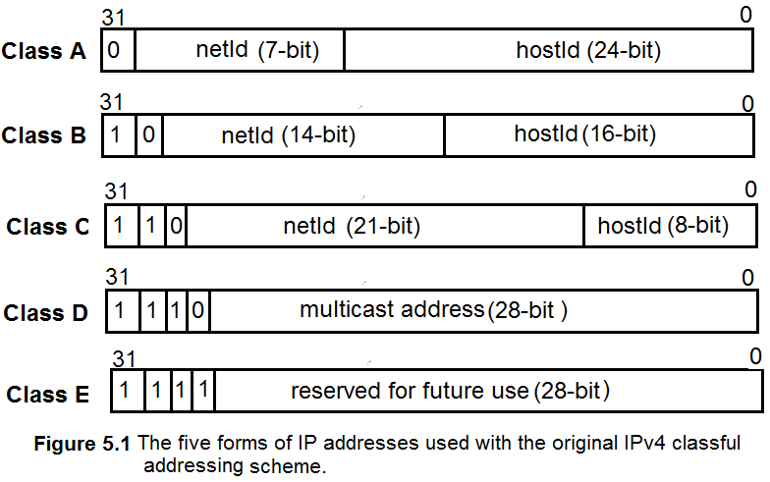
IPv4 Classful Addressing Scheme

Slide 4
Why is Subnetting Important?
Imagine we want to build four local networks supporting 30 devices each (i.e., 30 hosts/network, 120 devices).
Assume that the following four Class C networks are selected to support this design:
For network #1: 192.168.1.0 → supports 254 hosts
For network #2: 192.168.2.0 → supports 254 hosts
For network #3: 192.168.3.0 → supports 254 hosts
For network #4: 192.168.4.0 → supports 254 hosts

Slide 5
Why is Subnetting Important?
Each network will support 254 (2⁸ – 2)IP addresses leading to a wastage of 896 IP addresses! ((254 – 30) * 4 = 896)
30 hosts per network will be possible from the 5 bits (from the 4th Octet) of the host ID portion of a Class C network and the remaining 3-bits used for the local network:
The usable IP addresses with 5 bits of host ID = 2⁵ – 2 = 30 hosts
Subtracting 2 means, hostID with bits 00000 and 11111 are not used in the IP address configuration the first one is used as the network address and the latter one is the broadcast address.

Slide 6
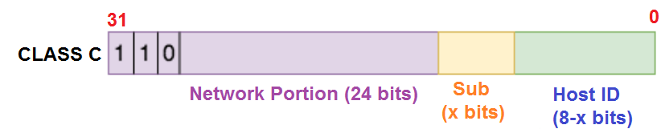
Subnetting Implementation
The following Figure1 shows how the subnetting is applied to the host ID portion of the Class C address (192.168.1.0)
It shows how IP addresses are generated from each subnet address
Figure1.

Slide 7
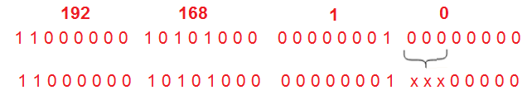
Subnetting Implementation
Based on the Figure1, how subnetting is possible with the 3 bits of the host ID portion (4th octet) of the Class C address described below:
For this example, let’s take one of the mentioned Class C network addresses, 192.168.1.0 :

Slide 8
Subnetting Implementation
The eight subnet addresses are generated by borrowing 3 bits of the host ID of the Class C address, 192.168.1.0 are:
192.168.1.0
192.168.1.32
192.168.1.64
192.168.1.96
192.168.1.128
192.168.1.160
192.168.1.192
192.168.1.224
Binary forms of these subnet addresses are shown in Figure2 and look like normal IP addresses.

Slide 9
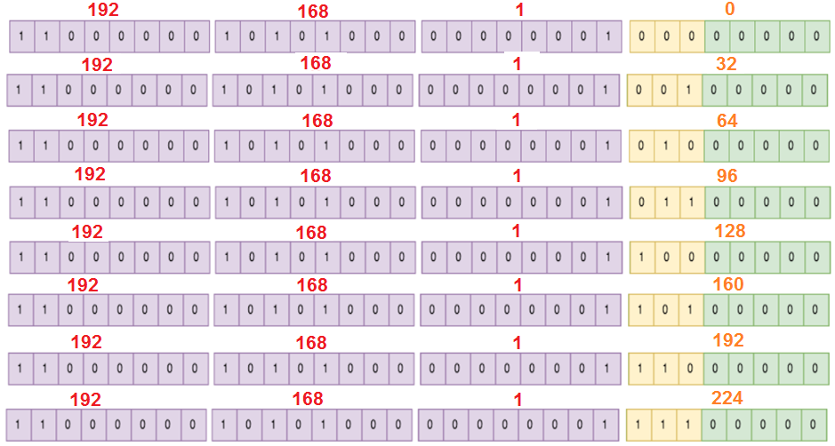
Figure2 Subnet addresses in binary form.

Slide 10
Subnetting -Implementation
With subnetting, we have created 8 subnets from the Class C 192.168.1.0 network address, and each one can support up to 30 hosts (2⁵ -2)!
We can use 4 subnets for our network and reserve the remaining 4 subnets (with 30 x 4 = 120 IP addresses) for future expansion.
Each host can have its own IP address
We can have the following 30 IP addresses generated from the subnet address 192.168.1.32:
11000000 10101000 00000001 001 00001 → 192.168.1.33
………………………………………………………………..
11000000 10101000 00000001 001 11110 → 192.168.1.62
This results in a great wastage reduction of IP addresses
from 896 wasted IP addresses to 120 reserved IP addresses.
30 IP addresses

Slide 11
Subnet Masks
How to differentiate between a subnet address 192.168.1.32 and an IP address (device/host address) 192.168.1.32?
This issue causes the arrival of subnet masks (also called network masks) in network addressing.
A subnet mask is the representation of the network portion of an address
All the bits that represent the network portion being marked as 1s and the other parts (host portion) marked as 0s.

Slide 12
Subnet Masks
For example, the subnet masks of the IP address classes are:
Class A: 255.0.0.0
Class B: 255.255.0.0
Class C: 255.255.255.0
Therefore, a Class C network address 192.168.1.0 can be represented as 192.168.1.0 255.255.255.0 (network address <> subnet mask).
Similarly, the Class C subnet address 192.168.1.32 can be represented as 192.168.1.32 255.255.255.224 = 192.168.1.32/27 (CIDR)
255.255.255.224 = 11111111 11111111 11111111 11100000 =/27
11000000 10101000 00000001 001 00000 → 192.168.1.32 (Subnet)
11000000 10101000 00000001 001 00001 → 192.168.1.33 (IP address)
----------------------------------------------------------------------------------
11000000 10101000 00000001 001 11110 → 192.168.1.62 (IP address)
11111111 11111111 11111111 111 00000 → 255.255.255.224 (Subnet mask)

Slide 13
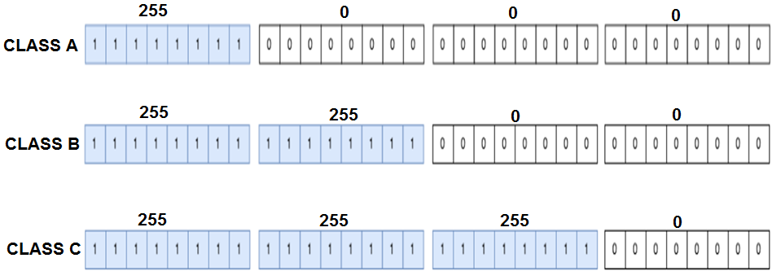
Subnet Masks

Slide 14
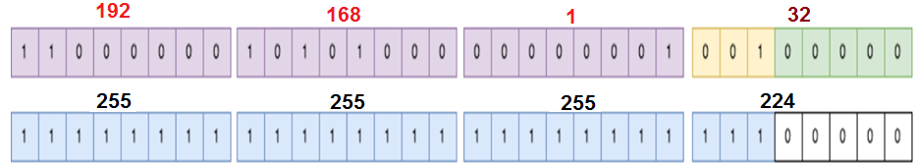
Subnet Masks
Subnet Masks can also be represented by CIDR (Classless Inter-domain Routing) notation.
The previous subnet <> subnet mask, 192.168.1.32 255.255.255.224 can be represented as CIDR notation: 192.168.1.32 /27
where “/27” = 255.255.255.224
= 11111111 11111111 11111111 11100000
With subnetting, the borrowed bits from the host ID are counted as part of the network bits.

Slide 15
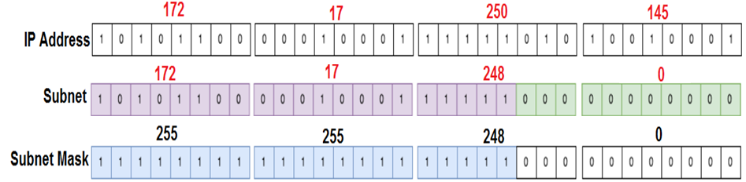
Subnet Masks
By comparing the subnet mask and IP address, a network device/host can determine which subnet it belongs to:
Consider a class B IP address: 172.17.250.145 and its subnet mask: 255.255.248.0 (or /21 means 11 last bits are used for host identification). What is its Subnet address?
Subnet address: 172.17.248.0
How many IP addresses are possible with the above subnetting?
2046 IP addresses (2¹¹ – 2 = 2046)

Slide 16
A Note about CIDR
So far, we have talked about subnetting in terms of IPv4 address classes
But most of today's networks are classless.
To slow down the exhaustion of IPv4 addresses and reduce the size of the Internet routing table, the IETF introduced Classless Inter-Domain Routing (CIDR) in 1993.
So, with CIDR, we have a network represented by a network address and a prefix length, e.g., 192.45.96.0/22.
This address block, 192.45.96.0/22, will be seen as Class C in a classful network address field.

Slide 17
Why do we need subnetting?
let us consider some of the reasons behind the subnets:
IP address wastage reduction: As we have already seen, subnetting helps us conserve IP addresses.
Improve Network Performance: Subnetting improves the overall performance of a network;
The larger a network is busiest and congested.
Consider the example of broadcasts – every host within an individual network will receive a broadcast even when it is not meant for them.
This can affect performance, especially during issues like broadcast storms.
Therefore, the smaller the network, the more you can contain such issues within the subnet.

Slide 18
Why do we need subnetting?
Isolation: With smaller networks, it is possible to isolate effectively as faults inside one subnet will not necessarily spread into other subnets.
This is also important during security incidents so that even if one subnet is affected, the entire network does not need to bring down.
Easier administration: Subnetting, when done correctly, can make network administration more effective
For example, a multinational organization can design its network so that each region is assigned an IP address block from a larger address block, and subnetting is used within areas to divide the blocks among networks further.
This kind of design also improves routing as the routers in one region only need to know the “summarized” IP address block for other regions rather than all the smaller IP address blocks.
This reduces the size of the routing table and ensures that fluctuations in one region do not affect the entire network.

Slide 19
Minimum Subnet Size to Accommodate a Number of Hosts
You need to be able to design networks in such a way that there will be enough IP addresses for the devices that will be used on the network
Of course, you can always go for a large address block, but as we already established, using smaller-sized subnets is more efficient.
It is possible to determine the minimum subnet size and its hosts on that subnet.

Slide 20
Minimum Subnet Size to Accommodate a Number of Hosts
To do a minimum subnet size to support several hosts on that subnet, you need to determine the number of host bits
this means counting host bits in the order of 2.
It is noticed that the two unusable IP addresses in a block are used for the network address and broadcast address.
Table1 below shows the number of CIDR usable IP addresses for /31 to /22 (i.e., 1 to 10 host bits):
You can do the same calculation for other prefix lengths.
From Table 1 shows the need for a minimum subnet size of /27 to support 25 hosts, /29 to support four hosts, /25 to support 120 hosts, and so on.

Slide 21
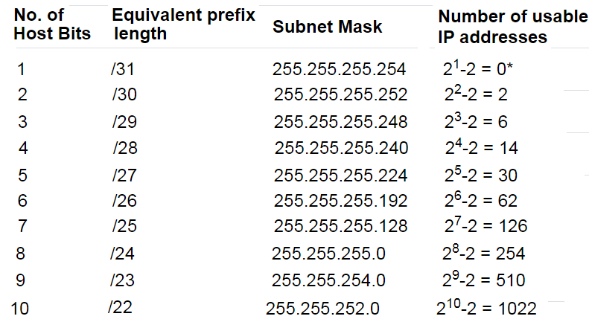
Minimum subnet size to accommodate a number of hosts
Table 1 Number of CIDR usable IP addresses for /31 to /22.

Slide 22
Minimum Subnet Size to Accommodate a Number of Hosts
Tip: When designing subnets, think about the future expansion of the network.
Using a /27 to support a network that needs 30 hosts (32-27 = 5, 2⁵ – 2 = 30 hosts) does not allow for further host expansion.
In such a case, it may be better to use the following block size, for example, select /26 (32-26 = 6, 2⁶ – 2 = 62 hosts)
Alternatively, reserve the following/24 subnet in the sequence for future expansion.

Slide 23
Number of Subnets in An Address Block
You can determine the number of subnets obtained from a given network address block (as long as you know the subnet size requirements). The formula is:
Number of subnets = 2required_Subnet_size − reference_block_size
For example, we can get sixteen /28 subnets from a /24 reference address block:
Number of /28 subnets from /24 block = 2²⁸ ⁻ ²⁴ = 2⁴ = 16
/28 = 11111111 11111111 11111111 11110000
/24 = 11111111 11111111 11111111 00000000
It means that, the 4 subnet bits (28-24) are located after the /24th bit, consecutive bits on the 4th octet.

Slide 24
List of Subnets in an Address Block
In the previous example, we determined the number of subnets that can be gotten from a particular address block.
Now, we need to determine, what those subnets are. To do this, we need to know the following three things:
1. The octet in which a subnet exists:
1st octet: /1 to /8
2nd octet: /9 to /16
3rd octet: /17 to /24
4th octet: /25 to /32

Slide 25
List of Subnets in an Address block
2. The maximum number of bits in the boundary (octet) in which the subnet belongs
1st octet: 8
2nd octet: 16
3rd octet: 24
4th octet: 32
The block size (subnet range) of a subnet:
For example, a /28 subnet exists in the 4th octet. The maximum number of bits in a 4 octet-address is 32. Therefore, the block size or subnet range is: 2³² ⁻ ²⁸ = 2⁴ = 16
(/28 = 11111111 11111111 11111111 11110000)

Slide 26
List of Subnets in an Address block
Similarly, a /18 subnet exists in the 3rd octet. The maximum number of bits in that octet is 24. Therefore, the block size is 2²⁴ ⁻ ¹⁸ = 2⁶ = 64
We can use this knowledge to list the subnets in a particular address block
What are the /27 subnets in the 174.53.4.0/24 address block?
174.53.4.0 → 10101110 00110101 00000100 00000000
/27 → 11111111 11111111 11111111 11100000
/24 → 11111111 11111111 11111111 00000000
There are eight /27 subnets in a /24 address block (i.e. 2²⁷⁻²⁴ = 2³ = 8). The 3 subnet bits (27-24) are the consecutive bits on the 4th octet after the /24th bits).
174.53.4.0 → 10101110 00110101 00000100 00000000 {3 subnet bits on the 4th octet}
The /27 subnet exists in the 4th octet, therefore,
block size (subnet range) = 2³² ⁻ ²⁷ = 2⁵ = 32

Slide 27
List of Subnets in an Address block
From the above information, we can list all the eight subnets (represented by first 3 bits of the 4th octet) by their block size (32):
174.53.4.0/27 → 10101110 00110101 00000100 000 00000 /27
174.53.4.32/27 → 10101110 00110101 00000100 001 00000 /27
174.53.4.64/27 → 10101110 00110101 00000100 010 00000 /27
174.53.4.96/27 → 10101110 00110101 00000100 011 00000 /27
174.53.4.128/27 → 10101110 00110101 00000100 100 00000 /27
174.53.4.160/27 → 10101110 00110101 00000100 101 00000 /27
174.53.4.192/27 → 10101110 00110101 00000100 110 00000 /27
174.53.4.224/27 → 10101110 00110101 00000100 111 00000 /27

Slide 28
List of Subnets in an Address block
List all the usable IP addresses under 174.53.4.32/27 subnet:
10101110 00110101 00000100 00100001 → 174.53.4.33
10101110 00110101 00000100 00100010 → 174.53.4.34
10101110 00110101 00000100 00100011 → 174.53.4.35
10101110 00110101 00000100 00100100 → 174.53.4.36
-------------------------------------------------------------------------------
10101110 00110101 00000100 00111110 → 174.53.4.62
Subnet mask:
11111111 11111111 11111111 111 00000 = /27
IP
address

Slide 29
List of Subnets in an Address block
List the /23 subnets that exist in the 141.67.128.0/21 address block
There are four /23 subnets in a /21 address block (2²³ ⁻ ²¹ = 2² = 4) The 2 Subnet bits (23-21) are located after the /21st bit of the 3rd octet. The /23 subnet exists in the 3rd octet (24 bits), therefore, the block size is: 2²⁴ ⁻ ²³ = 2¹ = 2.
Knowing this, we can now list the subnets by starting at first network of the given block and incrementing by the block size (2) in the 3rd octet:
141.67.128.0/23 → 10001101 01000011 10000000 00000000/23
141.67.130.0/23 → 10001101 01000011 10000010 00000000/23
141.67.132.0/23 → 10001101 01000011 10000100 00000000/23
141.67.134.0/23 → 10001101 01000011 10000110 00000000/23

Slide 30
List of Subnets in an Address Block
List the /13 subnets that exist in the 131.80.0.0/12 address block.
ANS:
Two /13 subnets can be gotten from a /12 address block (2¹³⁻¹² = 2¹ = 2). The 1 Subnet bit (13-12 = 1) is located after the 12th bit. /13 sits in the 2nd octet which has a maximum number of bits of 16. Therefore, the block size (subnet range) is 8 (2¹⁶ ⁻¹³ = 2³ = 8).
As such, the /13 subnets from the 131.80.0.0/12 block are:
131.80.0.0/13 → 10000011 01010000 00000000 00000000
131.88.0.0/13 → 10000011 01011000 00000000 00000000

Slide 31
Address Range of a Subnet
When you know the size of a subnet, it becomes easy to determine the valid addresses in that subnet.
We just need to add one IP address to the subnet address and subtract two IP addresses from the next subnet address.
We add 1 because the first address is the network address and we subtract 2 instead of 1 because the last address in a subnet is the broadcast address.
Note: The next subnet address is just the subnet plus the block size. Keep in mind that this “next subnet address” may not be a valid address block.

Slide 32
Address Range of a Subnet
What is the valid address range of the 141.67.132.0/23 subnet?
Since the block size is 2 (2²⁴ ⁻²³ =2¹ = 2), we know that the next subnet is 141.67.134.0/23 (132 + 2 = 134). Therefore, the valid address range is:
Start address: 141.67.132.0 + 1 = 141.67.132.1
End address: 141.67.134.0 – 2 = 141.67.133.254
Broadcast address: 141.67.134.0 – 1 = 141.67.133.255

Slide 33
Address Range of Subnet
What is the valid address range of the 10.192.0.0/10 subnet?
Since the block size is 64 (2¹⁶⁻¹⁰ = 2⁶ = 64) , we know that the next subnet will be 10.256.0.0/10 (64 + 192 = 256). Therefore, the valid address range is:
Start address: 10.192.0.0 + 1 = 10.192.0.1
End address: 10.256.0.0 – 2 = 10.255.255.254
Broadcast address: 10.256.0.0 – 1 = 10.255.255.255
Note: In this example, the next subnet is 10.256.0.0 which is not a valid address block. However, it helps with our calculation.

Slide 34
Address Range of Subnet
What is the valid address range of the 192.168.58.0/28 subnet?
The block size is 16 (2³²⁻²⁸ = 2⁴). Therefore, the next subnet will be 192.168.58.16/28 (0 + 16 = 16)). As such, the valid address range is:
Start address: 192.168.58.0 + 1 = 192.168.58.1
End address: 192.168.58.16 – 2 = 192.168.58.14
Broadcast address: 192.168.58.16 – 1 = 192.168.58.15

Slide 35
Variable Length Subnet Masks (VLSM)
So far, we have used subnetting to create fixed-size subnets, e.g. four /26 subnets from one /24 block (2²⁶⁻²⁴ = 2² = 4).
However, the use of subnet masks and prefix lengths provide more flexibility – we can create subnets of varying sizes from the same address block i.e. VLSM.
Let us consider the following example.
We are given a block of 172.16.1.0/24 and we need to split it such that the following requirements are met:
A subnet that can accommodate 100 hosts
A subnet that can accommodate up to 55 hosts
Two subnets that can accommodate up to 12 hosts each

Slide 36
Variable Length Subnet Masks (VLSM)
To solve this problem, start with the biggest block and keep going down.
For example, we need a minimum subnet of /25 to accommodate 100 hosts. Therefore, we can split the 172.16.1.0/24 block into two subnets (block size = 2³²⁻²⁵ = 2⁷ = 128):
172.16.1.0/25
172.16.1.128/25
We can use the first subnet 172.16.1.0/25 for the 100 hosts leaving us with the next subnet, 172.16.1.128/25.

Slide 37
Variable Length Subnet Masks (VLSM)
The next largest subnet needs 55 hosts which can be accommodated with a /26 subnet. This means we can split the 172.16.1.128/25 subnet into two smaller subnets (block size = 2³²⁻²⁶ = 2⁶ = 64):
172.16.1.128/26
172.16.1.192/26
We can use the 172.16.1.128/26 subnet for the network requiring 55 hosts leaving us with the 172.16.1.192/26 subnet to further break down.

Slide 38
Variable Length Subnet Masks (VLSM)
The two other networks require 12 hosts meaning we need a minimum of /28 subnets. Therefore, we can split the 172.16.1.192/26 subnet into 4(2²⁸⁻²⁶ = 2²) smaller subnets (with block size = 2³²⁻²⁸ = 2⁴ = 16). The 2 Subnet bits (28-26 = 2) are located after the /26th bit of the 4th octet:
172.16.1.192/28 → 10101100 00010000 00000001 11000000/28
172.16.1.208/28 → 10101100 00010000 00000001 11010000/28
172.16.1.224/28 → 10101100 00010000 00000001 11100000/28
172.16.1.240/28 → 10101100 00010000 00000001 11110000/28
Therefore, our subnets are:
172.16.1.0/25 for the network with 100 hosts
172.16.1.128/26 for the network with 55 hosts
172.16.1.192/28 for the first network with 12 hosts
172.16.1.208/28 for the second network with 12 hosts
This means we still have two subnets (172.16.1.224/28 and 172.16.1.240/28) to use in the future.

